Slide 1
EMPLOYEE PERFORMANCE ANALYSIS USING EXCEL
STUDENT NAME : CHITRALAKA S
REGISTER NO : asunm1330312208376
DEPARTMENT : B.COM (ACCOUNTING AND FINANCE)
COLLEGE. : CHELLAMMAL WOMEN’S COLLEGE

Slide 2
PROJECT TITLE
EMPLOYEE PERFORMANCE ANALYSIS USING EXCEL

Slide 3
AGENDA
PROJECT STATEMENT
PROJECT OVERVIEW
END USERS
OUR SOLUTION AND PROPOSITION
DATASET DESCRIPTION
MODELLING APPROACH
RESULTS AND DISCUSSION
CONCLUSION

Slide 4
PROBLEM STATEMENT :
To assess and improve employee performance across various departments in order to enhance overall productivity and efficiency.
Our company tracks multiple performance metrics, including sales figures, project completion rates, attendance, and customer feedback. However, we currently lack a systematic approach to analyzing this data, leading to difficulties in identifying high performers, areas needing improvement, and the impact of different performance factors.
Centralize and organize performance data from various sources.
Use formulas and charts to visualize and interpret performance metrics.
Create dynamic reports and dashboards that offer actionable insights.

Slide 5
PROJECT OVERVIEW
To design and implement an Excel-based tool for analyzing employee performance metrics to enhance productivity, identify areas for improvement, and support decision-making for human resource management. Gather performance-related data for all employees, including attendance, sales figures, project completion rates, and customer feedback. Create a structured Excel spreadsheet to input and organize this data. Utilize Excel functions, formulas, and PivotTables to analyze performance metrics. Generate insights into individual and team performance.

Slide 6
Who ARE The END USERS
They use the analysis to monitor the productivity and performance of their team members, identify bottlenecks, and ensure the project stays on track.
Adjust resource allocation, provide feedback, and make decisions on project timelines Team Leads/Supervisors are assess the performance of the employees they directly manage, focusing on individual contributions and team dynamics.
Human Resources (HR) uses the analysis to support performance appraisals, identify training needs, and manage career development.
senior Management/Executives are look at the overall performance trends to make strategic decisions regarding resource allocation, project prioritization, and company direction.
Employees (Self-Evaluation)is a Employees might use the analysis to understand their own performance, set personal goals, and seek areas for improvement. Self-improvement, goal setting, and career planning

Slide 7
OUR SOLUTION AND PROPOSITION:
Our solution is an Excel-based employee performance analysis tool designed to enhance productivity, optimize resource allocation, and support data-driven decision-making within project teams. This tool will enable project managers, team leads, and HR departments to efficiently track, analyze, and report on employee performance throughout the project lifecycle.

Slide 8
DATASET DESCRIPTION
When describing a dataset for employee performance analysis in a project context, it’s important to include details about the data structure, the types of dThe dataset contains performance-related information for employees working on a specific project or across multiple projects. It is structured to allow analysis of various key performance indicators (KPIs) that reflect individual and team contributions to project success.ata collected, and any relevant metadata

Slide 9
MODELING APPROACH:
When it comes to modeling employee performance using the data you’ve described, the approach will depend on the specific goals of your analysis. Here are some potential modeling approaches, ranging from descriptive to predictive analytics, which you can implement in Excel or there analytical tools
This modeling approach not only helps in understanding past performance but also in planning and optimizing future performance, thereby adding significant value to the project management process.

Slide 10
Types of modelling
PREDICTIVE MODELLING
EVALUATION AND VALIDATION
PRESCRIPTIVE MODELLING
DIAGNOSTIC MODELLING
DISCRIPTIVE MODELLING

Slide 11
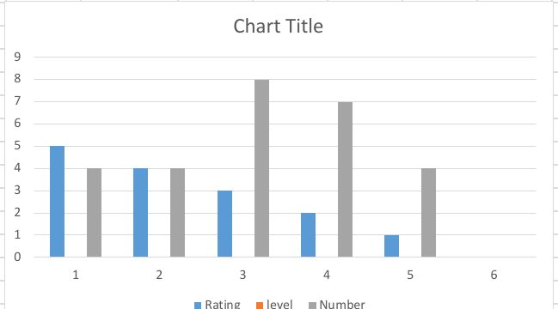
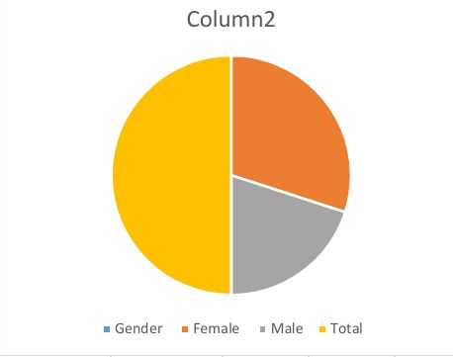
Results

Slide 12
Conclusions
The implementation of an Excel-based employee performance analysis tool represents a significant step toward more effective project management and employee engagement. By empowering managers with actionable insights and providing a platform for continuous improvement, this approach supports both short-term project success and long-term organizational growth.

