Slide 1

GROUP MEMBERS
CHITRALEKHA.CH - MBA202325-067
MOUNIKA BODEPU – MBA202325-119
SAI SRI PONNURU – MBA202325-188
PRAVEEN KR – MBA202325-158
INSURANCE AUTOMATION

Slide 2
TABLES CREATED
Customers - Stores customer details
Policies - Stores different types of policies (Life, Health, Vehicle, Asset)
Customer_Policies - Links customers to the policies they own
Customer_History - Tracks historical records of deleted customers for future reference
Agents - Stores details of agents who help customers with policy payments and claims
Employees - Stores employee details for the insurance company
Claims - Stores claim requests made by customers
Payments - Stores payment information for customer policies
Premium_Payment - Stores the schedule of premium payments
Payment_Schedules - Payment Schedules table to track payment dues

Slide 3
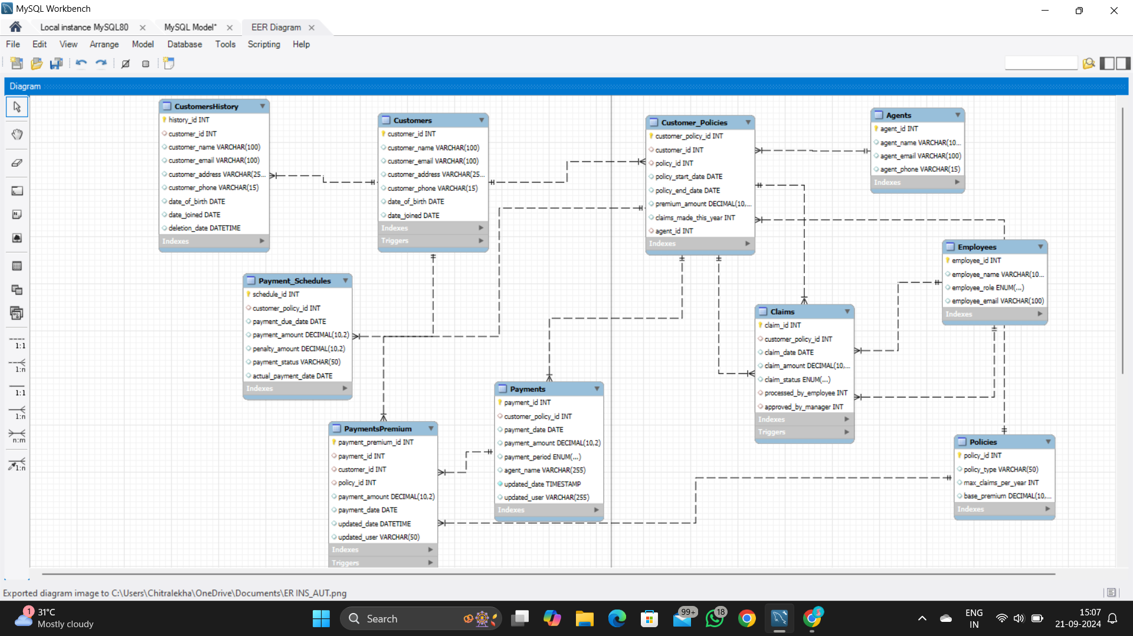

Slide 4
REQUIREMENTS
Core business of the Insurance Company is collecting premium for policy and settling claim amount.
Premium Payment Process:
Customer purchases a policy (linked via Customer_Policies).
Premium amount is stored in Customer_Policies.
Payments are recorded in the Payments table, which tracks when and how much is paid, along with penalties for late payments.
At policy renewal, a stored procedure recalculates the premium based on claims history.
Claim Settlement Process:
Customers submit a claim (linked via Claims to their policy).
Claims are processed by employees, and a manager must approve the claim.
The claim amount is settled and recorded in the Claims table.
A trigger ensures customers cannot exceed the maximum number of claims allowed per policy.

Slide 5
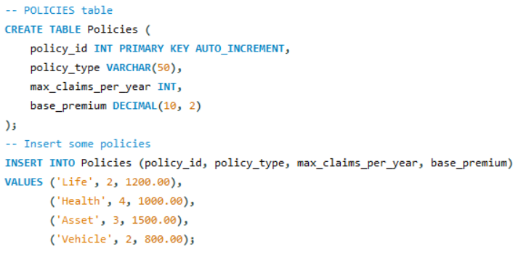
2) A Customer can take policy for various purposes (Life, Health, Asset, Vehicle etc)

Slide 6
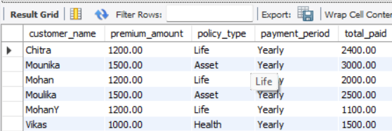
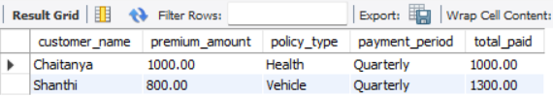

3) Premium will be calculated and collected on a periodical basis from each customer (Monthly / Quarterly / Annual etc)

Slide 7
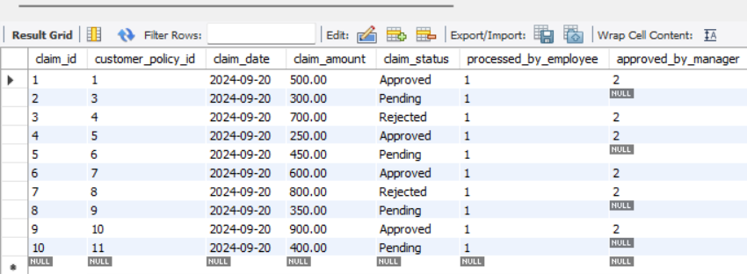
4) An Agent can be used to make these payments and follow up on any claims as well.
5) Claim Request form need to be filled by customer for making any claims with their policy reference. 6) An Employee of the Insurance Company can receive and process Claim request – but only a Manager can approve same.

Slide 8
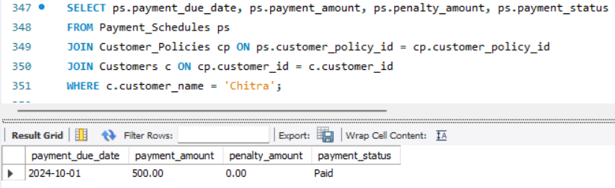
7) Premium Payment schedule will be published to customer and penalty will be charged late payment

Slide 9
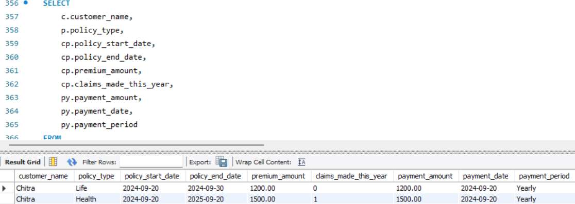
8) Insurance Company will provide online access to the customer to access their Policy details.

Slide 10
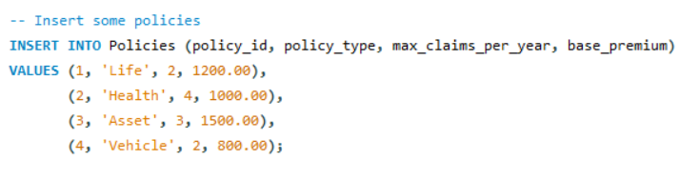
9) Number of Claims in a year will be regulated for each type of policy.

Slide 11
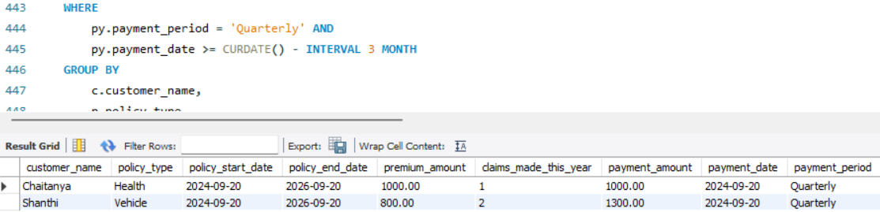
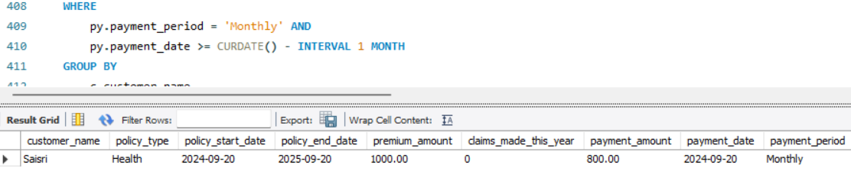
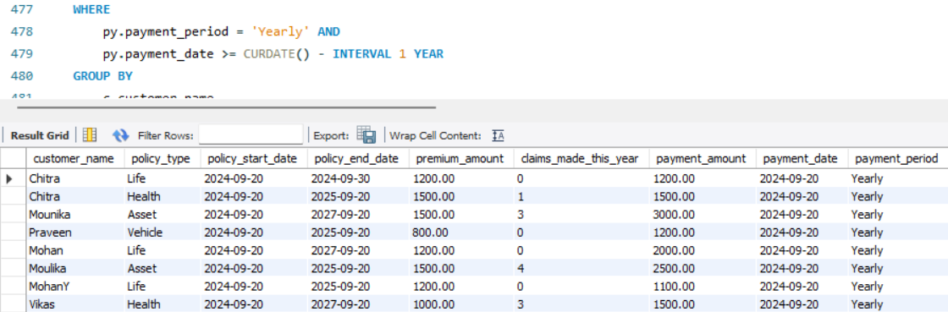
10) Monthly, quarterly and yearly statement will be generated and sent to the customer by system.

Slide 12
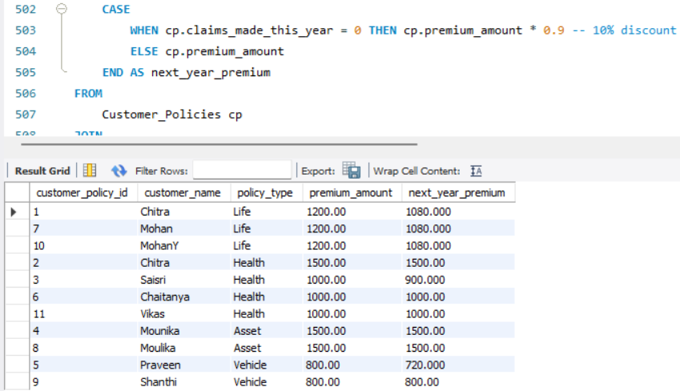
11) While renewing policy every year, Premium amount will be calculated based on the following factors:
If No claim is made during the previous year, a discount will be provided
If any claim is made, no discount will be provided (Premium amount will be same as previous year amount)

Slide 13
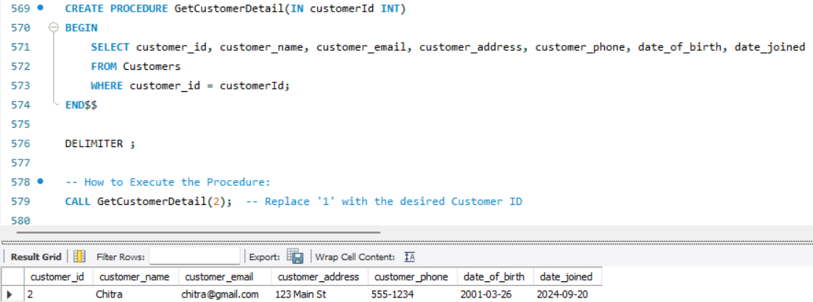
PROCEDURE To list customer details for a given customer (IN : Customer Id)

Slide 14
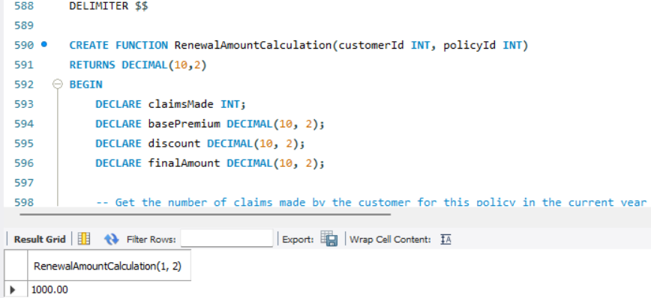
2) PROCEDURE To calculate policy amount at the time of renewal (IN: Customer id, Policy No)

Slide 15
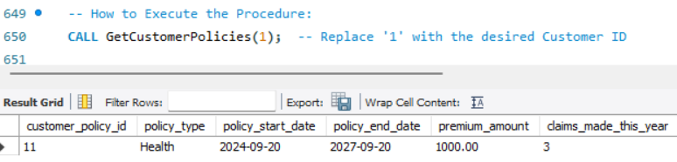
3) To list all policy details owned by a customer (IN : Customer Id)

Slide 16
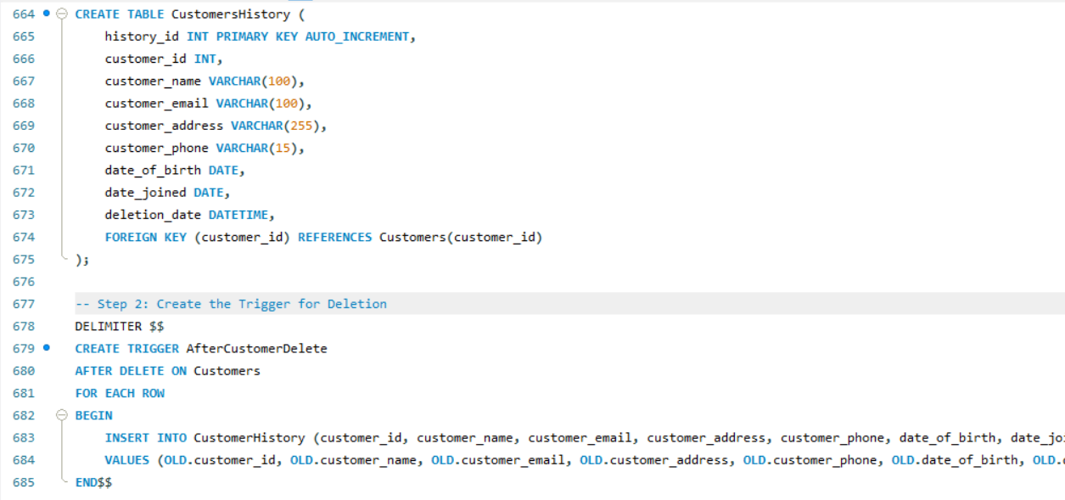
TRIGGER - For every record deletion in Customer table, for future reference, insert all details in Customer_history table

Slide 17
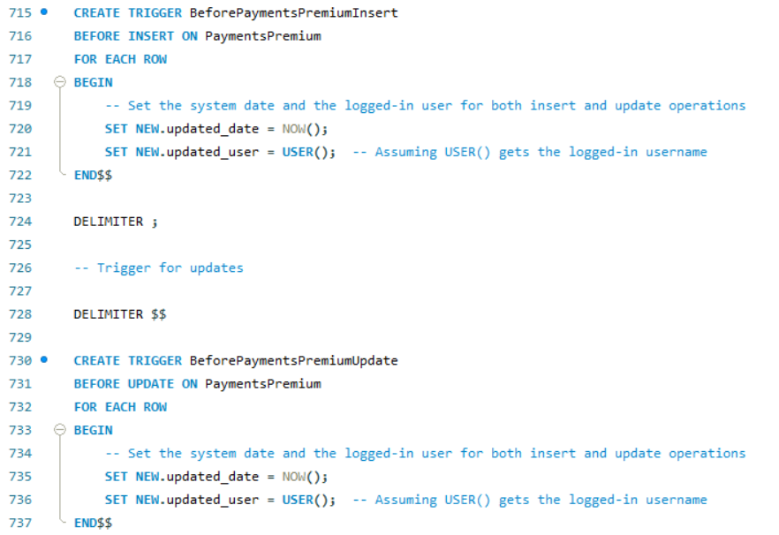
2) TRIGGER - Update / insert the following fields in Premium payment Table for all insertion and updations with system date and logged in user (Fields : Updated_date, updated_user)

Slide 18
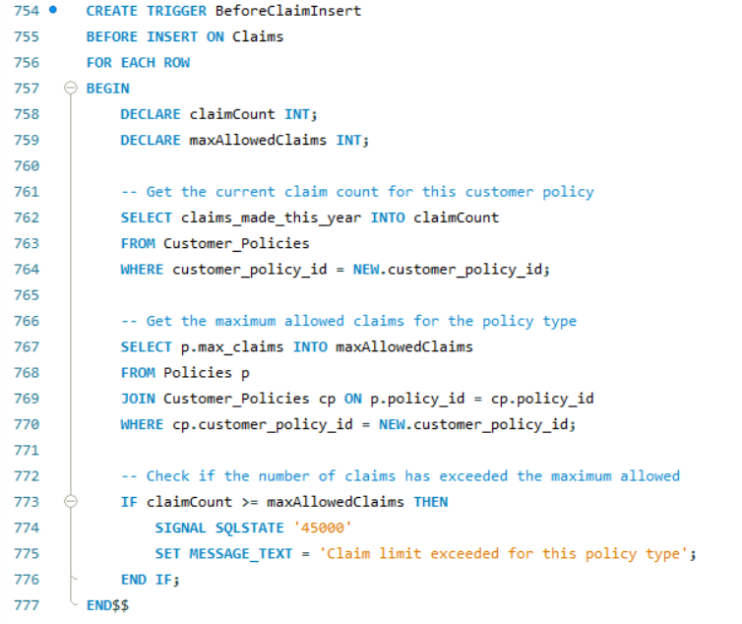
3) TRIGGER - Ensure that number of claims are regulated while creating a claim request.

