Slide 1


Investigation of EVerest
Recharging the EV Charging Stations with Open Source
Vishnupriya P S
Chitralekha Yaduvanshi
Piyush Kumar
Jyotirmayi Swaia
Yashi Vijay Vargiya
Akhila Haumakonda
Under the Guidance of
Mr. Biju P.K

Slide 2
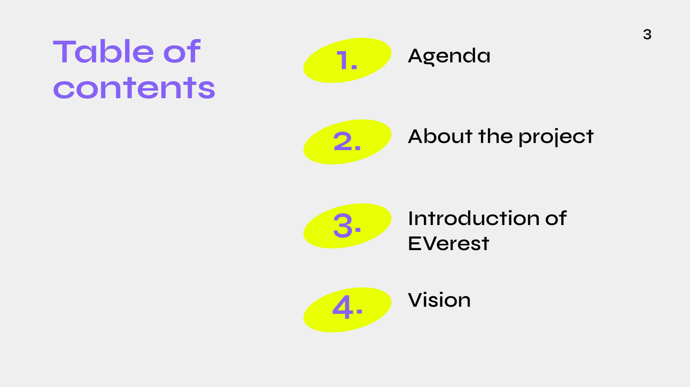
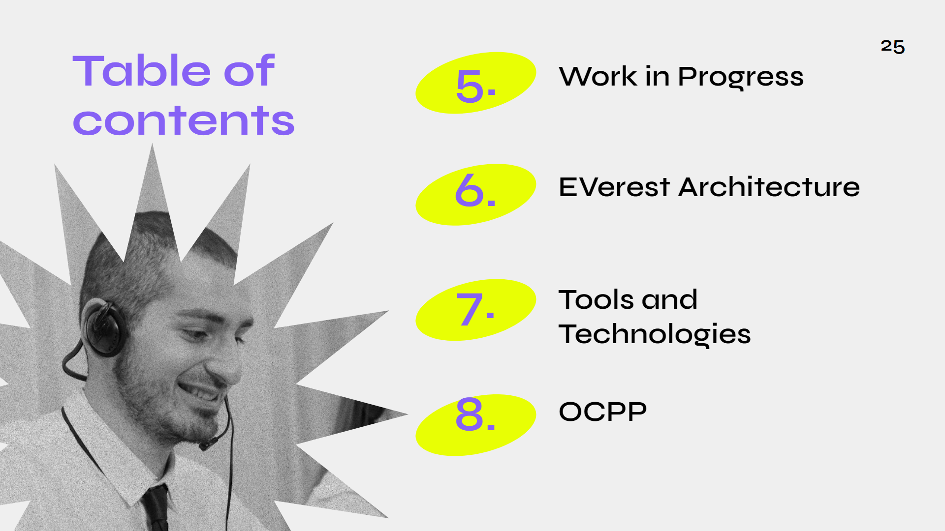
Table of contents

Slide 3
Agenda
To investigate EVerest from the Linux Foundation Energy projects. Evaluate the maturity level of the project, the existing functionality.
Outcomes -
Explore the whole project
Understand the architecture of the EVerest
Go through the source code created for the EVerest

Slide 4

LF Energy
LF Energy is an open source foundation focused on the power systems sector, hosted within The Linux Foundation. LF Energy provides a neutral, collaborative community to build the shared digital investments that will transform the world’s relationship to energy.
Everest is one among the lots of projects supported by this community.

Slide 5

About the project
Problem Statement
To speed the adoption to e-mobility
Enables for local energy management
Proposed Solution
Smart Charging at home
Public AC charging with integration of OCPP

Slide 6

Introduction of the Project
The primary goal of Everest is to develop and maintain an open source software stack for EV charging infrastructure.
The Everest project was initiated by PIONIX to electrify the mobility sector.

Slide 7
Vision
Bidirectional Charging
Car
Compatibility
Smart charging
Car
Communication

Slide 8
What we are working on
Packetization
OTA update support
For bandwidth sharing in communication networks
Service communicates to the targeted vehicle
Smart Charging
Web user interface
Based on solar charging
For the ease of organisation and user

Slide 9
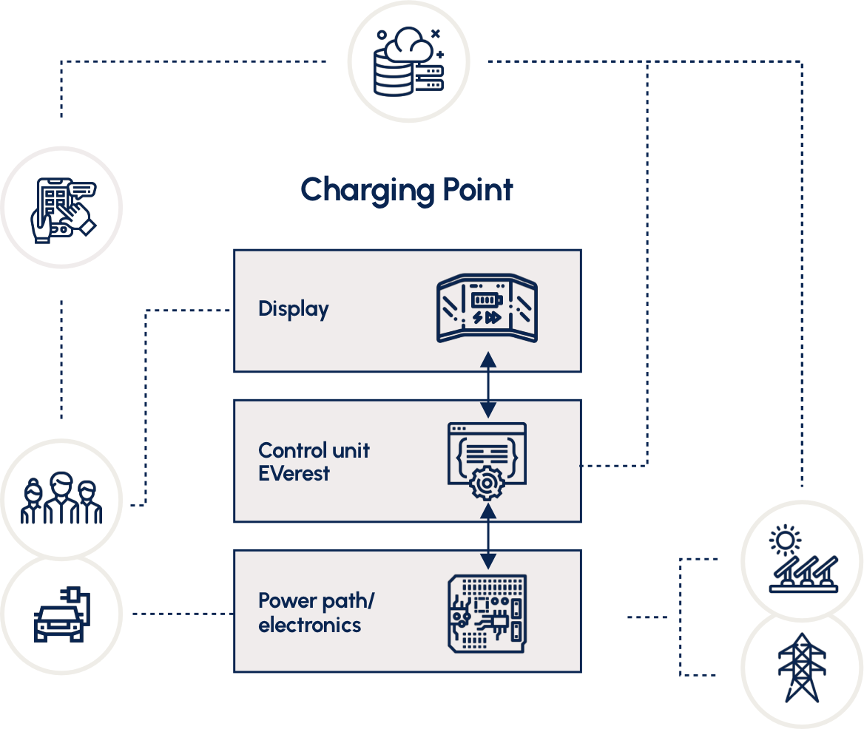
EVerest Architecture

Slide 10
Tools & Technologies
EDM
Docker
Github
C++
Python
Java
MQTT framework
NFC authentication
ISO 15118
OCPP

Slide 11
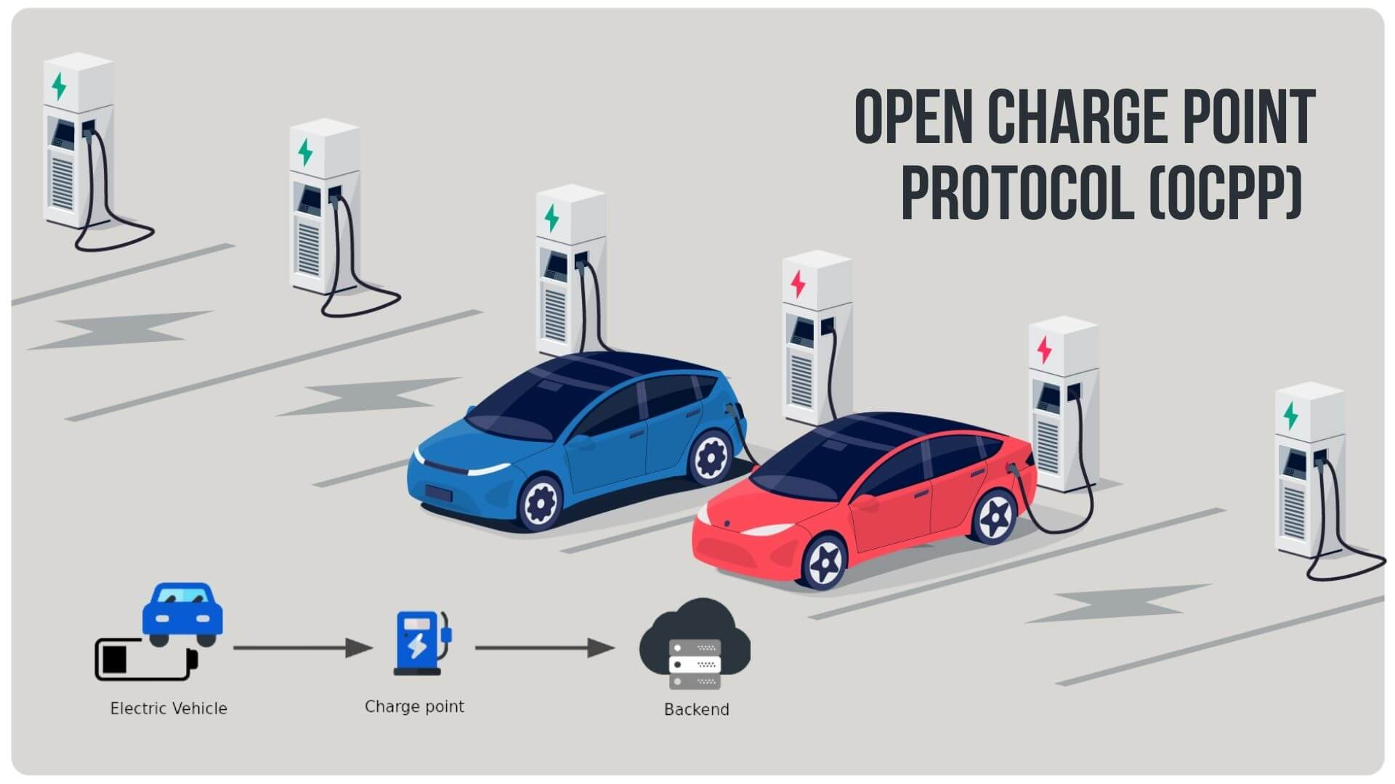
What is OCPP ??
OCPP is the shared language spoken between open EV chargers and charging station management systems(CSMS).

Slide 12
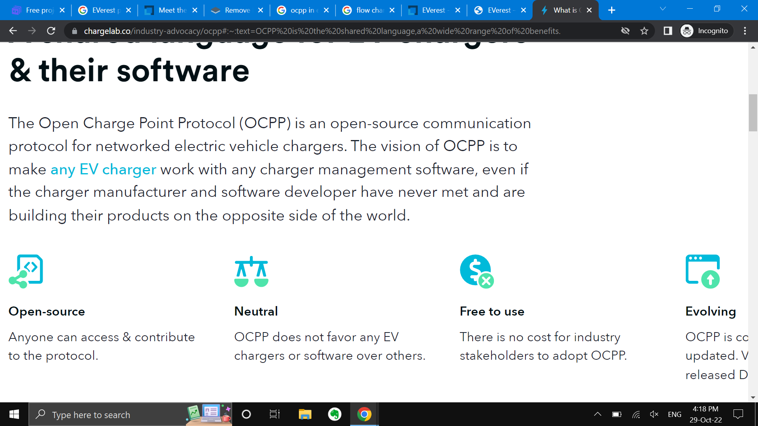
How OCPP is Game changer
The vision of OCPP is to make any EV charger work with any charger management software even if the charger manufacturer and software developer have never met

Slide 13
Resources
Everest. LF Energy. (n.d.). Retrieved October 29, 2022, from https://www.lfenergy.org/projects/everest/
Everest (no date) GitHub. Available at: https://github.com/EVerest (Accessed: October 29, 2022).
EVerest. (2022, May 10). Everest/roadmap.md at Main · Everest/Everest. GitHub. Retrieved October 29, 2022, from https://github.com/EVerest/everest/blob/main/tsc/ROADMAP.md
Everest(no date) EVerest. Available at: https://everest.github.io/ (Accessed: October 29, 2022).
OCPP? (no date) ChargeLab. Available at: https://www.chargelab.co/industry-advocacy/ocpp (Accessed: October 29, 2022).

Slide 14
Thank
You

