Slide 1
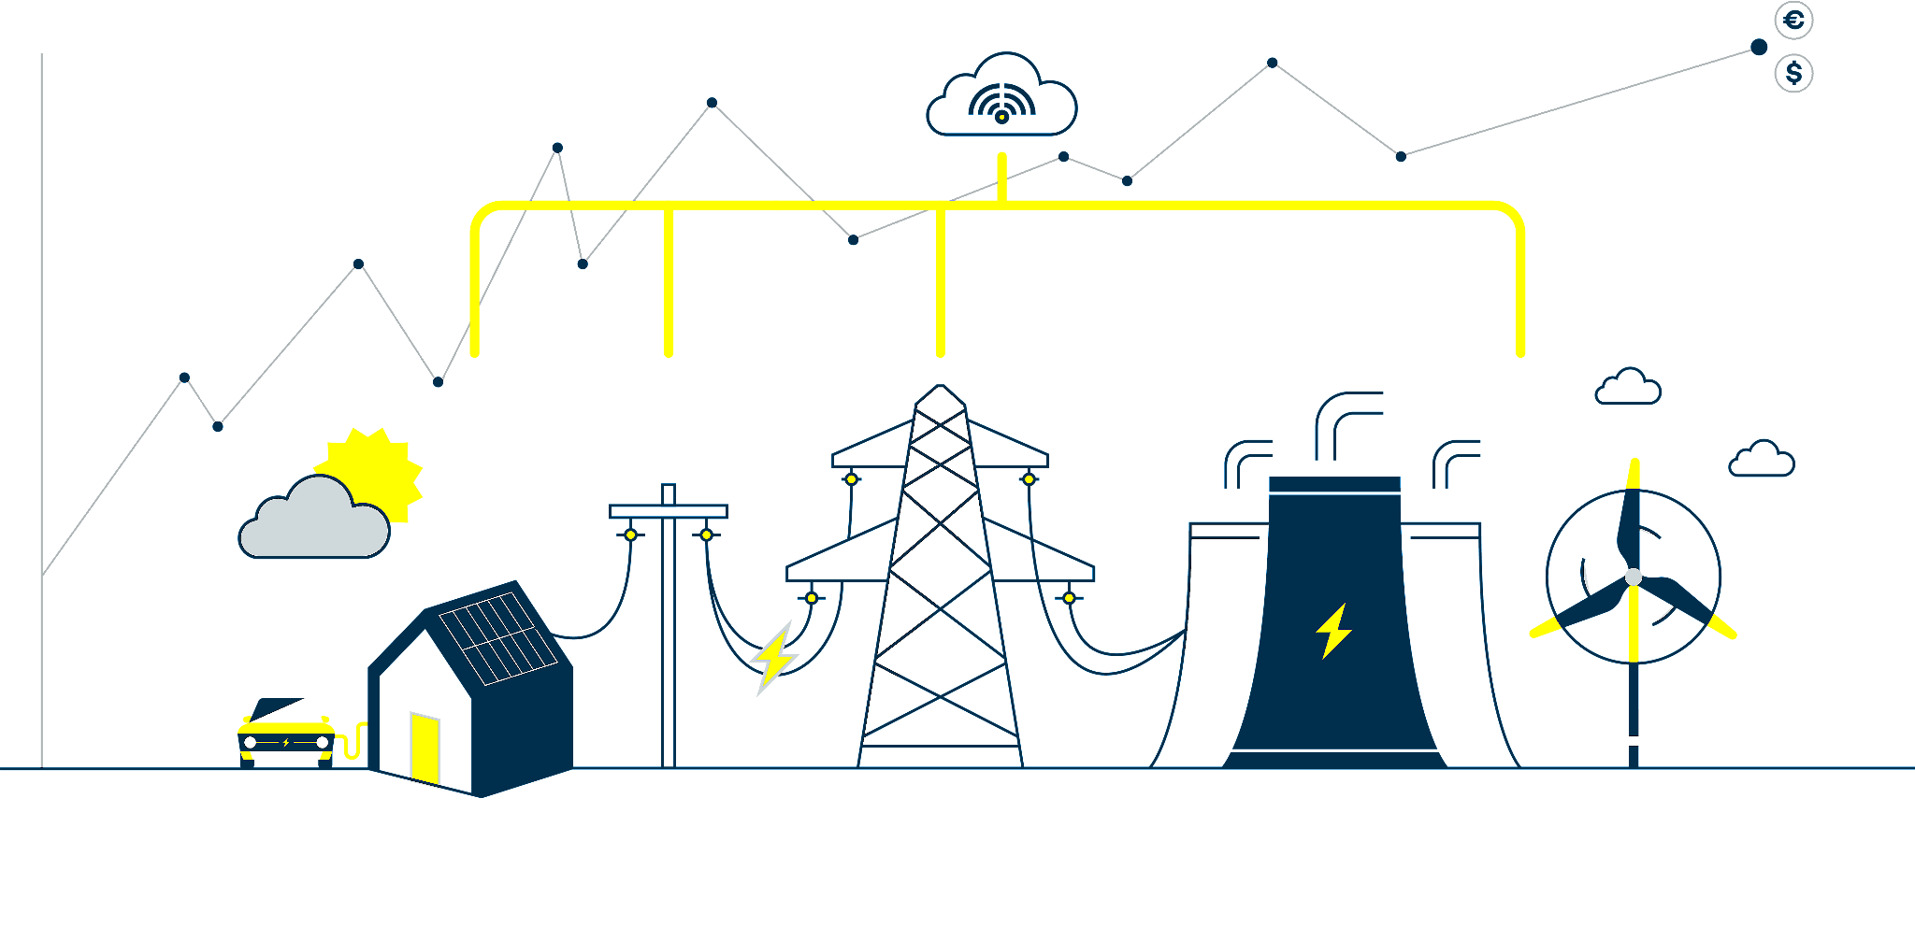

V2G: charging towards a greener future

Slide 2
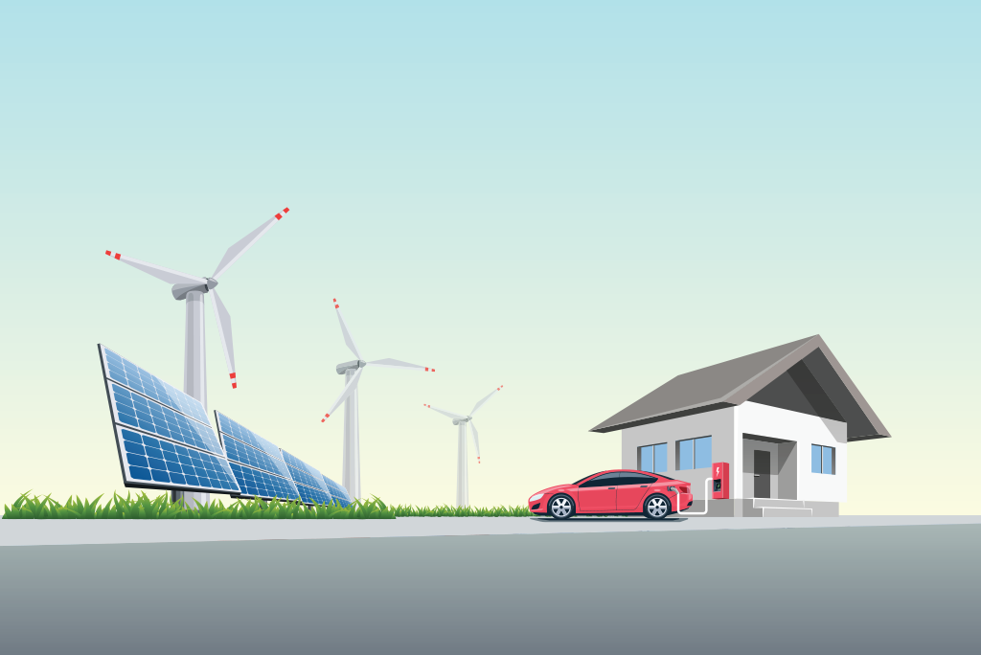
What is V2G?
Vehicle-to-grid technology involves drawing unused power from the car into the smart grid. V2G, which is also known as vehicle-grid integration (VGI).

Slide 3
WHY SHOULD YOU CARE ABOUT V2G?
01
Energy Efficient
Use of less energy to perform the same task
02
Decarbonization
The ultimate target is to achieve carbon neutrality
03
Electrification
Replacing technologies that use fossil fuels with technologies that use electricity

Slide 4
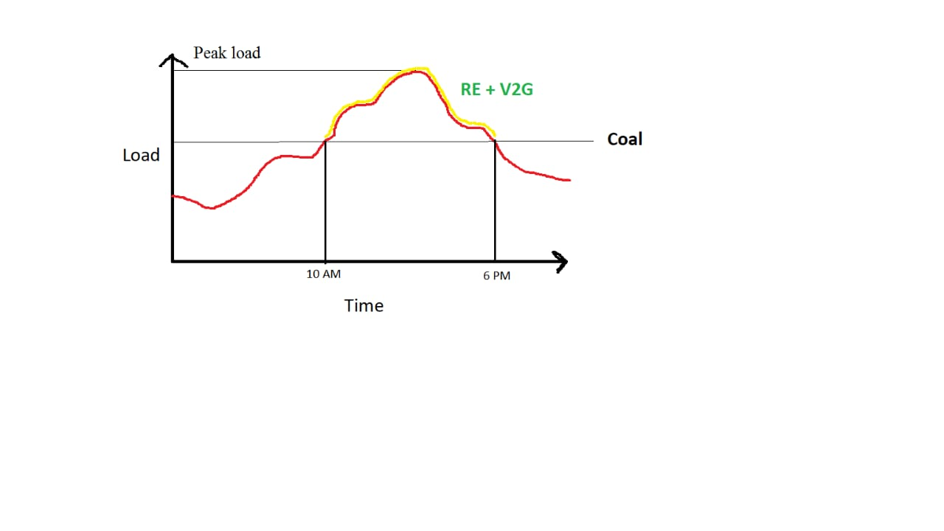
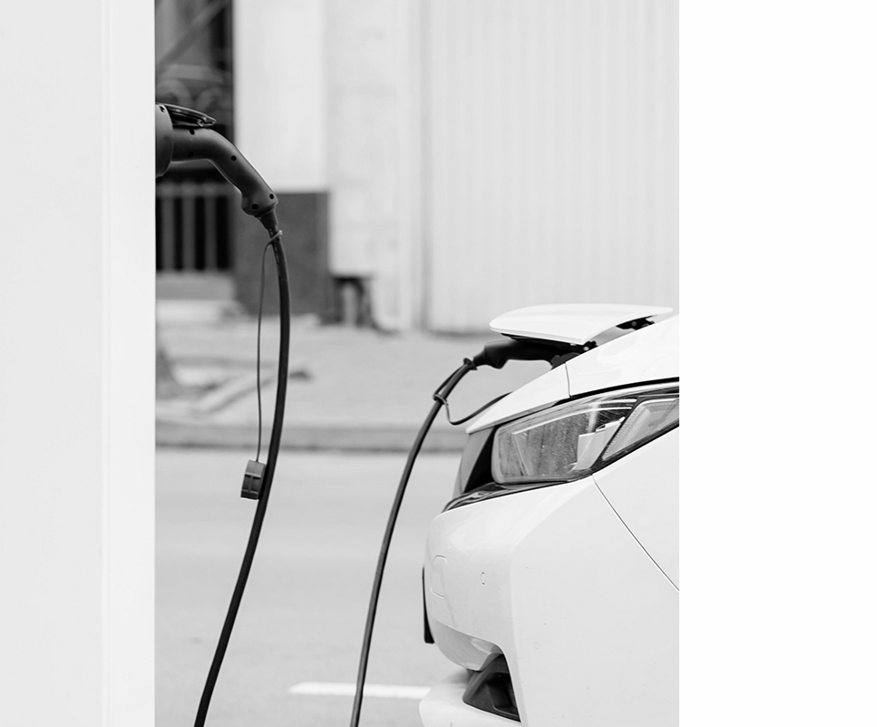
Load Demand Curve

Slide 5
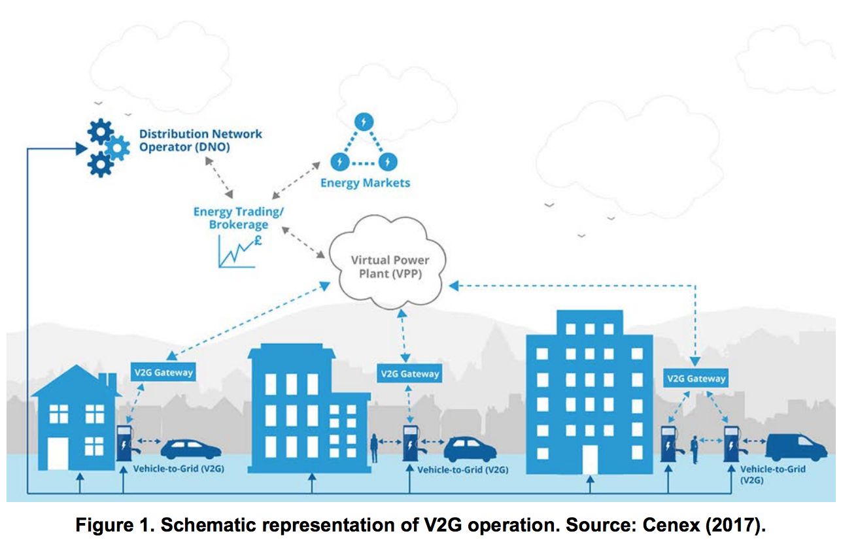
Architecture of V2G

Slide 6
Energy Trading
01.
02.
03.
04.
Secure V2G Energy Trading (SV2G-ET) scheme
Using RL and Blockchain Technology
maximizing owners profits and securing energy trading
suited for multiple parties for trading cooperation in real time
handle the interoperability

Slide 7
SV2G-ET scheme Benefits
Handling data storage cost issue on blockchain
increasing EV’s owner profit
Saving EVs charging cost
Improving scalability

Slide 8
Data Security in the Smart Grid Environment
V2G network is a significant part of the SG environment
Electric vehicles communicate with the service providers
Blind signature is one of the promising cryptographic techniques used to design privacy-preserving billing and payment

Slide 9
The Benefits of the Vehicle to Grid
Car OEMs (manufacturers) are able to sell vehicles with added value
Network operators can optimize investments & stabilize the grid
Reduce total cost of ownership of fleets
Energy market parties can trade and optimize their balance

Slide 10
CHALLENGES OF USING V2G
Battery efficiency and durability
Instability of electric grid :
Overloading of existing transmission lines
Demand and supply mismatch
Poor existing infrastructure and the current grid conditions

Slide 11
Protocols
IEC 15118
ISO 15118
IEC 63110
OCPP
promote communication between V2G technology and the application
Allow communication between Electric Vehicles and the Electric Vehicle Supply Equipment
facilitate bi-directional systems
connect EV chargers and software backend systems

Slide 12
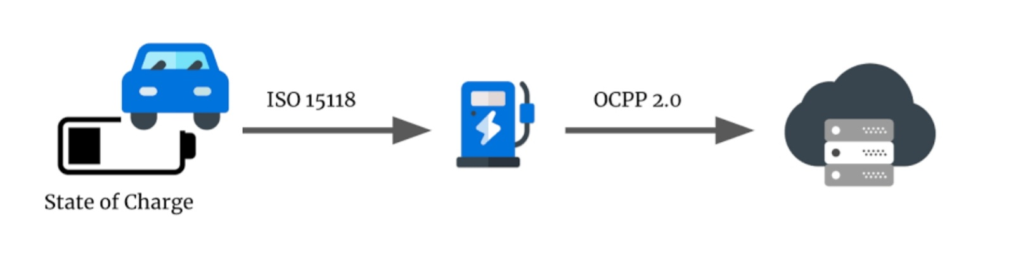
Protocols
ISO 15118
OCPP

Slide 13
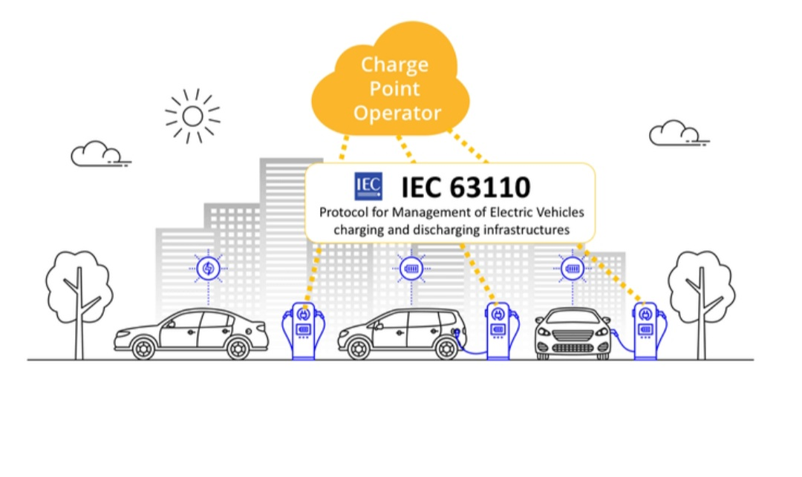
IEC 63110

Slide 14
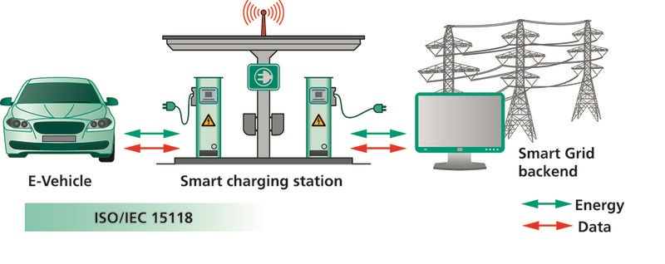
IEC 15118

Slide 15
References
Virta Ltd. (2021) Vehicle-to-grid (V2G): Everything you need to know, Virta Global. Virta Ltd. Available at: https://www.virta.global/vehicle-to-grid-v2g (Accessed: November 10, 2022).
Authorship, E.C. et al. (no date) Vehicle-to-grid technology is revving up, Greenbiz. Available at: https://www.greenbiz.com/article/vehicle-grid-technology-revving (Accessed: November 10, 2022).
Jperez (2022) Vehicle to grid (V2G) technology, IEEE Innovation at Work. Available at: https://innovationatwork.ieee.org/vehicle-to-grid-v2g-technology/ (Accessed: November 10, 2022).
Vehicle to grid (no date) Vehicle to Grid - an overview | ScienceDirect Topics. Available at: https://www.sciencedirect.com/topics/engineering/vehicle-to-grid (Accessed: November 10, 2022).
Authors Abhay Barnard Britto Product Marketing Manager Kevin Krannich Former Marketing Communications Apprentice (2022) What is vehicle to grid (V2G) technology?, Elektrobit. Available at: https://www.elektrobit.com/trends/vehicle-to-grid-technology/ (Accessed: November 10, 2022).
SV2G-ET: A secure vehicle-to-grid energy trading scheme using deep ... (no date). Available at: https://www.researchgate.net/publication/359840629_SV2G-ET_A_Secure_Vehicle-to-Grid_Energy_Trading_Scheme_using_Deep_Reinforcement_Learning (Accessed: November 14, 2022).

Slide 16
Thanks!

