Slide 1


Data Analytics Project on Retail
18th July 2024
Chitra Jayapalan

Slide 2

Agenda
Dataset Import and Data Cleansing in Python.
Loading the Dataset into SQL Server for Analysis.
Importing the Dataset in Power BI for Visual Analysis.
Creation of Report for Visual Analysis.
Insights to Business

Slide 3

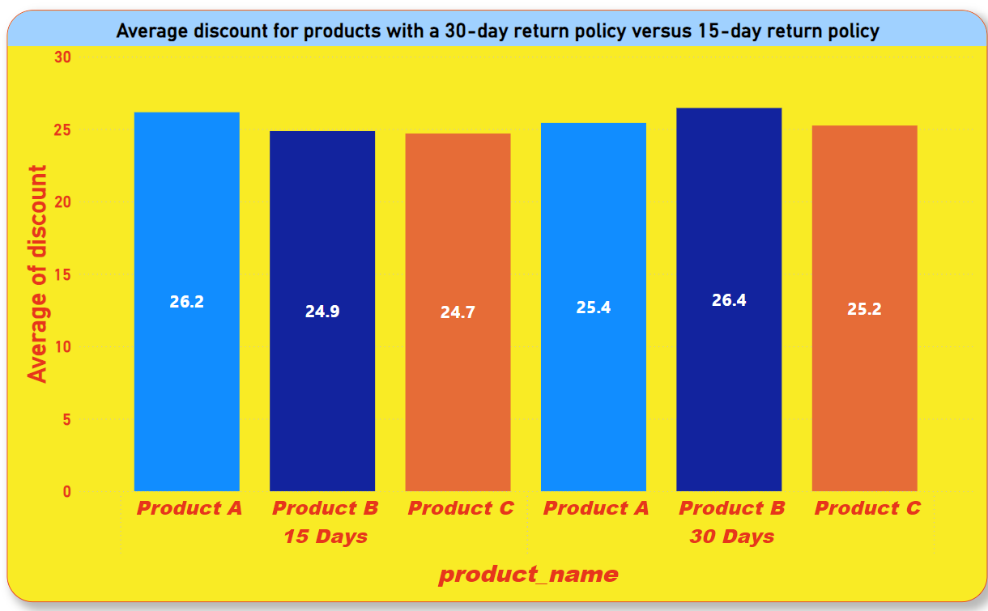

Average Discount
Average Discount offered for products with 30-day Return Policy those with 15-day Return Policy

Slide 4

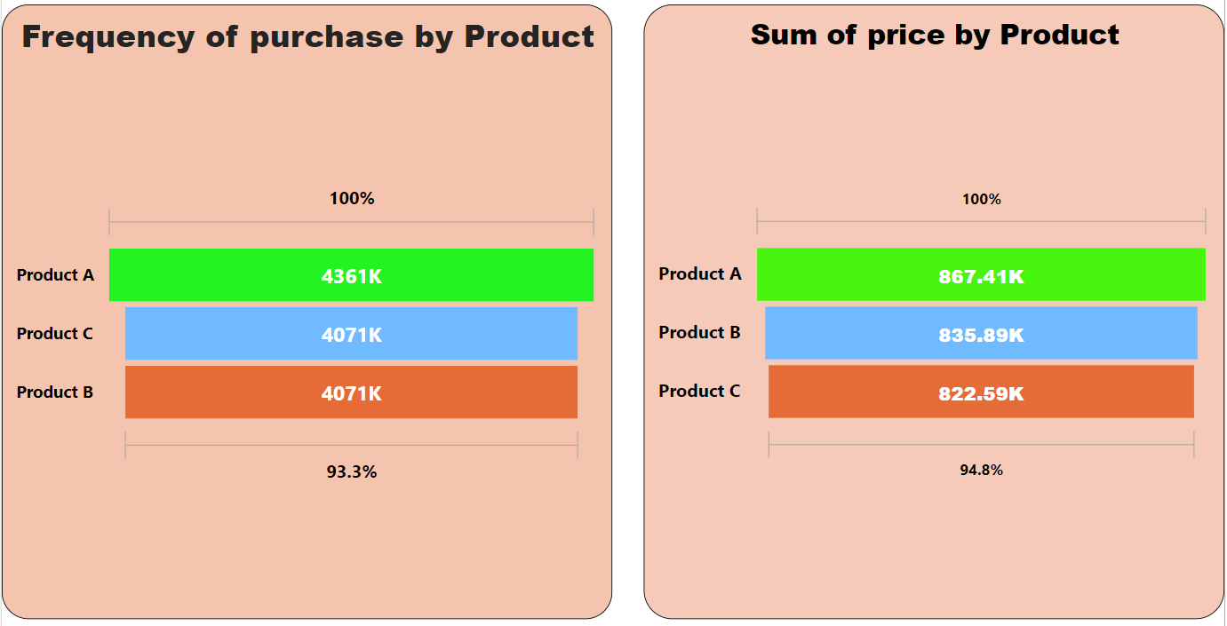

Behavioral Segmentation
Customer Segmentation based on products

Slide 5



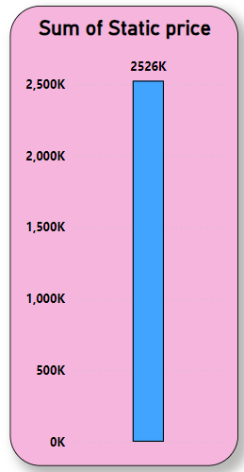
Pricing Strategy
Rating & Review of Products
Discount Percentage
Rating & Review of Products
Price

Slide 6

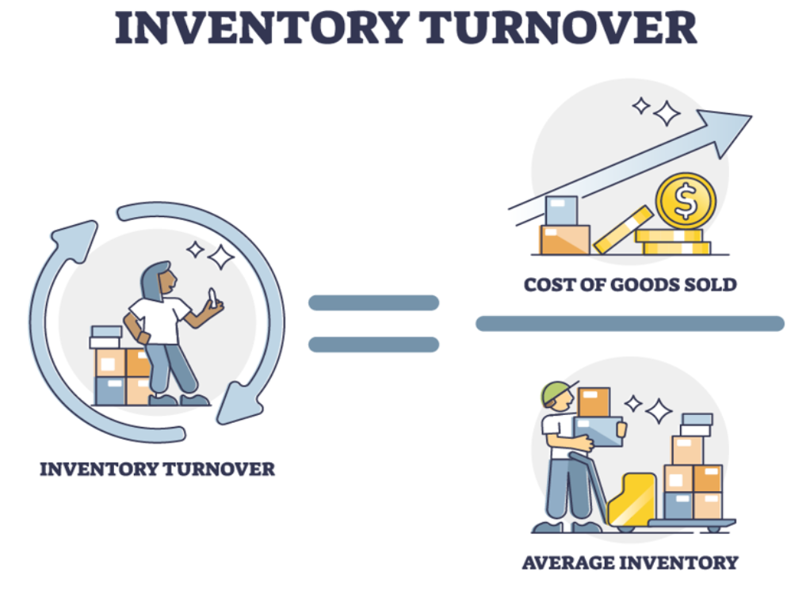
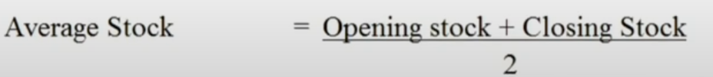
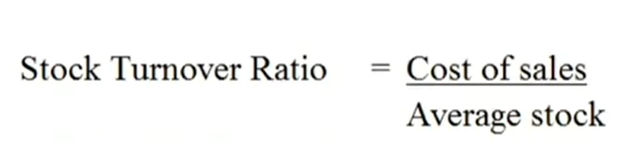
Stock Turnover Ratio

Slide 7
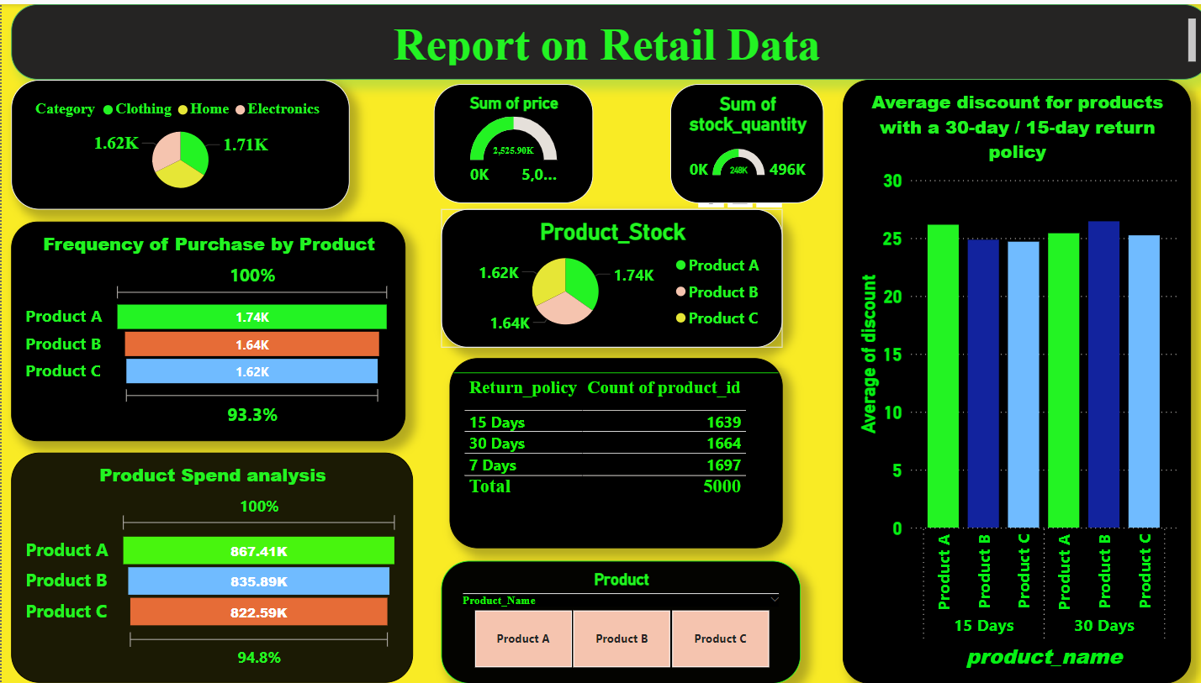

Slide 8



Insights
Based on product reviews the Products can be replenished in the corresponding warehouse.
According to reviews the price of the product can be increased in that particular warehouse
The most reviewed product in each warehouse
Categories with Highest Average Rating Across Products
Based on product category rating the discount can be reduced for the Product to get better profit

Slide 9


