Slide 1
Anisotropic spot broadening in Fourier Space

Slide 2
Confinement along X

Slide 3
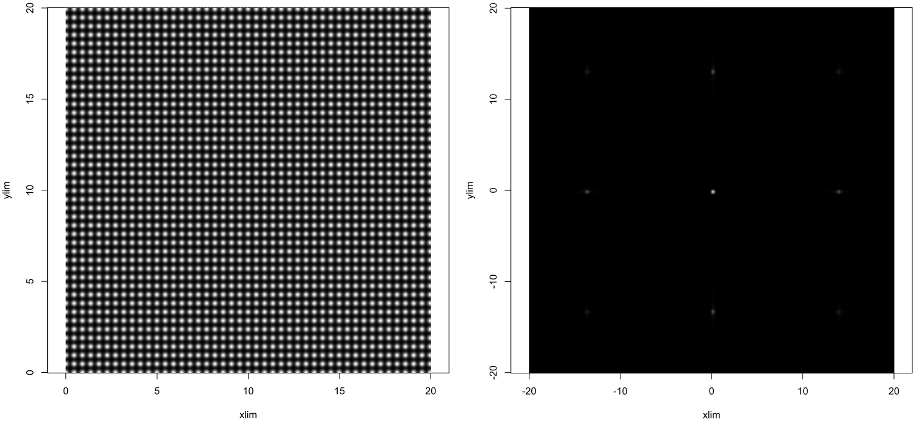

Slide 4
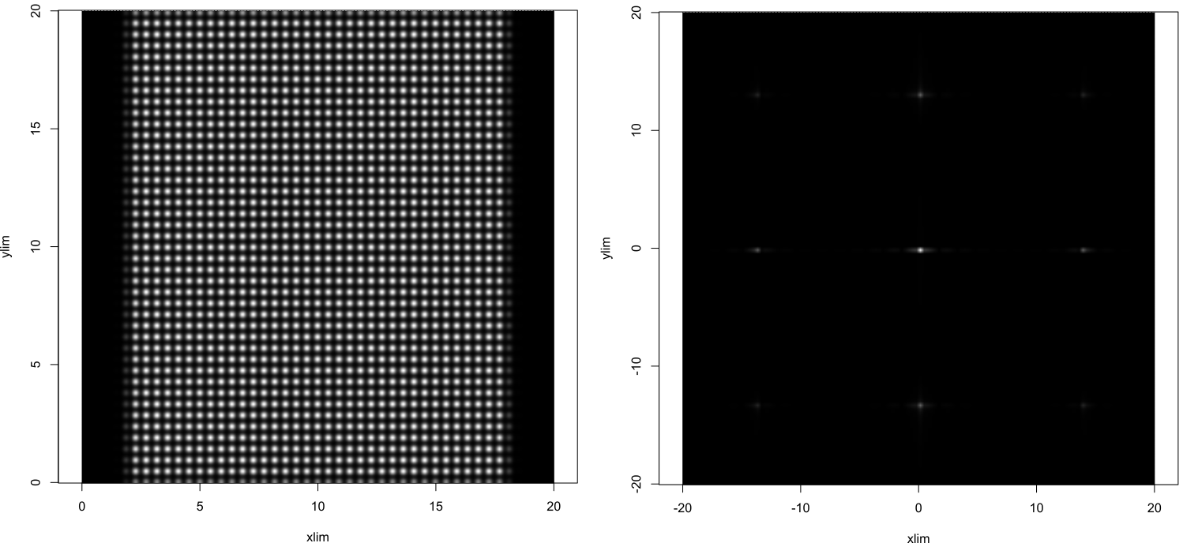

Slide 5
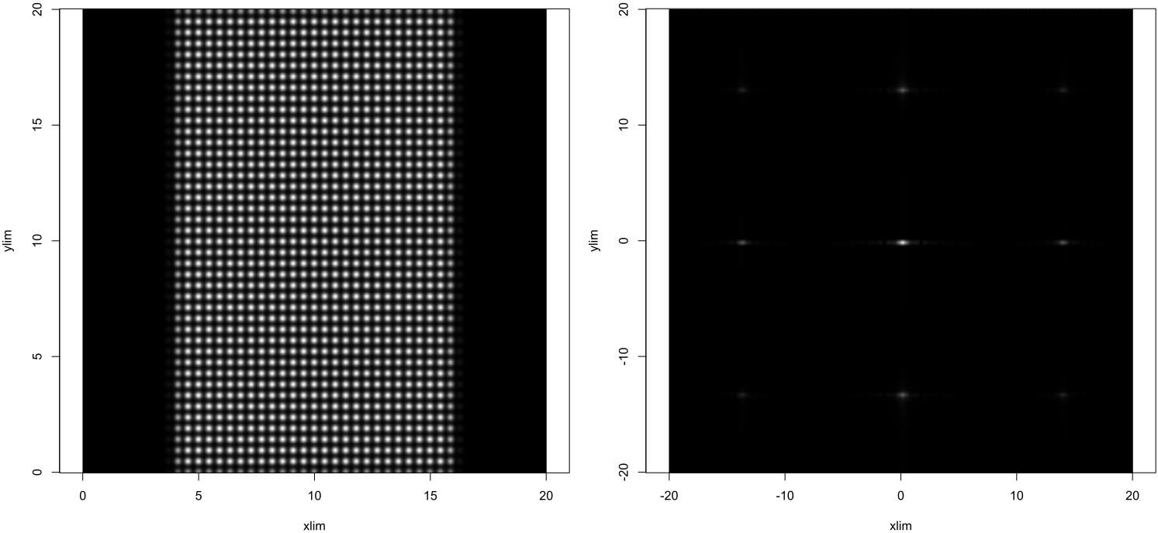

Slide 6


Slide 7


Slide 8
Confinement along Y

Slide 9
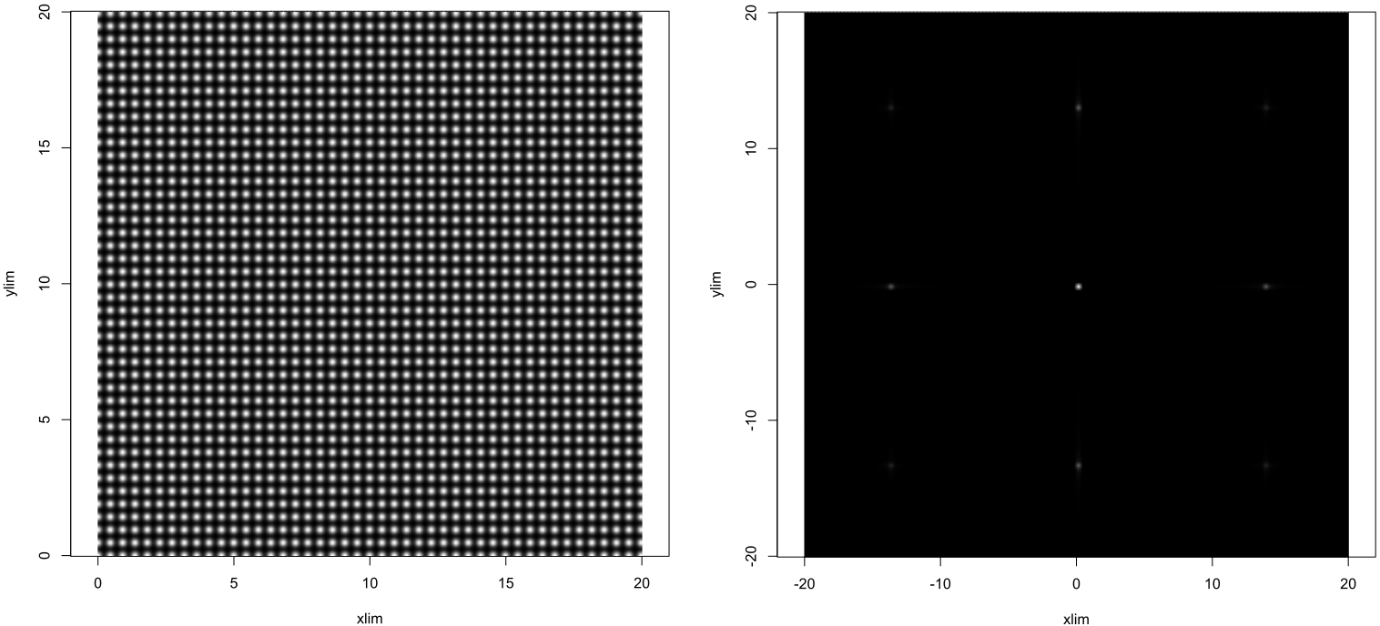

Slide 10
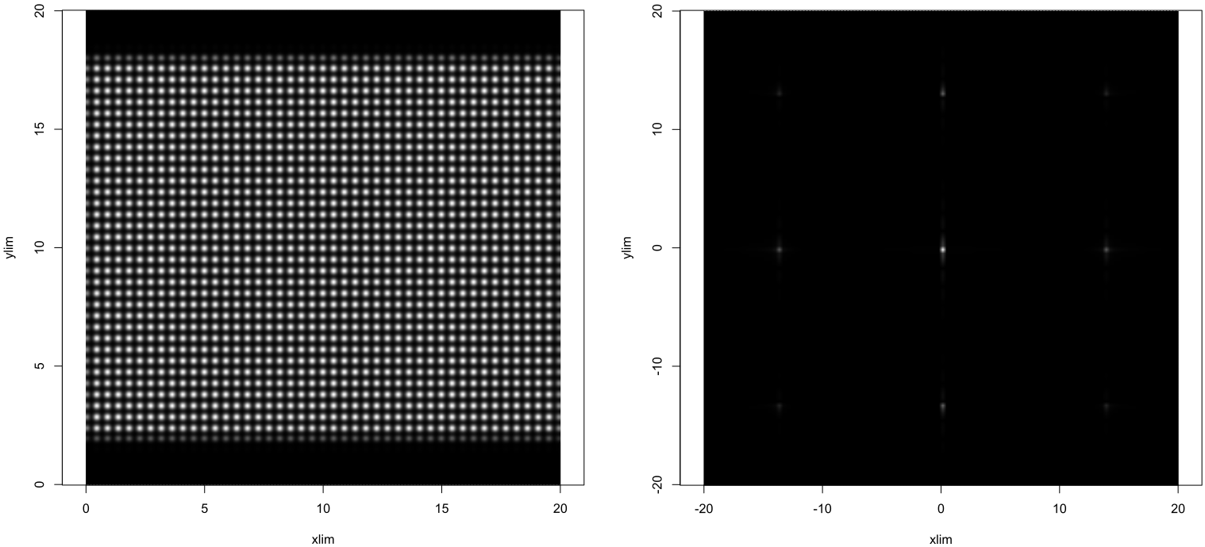

Slide 11
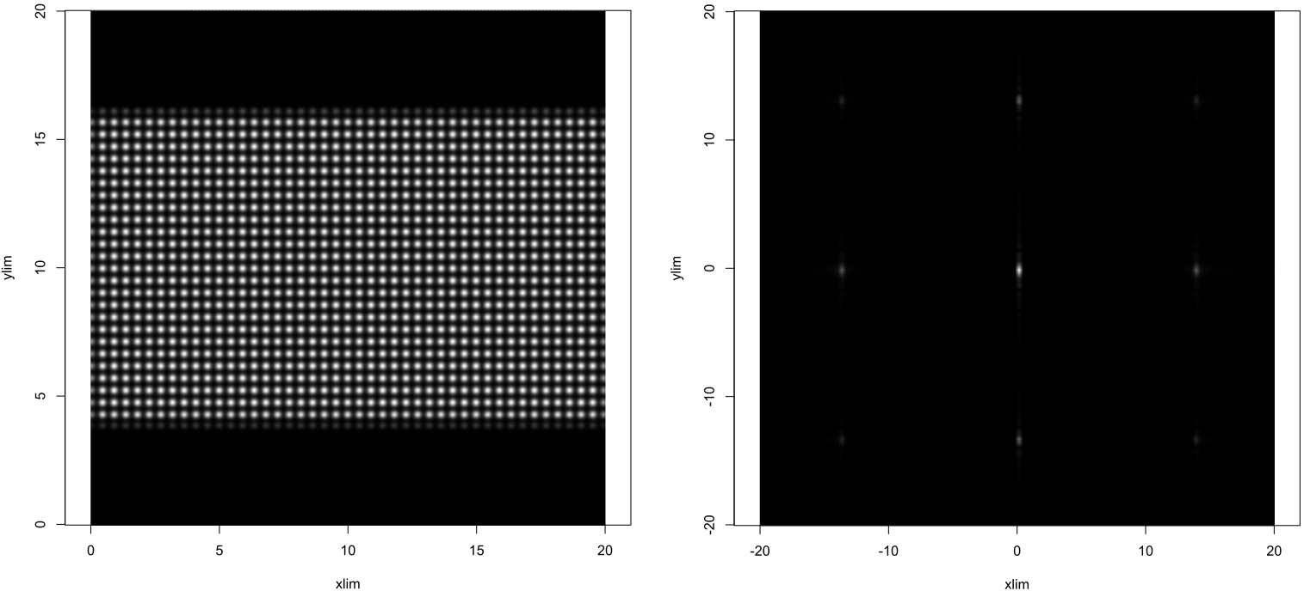

Slide 12
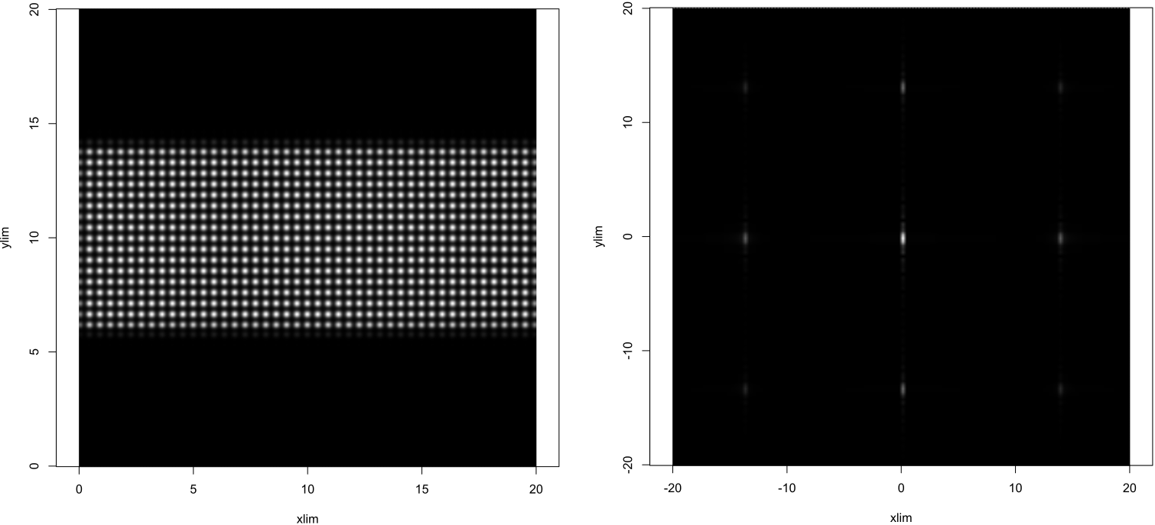

Slide 13
