Slide 1
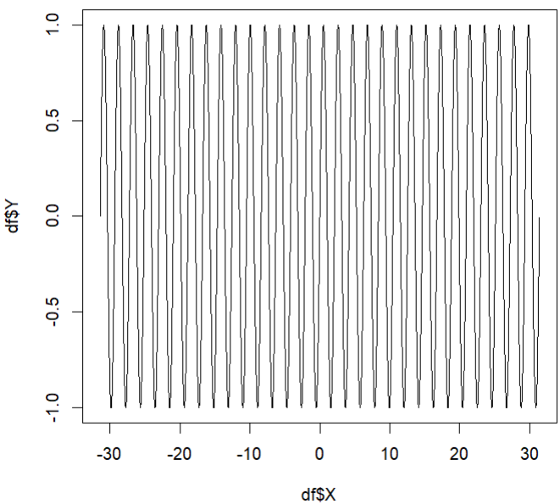
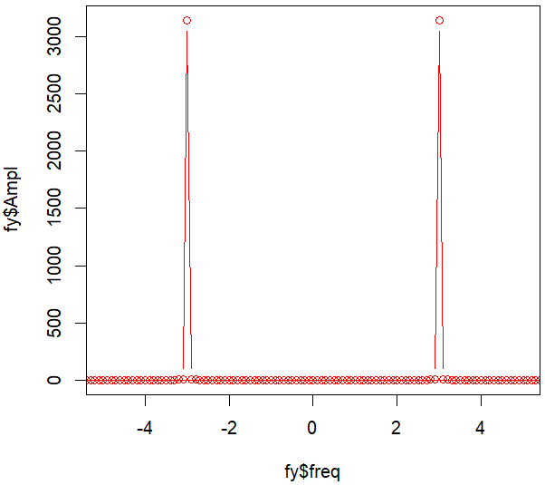
Signal: pure sine
FFT

Slide 2
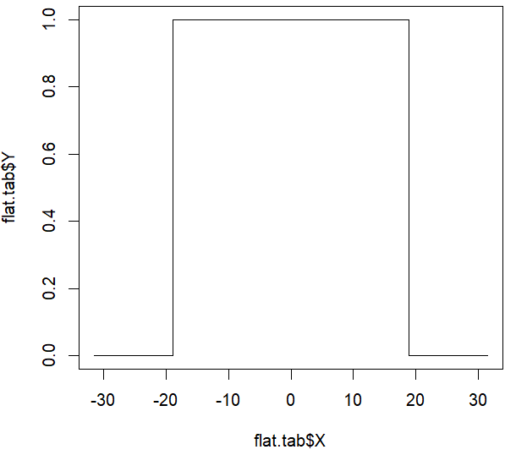
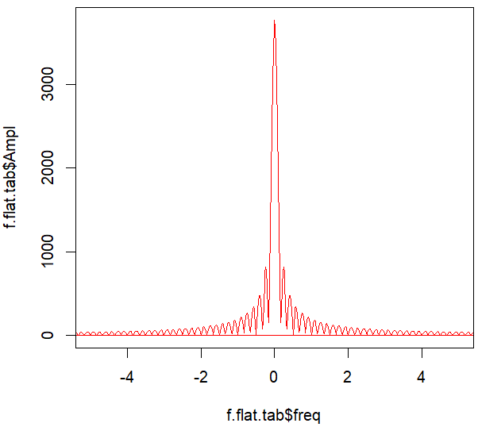
Window function
FFT: Window function
Window function has ringing (sinc function)
FFT leaks energy to side lobes

Slide 3
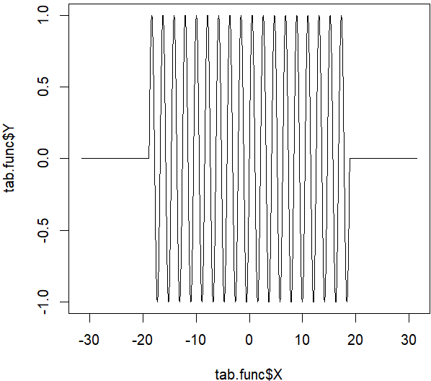
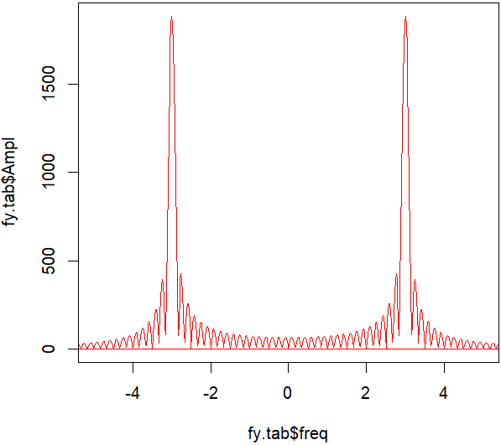
Signal: sine windowed (using a table function)
FFT (Zero padding done)
Sinc like ringing can be seen
Spectral energy leaks into side lobes
Spot broadening as a result of convolution with table function

