Slide 1
std_cases
By : Chitrang Goyani 1714081
Tejas Karia 1714088

Slide 2
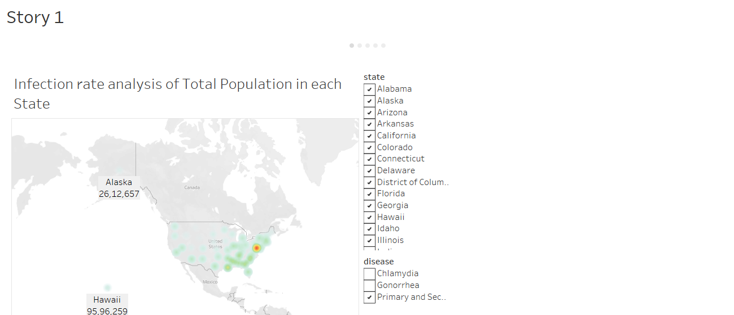

Slide 3
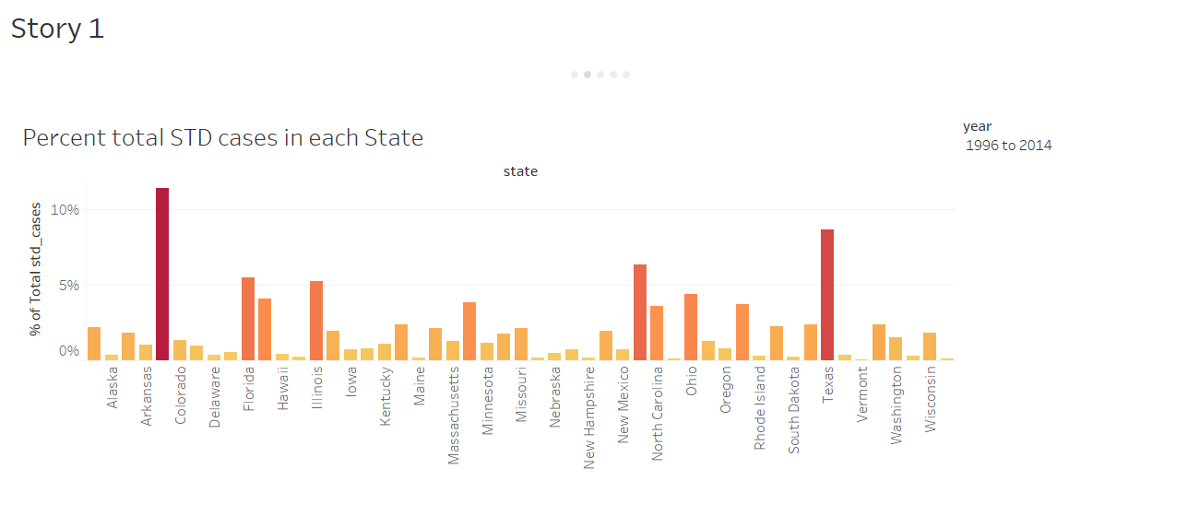

Slide 4
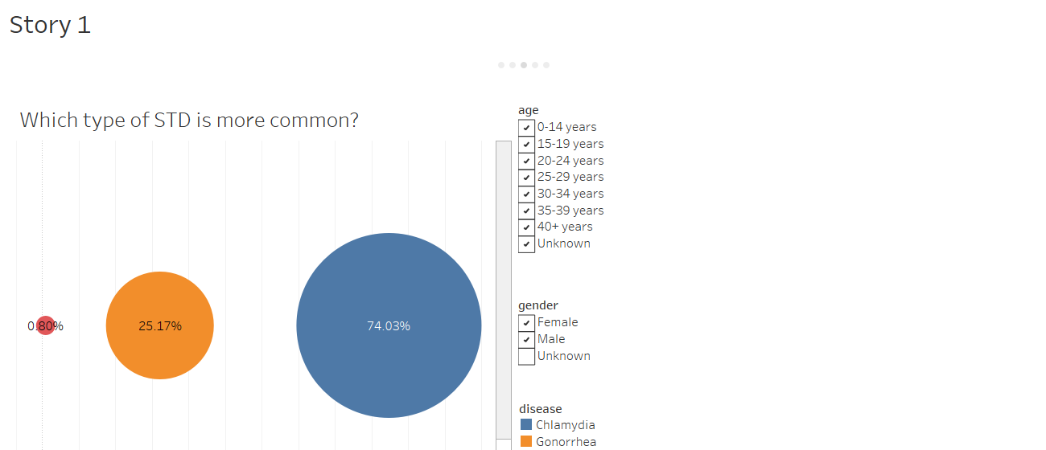

Slide 5
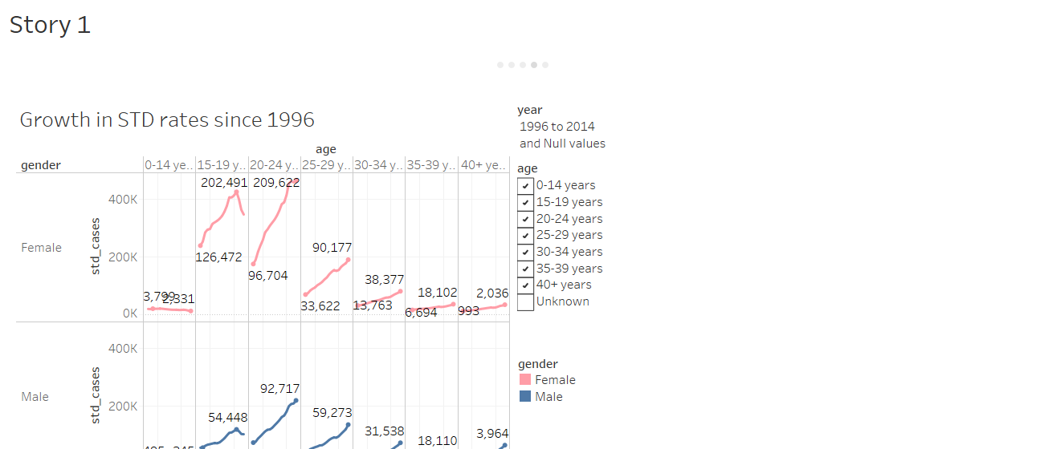

Slide 6


