Slide 1
CASE STUDY-1 CANCER MORTALITY RATES

Slide 2

ABSTRACT
This case study comes with a dataset which consists of numerous variables which will help us to do our analysis about Cancer Mortality in United States of America.
Our main aim is to predict cancer mortality rates for the US countries.
Task: Build a multivariate Ordinary Least Squares regression model to predict "TARGET_deathRate"

Slide 3

PROBLEM SOLVING METHODOLOGY
The clear approach to get to the desired output is using Python Programming Language for Data Analysis and the Machine Learning techniques to build a multivariate Ordinary Least Squares Regression model.
Data Extraction & Cleaning
Data Preparation
Testing & Training
Model Evaluation

Slide 4
CHECKPOINTS
DATA
UNDERSTANDING
DATA
VISUALISATION
DATA
CLEANING
BUILDING
MODEL
DATA
PREPARATION
RESIDUAL
ANALYSIS
TRAINING & TESTING
MODEL EVALUATION
4

Slide 5
CHECKPOINT ANALYSIS

Slide 6
ANALYSIS
Checkpoint-1
[DATA UNDERSTANDING]
Imported required libraries for eg. Pandas, matplotlib, etc.
Created a dataframe for our dataset.
Gained valuable information from our data about its size, rows and columns
Checkpoint-2
[DATA CLEANING]
Checked for NULL values and dropped column ‘PctSomeCol18_24’ with high percentage of NULL values.
Dropped 2 insignificant columns ‘binnedInc’ and ‘Geography’.
Replaced NULL values in columns by feeding mean values.

Slide 7
ANALYSIS
Checkpoint-3
[DATA PREPARATION]
Dealt with outliers in our dataset.
Used the Z-Score method for dealing with outliers.
All the values which got z > 4 were classified as outliers and removed from the dataframe as it made our data more normalised.
Checkpoint-4
[TRAINING & TESTING]
Split the data into 2 sets:
1. Training Data
2. Testing Data
Rescaled the features to standardize the range of independent variables.
Used Min-Max Scaling Technique.

Slide 8
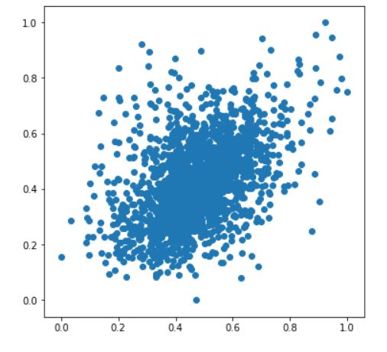
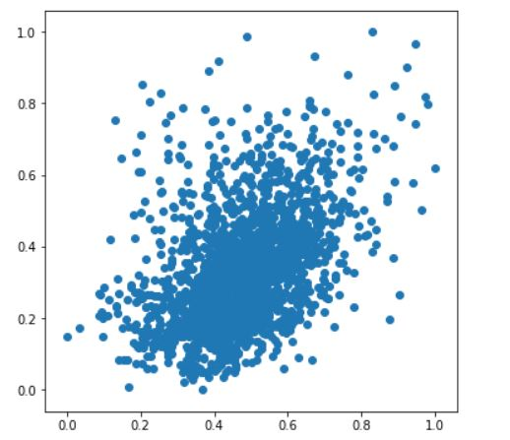
Checkpoint-5 [DATA VISUALISATION]
Visualised data for better understanding by plotting pairplots for 2 highly correlated variables with our target variable ‘TARGET_deathRate’:
PctPublicCoverageAlone vs TARGET_deathRate
povertyPercent vs TARGET_deathRate

Slide 9
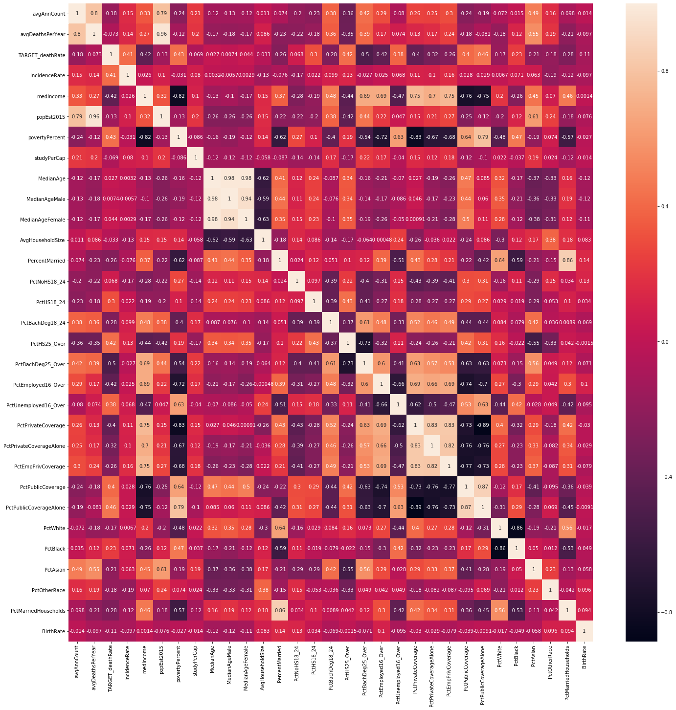
Correlation Heatmap

Slide 10
ANALYSIS
Checkpoint-6
[BUILDING MODEL]
Fitted model by adding variables to it so as to obtain a satisfactory value of R-Squared which justifies our model best.
Took help of Variance Inflation Factor (VIF) to analyse VIF value of variables.
Dropped variables which had high p-value and high VIF value.
Final Columns:- [ incidenceRate, PctBachDeg25_Over, povertyPercent, avgAnnCount,
avgDeathsPerYear, PctOtherRace ]

Slide 11
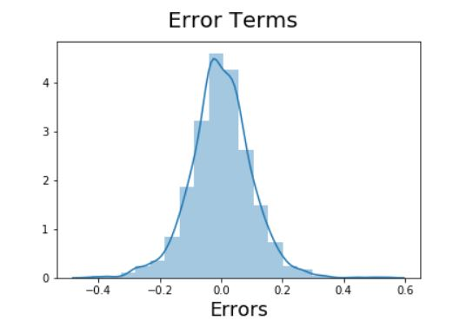
Checkpoint-7
[Residual Analysis]
Checked if the error terms are normally distributed or not.
Made predictions using the final model.
Applied the scaling on the test sets.

Slide 12
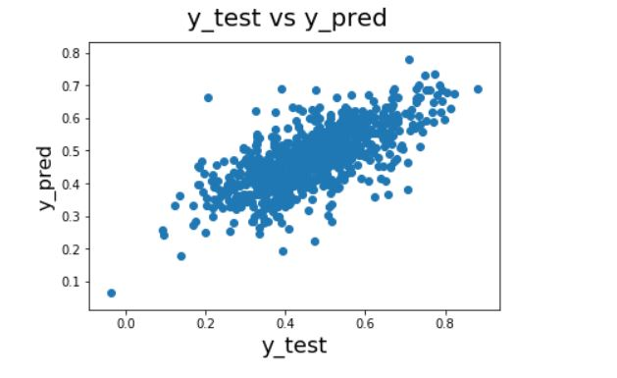
Checkpoint-8
[Model Evaluation]
Plotted a graph between actual values and predicted values

Slide 13
RESULTS
Selected some good features on the basis of level of significance, less VIF value and less p-value.
After attaining the model summary our R^2 came out to be 0.476.
All the variables selected had VIF value less than 10.
All the p-values for the selected variables came out to be 0.
Obtained a residual plot which is centered around 0 stating that it is a robust model.
Plotted a graph depicting actual y vs predicted y which gave us a linear relationship with less scattering

Slide 14

Thanks!

