Slide 1

Car Market Trends Analysis
AICTE STU ID : STU6a6aca966acaf1785383574
By Chitranjan Vishwakarma

Slide 2

PROBLEM STATEMENT
Buyers and sellers of used cars/bikes can't easily judge if a listed price is fair for its age, mileage, brand, and condition.
Raw marketplace data (like CarDekho's listings) mixes cars and bikes with no vehicle-type label, hiding depreciation and pricing trends.
This project analyzes 301 real listings (2003–2018) to answer 25 questions on pricing, depreciation, and “good deal” detection.

Slide 3
Project Description
Using Python (pandas, NumPy, Matplotlib, Seaborn) in a Jupyter Notebook, I cleaned and explored 301 used-vehicle listings from CarDekho. I classified every listing as a car or two-wheeler, engineered features such as vehicle age and price depreciation, and answered 25 structured questions covering price ranges, most-sold models, brand-wise depreciation, and the factors (age, mileage, fuel type, transmission) that affect resale value. I also built a simple linear-regression “expected price” model to flag specific cars and bikes whose selling price notably exceeded market expectations, and the likely reasons why.

Slide 4

WHO ARE THE END USERS?
Individual buyers checking whether an asking price is fair for a vehicle's age and mileage
Individual sellers deciding how to price their car or bike before listing it
Dealerships benchmarking their inventory pricing against the wider market
Marketplaces like CarDekho building pricing and insight features for users
Data analytics students studying a real-world exploratory data analysis workflow

Slide 5

Technology Used
  Python 3
  pandas & NumPy — data cleaning, feature engineering
  Matplotlib & Seaborn — data visualization
  NumPy linear regression (least squares) — “expected price” deal detection
  Jupyter Notebook — analysis environment

Slide 6
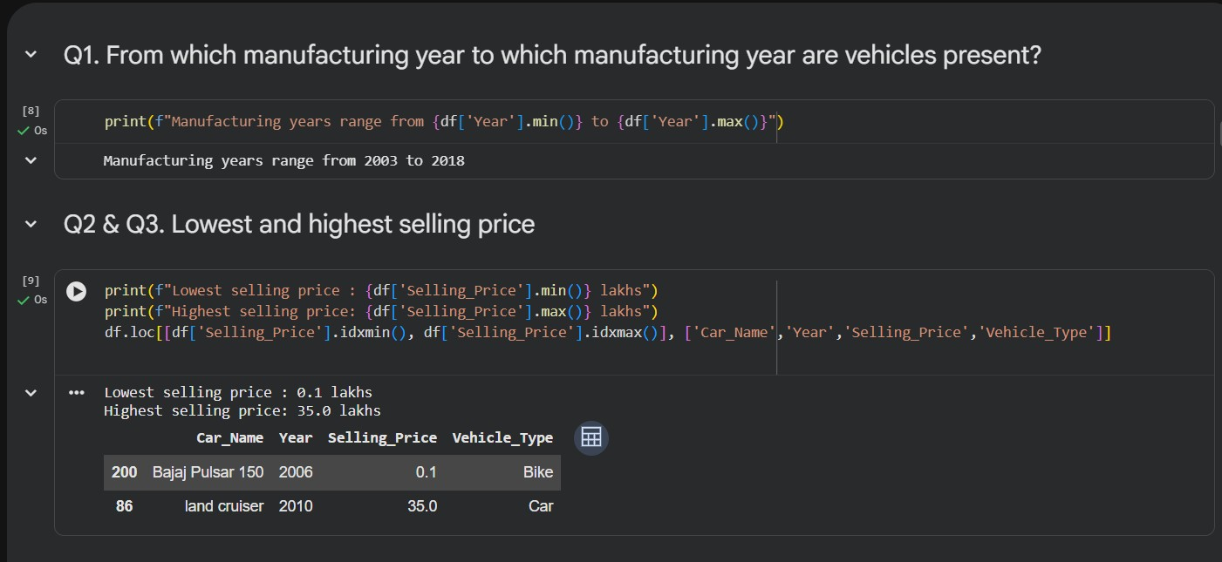
RESULTS
Demo Link

Slide 7
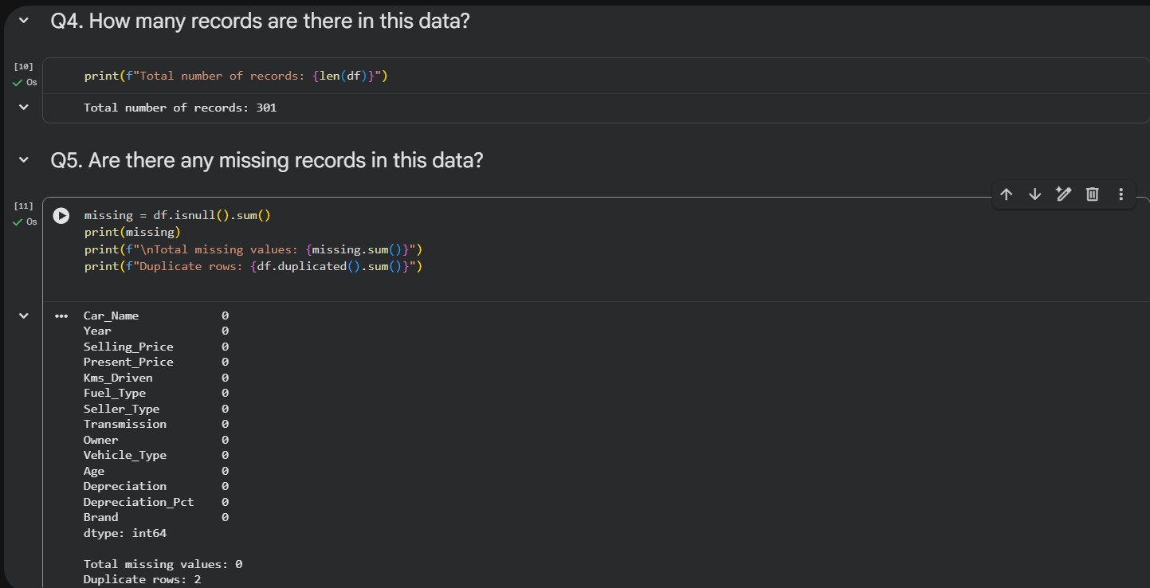
RESULTS
Demo Link

Slide 8
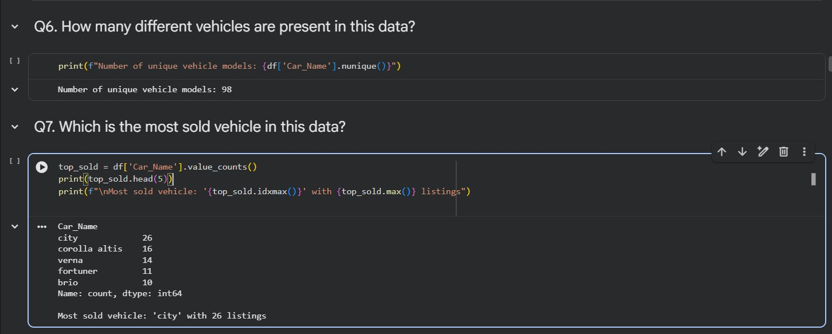
RESULTS
Demo Link

Slide 9
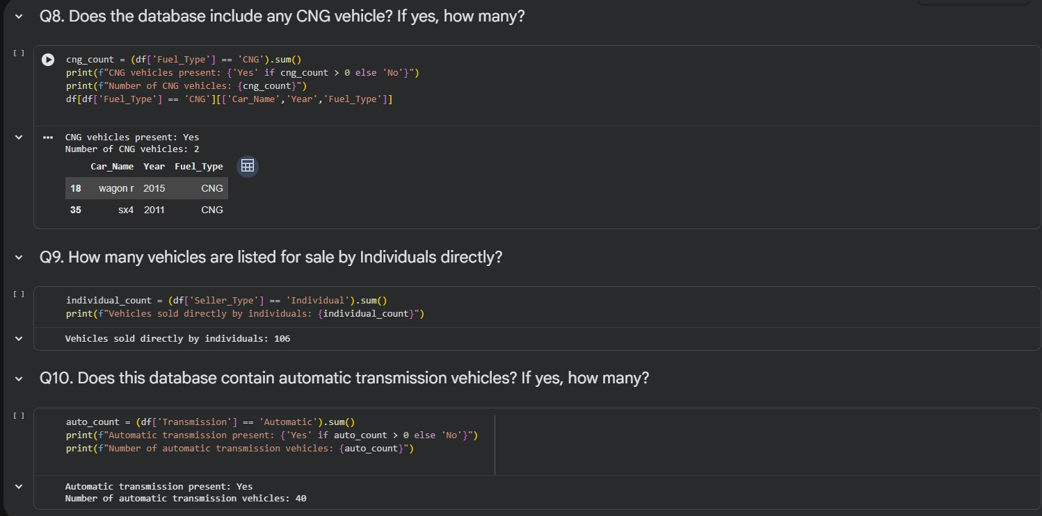
RESULTS
Demo Link

Slide 10
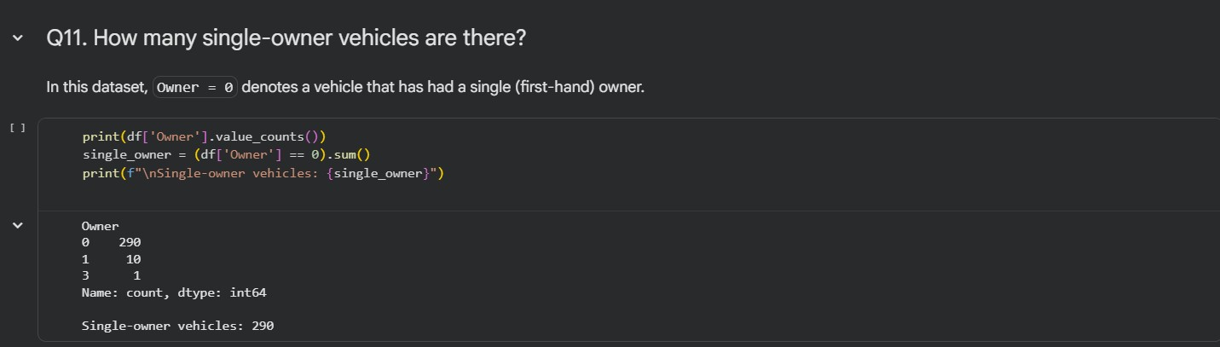
RESULTS
Demo Link

Slide 11
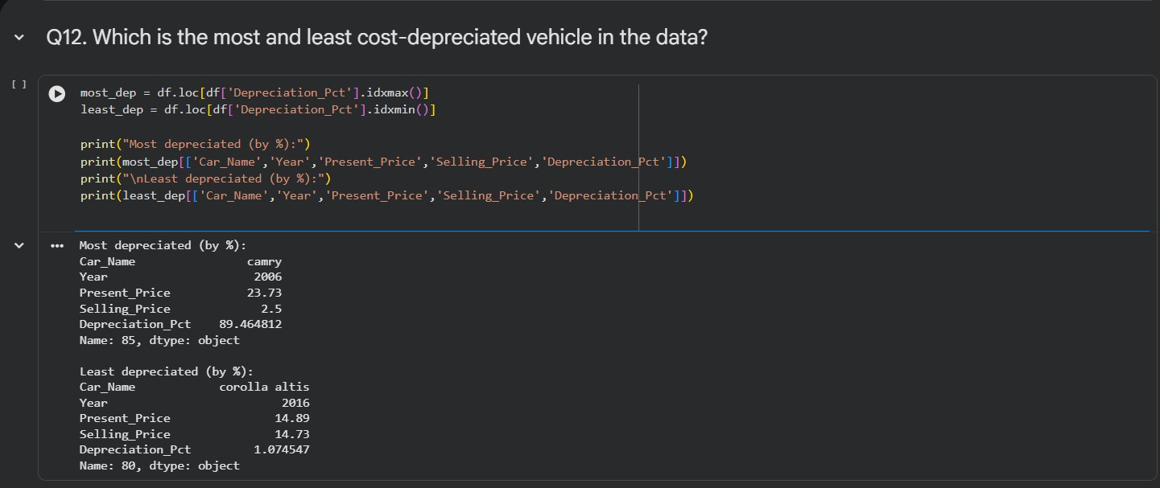
RESULTS
Demo Link

Slide 12
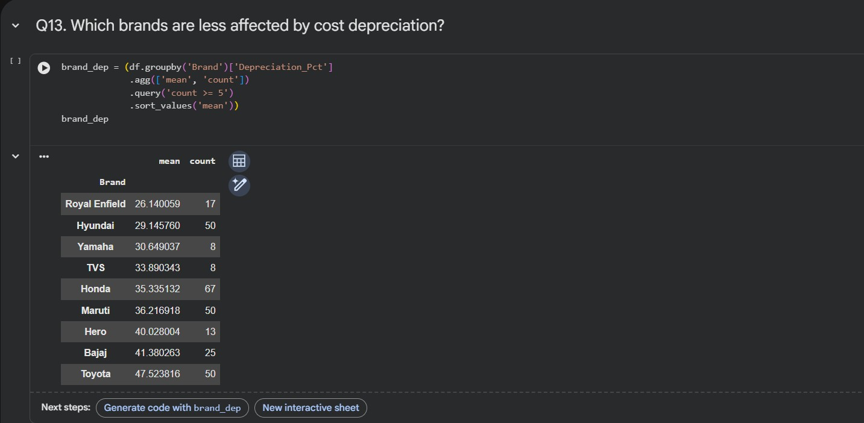
RESULTS
Demo Link

Slide 13
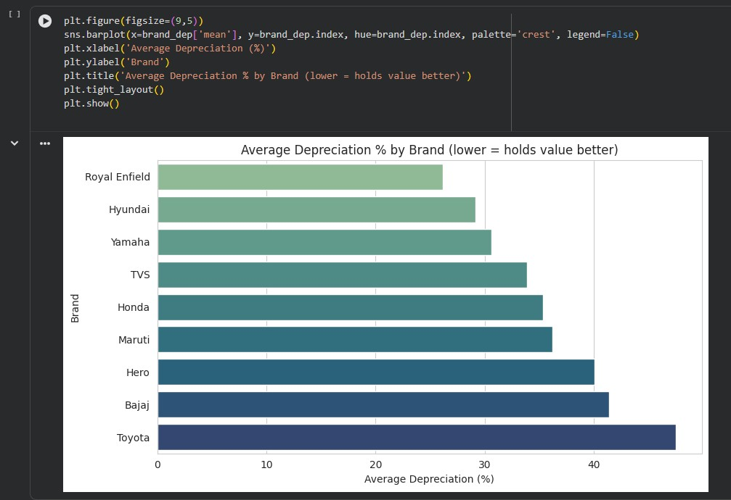
RESULTS
Demo Link

Slide 14
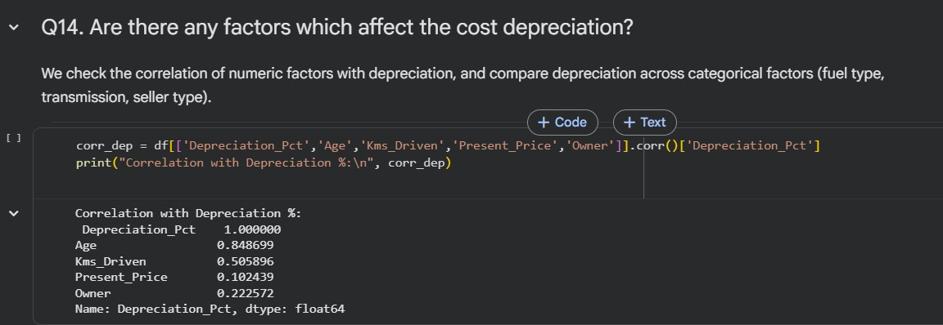
RESULTS
Demo Link

Slide 15
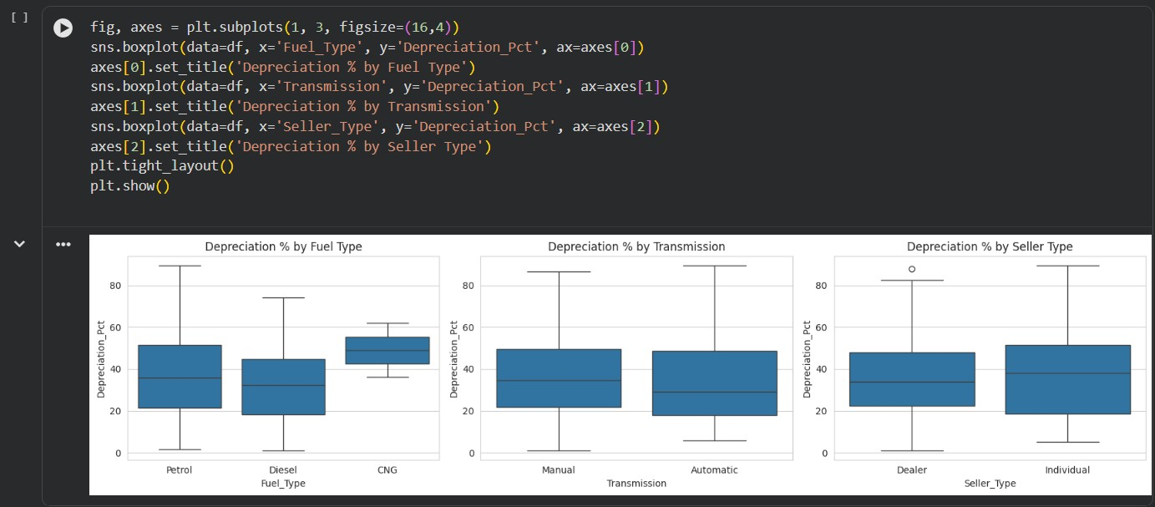
RESULTS
Demo Link

Slide 16
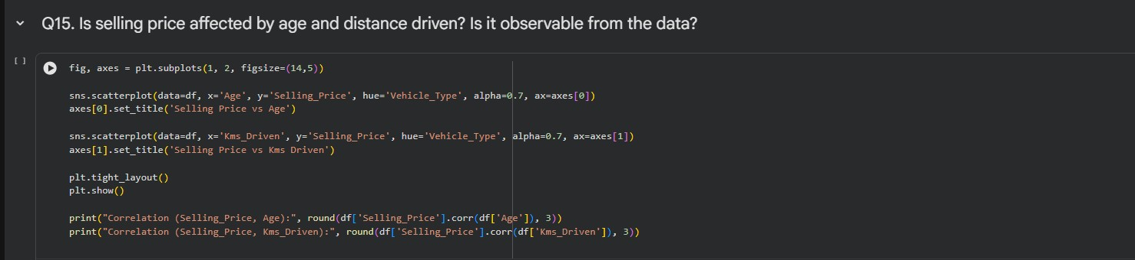
RESULTS
Demo Link

Slide 17
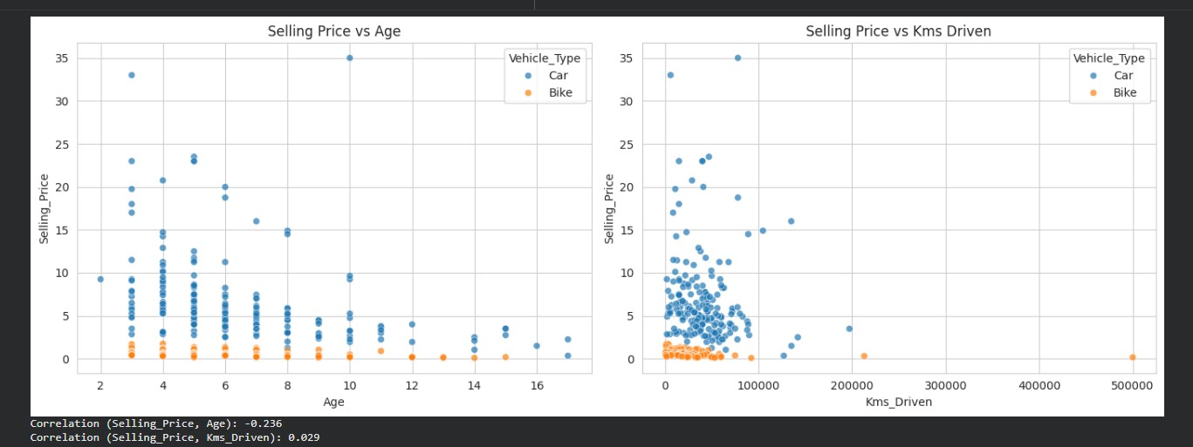
RESULTS
Demo Link

Slide 18
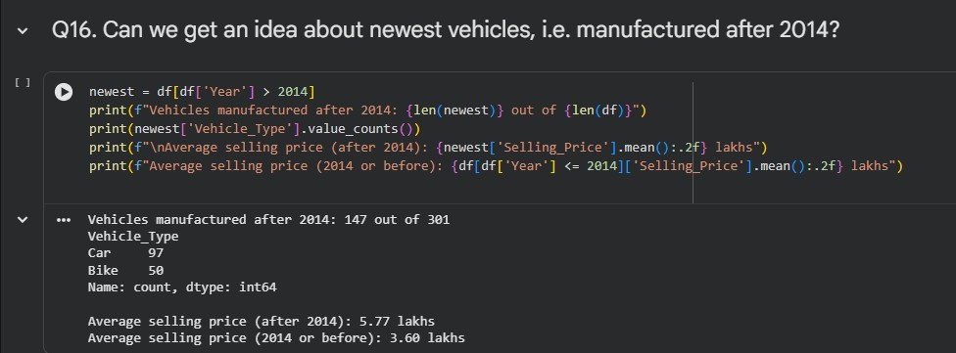
RESULTS
Demo Link

Slide 19
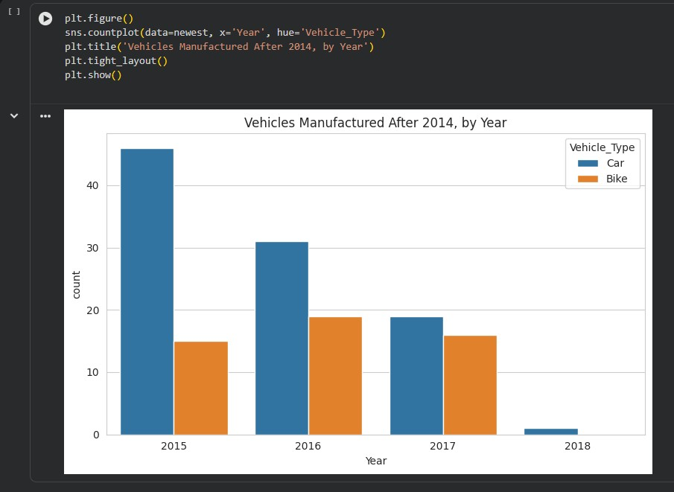
RESULTS
Demo Link

Slide 20
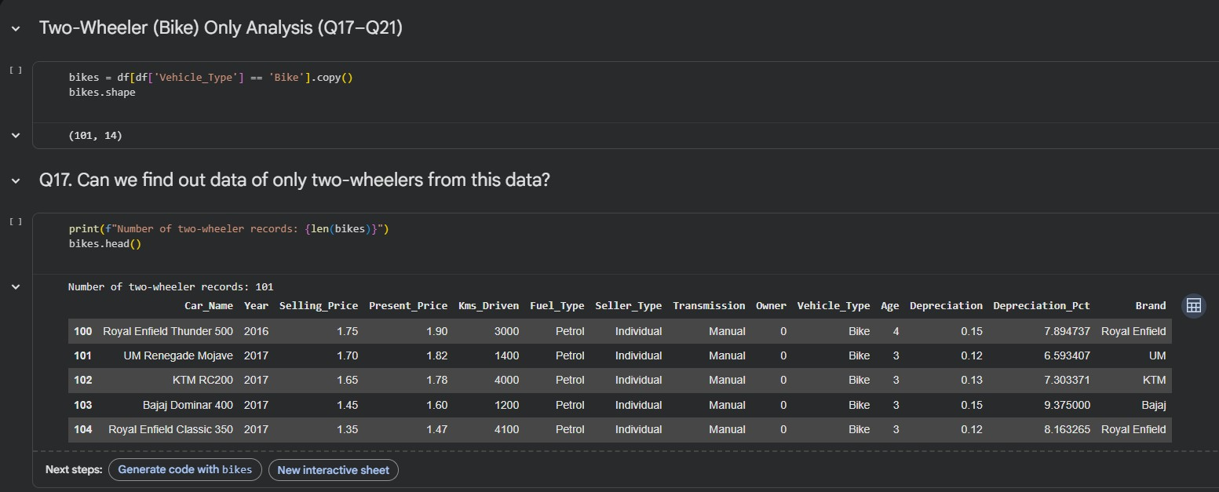
RESULTS
Demo Link

Slide 21
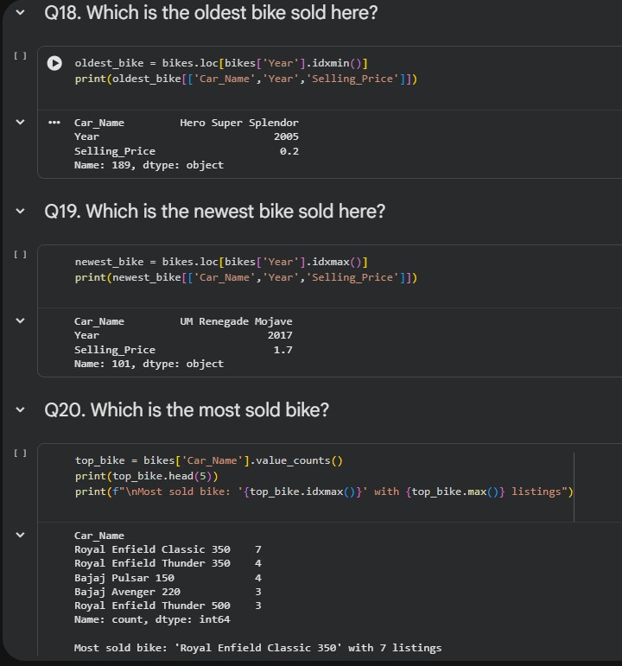
RESULTS
Demo Link

Slide 22
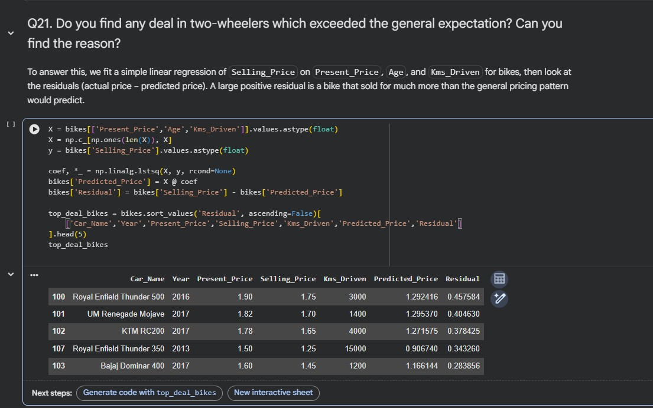
RESULTS
Demo Link

Slide 23
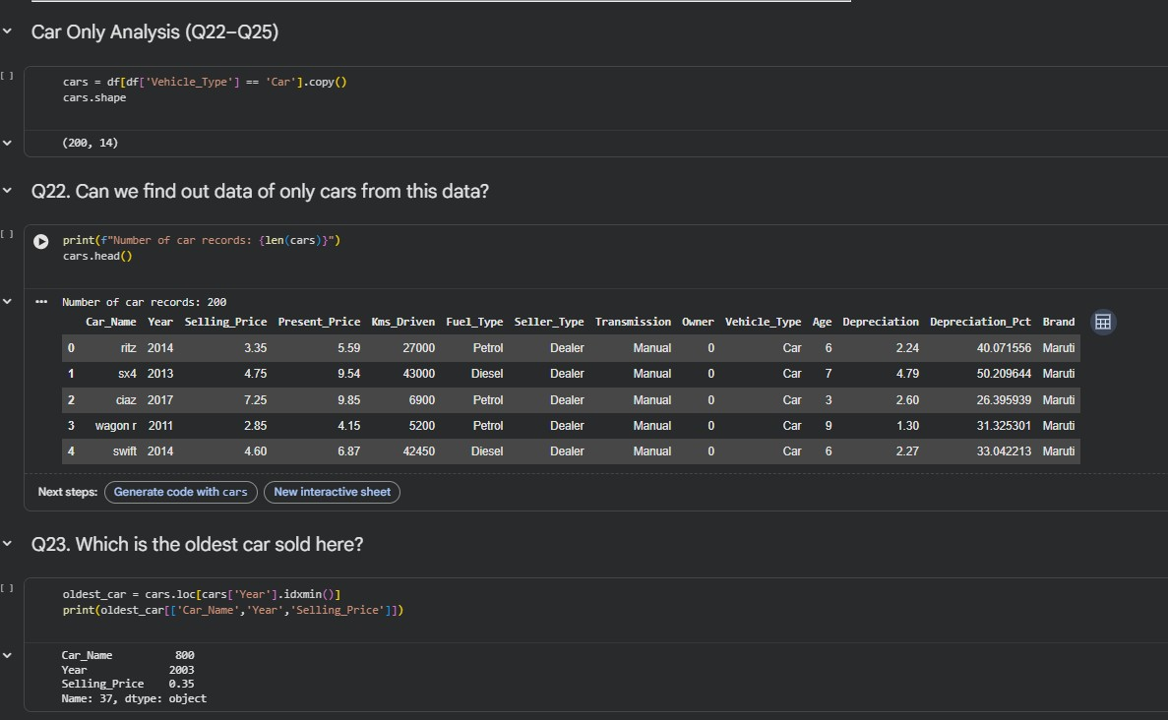
RESULTS
Demo Link

Slide 24
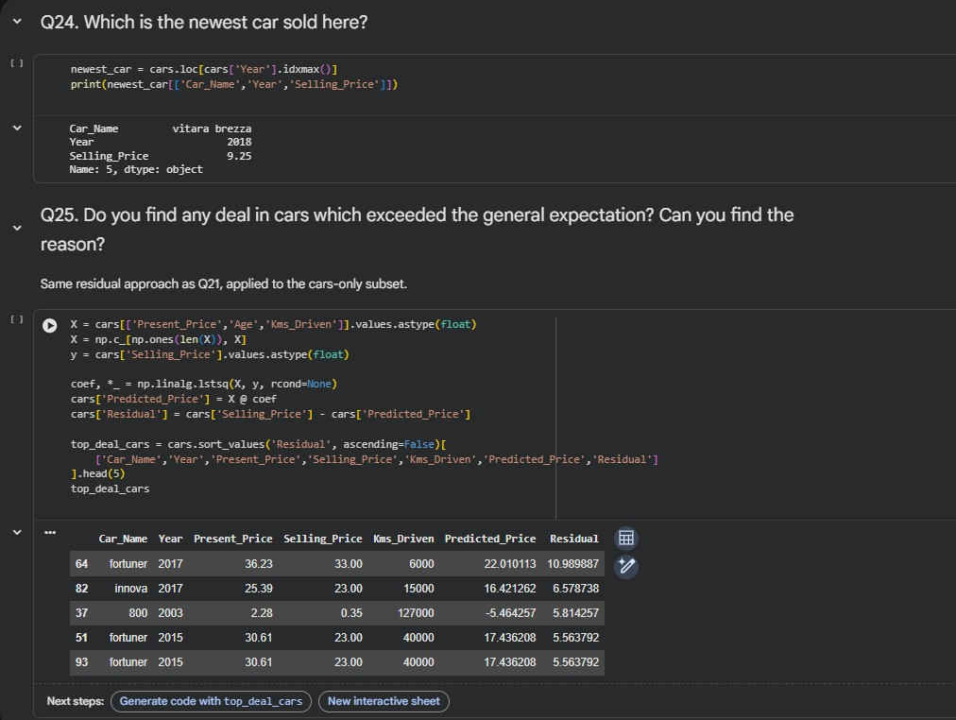
RESULTS
Demo Link

Slide 25
Thank you
.
.

