Slide 1

Healthcare Analytics for Doctor Visits
Name : Chitranjan Vishwakarma
College Name : Sri Ram Kishun P.G College Gokul, Karsada, Varanasi
AICTE STU ID : STU6a6aca966acaf1785383574

Slide 2

PROBLEM STATEMENT
Reactive planning: hospitals and insurers rarely know in advance which patients are likely to need frequent doctor visits.
No data-backed staffing: clinics plan staff and resources without a clear picture of what drives patient footfall.
Unclear risk factors: it isn't obvious how age, income, illness or insurance status combine to affect visit frequency.
The ask: analyze healthcare survey data to find what actually predicts doctor visits, so decisions can be proactive.

Slide 3
Project Description
For this project I worked with a real healthcare survey dataset covering 5,190 patients — how many times each one visited a doctor over a 2-week period, along with their age, gender, income, illness severity, chronic condition status and health insurance details.
I went through the complete data analytics workflow: cleaning the raw data, exploring it visually, running statistical tests (t-test, chi-square) to check which differences were actually significant, and then building two different predictive models — a Poisson Regression and a Random Forest — to figure out what really drives doctor visits.
The end goal was to turn this raw survey data into insights a hospital, clinic or insurance company could actually use for planning.

Slide 4

WHO ARE THE END USERS?
Hospitals & clinics — to plan staffing and resources around expected patient inflow.
Health insurance companies — to design fairer premiums and targeted plans for high-risk groups such as the elderly and chronically ill.
Public health policymakers — to plan awareness and preventive-care campaigns, especially for the ~80% of people who never visit a doctor.
Data analytics students/researchers — as a reference for applying regression and machine learning models to healthcare survey data.

Slide 5

Technology Used
  Python (pandas, NumPy) — data loading, cleaning and manipulation
Matplotlib & Seaborn — all charts and visualizations
SciPy — statistical hypothesis testing (t-test, chi-square test)
Statsmodels — Poisson Regression model for count data
Scikit-learn — Random Forest regression, train/test split & evaluation metrics
VS Code — end-to-end analysis environment

Slide 6
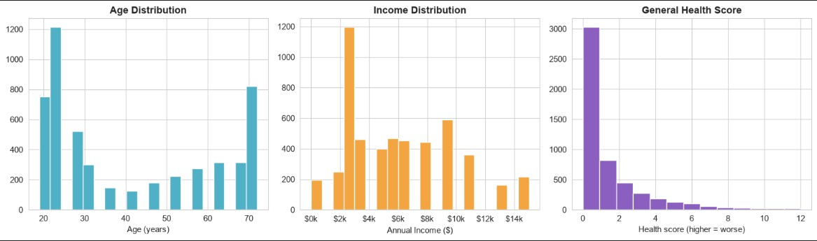
RESULTS
https://chitranjan-7-8-6.github.io/HealthCare_Analytics_for_Doctor_Visit_Analysis/

Slide 7
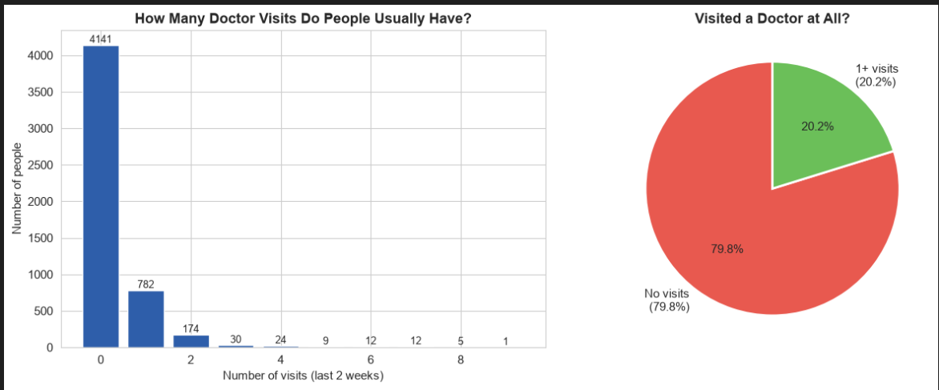
RESULTS
Doctor Visits Distribution
https://chitranjan-7-8-6.github.io/HealthCare_Analytics_for_Doctor_Visit_Analysis/

Slide 8
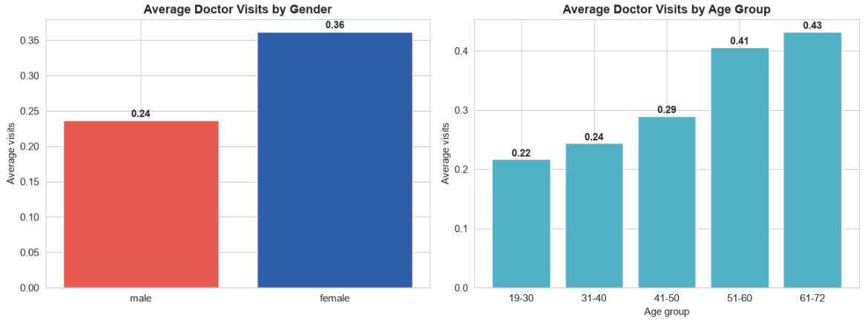
RESULTS
Bivariate Analysis
https://chitranjan-7-8-6.github.io/HealthCare_Analytics_for_Doctor_Visit_Analysis/

Slide 9
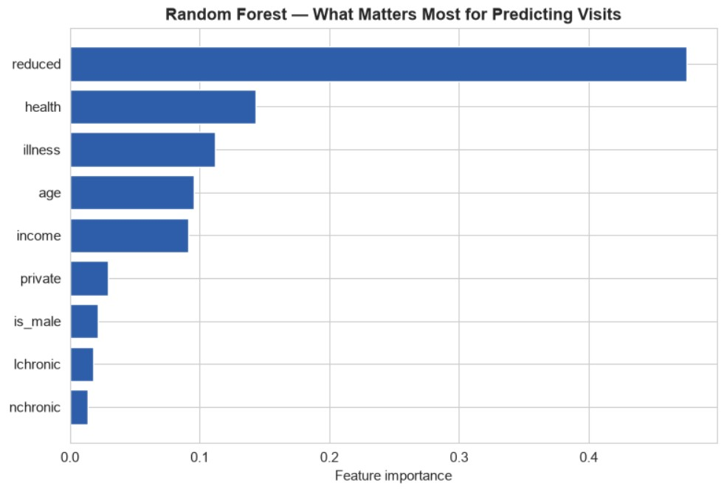
RESULTS
https://chitranjan-7-8-6.github.io/HealthCare_Analytics_for_Doctor_Visit_Analysis/

Slide 10
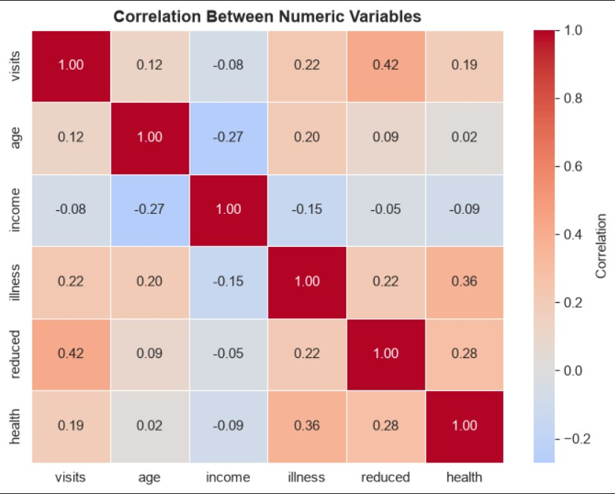
RESULTS
https://chitranjan-7-8-6.github.io/HealthCare_Analytics_for_Doctor_Visit_Analysis/

Slide 11
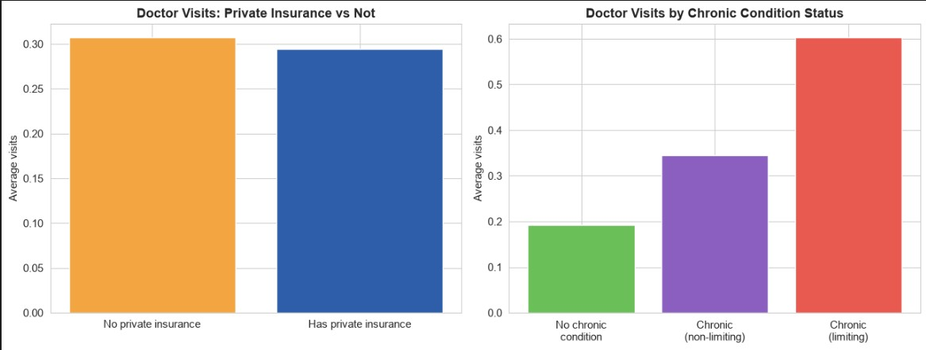
RESULTS
https://chitranjan-7-8-6.github.io/HealthCare_Analytics_for_Doctor_Visit_Analysis/

Slide 12
Github Link
https://chitranjan-7-8-6.github.io/HealthCare_Analytics_for_Doctor_Visit_Analysis/
.
.

Slide 13
Thank you
.
.

