Slide 1
Credit card customer segmentation

Slide 2
Problem Statement
The dataset we selected for this project contains 8950 rows and 18 columns. We have to create multiple segments and divide the customers into those segments accordingly. Also in order to do that we need to clean the dataset and it also requires feature engineering.
What we have?
Customer details like Balance, purchase frequency,credit limit, tenure etc.
What is to be done?
Data cleaning, feature engineering, apply clustering algorithms and finally create segments and get insights from these segments.

Slide 3
Scope and Objective
The primary objective of this project is to segment the customers into various clusters using clustering technique(s).
Analyze given data by performing EDA.
Perform feature engineering and advanced reporting based on these features.
Apply K-Means for segmentation.
Identifying how many clusters are giving better results.
Getting insights from the created segments.

Slide 4
Approach
Understanding the Data
Exploratory Data Analysis
Feature Engineering and insights
Missing Value and Outlier Treatment
Standardizing the data
Reducing Dimensions using PCA
Applying K-Means
Selecting optimum number of clusters using Silhouette Coefficient
Getting insights from these segments using Profiling

Slide 5
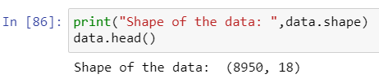
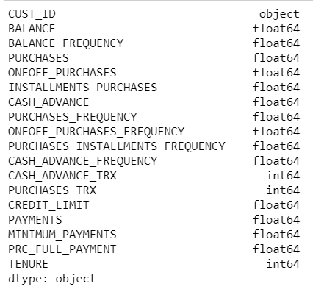
Understanding Data
Shape of the data
Features and datatypes

Slide 6
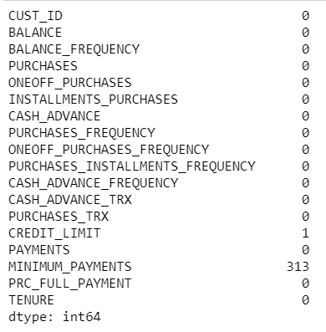
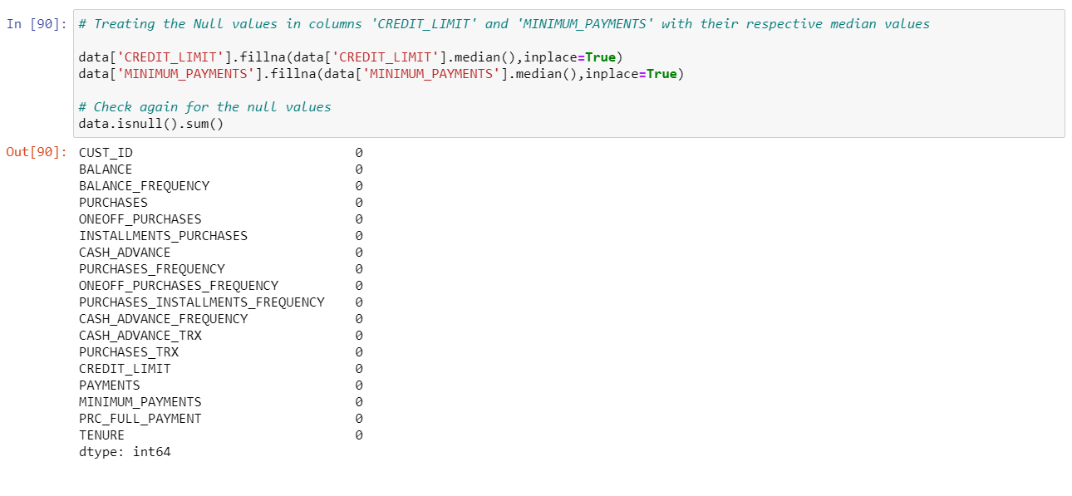
Missing Value Imputation
Checking for Null Values
Treatment of Null Values

Slide 7
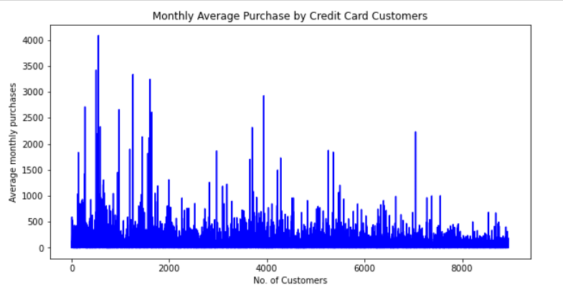
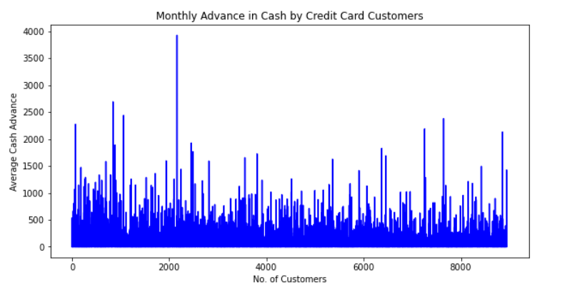
New KPIs
Based on the domain knowledge, we came up with new features that might affect the segmentation. We created the following five new features:
Average monthly purchase
Monthly cash advance
Purchase Types
Limit Usage
Payments to Min-Payment Ratios

Slide 8
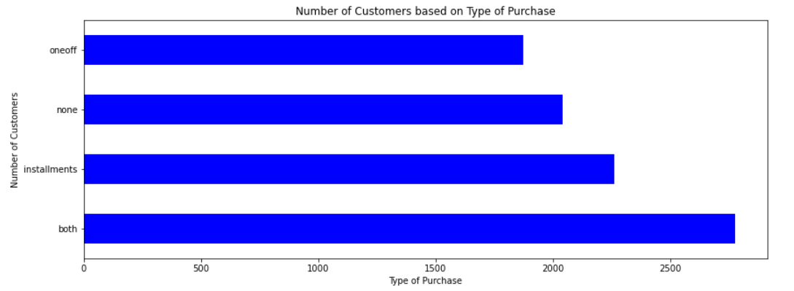
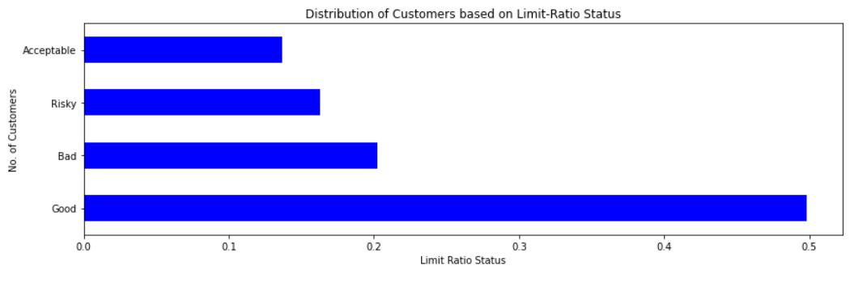

Slide 9
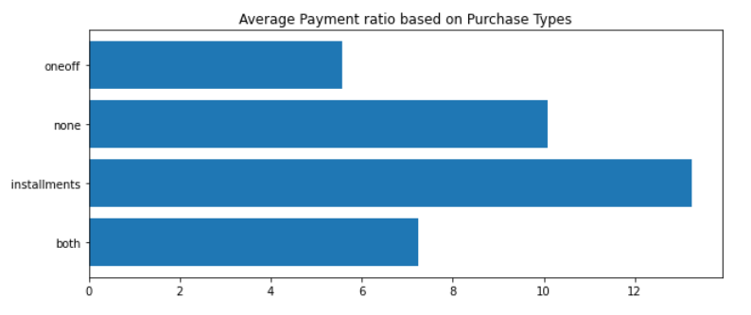
Insights
Average Payment ratio was higher for Installments and least for one-off purchases
Customers with neither installments nor One-Off purchases tend to impact a significant ratio of all customers.

Slide 10
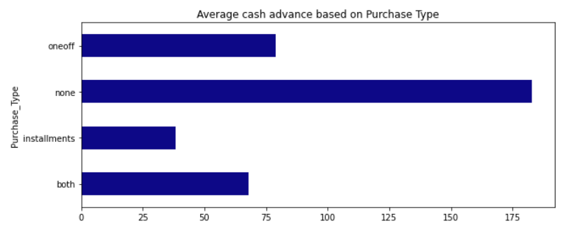
Customers with neither installments nor one-off purchases take much higher advance in cash.
Customers with Installment purchases are paying dues properly

Slide 11
Apply PCA
The main idea of principal component analysis (PCA) is to reduce the dimensionality of a data set consisting of many variables correlated with each other, either heavily or lightly, while retaining the variation present in the dataset, up to the maximum extent.
The same is done by transforming the variables to a new set of variables, which are known as the principal components (or simply, the PCs) and are orthogonal that means they are unrelated, ordered such that the retention of variation present in the original variables decreases as we move down in the order.
So, in this way, the 1st principal component retains maximum variation that was present in the original components.

Slide 12
K-Means
K-means clustering is one of the simplest and popular unsupervised machine learning algorithms.
We define a target number k, which refers to the number of centroids you need in the dataset. A centroid is the imaginary or real location representing the center of the cluster.
Every data point is allocated to each of the clusters through reducing the in-cluster sum of squares.
In other words, the K-means algorithm identifies k number of centroids, and then allocates every data point to the nearest cluster, while keeping the centroids as small as possible.
The ‘means’ in the K-means refers to averaging of the data; that is, finding the centroid.

Slide 13
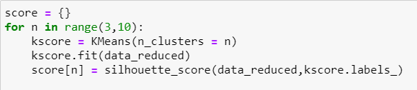
Identifying best number of segments
Silhouette Coefficient:
The silhouette value is a measure of how similar an object is to its own cluster (cohesion) compared to other clusters (separation). The silhouette ranges from −1 to +1, where a high value indicates that the object is well matched to its own cluster and poorly matched to neighboring clusters. If most objects have a high value, then the clustering configuration is appropriate. If many points have a low or negative value, then the clustering configuration may have too many or too few clusters.
The silhouette can be calculated with any distance
metric, such as the Euclidean distance.

Slide 14
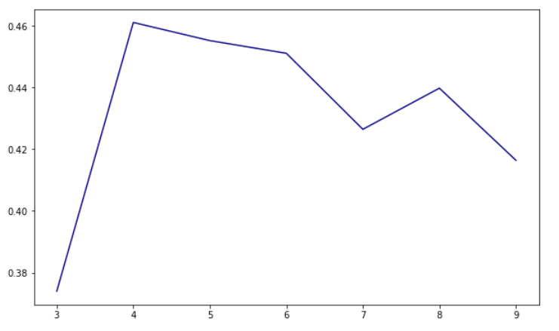
Based on Silhouette coefficient, we found that 4 clusters are giving better performances than 3,5 or 6 clusters. So we take 4 clusters

Slide 15
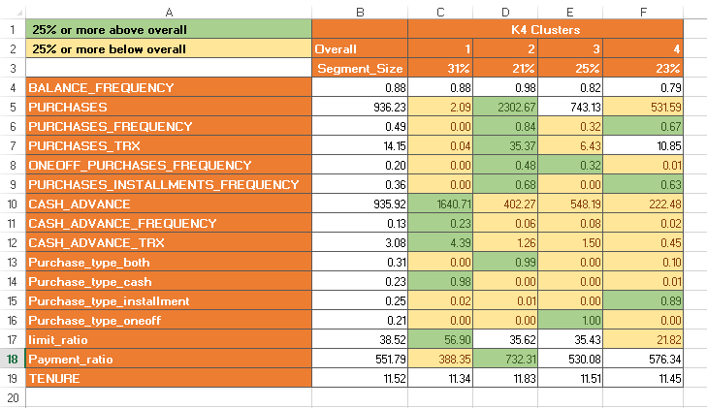
Profiling & Strategies
Profiling is another way to make sure the number of segments are correctly chosen.
Profiling refers to segment customers based on the clusters created by observing and analyzing the customers in segments. Mean gives a very good indication of distribution of data so we are finding mean for each variable grouped by each clusters.
The profiling is done using an Excel sheet.

Slide 16
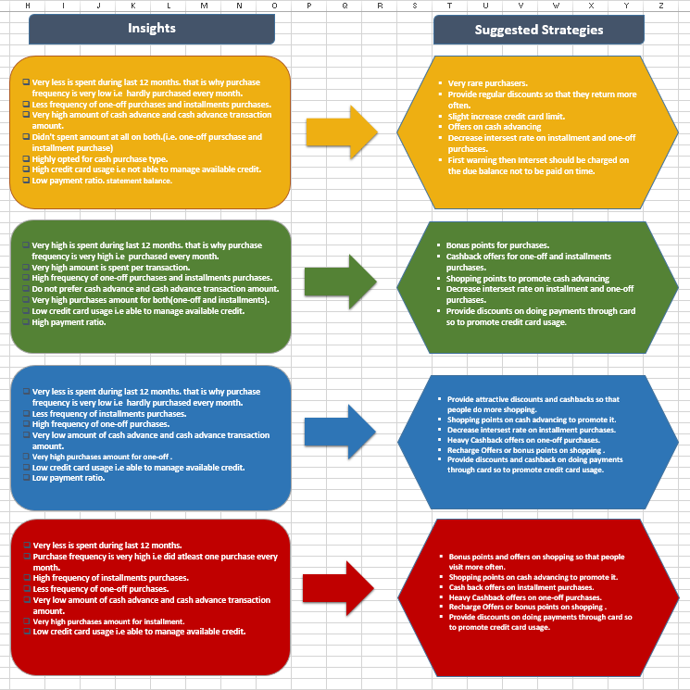
Suggested Strategies Complete details in the excel document

Slide 17
References
https://analyticsvidhya.com
https://seaborn.pydata.org
https://www.coursera.org/projects/machine-learning-for-customer-segmentation
https://morphio.ai/blog/machine-learning-for-customer-segmentation/
Thank You For The Opportunity

