Slide 1

Factors Affecting Tumor Sizes for Breast Cancer in Women
MSIS 642: Multivariate Statistics and Regression Analysis
Professor: Dr. Torrie Wu

Slide 2
Index:
1. Introduction | 14. Summarizing the models using stargazer
2. Motivation | 15. Adding Interaction Term
3. Literature Review | 16. Final Model
4. Hypothesis | 17. Interpretation
5. About Data Set | 18. Conclusion
6. Data Visualizations
7. Linear Regression
8. Summarizing the models using stargazer
9. Histogram
10. Linear-Log Model
11. Log-Linear Model
12. Log-Log Model
13. Quadratic Model

Slide 3
1. Introduction
Breast cancer is one of the most frequently occurring cancers and the most common reason for death in women.
Around 1 million cases of breast cancer have been reported with 50% of women dying every year due to cancer.
The American Cancer Society estimates that each year, about 2000 new cases of invasive breast cancer are diagnosed in men.
Therefore, this project explores the factors that cause breast cancer and checks if the factors from the dataset that might have an impact on tumor size that affects breast cancer survival rate.

Slide 4
2. Motivation
Breast cancer is one of the most prevalent malignancies among women worldwide. Hence, the goal is to check if age, race, tumor stage and size affect the tumor size.
The results of the paper might open door to take preventive measures by understanding the factors/variables that affect the tumor size.
The findings can also help implement ways for improved and better methods of diagnosis and treatment, given that we know the factors that affect the tumor size.

Slide 5
3. Literature Review
Understanding the risk of the stages and its impact on tumor size is necessary in order to control the number of breast cancer cases. (Sun, et al., 2017).
The mortality rate of African-American women was 40% higher than the American women. (McKenzie & Jeffreys, 2009).
Advanced stages in breast cancer combined with tumor stage are significant predictors of tumor size. ( Al-Asadi1 & Al-Mayah, 2020)
Estrogen has an impact on tumor size and survival rate of breast cancer patients. (Epidemiol, 2020).
Apart from the factors like age, stage, there are some other factors that affect the survival of breast cancer patients which were found using fuzzy logistic regression models. (Nikbakht,Nikbakht, & Bahrampour, 2017).

Slide 6
4. Hypothesis
Research question:
Is there any impact of age, race and tumor stage on tumor size
For our regression models, following hypotheses have been formed:
H0: There is no effect of age, race and tumor stage on tumor size (coefficients β1=β2=β3=0)
H1: There is some effect of age, race and tumor stage on tumor size (At Least one of the βi !=0)
Tumor Size = β1*age + β2*Race + β3* TumorStage + Constant

Slide 7
5. About Data Set
From the dataset, we have considered ‘Tumor size’ as target variable, and ‘Age’, ‘Race’ and ‘Tumor stage’ as predictor variables.
Some of the Important Variable in dataset are as follows:
Variable | Description
Age | It represents the age of the patient at diagnosis for the cancer.
Race | It represents the various races for cancer patients.
T Stage | It represents the size and extent of the tumor.
Tumor Size | It represents the size of the tumor in millimeters.

Slide 8
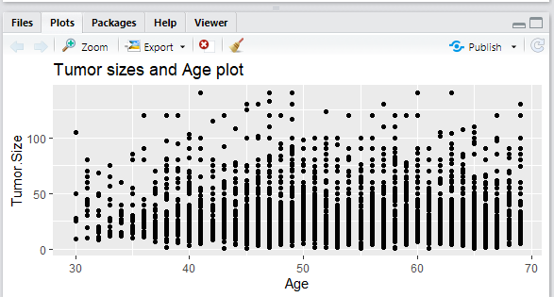
6. Data Visualization
Figure 1: Age and Tumor Size plot
It can be observed that the tumor size between 0 and 50 is found the most for almost all the age groups

Slide 9
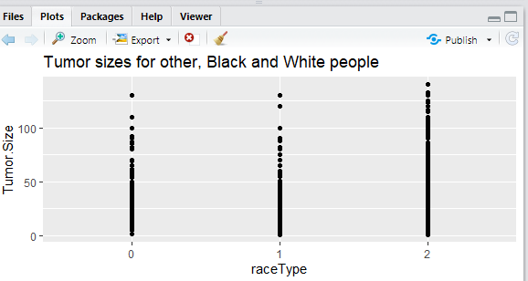
Fig 2: Race and Tumor Size plot
Most of the observations for others and black people fall between 0 and 50mm tumor size while for white people, it falls between 0 to 100 mm. So, we can predict that white people may have larger tumor sizes compared to other races.

Slide 10
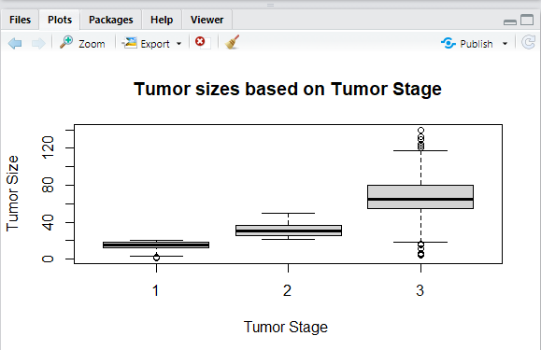
Figure 3: Tumor Stage and Tumor Size plot
From the plot, it can be identified that for tumor stage 1, the tumor size ranges approximately from 0 to 20mm. For tumor stage 2, tumor size ranges from 20 to 60mm and for tumor stage 3, it ranges from 20 to 120mm. We will further see the interactions between the variables using the regression models.

Slide 11
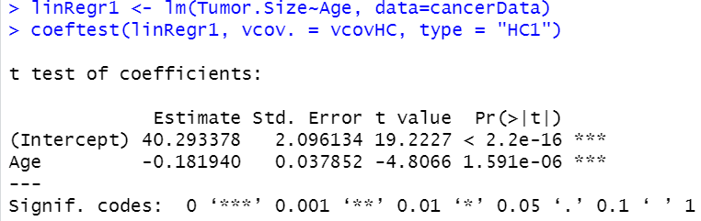
7. Linear Regression Models
To check the effect of age on tumor size
Findings:
If age increase by 1 unit then tumor size will decrease by 0.1819 millimetres.

Slide 12
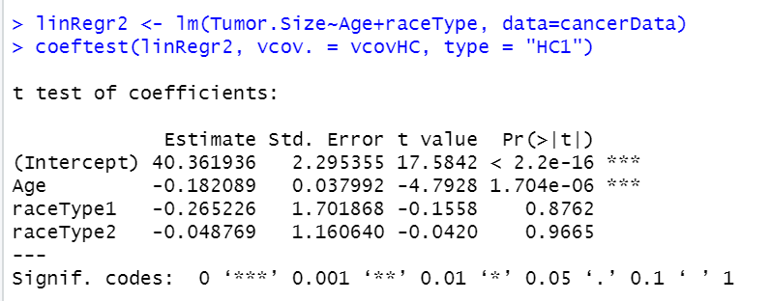
To check the change in effect on Tumor size after adding race type factor
Findings:
If age increases by 1 unit then tumor size will decrease by 0.122 mm (not much difference from previous model).
Mean of tumor size for black people(raceType1) is 0.27 units less than the mean of tumor size of other people(raceType0).
Mean of tumor size for white people(raceType2) is 0.04 units less than the mean of tumor size of other people(raceType0)

Slide 13
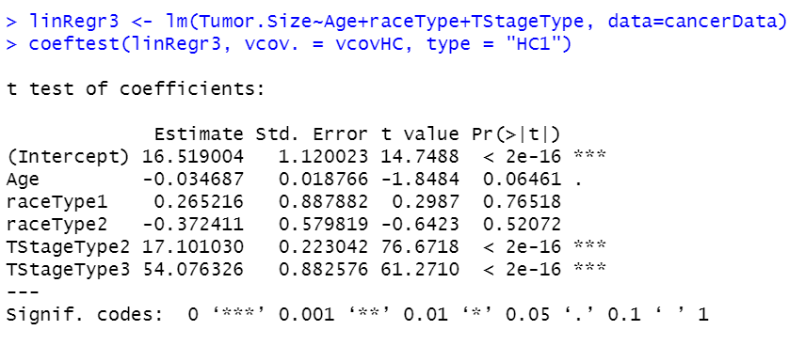
To check the change in effect on Tumor size after adding Tumor Stage factor
Findings:
If age increase by 1 unit then tumor size will decrease by 0.035 mm.
Mean of tumor size for stage 2(TStageType2) is 17.1 units more than the mean of tumor size of stage 1(TSTageType1).
Mean of tumor size for stage3(TStageType3) is 54.07 units more than the mean of tumor size of stage 1(TStageTyep1).

Slide 14
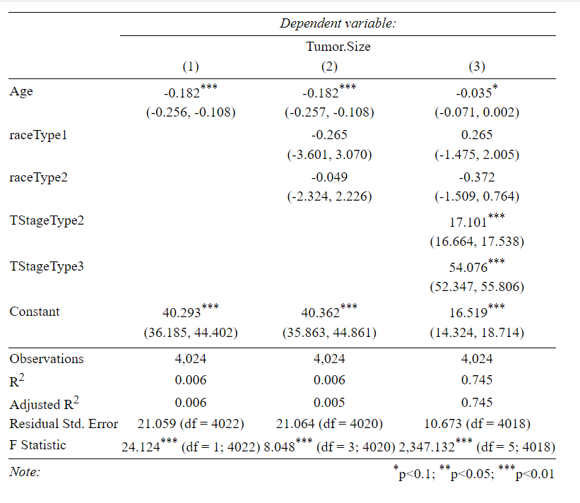
8. Summarizing the models using stargazer
From all three models above, the model 3 has higher adjusted r squared
So, we prefer regression model 3

Slide 15
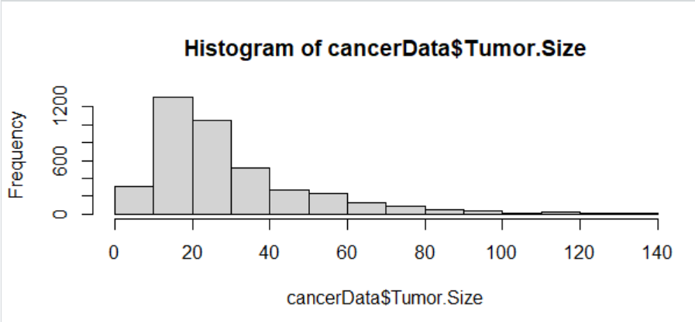
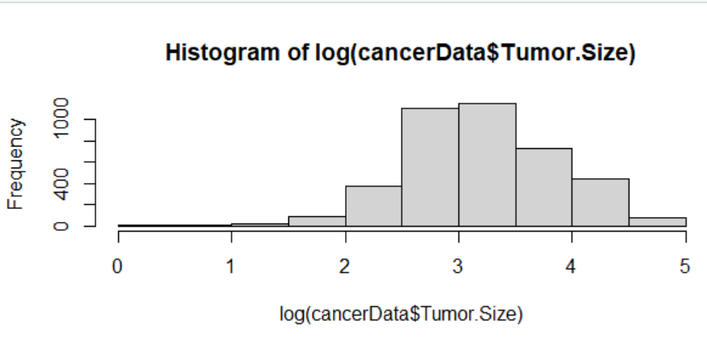
9. Histogram
After the log transformation the histogram becomes more symmetric.
Since we perform the analysis assuming normality, log transformation will help us in meeting this assumption.

Slide 16
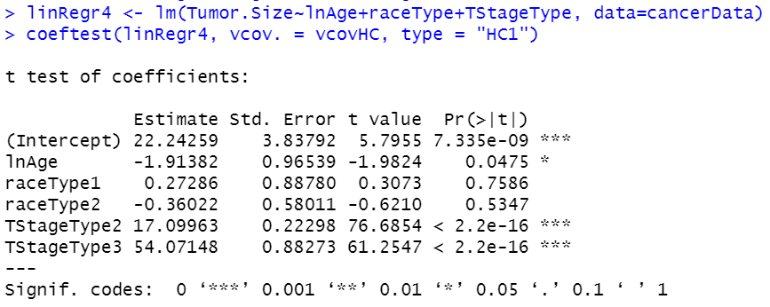
10. Linear-log model
Findings:
If age increases by 1% then tumor size decreases by 0.019 millimetre.

Slide 17
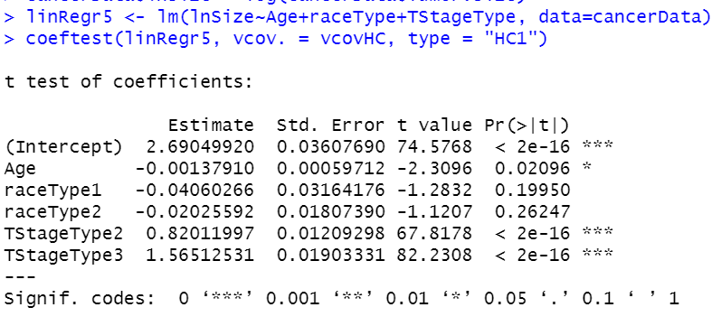
11. Log-Linear Model
Findings:
If the age increases by 1 unit then the tumor size will decrease by 0.13%.

Slide 18
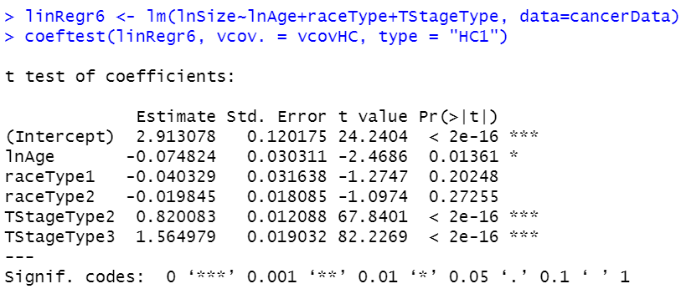
12. Log-Log Model
Findings:
If age changes by 1%, then tumor size is expected to change by 0.07%.

Slide 19
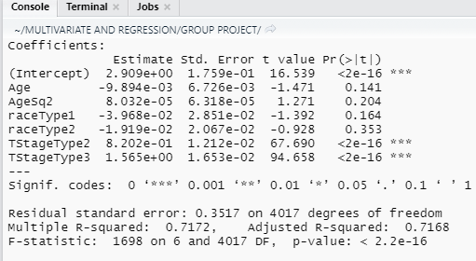
13. Quadratic Model
Findings:
The total variance in tumor size explained by the model has increased to 71.7%.

Slide 20
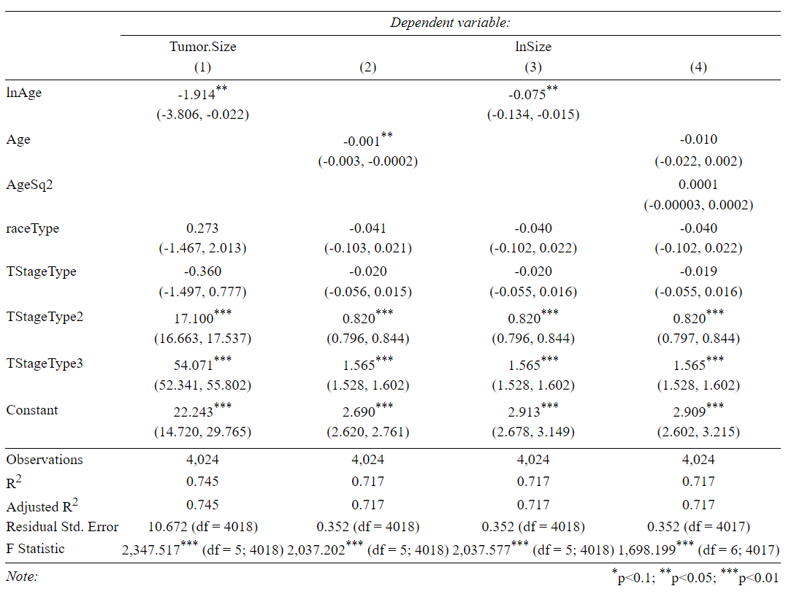
14. Summarizing the models using stargazer
So, we conclude that adjusted-R^2 for linear-log model is higher compared to others. We prefer model 4 over others.
From the stargazer for model 4 we can see that Age is significant at 5* and 10% significance level.
TstageType2, TStageType3 are significant at both 5% and 10% significance level
Race Type is not significant at 5% and 10% significance level.

Slide 21
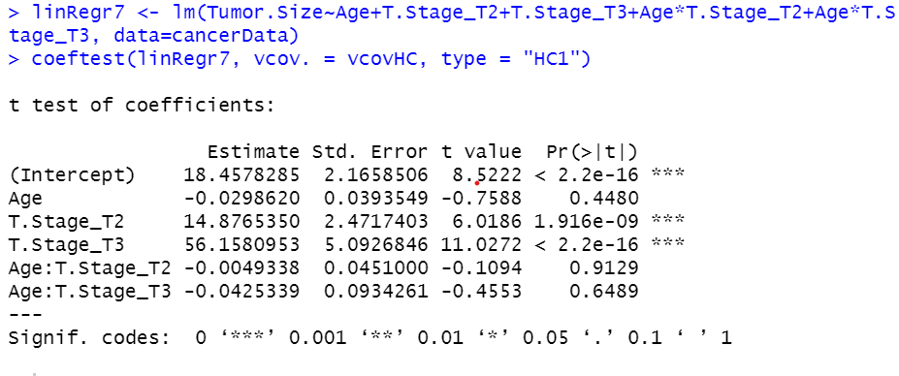
15. Interaction Term
Findings:
From the earlier model, it was found that T1 was not significant, so we have not considered it in the further models.
Hence, the individual effect of age on tumor size does not only depend on β1 but it also depends on the value of β4,T.Stage_T2, β5 and T.stage_T3. So, -0.004 represents that there is 0.004 more effect of age on tumor size of Stage 2 than on Stage 1
So, -0.04 represents that there is 0.04 more effect of age on tumor size of Stage 3 then on Stage 1
Both the interaction terms are insignificant at 5% and 10% significance value

Slide 22
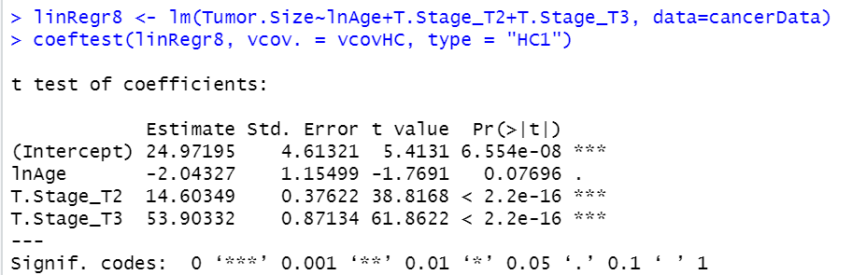
16. Final Model
Our final model suggests that age and whether the person has Tumor stage T2 and T3 might affect the increase or decrease in Tumor size.
Our final model is :
Tumor size = 24.97 - 2.04 * ln(Age) + 14.60 * TStageType2 + 53.90 * TStageType3

Slide 23
17. Interpretation
Holding all other factors fixed, if age increase by 1% unit then the tumor size decreases by 2.04 mm.
Holding all other factors fixed, Stage 2 people have 14.60mm increase in tumor size on average.
Holding all other factors fixed, Stage 3 people have 53.60 increase in tumor size on average.
The average tumor size will be 24.98 when age and stage 2 and 3 factor are zero, but this doesn't make sense as they will never be 0.

Slide 24
18. Conclusion
Hypothesis:
H0: There is no effect of age and Stage on tumor size.
H1: There is effect of age and Stage on tumor size.
p-value for age is 0.07 which is significant at 10%
T.Stage_T2 and T.Stage_T3 are significant at 10% significance level.
Thus, we can reject the null hypothesis stating that at least one of the coefficient might be zero.
Thus age and tumor stage affects increase or decrease in the tumor size.
It might be difficult to predict the increase or decrease of tumor size based on only age and tumor stage. Other Factors like financial challenges, surveillance characteristics, Developed/developing country, obesity, late pregnancy can be considered for further study.

Slide 25
THANK YOU
Group 5:
Marisha Mahadevia - 01979594
Garima Shah - 01994997
Shreya Patel - 01988619
Chitransh Joshi - 02002659

