Slide 1
Title: Product Sales Call Dashboard
Power BI Summary Report
Your Name : CHITRARTH VASDEV
Date: 26/06/2025

Slide 2
OBJECTIVE
To design an interactive dashboard that monitors call performance, tracks sales conversion, and identifies top-performing agents to support strategic decision-making.

Slide 3
DATASET SUMMARY
Source: Product_Sales (2).csv
Key fields:
CallID, Agent_Name, PickedUp, ProductSold, Duration, CallDate,etc.
1 year of simulated call center data (2024)
Focused on product sales via call interactions

Slide 4
📊 Key Metrics
Total Calls
PickedUp %
Total Products Sold
Conversion Rate
Average Call Duration (in minutes)
PickedUp Calls

Slide 5
🛠️ DAX Measures Used
Total Calls = COUNT('Product_Sales (2)'[CallID])
PickedUp Calls = CALCULATE( COUNT('Product_Sales (2)'[CallID]), FILTER('Product_Sales (2)', 'Product_Sales (2)'[PickedUp] = 1) )
PickedUp % = DIVIDE([PickedUp Calls], [Total Calls], 0)
Total Products Sold = SUM('Product_Sales (2)'[ProductSold])
Conversion Rate = DIVIDE([Total Products Sold], [PickedUp Calls], 0)
Avg Call Duration (mins) = AVERAGE('Product_Sales (2)'[Duration]) / 60

Slide 6
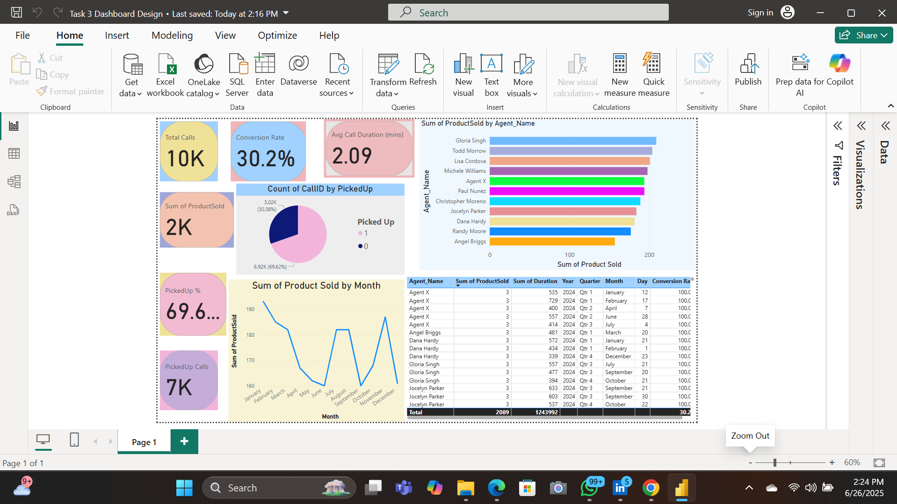
📈 Dashboard Snapshot

Slide 7
🔍 Key Insights
Q4 has the highest sales and conversions
Some agents have high calls but low conversion
Pickup % is good, but not translating into product sales
Shorter calls (<2 mins) correlate with fewer conversions

Slide 8
💡 Recommendations
Train low-performing agents with high call volume
Encourage best practices from top sellers
Revisit scripts or sales tactics for shorter calls
Focus more marketing in Q4, the strongest sales period

Slide 9
📌 Conclusion
Dashboard helps identify trends and agent performance
Easy filters for date/agent improve interactivity

