Slide 1

PRESENTED BY :
Chitra Sharma(21051646)

Slide 2

ALGORITHM USED
The algorithm used in this script is Long Short-Term Memory (LSTM), which is a type of recurrent neural network (RNN). LSTMs are particularly effective for modeling time-series data, like stock prices, because they can capture long-term dependencies and patterns in sequential data.
The LSTM layers in the model are used to process sequences of past stock prices (100 previous days in this case) to predict the stock's future closing price. The neural network learns the relationships and trends in the data through its training process.

Slide 3

LSTM MODEL
Build LSTM model
from keras.layers import Dense, Dropout, LSTM
from keras.models import Sequential
model = Sequential()
Imports required layers and initializes the model.
Add LSTM layers and Dropout
model.add(LSTM(units=50, activation='relu', return_sequences=True, input_shape=(x.shape[1], 1)))
model.add(Dropout(0.2))
Adds the first LSTM layer with 50 units and a dropout of 20% to reduce overfitting.
Similar steps are repeated with increasing units and dropout values:
model.add(LSTM(units=60, activation='relu', return_sequences=True))
model.add(Dropout(0.3))
model.add(LSTM(units=80, activation='relu', return_sequences=True))
model.add(Dropout(0.4))
model.add(LSTM(units=120, activation='relu'))
model.add(Dropout(0.5))

Slide 4
Add output layer
model.add(Dense(units=1))
Adds a dense layer for predicting a single value (closing price).
Compile the model
model.compile(optimizer='adam', loss='mean_squared_error')
Configures the model to use the Adam optimizer and Mean Squared Error as the loss function.
Train the Model
model.fit(x, y, epochs=50, batch_size=32, verbose=1)
Trains the model for 50 epochs with a batch size of 32.

Slide 5
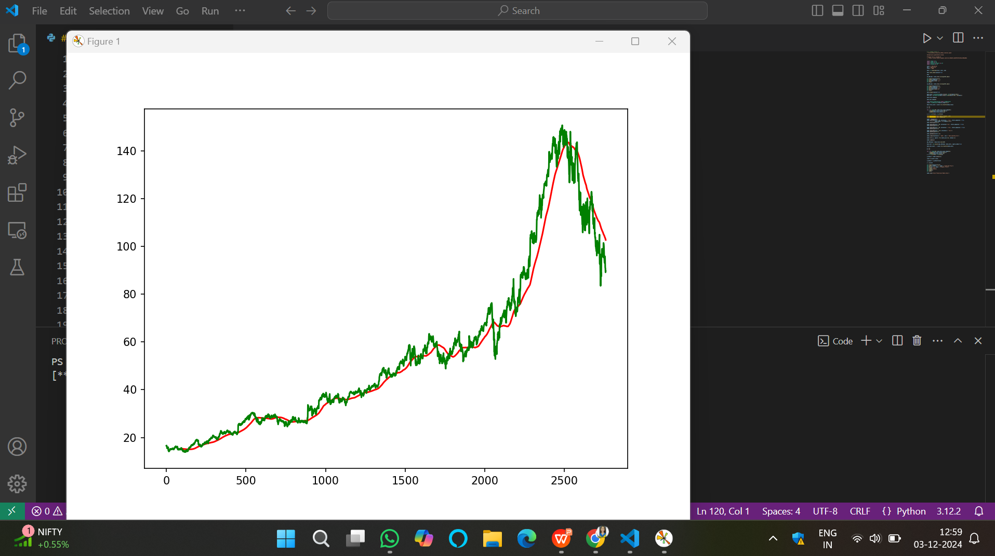
RESULTS

Slide 6
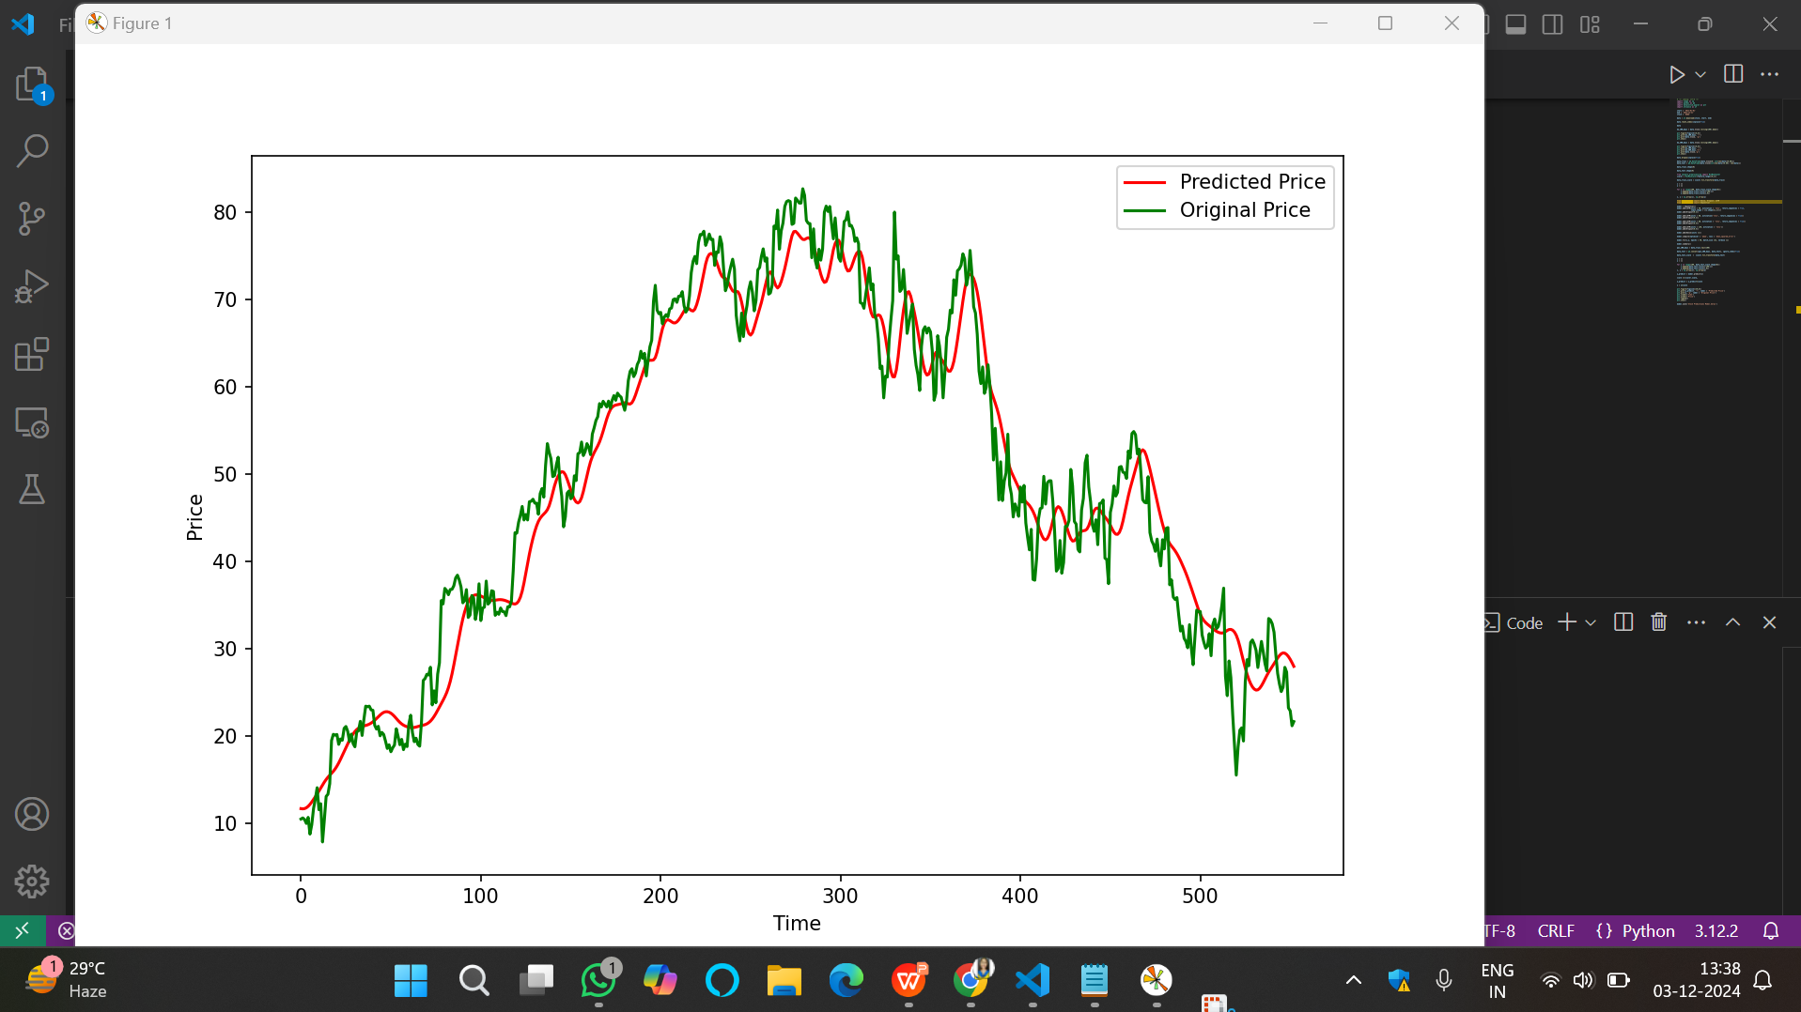

Slide 7

CHALLENGES AND IMPROVEMENT
Challenges
Stock prices are volatile and unpredictable.
Patterns change over time (non-stationary data).
External factors like news and global events are hard to include.
Overfitting can lead to poor predictions on new data.
Limited by noisy and incomplete data.
Improvements
Add more features like news sentiment and technical indicators.
Use hybrid models combining deep learning and statistics.
Apply regularization to avoid overfitting.
Include ensemble methods for better accuracy.
Use real-time data and fine-tune the model dynamically.

Slide 8
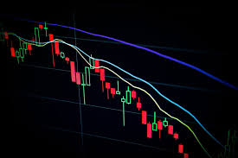
PURPOSE
The purpose of stock market prediction is to forecast future stock prices or trends using historical data and other influencing factors. Key objectives include:
Informed Decision-Making:
Help investors and traders decide when to buy, sell, or hold stocks.
Risk Management:
Minimize financial losses by predicting potential downturns.
Profit Maximization:
Identify opportunities to maximize returns by capitalizing on price movements.
Market Analysis:
Understand market behavior and trends over time.
Algorithmic Trading:
Enable automated systems to execute trades based on predictions.

Slide 9

CONCLUSION
Stock market prediction is a challenging yet essential field that leverages advanced techniques like machine learning to forecast stock prices. While no model can guarantee complete accuracy due to market volatility and external factors, incorporating historical data, technical indicators, and sentiment analysis improves predictions. With advancements in AI and data analytics, stock market prediction continues to evolve, empowering investors and traders to make informed decisions, manage risks, and maximize profits.

Slide 10
FUTURE SCOPE
Future Scope
Use advanced AI like deep learning and Reinforcement Learning.
Analyze big data, including social media and news.
Real-time predictions for faster decision-making.
Develop explainable models for trust and clarity.
Improve sentiment analysis for market trends.
Leverage quantum computing for complex predictions.
Provide personalized investment advice.
Focus on sustainable and ESG-based stock predictions.

Slide 11
THANK YOU

