Slide 1
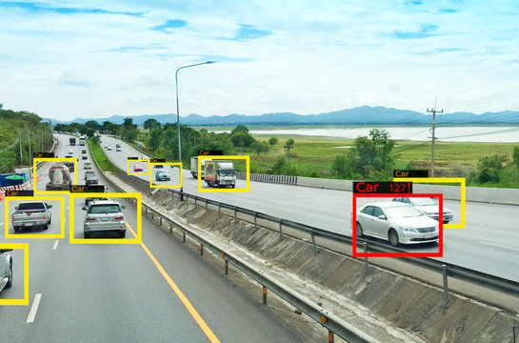
Real-Time Vehicle Detection and Counting
Using Background Subtraction in OpenCV"
PRESENTED BY-
Chitra Sharma

Slide 2
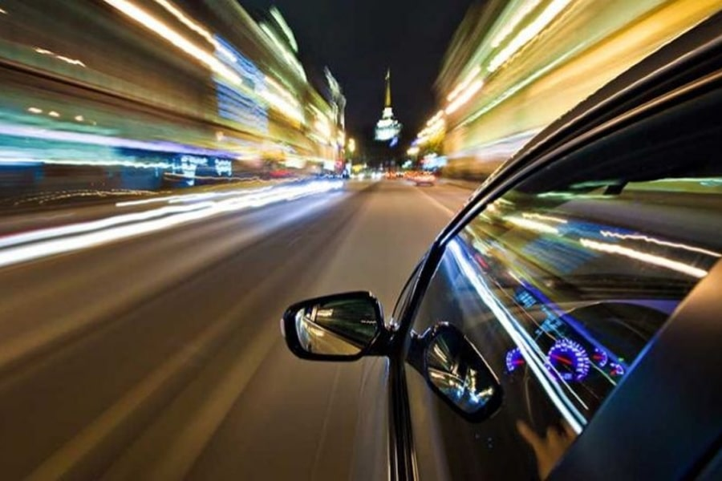
ALGORITHM USED
Background Subtraction using MOG2
SUPPORTING STEPS IN THE PIPELINE:
1) Preprocessing
Grayscale conversion
Gaussian Blur to reduce noise
2) Morphological Operations
Opening & Closing to clean the foreground mask
3) Contour Detection
cv2.findContours() is used to detect object boundaries
4) Object Filtering & Tracking
Filters small objects based on size
Calculates the center of detected objects
5) Line-Crossing Detection
Simple logic checks if the object’s center crosses a defined line (pos_linha ± offset)
cv2.createBackgroundSubtractorMOG2()
MOG2 (Mixture of Gaussians v2) is an adaptive background subtraction algorithm.
It models each pixel with a mixture of Gaussians and adapts over time to lighting changes and motion.
Good for detecting moving objects (like vehicles) in a static camera setup.

Slide 3
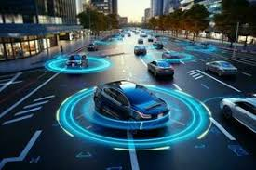
MAJOR TOPICS COVERED
1) Background Subtraction
2) Morphological Operations
3) Contour Detection
4) Object Filtering & Center Calculation
5) Vehicle Line Crossing Detection
6) Counting Mechanism
7) Display and Exit Logic

Slide 4
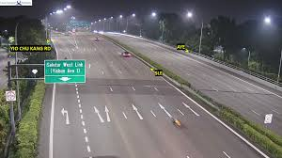
CODE EXPLANATION
1) INITIAL SETTINGS AND VARIABLES
largura_min = 40 # Minimum width for a detected object
altura_min = 40 # Minimum height for a detected object
offset = 6 # Margin of error for detecting crossing
pos_linha = 550 # Vertical line position for counting
delay = 60 # Frame delay in milliseconds
detec = [] # Stores centers of detected objects
carros = 0 # Vehicle count
3)VIDEO INPUT AND BACKGROUND SUBTRACTOR
cap = cv2.VideoCapture('video.mp4')
subtracao = cv2.createBackgroundSubtractorMOG2(...)
Loads the video file.
Uses MOG2 for background subtraction to identify moving objects.
4)MAIN LOOP
while True:
ret, frame1 = cap.read()
if not ret:
break
Reads video frame-by-frame.
Breaks the loop when video ends.
2. HELPER FUNCTION: pega_centro
def pega_centro(x, y, w, h):
return x + int(w / 2), y + int(h / 2)
Calculates the center point of a rectangle (used to determine when an object crosses the line).

Slide 5
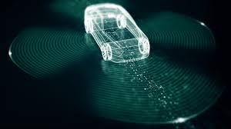
5)PREPROCESSING
grey = cv2.cvtColor(frame1, cv2.COLOR_BGR2GRAY)
blur = cv2.GaussianBlur(grey, (3, 3), 5)
img_sub = subtracao.apply(blur)
Converts frame to grayscale.
Applies blur to reduce noise.
Subtracts background to highlight moving objects.
6)NOISE REMOVAL(MORPHOLOGICAL OPERATIONS)
kernel = cv2.getStructuringElement(cv2.MORPH_ELLIPSE, (5, 5))
mask = cv2.morphologyEx(img_sub, cv2.MORPH_OPEN, kernel, iterations=2)
mask = cv2.morphologyEx(mask, cv2.MORPH_CLOSE, kernel, iterations=2)
_, mask = cv2.threshold(mask, 200, 255, cv2.THRESH_BINARY)
Cleans up the background mask by opening (removes small noise) and closing (fills gaps).
Applies a binary threshold to ensure a black-and-white mask.
7)CONTOUR DETECTION
contornos, _ = cv2.findContours(...)
Finds contours (edges of moving objects) in the binary mask.
8)DRAW LINE AND FILTER OBJECTS
cv2.line(frame1, (25, pos_linha), (1200, pos_linha), (255, 127, 0), 3)
Draws a counting line across the frame.
For each contour, checks size (width & height). If valid
Draws rectangle.
Calculates center.
Adds center to list.
Draws center point.

Slide 6
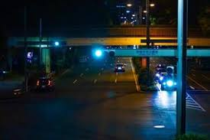
9)VEHICLE COUNTING LOGIC
for (cx, cy) in detec:
if pos_linha - offset < cy < pos_linha + offset:
carros += 1
cv2.line(...) # Highlight line when car is detected
detec.remove((cx, cy))
print("Car detected: " + str(carros))
Checks if a center crossed the line (within offset range).
Increments the count.
Draws highlighted line when a car is counted.
Removes the center from tracking list to avoid re-counting.
10)DISPLAY AND EXIT
cv2.putText(...) # Show count on video
cv2.imshow(...) # Display original frame and mask
Displays:
Original frame with annotations.
Detection mask.
ESC key exits the loop and closes windows.

Slide 7
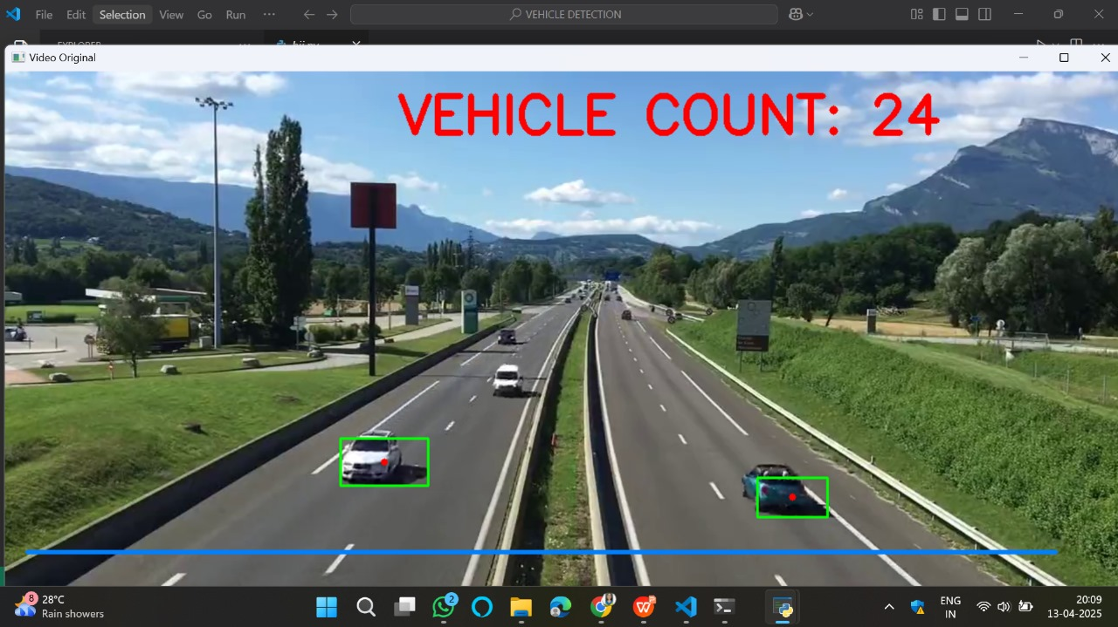
RESULTS

Slide 8
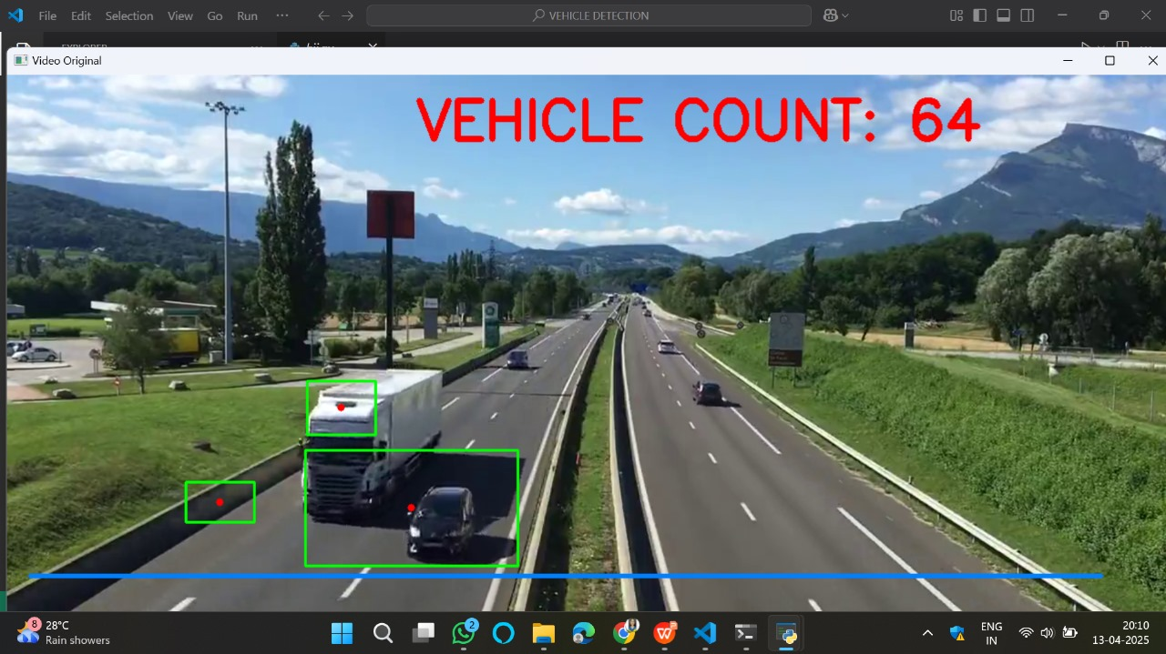

Slide 9
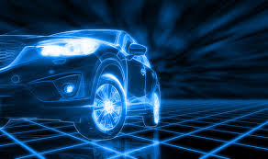
PURPOSE
This project aims to revolutionize intelligent traffic monitoring by enabling real-time, automated vehicle detection and counting using advanced computer vision techniques. By leveraging background subtraction, contour analysis, and motion detection, the system serves as a foundation for next-generation smart cities, capable of reducing human effort, minimizing traffic congestion, and offering deep insights into urban mobility. With its scalable design, this solution can be deployed in highways, toll booths, city roads, and surveillance systems — ultimately contributing to safer, smarter, and more efficient transportation networks worldwide.

Slide 10
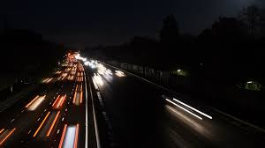
CHALLENGES AND IMPROVEMENT
1)Shadow & Noise Detection
Challenge: False positives from shadows.
Improvement: Apply shadow removal or advanced filtering.
2)Fixed Line Logic
Challenge: Works only with static, fixed-position lines.
Improvement: Use adaptive lines or zone-based detection.
3)No Object Tracking
Challenge: Same vehicle may be counted multiple times.
Improvement: Integrate tracking (e.g., SORT, DeepSORT).
4)No Vehicle Classification
Challenge: All objects are counted as vehicles.
Improvement: Use models like YOLO for type detection.
5)No Speed/Direction Analysis
Challenge: Only counts, no motion info.
Improvement: Track movement paths to estimate speed/direction.
6)Poor Low-Light Performance
Challenge: Doesn't work well at night.
Improvement: Use IR cameras or image enhancement.
7)Manual Parameters
Challenge: Hardcoded thresholds reduce flexibility.
Improvement: Use config files or GUI for dynamic setup.

Slide 11
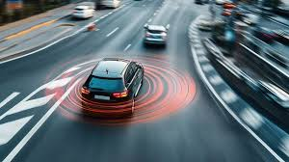
FUTURE SCOPE
1) Vehicle Type Classification
Identify cars, buses, bikes using deep learning (e.g., YOLO, SSD).
2) Object Tracking Integration
Improve accuracy with tracking algorithms like SORT or DeepSORT.
3) Speed and Direction Estimation
Analyze vehicle movement patterns for traffic flow insights.
4) Adaptive and Smart Detection Zones
Enable detection in different lanes, directions, and intersections.
5) Night and Low-Light Detection
Enhance visibility using IR cameras or image processing techniques.
6) Cloud-Based Real-Time Monitoring
Stream and analyze traffic data remotely via IoT platforms.
7) Data Analytics Dashboard
Visualize counts, trends, and traffic metrics over time.

Slide 12
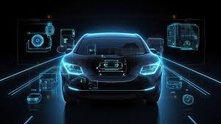
CONCLUSION
In conclusion, this project successfully demonstrates a real-time vehicle detection and counting system using classical computer vision techniques with OpenCV. By applying background subtraction, contour detection, and line-crossing logic, it effectively monitors traffic flow in video feeds. Although simple and efficient, it highlights the potential for intelligent traffic surveillance systems. With future enhancements like object tracking, deep learning-based detection, and vehicle classification, this system can evolve into a powerful tool for smart city traffic management and automated transportation analytics.

Slide 13
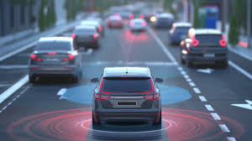
THANK YOU!

