Slide 1



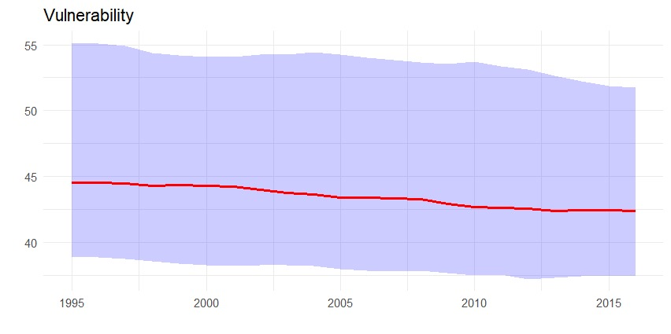
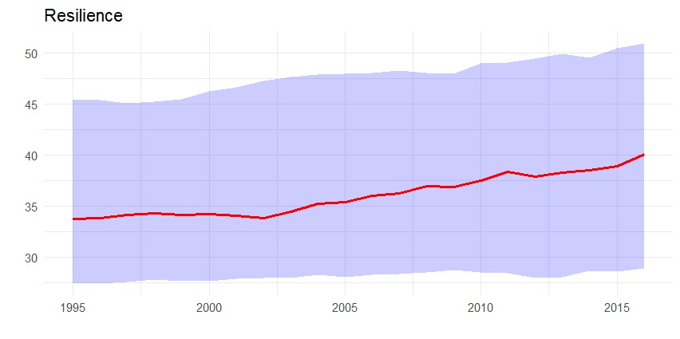
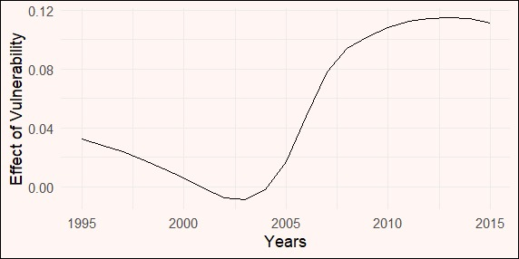
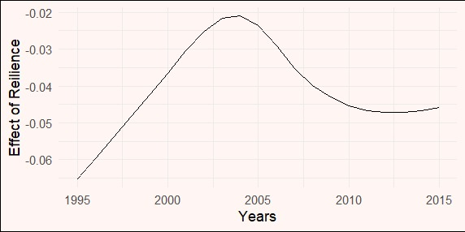


Climate Change and Its Impact on Sovereign Bonds
Chitresh Meena, Dr. Sanjiv Kumar
Economics Science, IIT Kanpur
[‘
Introduction
The impact of climate change on the global economy and financial markets is significant, but the degree of vulnerability varies by country.
Factors influencing a country's vulnerability include the size and structure of its economy, its ability to adapt, and the resilience of its institutions and infrastructure.
The main policy takeaway is the fact that climate change cannot be stopped, governments should strengthen economic resilience to withstand shocks and improve public financial management.
Empirical strategy and results
Liability Risk
Physical Risk
Analyse the time series properties of data to avoid spurious result by conducting panel unit root test, for this we use the Im-Persaran-Shin (2003) procedure.
To empirically evaluate the influence of climate change on sovereign bond spreads, we use a panel linear model with the following specifications:
Transition Risk
Dependent variable:
Bond spread
Specification (1) (2) (3) (4) (5) (6) (7)
Vulnerability 2.013*** 1.616*** 0.572*** 0.326*
(0.267) (0.297) (0.183) (0.194)
Resilience -0.421*** -0.234*** -0.219*** -0.188***
(0.071) (0.078) (0.049) (0.052)
Real GDP growth -0.167*** -0.179*** -0.193*** -0.197***
(0.035) (0.035) (0.035) (0.035)
Inflation 0.387*** 0.371*** 0.369*** 0.362***
(0.026) (0.027) (0.026) (0.026)
Debt 0.050*** 0.052*** 0.054*** 0.055***
(0.007) (0.007) (0.007) (0.007)
Budget balance 0.041 0.039 0.043 0.041
(0.038) (0.038) (0.038) (0.038)
International reserves -0.006 -0.005 -0.008 -0.007
(0.015) (0.015) (0.015) (0.015)
Bureaucratic quality -0.792 -0.675 -0.240 -0.251
(0.781) (0.777) (0.781) (0.780)
Government effectiveness -0.797 -0.589 -0.271 -0.227
(0.710) (0.709) (0.711) (0.711)
Terms of trade 0.006 0.014 0.011 0.015
(0.011) (0.011) (0.011) (0.011)
Note: *p<0.1; **p<0.05; ***p<0.01
Research objectives
The present study investigates the following objectives:
Objective 1: To empirically verify the negative effect of climate change on sovereign borrowing.
Objective 1: To empirically verify the negative effect of climate change on sovereign borrowing
Objective 2: To find the temporal variation of climate change’s impact on sovereign debt
Overview of Data Analysis
The balanced panel dataset utilized in this study includes observations from 35 advanced and developing countries between 1995 and 2016.
The dependent variable is government bond spread as measured by 10-year foreign-currency-denominated bond spread vis-a-vis the U.S. benchmark.
The major explanatory variables of importance are vulnerability and resilience to climate change, as evaluated by the ND-GAIN indices.
Table 1: Results of the fixed effect panel linear model
Figure 1: Graph of Vulnerability and Resilience over Time
Figure 3: Results of the time-varying panel linear model
It is apparent from statistics that vulnerability reduces over time. It also illustrates that resilience has increased over time, particularly since the early 2000s.
It is worth noting that the vulnerability score is calculated using 36 factors, whereas the resilience score is calculated using 9 factors.
Country Group Analysis
 | vulnerability | readiness | growth | cpi | debt_gdp | OB_gdp | reserves | rqe | gee | tt
Developing | 3.1042*** | -0.542** | 0.154** | 0.87*** | 0.0921 | -0.152* | 10.2** | -1.786 | 2.294 | 0.011
 | (1.107) | (0.124) | (0.021) | (0.314) | (0.034) | (0.042) | (0.102) | (0.134) | (1.542) | (0.034)
Advanced | -0.895 | -0.532 | 0.244 | 0.182** | 0.025 | 0.0383 | -0.006 | -0.619 | 0.109 | -0.007
 | (0.732) | (0.373) | (0.033) | (0.056) | (0.005) | (0.027) | (0.011) | (0.653) | (0.575) | (0.012)
Table 2: Results of Country Group the fixed effect panel linear model
Conclusion
Countries with greater vulnerability to climate change pay a higher interest rate on government bonds while those with greater climate resilience pay lower interest rate on the cost of borrowing.
One Point for TvPLM
Furthermore, dividing the sample into country groups reveals that the magnitude and statistical significance of these effects are much greater in developing countries with weaker capacity to adapt to and mitigate the consequences of climate change.
Figure 2: Correlation coefficients between bond spreads and three independent variables (vulnerability, readiness, and growth)
The correlations for readiness and growth also display diverse patterns, reflecting the unique economic and financial conditions in these countries.
Higher growth leads to lower bond spreads in almost all countries, indicating that investors view growth as a sign of stability and lower risk.
References
John Beirne, Nuobu Renzhi, and Ulrich Volz, “Feeling the Heat: Climate Risks and the cost of Sovereign Borrowing“, Asian Development Bank Institute, No. 1160 ,June 2020
Serhan Cevik, Joao Tovar Jalles, “This changes everything: Climate shocks and sovereign bonds”, IMF, 1018-5941, No. 24, Jan 2022
Xia Wang, Yingxing Li, Junhui Qian and Liangjun Su, ” On Time-varying Panel Data Models with Time-varying Interactive Fixed Effects”, School of Economics, Renmin University of China, March 2023

