Slide 1
How to BaandaId
Participate
Join our movement and work, or play, with us. Tell us how we can better our services. Spread the name of Baanda across the globe. If your idea or effort is inducted in Baanda, you will also earn EIR coin.
BaandaId
Invest
Please be our
Baanda for
the wellbeing
of many around the world
You could invest in most fiat or crypto currency. Once you invest, you will get EIR (Baanda’s PCO or perpetual coin offerings). EIR maps to shares of Baanda organization. Hence, via EIR you will get stochastically increasing in value coin and be a shareholder. Once, you invest, all aspects of Baanda will be transparent to you. Any amount is good amount.
Donate
Enabler of Crowd Sourcing
You could donate to Baanda to propagate your goodwill to the world. When you donate, your donation would be stored in Baanda charity vault. In turn, and per your choice, Baanda will invest to all those in need and could enhance their life via cooperation. Upon you wish, your name would be mentioned to the recipients and the world. Once again, every aspect of the handling of your donation would be visible to you.
On-line BaandaId is under construction. It will be available shortly.
When you want to be Baanda, please contact baandaId@baanda.com or anyone in on baanda.com. We are all Baanda and we are a flat-org.

Slide 2
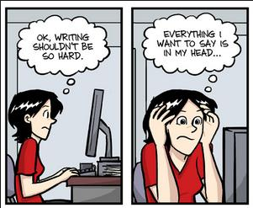
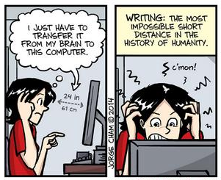
Third leg of Baanda.
Baanda Services
Like copyright, Baanda will provide the expertise and cooperation platform for multitude of domains … as Baanda learns more and more of the world we live in.
Copyright
You have all your creations in copyright. What good is it if your work is not seen and celebrated your work? You have a dream behind your creation … right?
Expertise Sharing
Enabler of Crowd Sourcing
As an initiation, Baanda will increasingly provide services in the following areas:
Scholarly :
Movie Scripts:
Other similar areas are: Cooking recipe; short story; novels; sound bits; and other creative ideas.
You will be provided the contextual list of publishing conduits; cost of publishing; Baanda recommendations etc.
You will get list of places where you could send your scripts contextually along with advises.
Baanda Cooperation
You will collaborate with you in distributing your work per your choice; get feedback; and in case of bidirectional interest … connect you with others who would be delighted to pursue your dreams together.
Work in Progress
When you want to be Baanda, please contact baandaId@baanda.com or anyone in on baanda.com. We are all Baanda and we are a flat-org.

