Slide 1
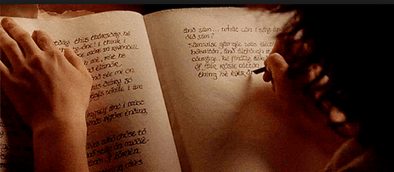
Copyright First Phase
Comparisons
Baanda takes your digital assets, converts them into cryptographic unique hash, stores your asset in the cloud and the location along with hash is stored in Ethereum block chain for immutability.
Legal Zoom and similar legal organization starts from around $30 per copyright. Individual representation would be additional charge in case of dispute.
If you want to print, store in stamped envelop by the post office, then the cost of printing, going to post office etc. For one time validation, cost would be about $10. This would be vetted only once and before the judge.
Copyright Second Phase
Baanda enables you to distribute to the right target or your choice. Baanda will also endeavor to get you a feedback. In Baanda vision, it will recommend you target audience, connect you to people who may want to cooperate and work to make your dreams come true.
Additional Services
Provide expertise for the propagation of your aspirations
Connect you to achieve your dreams.
Provide check up any number of time as and when needed.
Copyright Cost
That is your work … Baanda will vouch for you.
A portion of the cost will be for millions of people who would be storing and guarding your assets (Ethereum)
A portion of the cost would be for cloud vendors and other technology providers.
Baanda will asks for a miniscule percentage to continue to endeavor to make your dreams come true and permeate cooperation and togetherness among people.
Baanda Cost:
Gas (about) 500000 Wie. [1 Eth = 10 ¹⁹ ] in pennies
Cloud cost ranging between 50C for a year.
Undecided … but, it would be free in the beginning and in terms of pennies.
Total cost about $1.

