Slide 1
23ECE285 Machine Learning Term Project
Chittesh S CB.EN.U4ECE23212
CH.Saathvik CB.EN.U4ECE23214
M.Rahul CB.EN.U4ECE23227

Slide 2

Telecom Service Churn Perdiction

Slide 3
TABLE OF CONTENTS
01
02
03
04
INTRODUCTION
05
OBJECTIVE
PROBLEM STATEMENT
06
RESULTS
LITERATURE SURVEY
07
TIMELINE AND MILESTONES ACHIVED
MOTIVATION
08
REFERENCE

Slide 4

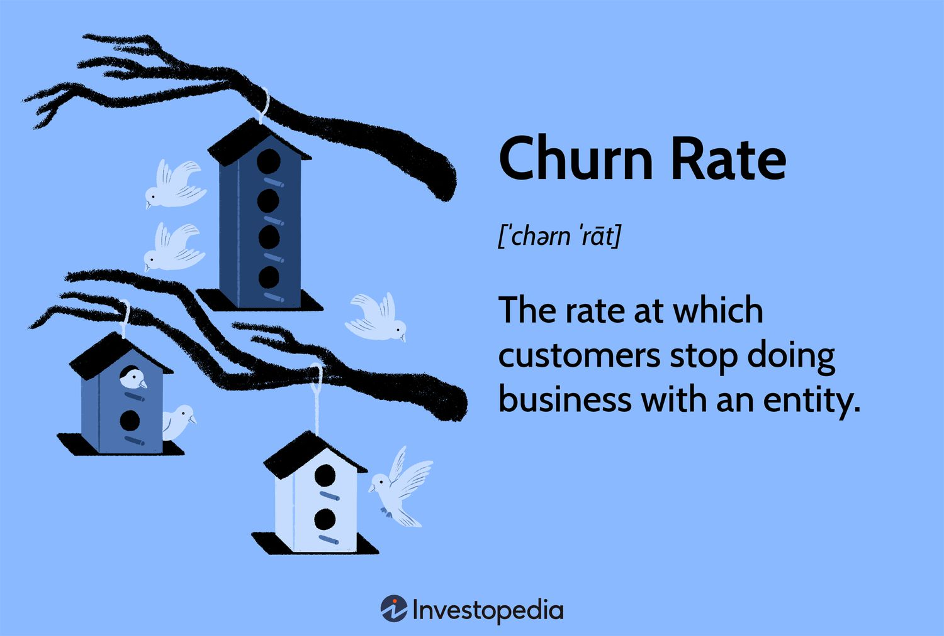
Introduction

Slide 5
Introduction
Objective: Predict customer churn, crucial for subscription-based businesses or those with strong competition.
Approach: Recreated a research paper's method to evaluate machine learning models' performance in churn prediction.
Machine Learning Models Used:
Decision Trees
Random Forest
KNN
Naïve Bayes
Support Vector Machine (SVM)
SGD
ADAM using (MLP)
Evaluation Metrics:
Precision
Recall
F1-score
Survival Plot
Data Balancing:
Used SMOTE (Synthetic Minority Over-sampling Technique) to handle class imbalance.

Slide 6
Problem Satement
Predict customer churn by analyzing customer behavior and service usage.
Purpose: Help businesses take proactive measures to improve customer retention.
Focus: Identify key factors influencing churn.
Outcome: Enable accurate predictions for better decision-making and customer engagement.

Slide 7
Literature Survey
Base Paper: Customer churn prediction in telecom sector using machine
learning techniques From ScienceDirect
Paper used for reference:
A Churn Prediction Model Using Random Forest: Analysis of Machine Learning Techniques for Churn Prediction and Factor Identification in Telecom Sector From IEEE Access
PREDICTING CUSTOMER CHURN PREDICTION IN TELECOM SECTOR USING VARIOUS MACHINE LEARNING TECHNIQUES From IEEE

Slide 8
Literature Survey (Base Paper)
Title :
Customer churn prediction in telecom sector using machine learning techniques Sharmila K. Wagh et al.Results in Control and Optimization, 2024
Methodology :
The paper uses machine learning models like Decision Trees and Random Forest to predict customer churn. To improve accuracy, it also applies techniques like SMOTE (up sampling) to balance the data and survival analysis (Kaplan-Meier and Cox Proportional Hazard Model) to study customer retention. The dataset used is the Telco-Customer-Churn dataset from Kaggle, and various data preprocessing methods, including feature engineering and one-hot encoding, are used to prepare the data.

Slide 9
Literature Survey (Base Paper)
Highlights :
The Random Forest model predicted customer churn with 99.09% accuracy.
Survival analysis was used to estimate how long customers would stay.
Different customer factors were studied to understand their impact on churn.
Retention strategies were applied to reduce churn and improve business decisions.
Limitation :
The Cox model's assumptions may not always fit real telecom data, and the model may struggle with large, complex datasets.

Slide 10
Literature Survey (paper 1)
Title :
Predicting Customer Churn Prediction in Telecom Sector Using Various Machine Learning Techniques, Abhishek Gaur, Ratnesh Dubey, DOI: 978-1-5386-5367-8/18/$31.00 ©2018 IEEE
Methodology :
This study uses machine learning to predict customer churn in the telecom industry. It applies classification models like Logistic Regression, SVM, Random Forest, and Gradient Boosted Trees to build predictions. The dataset used has 7043 records and 21 features for training and testing. The models are evaluated based on accuracy, precision, recall, and AUC scores to measure their performance.

Slide 11
Literature Survey (paper 1)
Highlights :
This study highlights the importance of churn prediction for customer retention and compares different models, finding Gradient Boosted Trees to be the most accurate. It also emphasizes proper data preprocessing, including handling categorical data and feature selection.
Limitation :
It focuses on specific machine learning models and may not generalize to all telecom industries. Feature engineering is not deeply analyzed, which could impact model performance.

Slide 12
Literature Survey (paper 2)
Title :
A Churn Prediction Model Using Random Forest: Analysis of Machine Learning Techniques for Churn Prediction and Factor Identification in Telecom Sector.
Methodology :
The paper presents a churn prediction model using classification methods like Random Forest, Decision Trees, and SVM, along with clustering (k-means) to identify churned customers and their reasons for leaving. Feature selection is done using information gain and correlation ranking. The model is tested using accuracy, precision, recall, and F-measure to measure its performance.

Slide 13
Literature Survey (paper 2)
Highlights :
Random Forest model predicts churn with 88.63% accuracy.
Finds key churn reasons using attribute selection.
Uses k-means clustering.
Focuses on customer segmentation for better retention strategies.
Limitation :
The model is tested only on a South Asian telecom dataset, limiting its use in other regions. The Random Forest model is complex, making it hard to interpret its decision rules. Some important features may be missed during selection, affecting accuracy. Additionally, the study lacks real-world testing on live telecom systems.

Slide 14
Motivation
The telecom industry in India is highly competitive, with companies like Airtel, Jio, Vi (Vodafone-Idea), and BSNL working hard to keep their customers. Many users switch between service providers due to issues like poor network coverage, high prices, and customer service problems.
For example, Jio's low-cost plans caused many customers to leave other networks, while Vi has struggled to retain its users. To tackle this, telecom companies need smart churn prediction models to identify customers who might leave. By using machine learning, they can offer better deals, improve customer service, and reduce churn, leading to higher customer satisfaction and increased profits.

Slide 15
Objectives
To predict customer churn using various machine learning models including Decision Trees, Random Forest, Support Vector Machine (SVM), K-Nearest Neighbors (KNN), Naive Bayes, SGD and ADAM.
To handle class imbalance in the dataset effectively using the SMOTE (Synthetic Minority Over-sampling Technique) method.
To perform survival analysis for estimating customer lifetime and gaining deeper insights into customer retention behavior.
To evaluate and compare model performance using metrics such as accuracy, precision, recall.
To identify the most effective model(s) for predicting churn and provide actionable insights that can help in reducing customer churn.

Slide 16
Best Performing Model: Random Forest
Highest Accuracy
The base paper showed 99.09% accuracy with Random Forest.
Our results also followed the same trend, proving it’s a strong model.
Good Performance on Key Metrics
While exact numbers aren’t given, both Random Forest and Decision Tree performed well in terms of precision, recall, and F1-score.
Handles Data Imbalance Well
After using SMOTE to fix class imbalance, Random Forest still performed strongly, making it a stable and reliable model.

Slide 17
Additional Work Done:
To enhance the churn prediction system, we implemented several improvements beyond the base model:
• Model Variety: Evaluated additional classifiers including KNN, SVM, and Naive Bayes alongside main models to benchmark performance
• Data Balancing (SMOTE): Addressed class imbalance to improve fairness and prevent biased learning.
• Feature Engineering: Derived new features such as MonthlyCharge/Tenure and binary indicators like AutoPay for better model insight.
• Model Optimization: Applied Adam and SGD optimizers in training neural networks for faster and more stable convergence

Slide 18
Overall Analysis:
• We combined basic models like Decision Trees with advanced ones like Random Forest, SVM, KNN to predict customer churn. Random Forest worked best, with an accuracy of 98%, close to the base paper’s result.
• Our model was reliable, with high precision (97.88%), recall (96.71%), and a strong F1-score (97.29%).
• Graphs like survival plots helped us understand and trust the results better.
• Compared to the base paper, we did just as well or better by using more models and extra tools like SMOTE and optimization.

Slide 19
Discussion On Result
Results Comparison: Model results are similar to the base paper, with minor accuracy and F1-score differences.
Model Performance: Random Forest and Decision Tree models closely match the base paper's trends.
SMOTE Effectiveness: SMOTE effectively handles data imbalance, improving classification.
Scope for Improvement: Minor precision and recall variations indicate potential for further fine-tuning.
Conclusion: The model's accuracy is comparable to the base paper, validating the applied techniques.

Slide 20



Timeline
Week 1–2
Week 5–6
Base paper research and analysis
Base paper implementation & testing
Week 3–4
Week 7–8
Data preprocessing & exploration od dataset of the base paper
Final Model Implementation. Optimization & final evaluation

Slide 21
MileStone Achieved
Week
Week
Week
Week
1
2
3–4
5–6
Base paper
ML Models In Basepaper
Data preprocessing
Base Paper Implementation
Found the base paper and finalized it.
Research done for ML Models
In Base paper and Verified the Dataset used in the Base paper.
Done data Preprocessing for the dataset
Implemented the code forBase paper and got almost similar results

Slide 22
Summary:
We worked on predicting customer churn using models like Decision Trees, Random Forest, SVM, KNN, Naive Bayes. SMOTE helped fix data imbalance, and survival analysis gave insights on how long customers might stay.
We used metrics like accuracy, precision, recall, and ROC curves to check model performance. Some models gave better results than others, and overall, our system gave useful insights to understand and reduce churn.

Slide 23
Reference
[1] A. Gaur and R. Dubey, “Predicting Customer Churn Prediction in Telecom Sector Using Various Machine Learning Techniques,” Proc. IEEE Conf., 2018.
[2] A. Kasem Ahmad, A. Jafar, and K. Aljoumaa, “Customer churn prediction in telecom using machine learning in big data platform,” J. Big Data, vol. 6, no. 28, 2019. DOI: https://doi.org/10.1186/s40537-019-0191-6.
[3] “A Churn Prediction Model Using Random Forest Analysis of Machine Learning Techniques for Churn Prediction and Factor Identification in Telecom Sector,”. DOI: 10.1109/ACCESS.2019.2914999.

Slide 24
Reference
[4] H.Jain, A.Khunteta,“Churn Prediction in Telecommunication using Logistic Regression and Logit Boost,”.
[5] “Telco Customer Churn Dataset,”. Available: https://www.kaggle.com/blastchar/telco-customer-churn .
[6] “Lifelines: Survival Analysis in Python,” [Online]. Available: https://lifelines.readthedocs.io/en/latest/ .

Slide 25
Thank You

