Slide 1

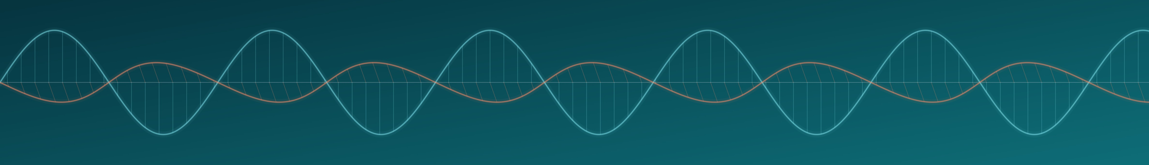


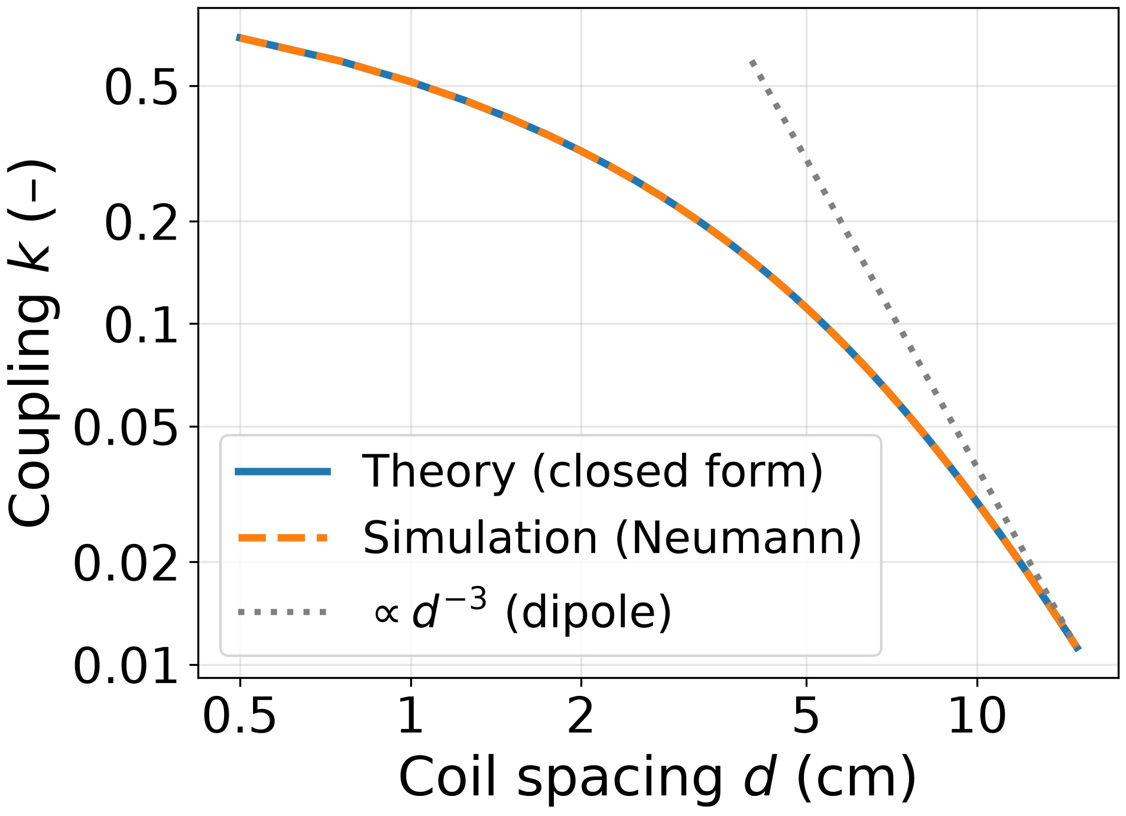
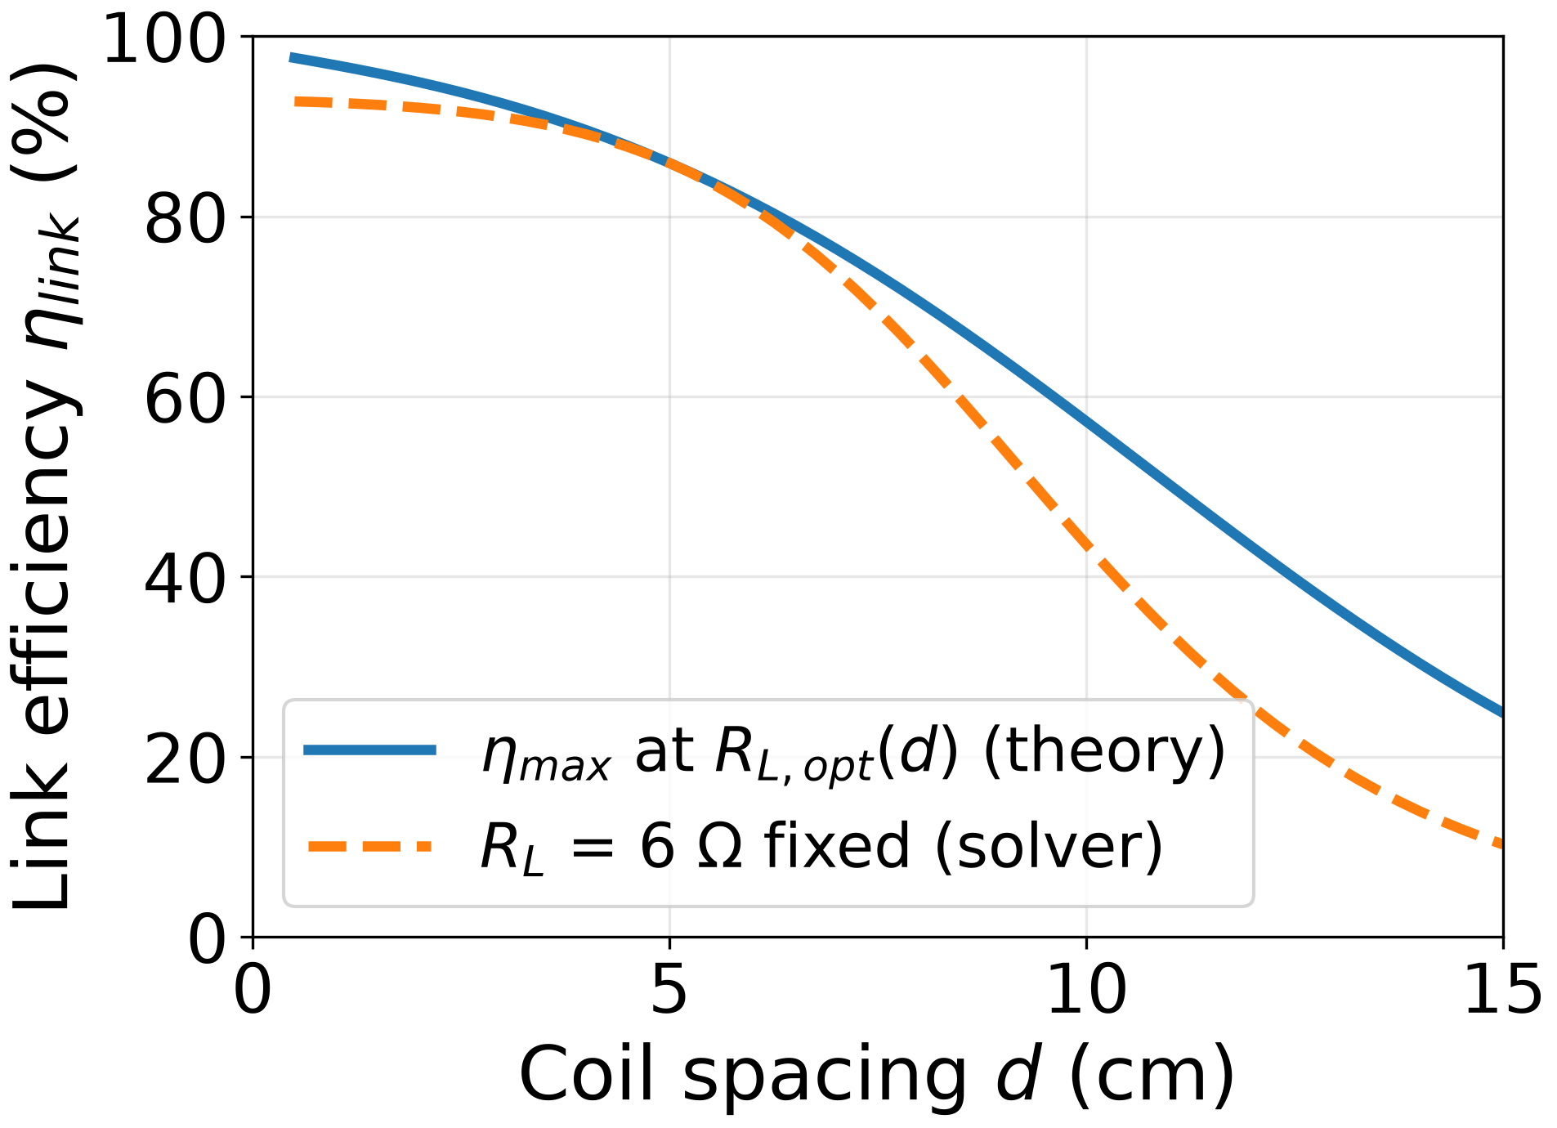
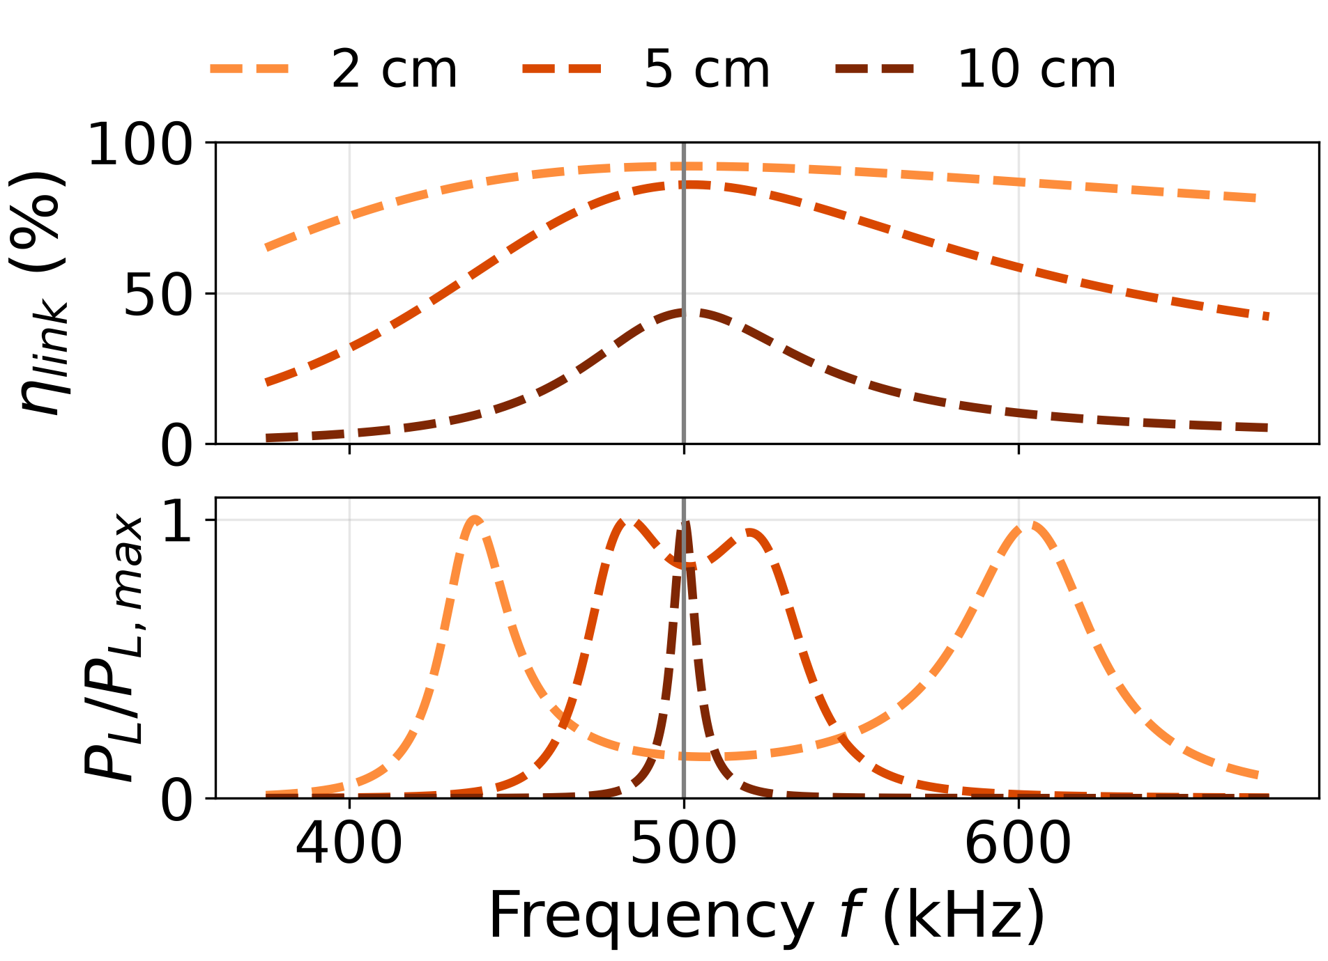
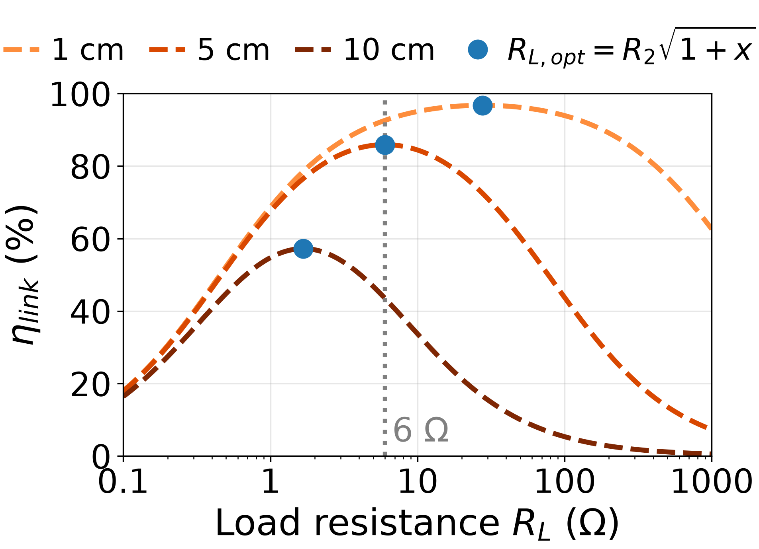
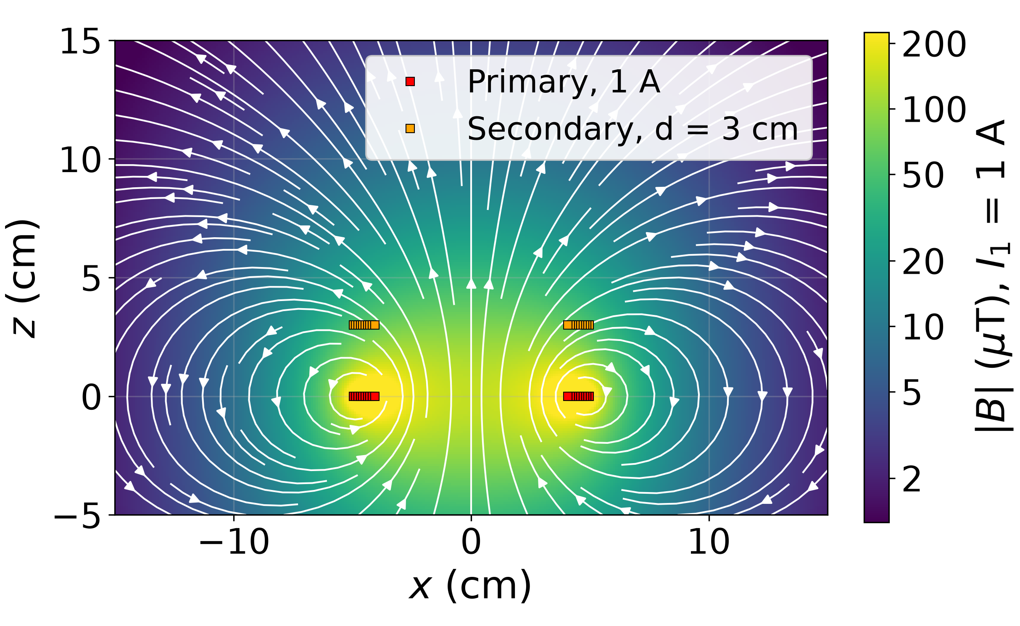
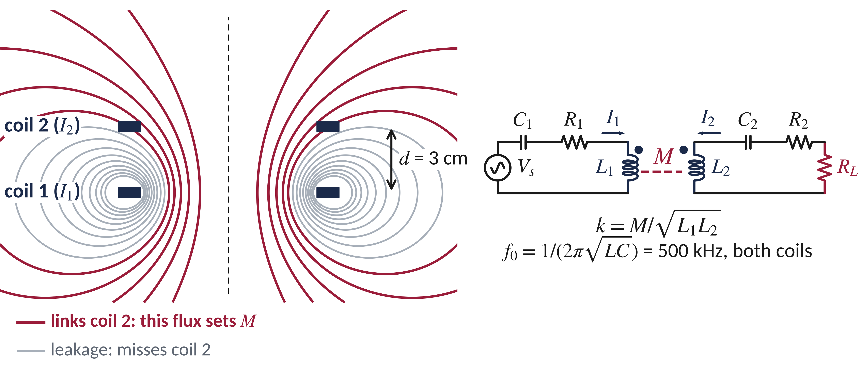
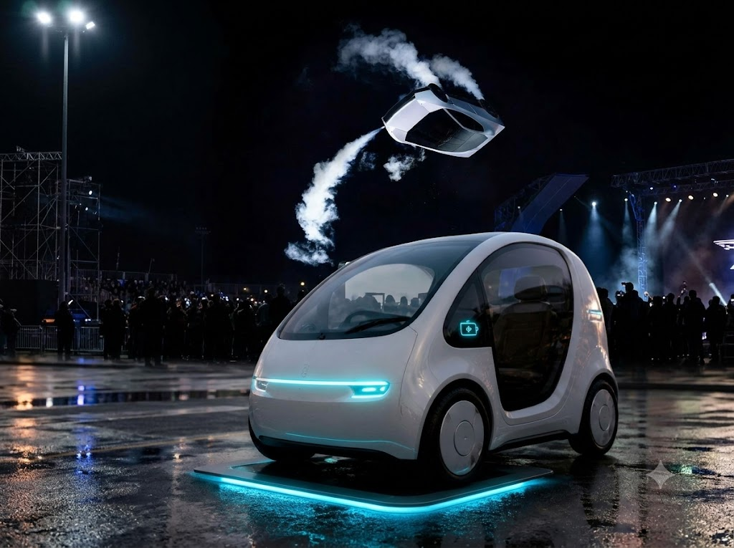
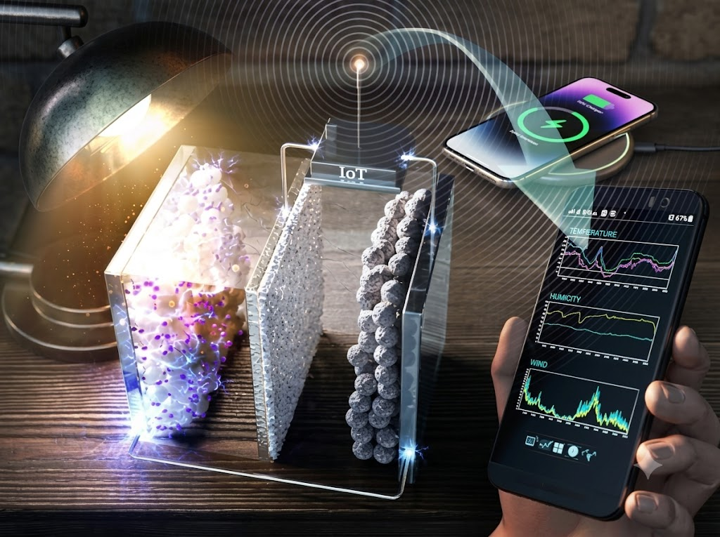
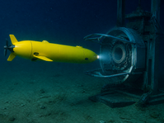
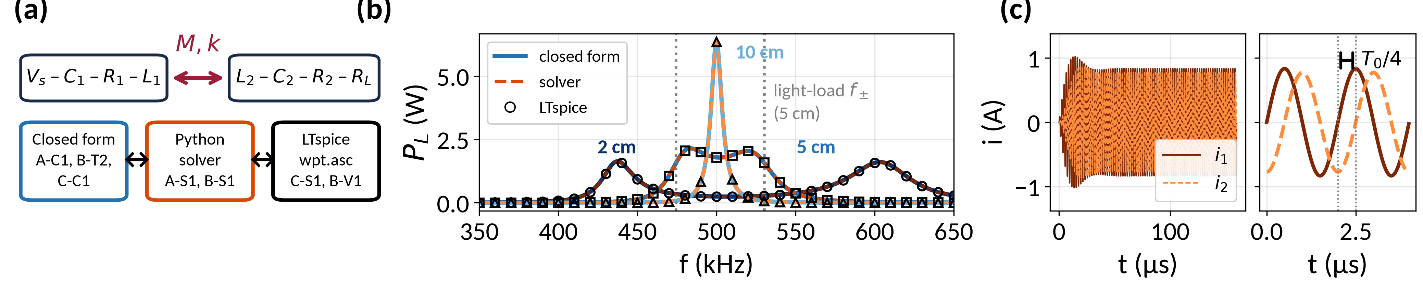
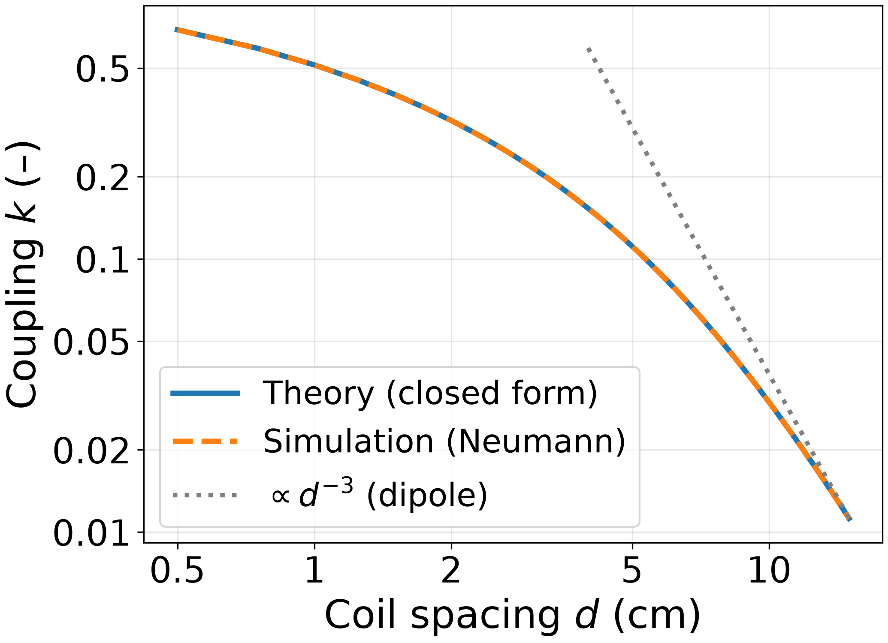
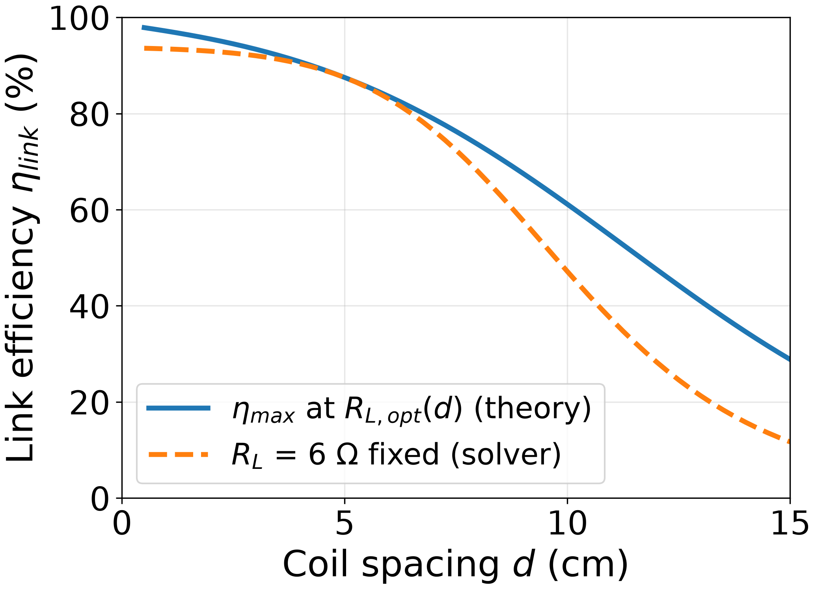
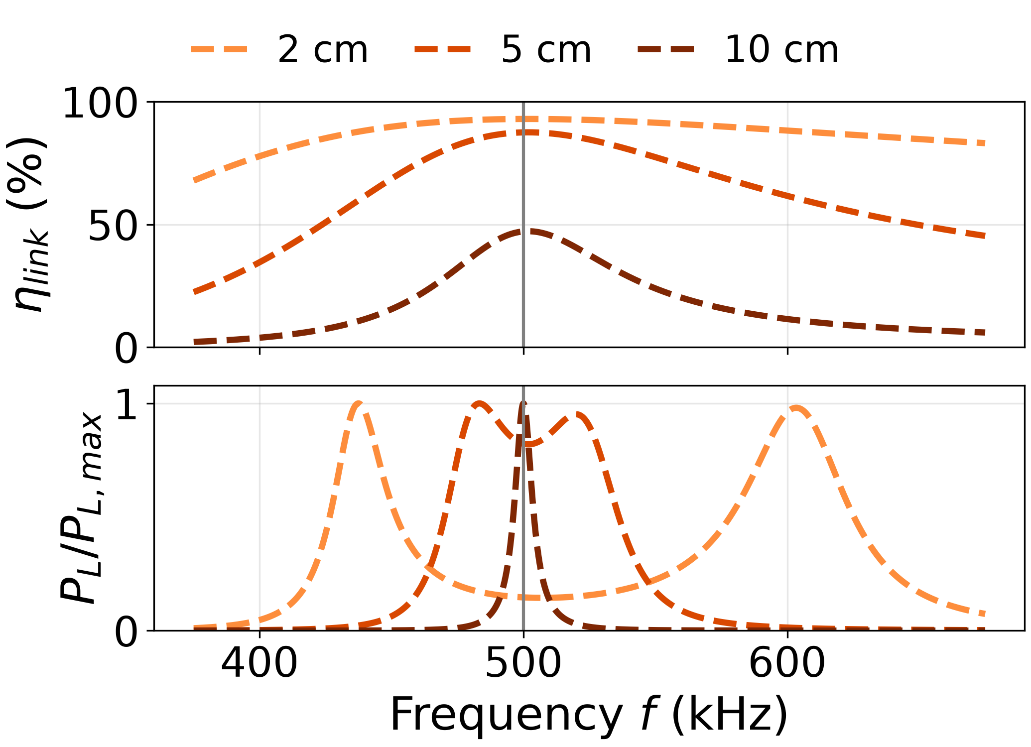
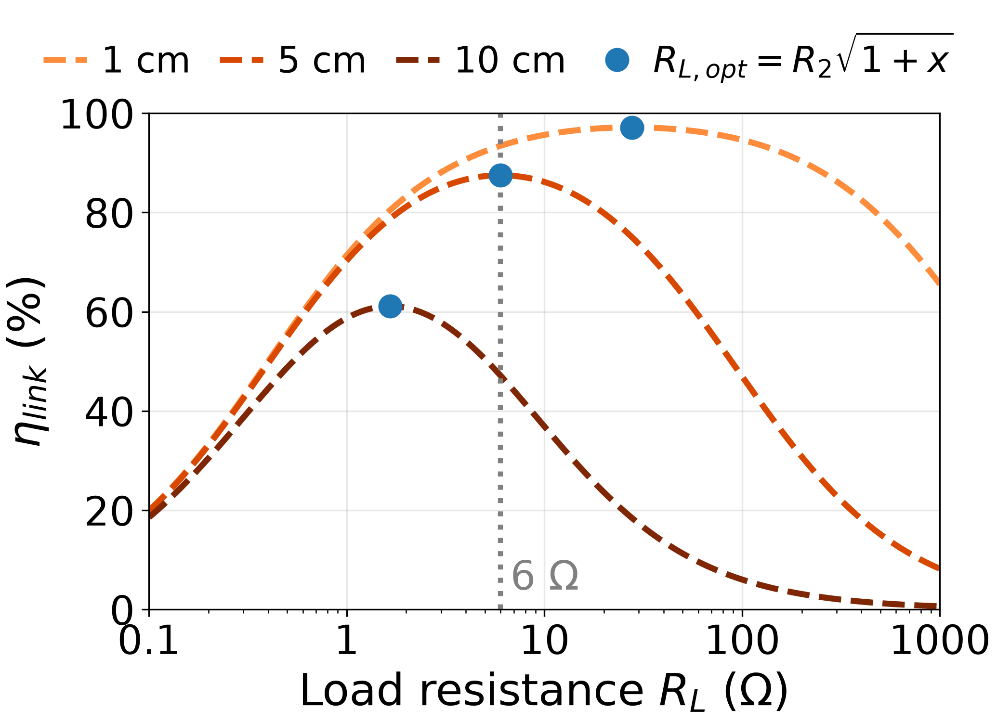
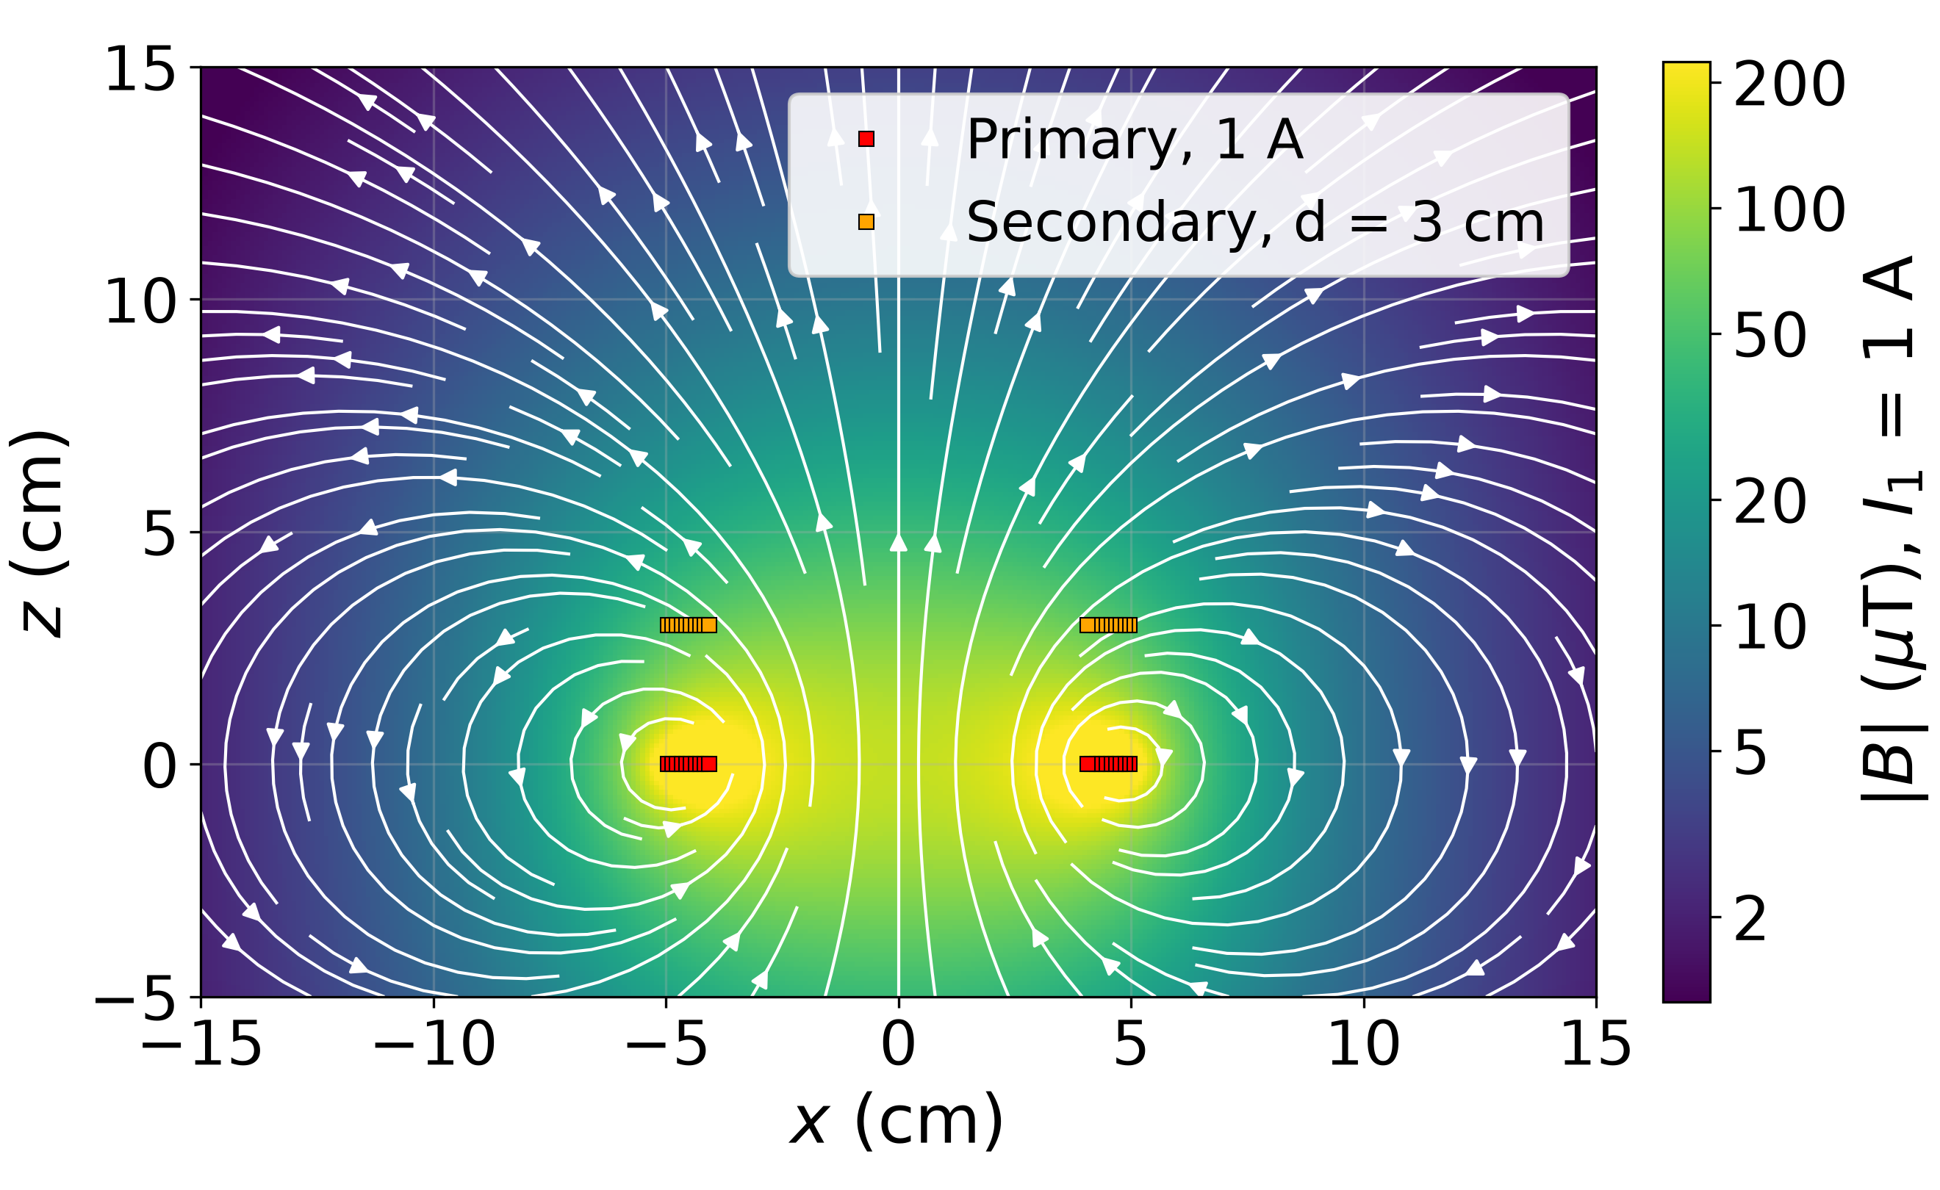
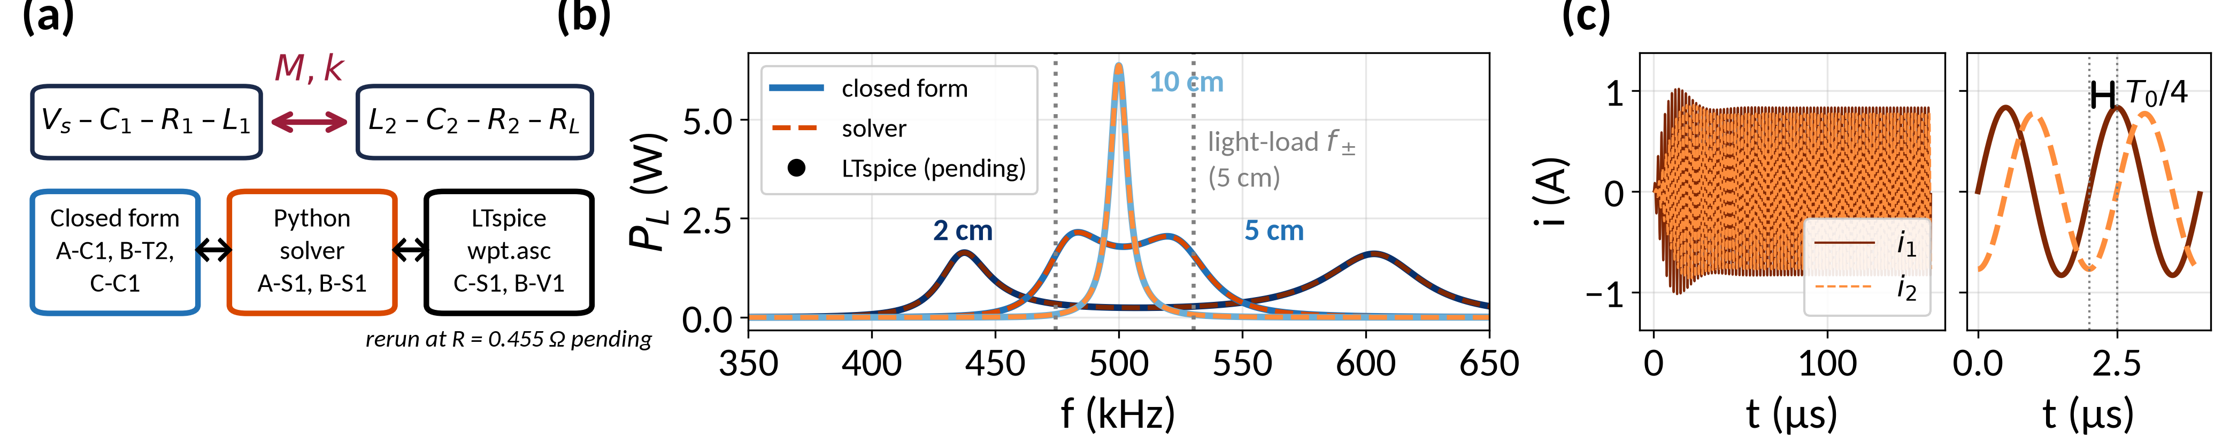

Wireless Power by Resonant Magnetic Coupling
Chittharanjan S · Deekshitha R · Dani Firas Payyanakadavan
Department of Electrical Engineering, IIT Madras · EE2025 Engineering Electromagnetics
2 Executive Summary
5 Analysis and Simulation
Two identical 10-turn, 10 cm air-core spiral coils, series-tuned to 500 kHz, transfer power across a 1–10 cm gap with no wire between them. At 500 kHz the wavelength is 600 m, so the coils interact through the reactive near field: primary current creates a magnetic field (Ampère), part of its flux links the secondary (mutual inductance M), and Faraday's law induces the secondary voltage. Resonance cancels the coil reactance, so performance is set by coupling k and quality factor Q = 118.3. A Neumann-integral model gives k falling from 0.51 at 1 cm to 0.030 at 10 cm. A phasor circuit model, confirmed by closed-form theory and LTspice, predicts maximum efficiencies of 97 % at 1 cm, 86 % at 5 cm and 57 % at 10 cm. With the 6 Ω load (optimal at 5 cm), delivered power peaks at critical coupling (6.4 W near 9.75 cm), not where efficiency is highest. All results are analytical and simulated.
Closed form and Neumann agree to ≤ 0.05 % (0.5–15 cm); k ∝ 1/d³ only for d ≫ a.
η_{max} is 97 % at 1 cm, 86 % at 5 cm, 57 % at 10 cm; the fixed 6 Ω load gives 44 % at 10 cm.
3 The Physical Concept
Why it matters. With no plugs or contacts, a device can be sealed, waterproof, or even inside the body, so wireless power now reaches from phones to electric vehicles and deep-sea robots.
How it works. An alternating current in coil 1 makes a magnetic field. Part of that field passes through coil 2 and, because it changes, induces a voltage there (Faraday's law). A capacitor in series with each coil makes it resonate: energy sloshes between the coil's magnetic field and the capacitor's electric field, so a small drive builds a large current. Both coils are tuned to the same f₀, so power crosses the gap to R_{L}.
Why it is short range. The field is stored near the coils rather than radiated, so k falls from 0.51 at 1 cm to 0.03 at 10 cm.
At 2 and 5 cm the power peak splits in two; at 10 cm a single sharp peak sits at f₀.
The best load R_{L,opt} = R₂√(1+x) moves with spacing; 6 Ω is best only at 5 cm.
Setup
Planar spiral, N = 10
d_{out} = 100 mm
wire 0.7 mm, pitch 1.0 mm
L = 17.13 µH, C = 5.915 nF
f₀ = 500 kHz
R = 0.455 Ω, Q = 118.3
R_{L} = 6.0 Ω
V_{s} = 5 V peak, R_{s} = 0
Left: field lines of coil 1, computed for our coils at d = 3 cm; wine lines thread coil 2 and set M. Right: the series-series circuit. Photos below: AI-generated illustrations.
|B| (µT) in the x–z plane: primary at 1 A, coil 2 at d = 3 cm.
6 Demonstration: Model vs Model
• Validation chain: closed form ↔ Python Neumann sum + 2 × 2 phasor solver ↔ LTspice sim/wpt.asc. LTspice agrees with the solver to 5 × 10⁻¹⁰ % (2, 5, 10 cm, 350–650 kHz).
• Faraday in time: at f₀, V₂ = −jωMI₁ and Z₂ = R₂ + R_{L} is real, so i₂ lags i₁ by 90° (T₀/4 = 0.50 µs).
• Light-load peaks f± (eq. 5) give k within 0.3 % at 1, 2, 5 cm (5 cm: 474.4 / 530.3 kHz → 0.1109).
• Finding: a 6 Ω load pulls them in (5 cm: 483.5 / 519.6 kHz → k = 0.072, 35 % low; 10 cm: 1 peak).
Electric vehicles: a ground pad charges a parked robotaxi.
Phones and IoT: pads charge phones and power sensor nodes.
Underwater robots: AUVs recharge at seabed docks.
d (cm) | M (µH) | k | ηmax (RL,opt) | η at 6 Ω | PL at 6 Ω (W) | Regime
1 | 8.79 | 0.513 | 96.8 % (27.6 Ω) | 92.6 % | 0.098 | over-coupled
3 | 3.72 | 0.217 | 92.5 % (11.7 Ω) | 91.0 % | 0.526 | over-coupled
5 | 1.90 | 0.111 | 85.9 % (6.00 Ω) | 85.9 % | 1.79 | over-coupled; design point
10 | 0.51 | 0.030 | 57.2 % (1.67 Ω) | 43.5 % | 6.36 | near critical (k < kc)
4 Governing EM Physics
V_{s} = 5 V pk, R_{s} = 0, R₁ = R₂ = 0.455 Ω; regime from k_{c} = 0.0318 (R_{L} = 6 Ω, R_{s} = 0).
k, M: closed form vs Neumann agree to ≤ 0.05 % (0.5–15 cm).
(1) ∇ × H = J + ∂D/∂t ≈ J (k₀a = ωa/c ≈ 5 × 10⁻⁴)
Ampère, quasi-static: the coil is 1/6000 of λ = 600 m, so displacement current is negligible.
(2) ∮ E·dl = −dΦ/dt ⇒ V₂ = −jωM I₁
Faraday: the changing shared flux induces the EMF that drives coil 2.
(3) B_{z} = μ₀NIa² / [2(a² + z²)^{3/2}]
M = Φ₂₁/I₁ = (μ₀/4π) ∮∮ dl₁·dl₂ / r
Biot–Savart, Neumann: flux of coil 1 through coil 2 per amp. Pure geometry; M₁₂ = M₂₁.
(4) k = M/√(L₁L₂), k ∝ 1/d³ for d ≫ a
Coupling: ours is 0.513, 0.111, 0.030 at 1, 5, 10 cm; 1/d³ only for d ≳ 4a.
(5) f₀ = 1/(2π√(LC)), Q = ω₀L/R, f± = f₀/√(1 ± k)
Resonance: 17.13 µH, 5.915 nF → 500 kHz; Q = 118.3 at 0.455 Ω. Strong k splits the peak.
(6) Z₁I₁ + jωM I₂ = V_{s}, jωM I₁ + Z₂I₂ = 0
Z_{in} = R₁ + ω₀²M²/(R₂ + R_{L}) at f₀
Circuit, Poynting: at f₀, W_{m} = W_{e} in each coil, so the source sees only resistance.
(7) η_{max} = x / (1 + √(1 + x))², x = k²Q₁Q₂
Efficiency: at R_{L} = R₂√(1 + x). At 5 cm x = 173, η_{max} = 85.9 %, R_{L} = 6.0 Ω.
(8) δ = √(2/(ωμ₀σ)) = 0.094 mm (Cu, 500 kHz)
Skin depth: current crowds into a skin thinner than the 0.35 mm wire radius, raising R.
Boundary conditions: n̂·(B₁ − B₂) = 0, n̂ × (H₁ − H₂) = K. Metal forces B_{n} ≈ 0 (eddy currents): L, k fall and an Al plate 10 mm away adds 87 mΩ. Ferrite guides flux, raising k.
Symbols: N turns, a coil radius, d spacing; I₁, I₂ into the dots; Z_{i} = R_{i} + jωL_{i} + 1/(jωC_{i}), R_{L} added in Z₂; σ conductivity; μ₀ = 4π × 10⁻⁷ H/m.
(a) Model chain. (b) P_{L} (W) vs f (kHz) at 2, 5, 10 cm, R_{L} = 6 Ω; markers: LTspice; dotted lines: light-load f± at 5 cm. (c) i₁, i₂ (A) vs t (µs), 5 cm: i₂ lags i₁ by 90°. Read k only from light-load peaks.
7 Conclusion and References
Key findings
• Q = 118.3: η_{max} = 96.8 % at 1 cm, 85.9 % at 5 cm (R_{L,opt} = 6.0 Ω), 57.2 % at 10 cm.
• Max η ≠ max power: at 5 cm, R_{L,opt} = 6.0 Ω, but R_{L} = 79.1 Ω gives the most power.
Limitations
• Range: M ∝ 1/d³ only for d ≫ a (log-log slope −2.1 at 8–10 cm, −2.97 at 50–100 cm).
• AC loss: R_{dc} 0.13 → 0.455 Ω (skin 0.269, prox. 0.136, ESR 0.035, joints 0.015); range 0.38–0.48 Ω.
• Misalignment (3 cm): η = 91.1 / 88.8 / 84.2 % at Δx = 2 / 3 / 4 cm; M = 0 at 8.22 cm, then M < 0.
• Al plate 5 mm behind coil 2: k −56.4 %, R₂ +178 mΩ, L₂ −51 %; ferrite: k +34.5 %. η (3 cm): 92.5 → 24.0 % (63.9 % with C₂ retuned).
• Stress (R_{s} = 0): V_{C1} 44.8 / 314 V pk at 5 / 10 cm; I₁ ≤ 11.0 A pk, 27.5 W (50 Ω source: 0.1 A). Field: 82.3 µT rms at z = 0, < 27 µT rms (ICNIRP 2010) beyond 4.7 cm, < 1.84 beyond 15.4 cm.
Future work: build and measure a prototype; ferrite backing; adaptive frequency tuning [2].
[1] A. Kurs et al., Science, vol. 317, no. 5834, pp. 83–86, 2007.
[2] A. P. Sample, D. A. Meyer, and J. R. Smith, IEEE Trans. Ind. Electron., vol. 58, no. 2, pp. 544–554, 2011.
[3] S. Y. R. Hui, W. Zhong, and C. K. Lee, IEEE Trans. Power Electron., vol. 29, no. 9, pp. 4500–4511, 2014.
[4] R. K. Shevgaonkar, Electromagnetic Waves. New Delhi: Tata McGraw-Hill, 2006.

