Slide 1

Emotion Identification
and Tagging Music with
Appropriate Emotion
Sai Suman Chitturi (1602-18-733-097)
Praneeth Kapila (1602-18-733-116)

Slide 2
Introduction
Suggest Music based on User's Current Emotion
Implicit: Facial Emotion, Keystrokes, Mouse-click patterns
Emotion Identification
Explicit: Input from User
Music Tagging: K-Means Clustering
Tag Music & Suggest
Suggestions using Random Sampling

Slide 3
Motivation
Lack of Context-aware Music system
Constantly Expanding Digital Music Libraries
Difficult to recall a particular song matching the current mood
Confusion while choosing songs
Useful when users can't reveal or express their emotion

Slide 4
Flow
Valence Arousal
Dominance
Facial Expression
Web Cam
Music
Dataset
Pre-process
FER
Dataset
Detection
Capturing
K-Means Clustering
Centroid Identification
Emotion
Music Tagging
Top K songs with same Emotion

Slide 5
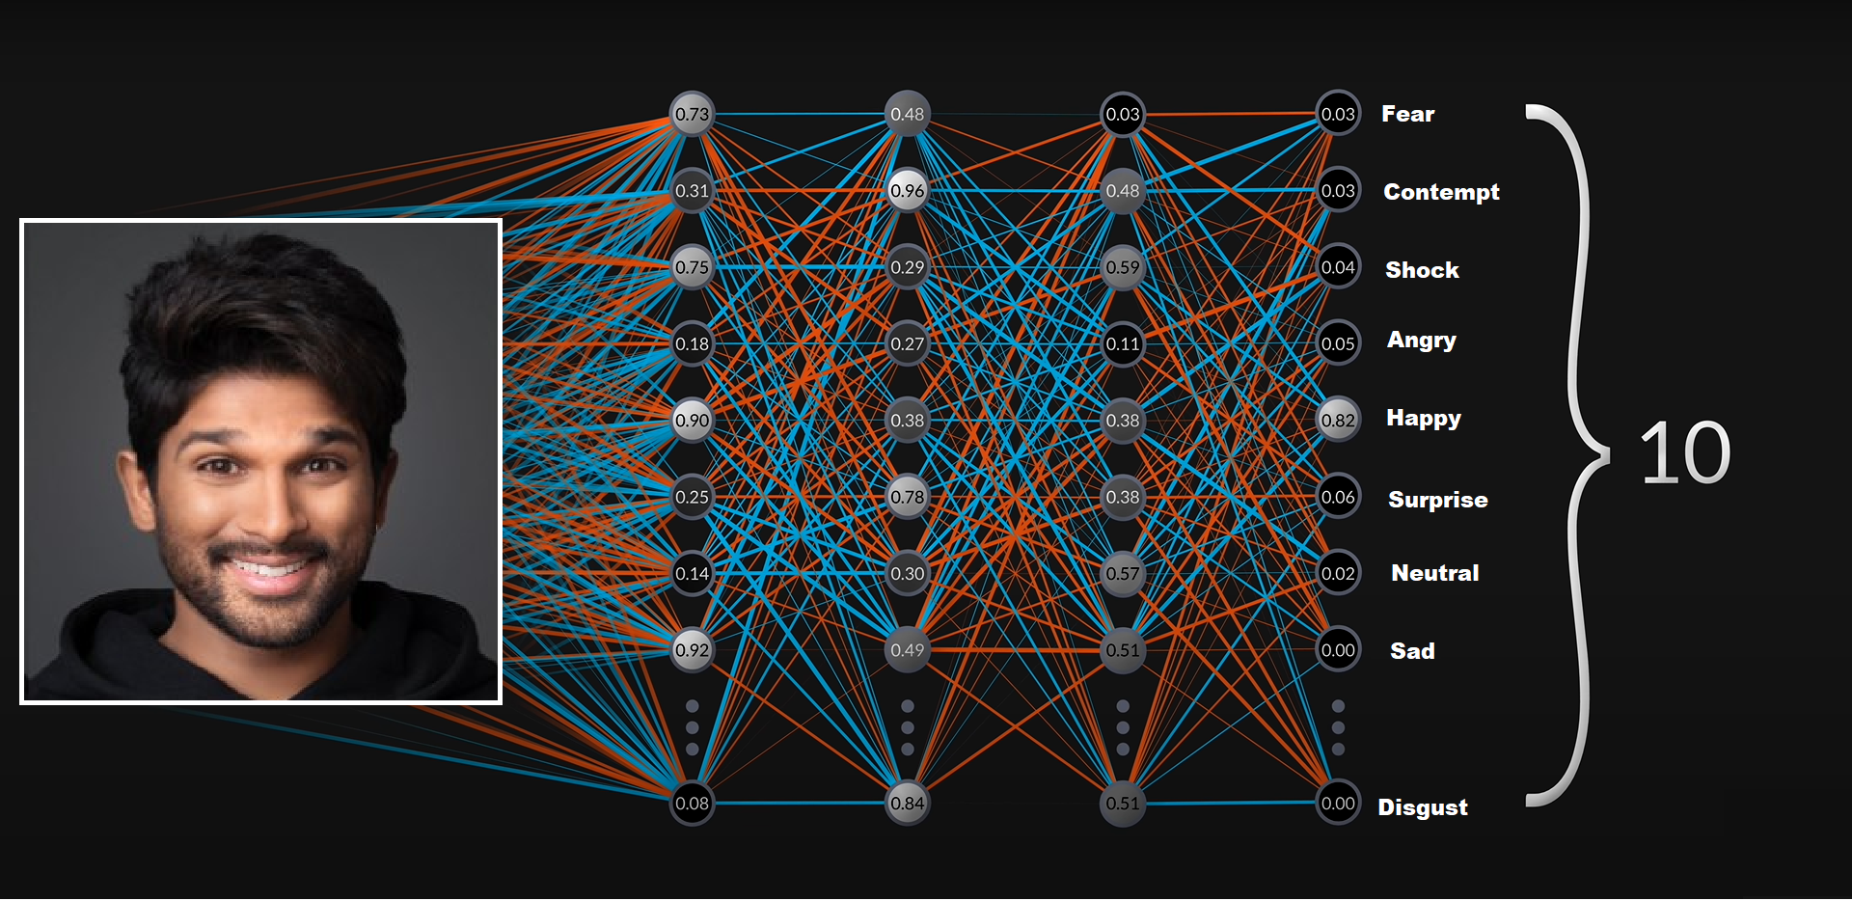
Facial Emotion Recognition: How it Works

Slide 6
Literature Review:
Convolutional Neural Networks

Slide 7
[1]. Facial Emotion Recognition using an Ensemble of Multi-Level Convolutional Neural Networks
Proposed a CNN based on multi-level features for Facial emotion identification.
Hierarchy of Characteristics are considered to improve the classification job.
Tested on the FER2013 dataset:
Found to be similar to existing state-of-the-art approaches in terms of performance

Slide 8
Literature Review:
Multi-task Cascaded Neural Network

Slide 9
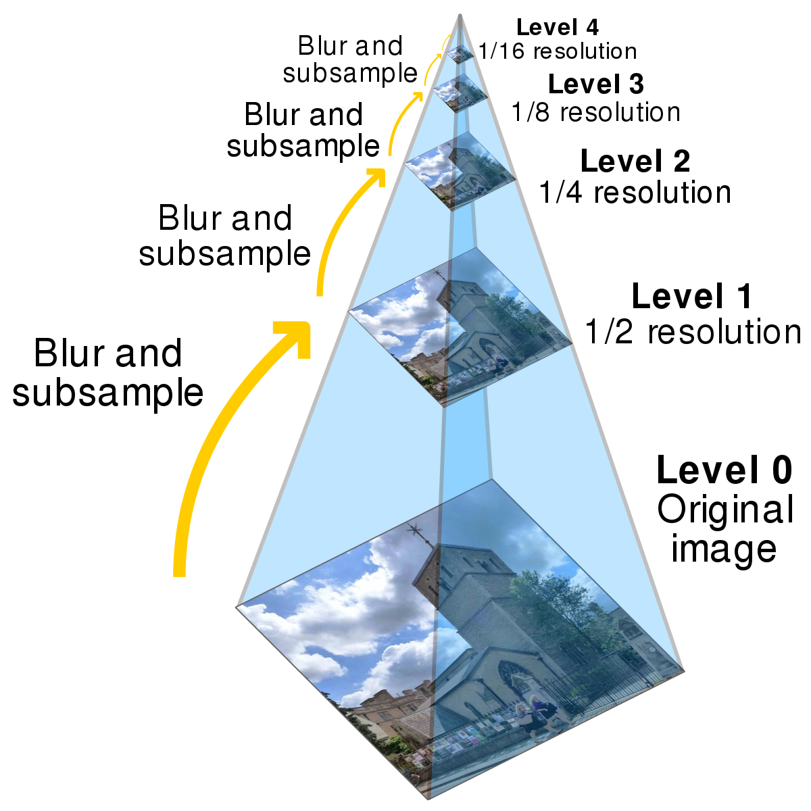
[2]. Research on Face Detection Technology Based on MTCNN
Multitask Neural Network model for face detection.
Image pyramid is used to transform the scale of the initial image.
Require GPUs to train faster
Very accurate and Robust
Image Pyramid

Slide 10
Literature Review: Compare & Contrast
Parameter | CNN | Deep Face (DNN) | FER (MTCNN)
Accuracy | High | Low | High
Train time | Low | High | High
Validation time | Low | High | High
Advantages | Speed | Light Weight | Self-alignment of Face
Disadvantages | Large Training Data | Low Accuracy | High Train Time
Common | Unable to detect rare facial expressions like Disgust

Slide 11
Proposed Methodology: Emotion Detection
Based on the accuracies, both, CNN and MTCNN, seem a good fit for Facial Emotion Detection
Choose CNN if time is an Important Factor
Choose MTCNN if Accuracy is more important
Time factor can be reduced by using GPUs.
MTCNN is better than CNN

Slide 12
Implementation of Facial Emotion Recognition
Datasets used:
FER2013: 28k train images + 7k test images; 48x48; B&W
Affect Net: 49k train images + 4k test images; 224x224; Colored
Parameter | CNN | Deep Face (DNN) | FER (MTCNN)
Train Accuracy | 74.83 % | 87.35 % | 92.19 %
Train Dataset | FER 2013 Train | FER 2013 Train | FER 2013 Train
Test Dataset | Affect Net | Affect Net | Affect Net

Slide 13
Tagging Music with
Appropriate Emotion

Slide 14
Column Label | Description
lastfm_url | Last.fm page of the song
track | Song title
artist | Artist name
seeds | The initial keyword(s) that seeded the scraping of this song
number_of_emotion_tags | Number of words that contributed to the emotion score of the song
valence_tags | Pleasantness dimension of the song
arousal_tags | Intensity dimension of the song
dominance_tags | Control dimension of the song
mbid | MusicBrainz Identifier of the song
spotify_id | Spotify Identifier of the song
Subset of LastFM Million Song Dataset
MuSe: The Musical Sentiment Dataset

Slide 15
Tagging Music
Tagging Music involves clustering based on Valence, Arousal and Dominance values.
VAD values identify the emotion associated with the song.
These are floating-point values.
Therefore, the dataset is plotted in 3-D space.
K-Means clustering is used to group similar content.
7 Clusters are obtained: Each uniquely identifies an emotion.

Slide 16
K-Means clustering
VAD values are relative:
They change as the range of the dataset varies.
Based on the range of VAD in MuSe dataset, initial centroids were identified.
The 7 identified initial centroids uniquely determine the emotion associated with the song.
K-Means Clustering is then performed with the initial centroids.
7 Clusters are obtained at the end, each identifying an emotion.

Slide 17
Results
Method | Accuracy/Silhouette score
Without Initial Centroids | 0.31
With Initial Centroids | 0.35
Split into Train/Test | 87%

Slide 18
Flow: Recap
Valence Arousal
Dominance
Facial Expression
Web Cam
Music
Dataset
Pre-process
FER
Dataset
Detection
Capturing
K-Means Clustering
Centroid Identification
Emotion
Music Tagging
Top K songs with same Emotion

Slide 19
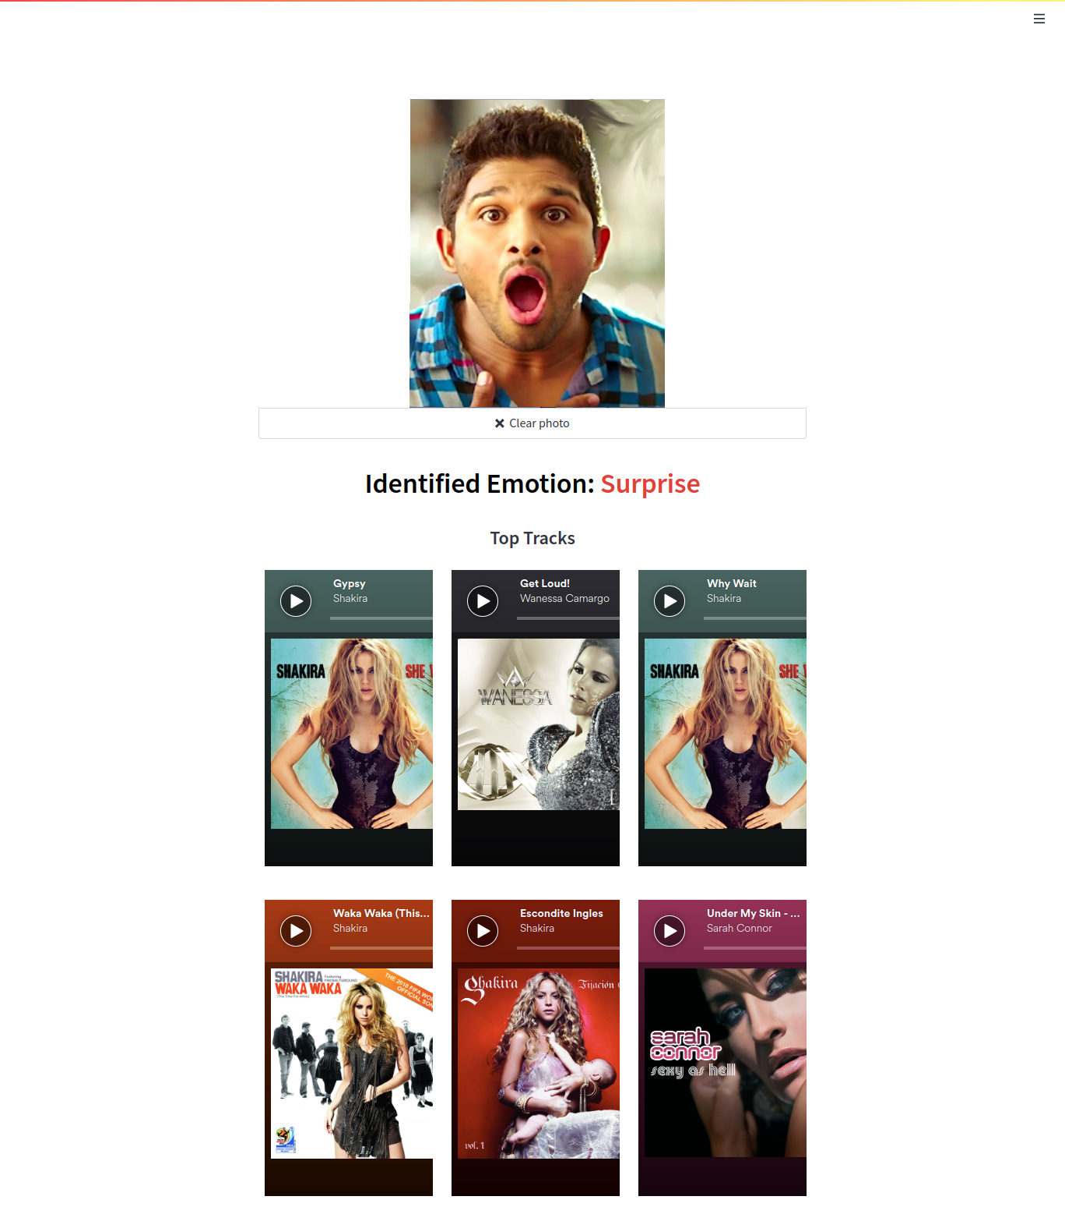
Top picks for
Identified Emotion
Based on the identified emotion, top 15 songs that are tagged with same emotion are picked and displayed.
Clickable Spotify Embed widgets are displayed that can be used to play the song.

Slide 20
Thank you

