Slide 1
Video-on-Demand
Proposed name: Meta Stream
Video on demand (VOD) is a media distribution system that allows users to access videos using a web-browser without a traditional video playback device.
This Application offers the following features.
1. User Registration. 2. Search and Watchlist. 3. Personalized Recommendations based on previously watched videos. 4. User reviews - Videos with higher rating are more likely to appear on dashboard. 5. Downloadable content.

Slide 2
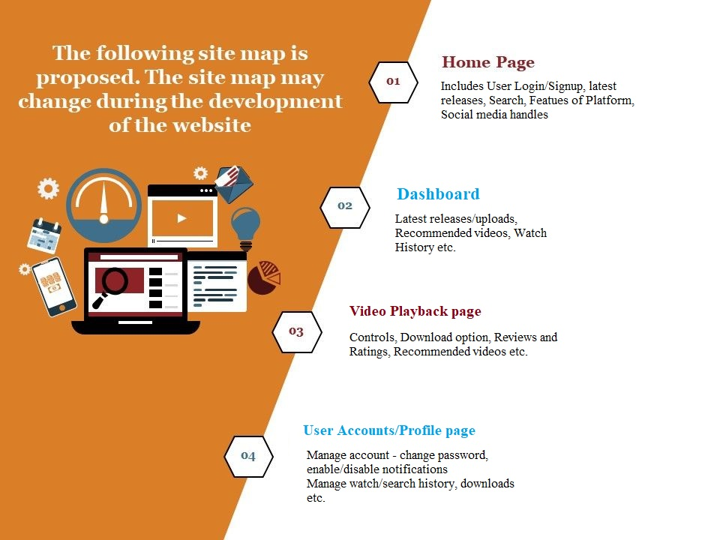
Frontend

Slide 3
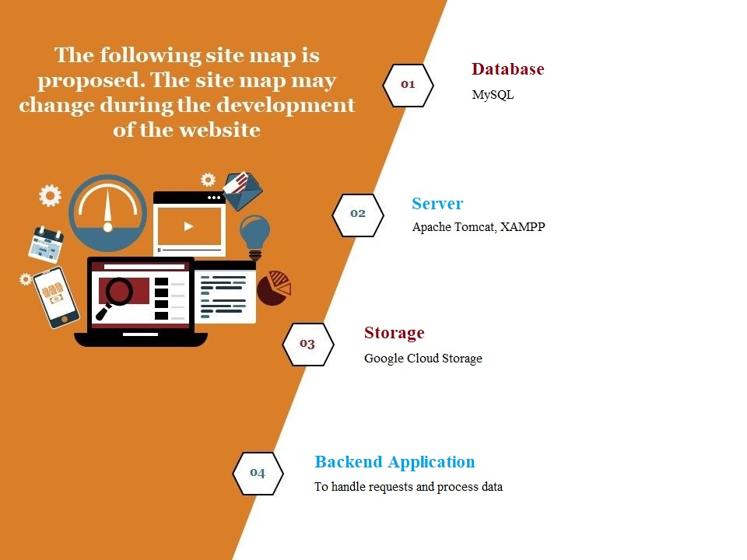
Backend

Slide 4
Thank you
Project by
Praneeth Kapila - 116
Chitturi Sai Suman - 097

