Slide 1

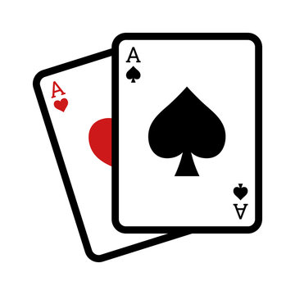

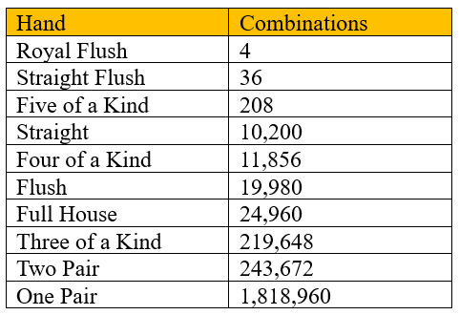
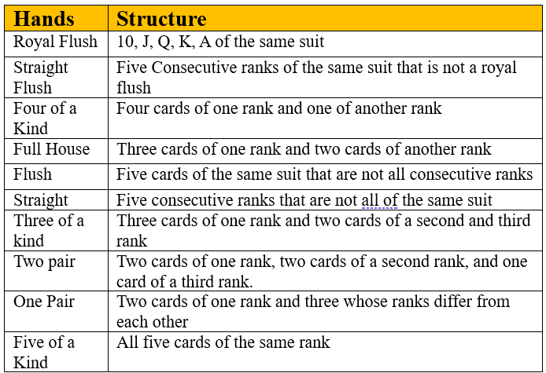
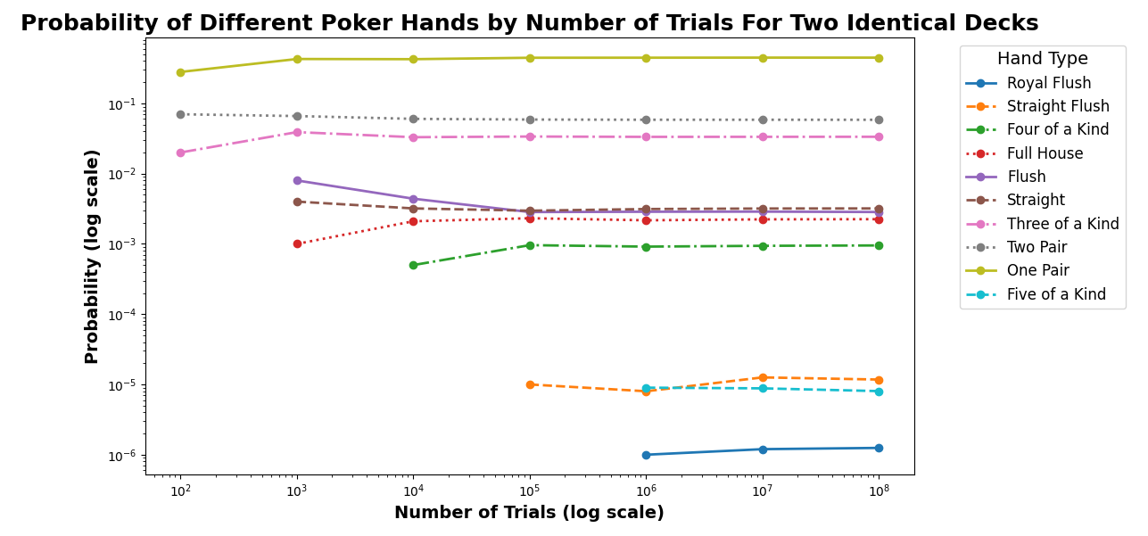
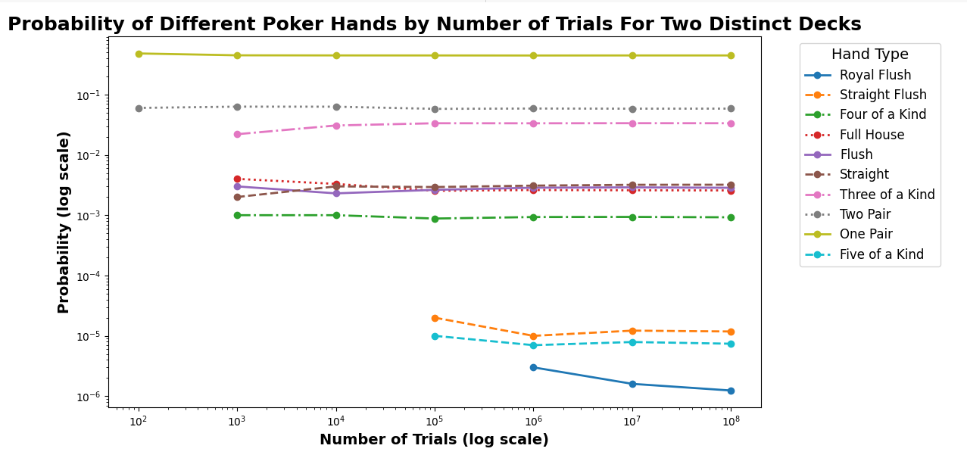


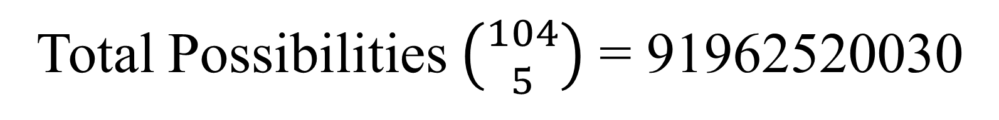
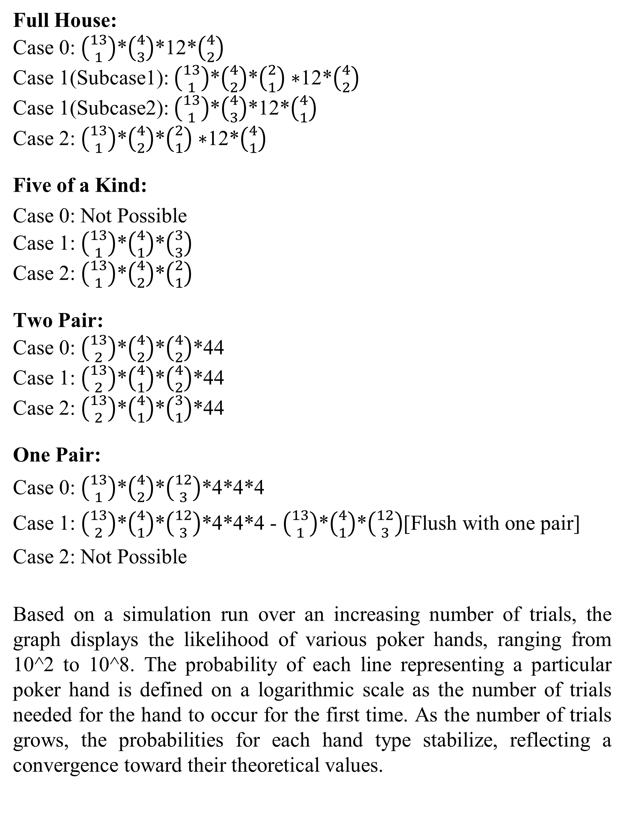
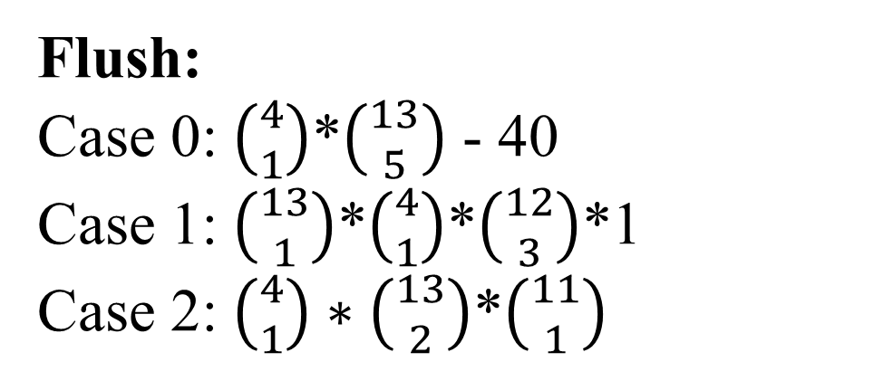
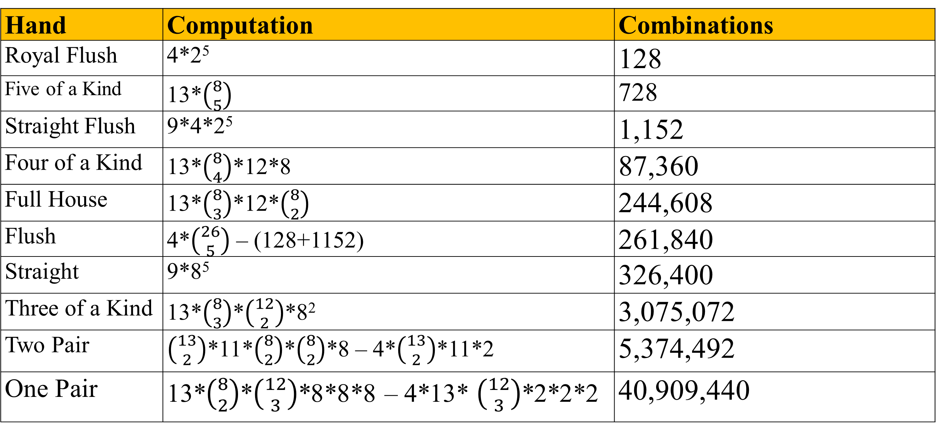
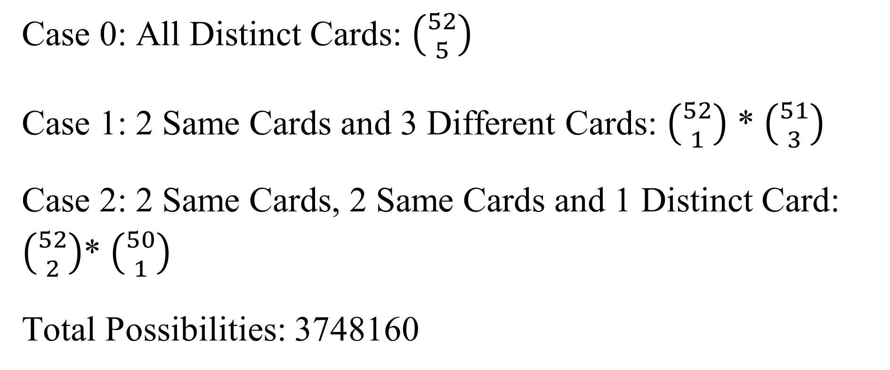
Analyzing the Impact of Two Decks on Poker Probability
Venkata Abhiram Chitty and Promi Roy
Dr. Joseph DeMaio
INTRODUCTION
DISCUSSION & RESULTS
Since its early 19th-century origins, poker as a favorite pastime for many card game lovers has evolved into many versions, adding twists to captivate players. This project takes that spirit of innovation to a classic 5-card poker setup, adding a twist: two decks in play. With this double-deck approach, we uncover how variations in deck composition influence hand probabilities and strategic gameplay. To dive deeper into these probabilities, we turn to the Law of Large Numbers (LLN), a cornerstone concept in probability and statistics. In poker, the LLN helps us understand what outcomes to expect as we simulate thousands—or even millions—of hands. Essentially, the Law of Large Numbers (LLN) states that as the number of trials or observations increases, the observed frequencies of events tend to stabilize around theoretical probabilities.
Total Possibilities $\left({104 \atop 5}\right)$ = 91962520030
Case 0: All Distinct Cards: $\left({52 \atop 5}\right)$
Case 1: 2 Same Cards and 3 Different Cards: $\left({52 \atop 1}\right)$ * $\left({51 \atop 3}\right)$
Case 2: 2 Same Cards, 2 Same Cards and 1 Distinct Card: $\left({52 \atop 2}\right)$* $\left({50 \atop 1}\right)$
Total Possibilities: 3748160
Hand | Computation | Combinations
Royal Flush | 4*2⁵ | 128
Five of a Kind | 13*$\left({8 \atop 5}\right)$ | 728
Straight Flush | 9*4*2⁵ | 1,152
Four of a Kind | 13*$\left({8 \atop 4}\right)$*12*8 | 87,360
Full House | 13*$\left({8 \atop 3}\right)$*12*$\left({8 \atop 2}\right)$ | 244,608
Flush | 4*$\left({26 \atop 5}\right)$ – (128+1152) | 261,840
Straight | 9*8⁵ | 326,400
Three of a Kind | 13*$\left({8 \atop 3}\right)$*$\left({12 \atop 2}\right)$*8² | 3,075,072
Two Pair | $\left({13 \atop 2}\right)$*11*$\left({8 \atop 2}\right)$*$\left({8 \atop 2}\right)$*8 – 4*$\left({13 \atop 2}\right)$*11*2 | 5,374,492
One Pair | 13*$\left({8 \atop 2}\right)$*$\left({12 \atop 3}\right)$*8*8*8 – 4*13* $\left({12 \atop 3}\right)$*2*2*2 | 40,909,440
Table 1. Two Distinct Deck Combinations
Table 2. Two Identical Deck Combinations
METHODS
Full House:
Case 0: $\left({13 \atop 1}\right)$*$\left({4 \atop 3}\right)$*12*$\left({4 \atop 2}\right)$
Case 1(Subcase1): $\left({13 \atop 1}\right)$*$\left({4 \atop 2}\right)$*$\left({2 \atop 1}\right)∗$12*$\left({4 \atop 2}\right)$
Case 1(Subcase2): $\left({13 \atop 1}\right)$*$\left({4 \atop 3}\right)$*12*$\left({4 \atop 1}\right)$
Case 2: $\left({13 \atop 1}\right)$*$\left({4 \atop 2}\right)$*$\left({2 \atop 1}\right)∗$12*$\left({4 \atop 1}\right)$
Five of a Kind:
Case 0: Not Possible
Case 1: $\left({13 \atop 1}\right)$*$\left({4 \atop 1}\right)$*$\left({3 \atop 3}\right)$
Case 2: $\left({13 \atop 1}\right)$*$\left({4 \atop 2}\right)$*$\left({2 \atop 1}\right)$
Two Pair:
Case 0: $\left({13 \atop 2}\right)$*$\left({4 \atop 2}\right)$*$\left({4 \atop 2}\right)$*44
Case 1: $\left({13 \atop 2}\right)$*$\left({4 \atop 1}\right)$*$\left({4 \atop 2}\right)$*44
Case 2: $\left({13 \atop 2}\right)$*$\left({4 \atop 1}\right)$*$\left({3 \atop 1}\right)$*44
One Pair:
Case 0: $\left({13 \atop 1}\right)$*$\left({4 \atop 2}\right)$*$\left({12 \atop 3}\right)$*4*4*4
Case 1: $\left({13 \atop 2}\right)$*$\left({4 \atop 1}\right)$*$\left({12 \atop 3}\right)$*4*4*4 - $\left({13 \atop 1}\right)$*$\left({4 \atop 1}\right)$*$\left({12 \atop 3}\right)$[Flush with one pair]
Case 2: Not Possible
Based on a simulation run over an increasing number of trials, the graph displays the likelihood of various poker hands, ranging from 10^2 to 10^8. The probability of each line representing a particular poker hand is defined on a logarithmic scale as the number of trials needed for the hand to occur for the first time. As the number of trials grows, the probabilities for each hand type stabilize, reflecting a convergence toward their theoretical values.
Step 1: Combine two distinct standard decks and shuffle them, pick 5 random cards from the combined deck.
Step 2: Defined the functions for checking the type of hand and check the hand for each poker hand
Step 4: Record the Results obtained from the hands
Step 5: Repeat the steps for a large number of trials
Distinct Two Deck Cards (Blue Deck, Red Deck): We introduced one blue deck and one red deck. For example, there are two Aces of Hearts, one from the blue deck and another from the red deck.
Identical Two Deck Cards (Both Blue decks): We introduced 2 identical blue decks where each rank appears twice in each suit. For example, there are two Aces of Hearts, two 10s of Clubs, etc. Since we are unable to distinguish the two ACEs of Hearts, we introduced cases to better identify our hands. For example:
Full House consists of three cards of one rank and two of other ranks
Case 1: All cards will be distinct. 2 , 2♥️, 2 , 5♦️, and 5
Case 2: Two cards will be the same, the other three cards will be distinct. 2♥️, 2 , 2 , 5♦️, 5♦️ or, 2♥️, 2♥️, 2 , 5♦️, and 5
Case 3: Two cards will be the same, another two cards will be the same, and one distinct card. 2♥️, 2♥️, 2 , 5♦️, and 5♦️
Flush:
Case 0: $\left({4 \atop 1}\right)$*$\left({13 \atop 5}\right)$ - 40
Case 1: $\left({13 \atop 1}\right)$*$\left({4 \atop 1}\right)$*$\left({12 \atop 3}\right)$*1
Case 2: $\left({4 \atop 1}\right)∗\left({13 \atop 2}\right)$*$\left({11 \atop 1}\right)$
Fig 1. Simulations for Two Identical Deck
Fig 1. Simulations for Two Distinct Deck

