Slide 1


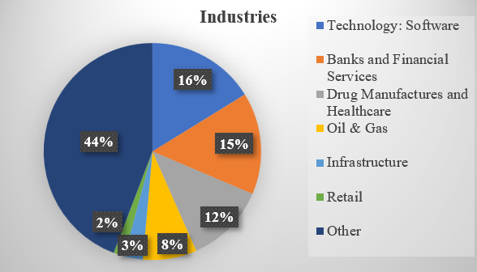
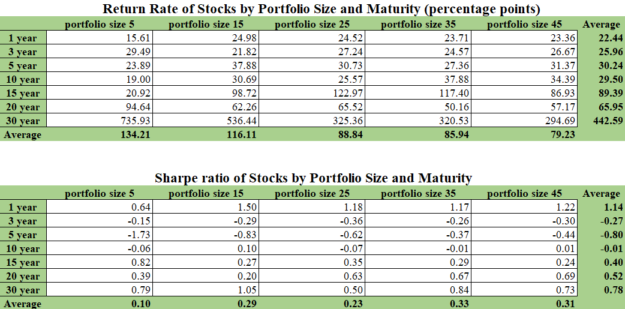
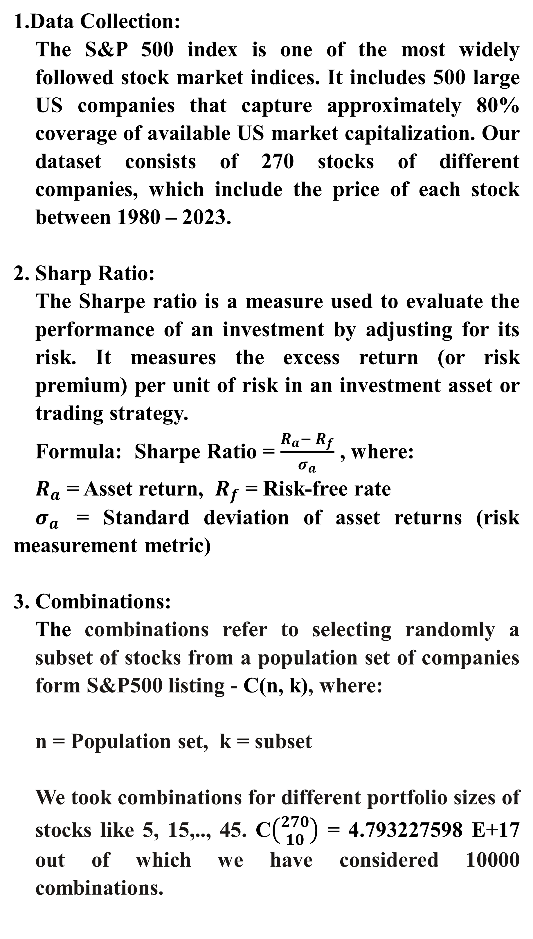
Portfolio Diversification Analysis Using S&P 500 Stocks
Askhat Yktybaev and Venkata Abhiram Chitty
INTRODUCTION
Dr. Joseph DeMaio
DISCUSSION
For a novice investor, it's a natural question to ask: "How many stocks should I buy, for what duration, and which industries should I invest in to maximize my returns?" Our project revolves around determining the optimal parameters of the investments in stocks to create a well-diversified portfolio that outperforms the market index.
We will perform our analysis by exploring how the diversification concept operates across various industries, timeframes, and portfolio sizes in historical stock dataset.
Diversification = Compounding effect + Averaging effect
The rationale behind the Diversification is that a portfolio constructed of different kinds of assets will, on average, yield higher long-term returns and lower the risk of any individual holdings or securities.
From our analysis we can see that diversification has two major components: compounding effect and averaging effect.
We can observe discernible patterns as investment maturity extends. Longer investment periods are associated with higher annualized returns for your portfolio, hinting at the compounding effect's positive influence.
Another pattern that emerges is that as we increase the number of stocks in our portfolio, the overall return tends to decrease. This phenomenon can be attributed to the averaging effect.
Compounding effect:
accumulates interest from previous periods, causing exponential-like growth
Averaging effect:
reduces the impact of market volatility and shocks by spreading your investments over uncorrelated stocks
METHODS
Data Collection:
The S&P 500 index is one of the most widely followed stock market indices. It includes 500 large US companies that capture approximately 80% coverage of available US market capitalization. Our dataset consists of 270 stocks of different companies, which include the price of each stock between 1980 – 2023.
2. Sharp Ratio:
The Sharpe ratio is a measure used to evaluate the performance of an investment by adjusting for its risk. It measures the excess return (or risk premium) per unit of risk in an investment asset or trading strategy.
Formula: Sharpe Ratio = $\frac{R_{a}− R_{f}}{σ_{a}}$ , where:
$R_{a}$ = Asset return, $R_{f}$ = Risk-free rate
$σ_{a}$ = Standard deviation of asset returns (risk measurement metric)
3. Combinations:
The combinations refer to selecting randomly a subset of stocks from a population set of companies form S&P500 listing - C(n, k), where:
n = Population set, k = subset
We took combinations for different portfolio sizes of stocks like 5, 15,.., 45. C$\left({270 \atop 10}\right)$ = 4.793227598 E+17 out of which we have considered 10000 combinations.
RESULTS
The outcome provides insights into portfolio optimization. We find that the optimal number of stocks an investor should hold is approximately 35. This specific quantity corresponds to the highest Sharpe Ratios, signifying an ideal equilibrium between return and risk within this stock combination.
We have also found that the time is a key factor. We can clearly see the compounding effect can significantly boost the overall return on the investment. The longer the investment is held, the more pronounced diversification effect becomes.
The pie Chart shows the most represented industries. Our ideal portfolio is concentrated in industries like Technology, Banks and Financial Services, Drug manufacturing and Healthcare, etc.
Compounding effect
Averaging effect
REFERENCES
https://www.investopedia.com/terms/s/sharperatio.asp
https://www.investopedia.com/terms/d/diversification.asp#:~:text=Diversification%20is%20a%20risk%20management,any%20single%20asset%20or%20risk
https://www.macrotrends.net/

