Slide 1



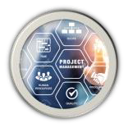
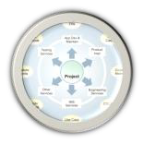
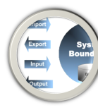
By: Võ Văn Hải
Email: vovanhai@iuh.edu.vn
Jakarta EE / Java EE
1
14/08/2023
1

Slide 2
Objectives
▸JakartaEE Architecture Overview
▸JakartaEE Containers Overview
▸JakartaEE APIs Overview
▸Jakarta Servlet
Servlet Life cycle
Sharing Information
Asynchronous Processing
Contexts and Dependency Injection (CDI)
REST API
JSP
Web Socket
▸Java Server Page
14/08/2023
2
2

Slide 3
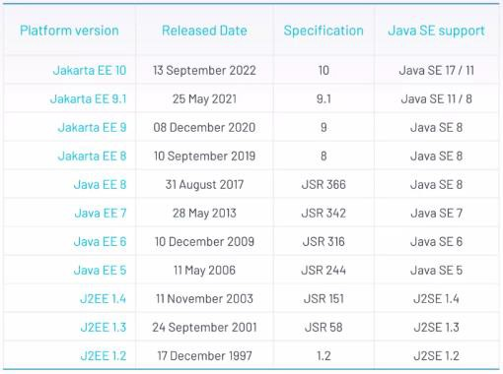
History
14/08/2023
3
3

Slide 4
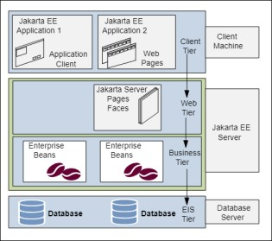
JavaEE Architecture
Distributed Multitiered Applications
▸The Jakarta EE application parts:
Client-tier components run on the client machine.
Web-tier components run on the Jakarta EE server.
Business-tier components run on the Jakarta EE server.
Enterprise information system (EIS)- tier software runs on the EIS server.
▸Although a Jakarta EE application can consist of all tiers , Jakarta EE multitiered applications are generally considered to be three- tiered applications because they are distributed over three locations: client machines, the Jakarta EE server machine, and the database or legacy machines at
the back end.
Figure 1-1 Multitiered Applications
14/08/2023
4
4

Slide 5
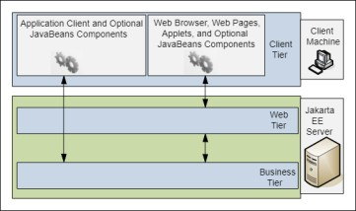
JavaEE Architecture
Jakarta EE Server Communications
▸The various elements that can make up the client tier.
▸The client communicates with the business tier running on the Jakarta EE server either directly or, as in the case of a client running in a browser, by going through web pages or servlets running in the web tier.
Figure 1-2 Server Communication
14/08/2023
5
5

Slide 6
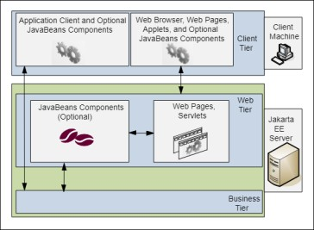
JavaEE Architecture
Web Components
Figure 1-3 Web Tier and Jakarta EE Applications
14/08/2023
6
6

Slide 7
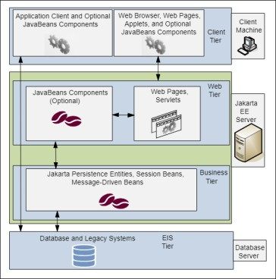
JavaEE Architecture
Business Components
Figure 1-4 Business and EIS Tiers
14/08/2023
7
7

Slide 8
Jakarta EE Containers
Container Services
▸Containers are the interface between a component and the low-level, platform- specific functionality that supports the component. Before it can be executed, a web, enterprise bean, or application client component must be assembled into a Jakarta EE module and deployed into its container.
▸The assembly process involves specifying container settings for each component in the Jakarta EE application and for the Jakarta EE application itself. Container settings customize the underlying support provided by the Jakarta EE server, including such services as security, transaction management, Java Naming and Directory Interface (JNDI) API lookups, and remote connectivity. Here are some of the highlights.
The Jakarta EE security model lets you configure a web component or enterprise bean so that system resources are accessed only by authorized users.
The Jakarta EE transaction model lets you specify relationships among methods that make up a single transaction so that all methods in one transaction are treated as a single unit.
JNDI lookup services provide a unified interface to multiple naming and directory services in the enterprise so that application components can access these services.
The Jakarta EE remote connectivity model manages low-level communications between clients and enterprise beans. After an enterprise bean is created, a client invokes methods on it as if it were in the same virtual machine.
14/08/2023
8
8

Slide 9
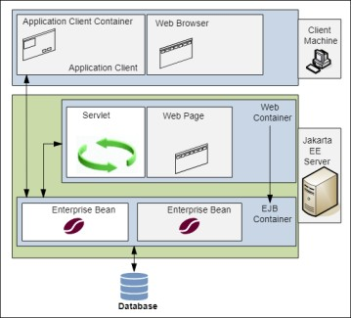
Jakarta EE Containers
Container Types
Figure 1-5 Jakarta EE Server and Containers
14/08/2023
9
9

Slide 10
Jakarta EE Containers
Container Types
▸The server and containers are as follows:
Jakarta EE server: The runtime portion of a Jakarta EE product. A Jakarta EE server provides enterprise and web containers.
Jakarta Enterprise Bean container: Manages the execution of enterprise beans for Jakarta EE applications. Jakarta Enterprise Beans and their container run on the Jakarta EE server.
Web container: Manages the execution of web pages, servlets, and some enterprise bean components for Jakarta EE applications. Web components and their container run on the Jakarta EE server.
Application client container: Manages the execution of application client components. Application clients and their container run on the client.
Applet container: Manages the execution of applets. Consists of a web browser and a Java Plug-in running on the client together.
14/08/2023
10
10

Slide 11
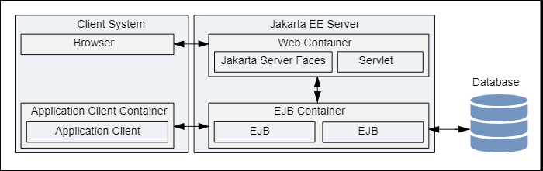
Jakarta EE Containers
The relationships among the Jakarta EE containers
Figure 1-6 The Jakarta EE containers
14/08/2023
11
11

Slide 12
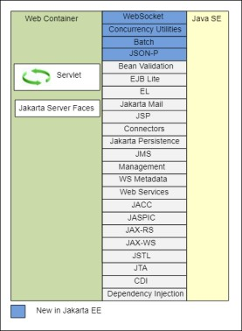
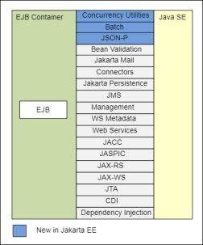
Jakarta EE APIs
Figure 1-8 Jakarta EE APIs in the enterprise bean Container
Figure 1-7 Jakarta EE APIs in the Web Container 14/08/2023
12
12

Slide 13
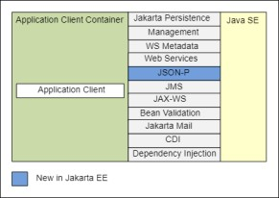
Jakarta EE APIs
Figure 1-9 Jakarta EE APIs in the Application Client Container
Figure 1-8 Jakarta EE APIs in the enterprise bean Container
14/08/2023
13
13

Slide 14
Jakarta Enterprise Beans Technologies
Jakarta Enterprise Beans Technologies
Jakarta Servlet Technology | Jakarta Authorization
Jakarta Faces Technology | Jakarta Authentication
Jakarta Server Pages Technology | Jakarta Security
Jakarta Standard Tag Library | Jakarta WebSocket
Jakarta Persistence | Jakarta JSON Processing
Jakarta Transactions | Jakarta JSON Binding
Jakarta RESTful Web Services | Jakarta Concurrency
Jakarta Managed Beans | Jakarta Batch
Jakarta Contexts and Dependency Injection | Jakarta Activation
Jakarta Dependency Injection | Jakarta XML Binding
Jakarta Bean Validation | Jakarta XML Web Services
Jakarta Messaging | Jakarta SOAP with Attachments
Jakarta Connectors | Jakarta Annotations
Jakarta Mail
Read more: https://eclipse-ee4j.github.io/jakartaee-tutorial/
14/08/2023
14
14

Slide 15
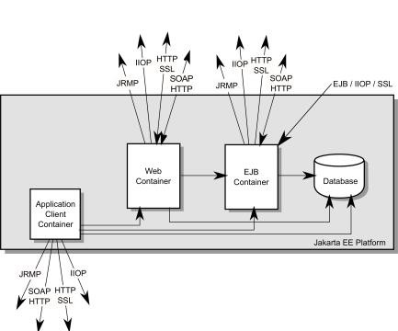
Jakarta EE API Interoperability
Figure 2. Jakarta EE Interoperability
14/08/2023
15
15

Slide 16
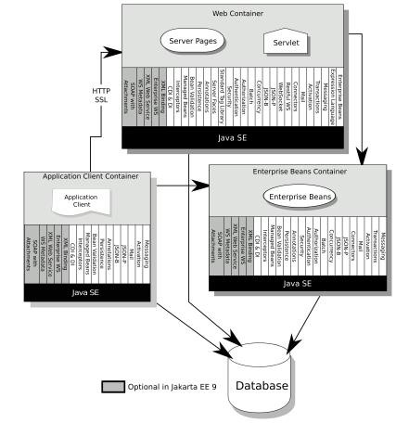
Architecture
Fig1. Jakarta EE Architecture Diagram
https://jakarta.ee/specifications/platform/10
/jakarta-platform-spec-10.0
14/08/2023
16
16

Slide 17
Jakarta Servlet 6.0
https://jakarta.ee/specifications/servlet/6.0/jakarta-servlet-spec-6.0
17
14/08/2023
17

Slide 18
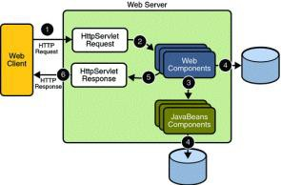
Terminologies
What is a Servlet?
▸ A servlet is a Jakarta technology-based web component, managed by a container, that generates dynamic content.
▸ Like other Jakarta technology-based components, servlets are platform-independent Java classes that are compiled to platform-neutral byte code that can be loaded dynamically into and run by a Jakarta technology-enabled web server.
▸ Containers, sometimes called servlet engines, are web server extensions that provide servlet functionality. Servlets interact with web clients via a request/response paradigm implemented by the servlet container.
14/08/2023
18
18

Slide 19
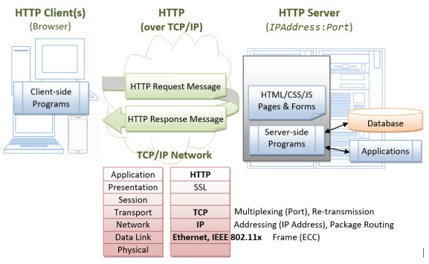
Servlet Request/Response Handling
Java Web Application Request Handling
14/08/2023
19
19

Slide 20
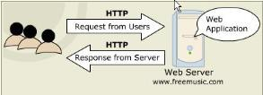
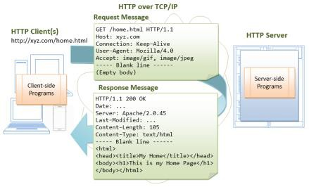
Servlet Communication & Protocols
Message
14/08/2023
20
20

Slide 21
Http methods and Servlet methods
HTTP – Servlet methods mapping
Http method | Description | Servlet Method
GET | The GET method requests a representation of the specified resource. Requests using GET should only retrieve data. | doGet
POST | The POST method submits an entity to the specified resource, often causing a change in state or side effects on the server. | doPost
PUT | The PUT method replaces all current representations of the target resource with the request payload. | doPut
DELETE | The DELETE method deletes the specified resource. | doDelete
HEAD | The HEAD method asks for a response identical to a GET request, but without the response body. | doHead
OPTIONS | The OPTIONS method describes the communication options for the target resource. | doOptions
TRACE | The TRACE method performs a message loop-back test along the path to the target resource. | doTrace
CONNECT | The CONNECT method establishes a tunnel to the server identified by the target resource.
PATCH | The PATCH method applies partial modifications to a resource.
14/08/2023
21
21

Slide 22
Terminologies
What is a Servlet Container?
▸The servlet container is a part of a web server or application server that provides the network services over which requests and responses are sent, decodes MIME-based requests, and formats MIME-based responses. A servlet container also contains and manages servlets through their lifecycle.
▸A servlet container can be built into a host web server or installed as an add-on component to a web server via that server’s native extension API. Servlet containers can also be built into or possibly installed into web- enabled application servers.
▸All servlet containers must support HTTP as a protocol for requests and responses, but additional request/response-based protocols such as HTTPS (HTTP over SSL) may be supported.
14/08/2023
22
22

Slide 23
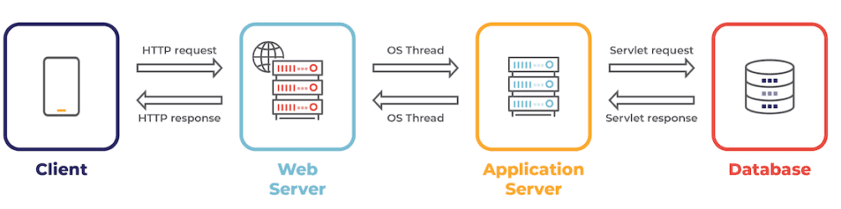
Terminologies
Java Web Server vs. Application Server
▸Web Server is a computer program that accepts the request for data and sends the specified documents. Web server may be a computer where the online content is kept. Essentially internet server is employed to host sites however there exist different web servers conjointly like recreation, storage, FTP, email, etc.
▸Application Server encompasses Web container as well as EJB container. Application servers organize the run atmosphere for enterprises applications. Application server may be a reasonably server that mean how to put operating system, hosting the applications and services for users, IT services and organizations. In this, user interface similarly as protocol and RPC/RMI protocols are used.
14/08/2023
23
23

Slide 24
Web Server vs. Application Server
.NO | Web Server | Application Server
1. | Web server encompasses web container only. | While application server encompasses Web container as well as EJB container.
2. | Web server is useful or fitted for static content. | Whereas application server is fitted for dynamic content.
3. | Web server consumes or utilizes less resources. | While application server utilize more resources.
4. | Web servers arrange the run environment for web applications. | While application servers arrange the run environment for enterprises applications.
5. | In web servers, multithreading is supported. | While in application server, multithreading is not supported.
6. | Web server’s capacity is lower than application server. | While application server’s capacity is higher than web server.
7. | In web server, HTML and HTTP protocols are used. | While in this, GUI as well as HTTP and RPC/RMI protocols are used.
8. | Processes that are not resource-intensive are supported. | Processes that are resource-intensive are supported.
9. | Transactions and connection pooling is not supported. | Transactions and connection pooling is supported.
10. | The capacity of fault tolerance is low as compared to application servers. | It has high fault tolerance.
11. | Web Server examples are Apache HTTP Server , Tomcat, Jetty, Nginx,... | Application Servers example are JBoss EAP, WildFly, Glassfish, Apache TomEE, IBM Websphere,….
14/08/2023
24
24

Slide 25

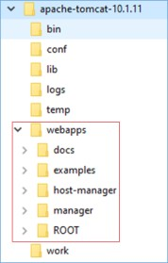
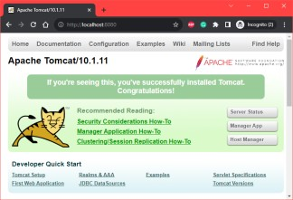
Apache Tomcat Web Server
▸Download: https://tomcat.apache.org/download- 10.cgi (v 10.1.11 or higher)
▸Configuration:
Install JDK (8/11/17), add to PATH environment
Edit: .\conf\tomcat-user.xml
Start Tomcat: .\bin\startup.bat
14/08/2023
25
25

Slide 26
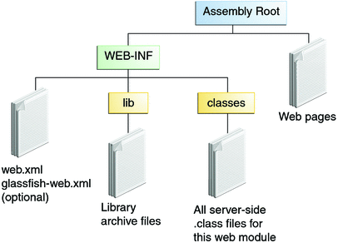
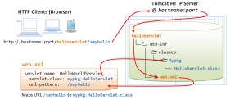
Development
Web Application Directory Structure
Create directory structure
Put resources into these folders appropriately
Copy it to webapps folder of Tomcat web server
➔ automatically deploy
Fig1. Java web-application Structure
Fig2: Sample application
14/08/2023
26
26

Slide 27
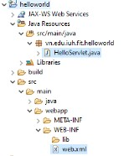
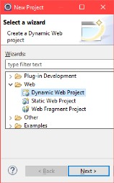
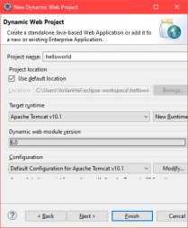
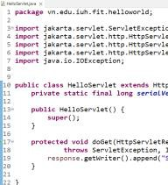
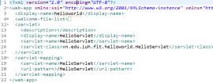
Create Application
With Eclipse
14/08/2023
27
27

Slide 28
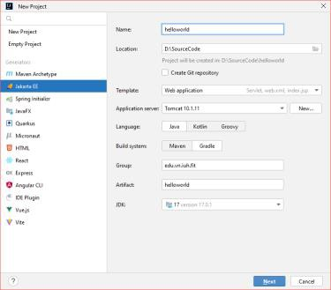
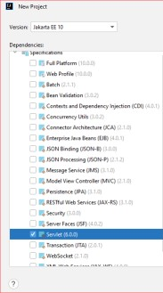
Create Application
With IntelliJ IDEA
14/08/2023
28
28

Slide 29
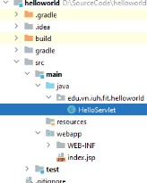
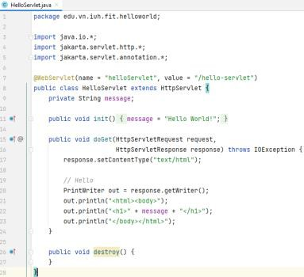
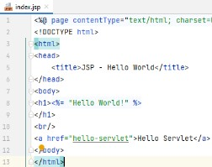
Sample Servlet
14/08/2023
29
29

Slide 30




Create Project with Build tools
Maven:
<dependency>
<groupId>jakarta.servlet</groupId>
<artifactId>jakarta.servlet- api</artifactId>
<version>6.0.0</version>
</dependency>
Gradle:
compileOnly('jakarta.servlet:jakarta.servlet-api:6.0.0')
14/08/2023
30
30

Slide 31
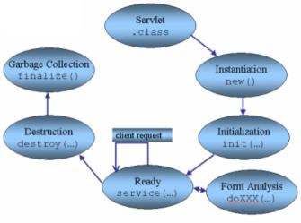
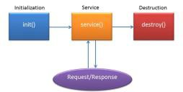
Jakarta Servlet Life Cycle
Generic Servlet Life Cycle
▸The life cycle is defined by:
init() – called only one by the server in the first request
service() – process the client’s request
destroy() – called after all requests have been processed or a server-specific number of seconds have passed
Source
Fig: The Servlet Life Cycle
Source
14/08/2023
31
31

Slide 32
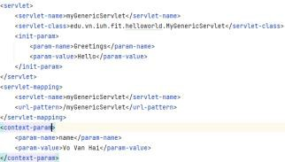
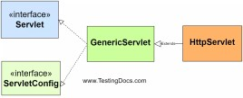
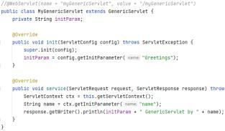
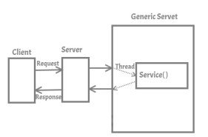
Types of Servlet
The jakarta.servlet.GenericServle
t
14/08/2023
32
32

Slide 33
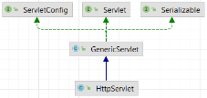
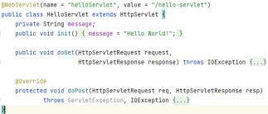
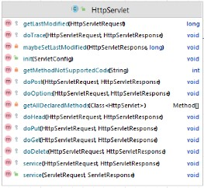
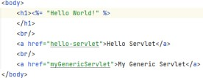

Types of Servlet
jakarta.servlet.http.HttpServlet
14/08/2023
33
33

Slide 34

Handling Servlet Lifecycle Events
▸ You can monitor and react to events in a servlet’s lifecycle by defining listener objects whose methods get invoked when lifecycle events occur.
Servlet Lifecycle Events
Object | Event | Listener Interface and Event Class
Web context | Initialization and destruction | jakarta.servlet.ServletContextListener and Servlet ContextEvent
Web context | Attribute added, removed, or replaced | jakarta.servlet.ServletContextAttributeListener an d ServletContextAttributeEvent
Session | Creation, invalidation, activation, passivation, and timeout | jakarta.servlet.http.HttpSessionListener, jakarta.s ervlet.http.HttpSessionActivationListener, and HttpSessionEvent
Session | Attribute added, removed, or replaced | jakarta.servlet.http.HttpSessionAttributeListener and HttpSessionBindingEvent
Request | A servlet request has started being processed by web components | jakarta.servlet.ServletRequestListener and Servlet RequestEvent
Request | Attribute added, removed, or replaced | jakarta.servlet.ServletRequestAttributeListener an d ServletRequestAttributeEvent
14/08/2023
34
34

Slide 35
Sharing Information
Using Scope Objects
▸Collaborating web components share information by means of objects that are maintained as attributes of four scope objects. You access these attributes by using the getAttribute and setAttribute methods of the class representing the scope.
Scope Objects
Scope Object
Class
Accessible From
Web context
jakarta.servlet.ServletContext
Web components within a web context. See [accessing-the-web-context].
Session
jakarta.servlet.http.HttpSession
Web components handling a request that belongs to the session. See [maintaining-client-state].
Request
Subtype
of jakarta.servlet.ServletRequest
Web components handling the request.
Page
jakarta.servlet.jsp.JspContext
The Jakarta Server Pages page that creates the object.
14/08/2023
35
35

Slide 36
Sharing Information
Controlling Concurrent Access to Shared Resources
▸In a multithreaded server, shared resources can be accessed concurrently. In addition to scope object attributes, shared resources include in-memory data, such as instance or class variables, and external objects, such as files, database connections, and network connections.
▸Concurrent access can arise in several situations.
Multiple web components accessing objects stored in the web context.
Multiple web components accessing objects stored in a session.
Multiple threads within a web component accessing instance variables.
▸A web container will typically create a thread to handle each request. To ensure that a servlet instance handles only one request at a time, a servlet can implement the SingleThreadModel interface. If a servlet implements this interface, no two threads will execute concurrently in the servlet’s service method. A web container can implement this guarantee by synchronizing access to a single instance of the servlet or by maintaining a pool of web component instances and dispatching each new request to a free instance. This interface does not prevent synchronization problems that result from web components' accessing shared resources, such as static class variables or external objects.
14/08/2023 36
36

Slide 37
Asynchronous Processing
Introduction
▸Web containers in application servers normally use a server thread per client request.
▸Under heavy load conditions, containers need a large amount of threads to serve all the client requests.
▸Scalability limitations include running out of memory or exhausting the pool of container threads.
▸To create scalable web applications, you must ensure that no threads associated with a request are sitting idle, so the container can use them to process new requests.
▸There are two common scenarios in which a thread associated with a request can be sitting idle:
The thread needs to wait for a resource to become available or process data before building the response. For example, an application may need to query a database or access data from a remote web service before generating the response.
The thread needs to wait for an event before generating the response. For example, an application may have to wait for a Jakarta Messaging message, new information from another client, or new data available in a queue before generating the response.
14/08/2023
37
37

Slide 38

Asynchronous Processing
Asynchronous Processing in Servlets
▸To enable asynchronous processing on a servlet, set the parameter asyncSupported to true on the @WebServlet annotation as follows:
▸The jakarta.servlet.AsyncContext class provides the functionality that you need to perform asynchronous processing inside service methods. To obtain an instance of AsyncContext, call the startAsync() method on the request object of your service method;
▸The AsyncListener class provides the functionality that you can use to listen the
states of async thread.
public class MyAsyncListener implements AsyncListener {
//…
}
14/08/2023
38
38

Slide 39
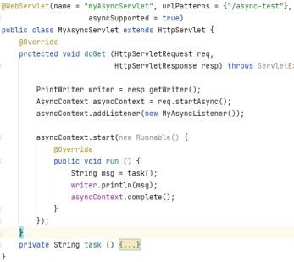
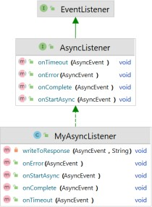
Asynchronous Processing
Example
Read more: https://github.com/eclipse-ee4j/jakartaee-tutorial/blob/master/src/main/asciidoc/servlets/servlets012.adoc
14/08/2023
39
39

Slide 40


Contexts and Dependency Injection (CDI)
Introduction
▸CDI (Contexts and Dependency Injection) is a standard dependency injection framework included in Java EE 6 and higher.
▸It allows us to manage the lifecycle of stateful components via domain- specific lifecycle contexts and inject components (services) into client objects in a type-safe way
▸CDI
Contexts: The ability to bind the lifecycle and interactions of stateful components to well-defined but extensible lifecycle contexts
Dependency injection: The ability to inject components into an application in a type- safe way, including the ability to choose at deployment time which implementation of a particular interface to inject.
▸In Tomcat Server, it’s needed to add reference to jboss weld dependency
Read more:
https://github.com/eclipse-ee4j/jakartaee-tutorial/tree/master/src/main/asciidoc/cdi-basic
40
14/08/2023
40

Slide 41
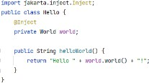
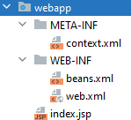

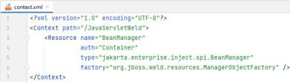

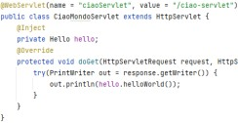

Contexts and Dependency Injection (CDI)
Example
<a href
="ciao-servlet">CDI Servlet</a>
14/08/2023
41
41

Slide 42
REST API
42
14/08/2023
42

Slide 43
RESTful Web Services
Introduction
▸RESTful web services are loosely coupled, lightweight web services that are particularly well suited for creating APIs for clients spread out across the internet.
▸Representational State Transfer (REST) is an architectural style of client- server application centered around the transfer of representations of resources through requests and responses.
▸In the REST architectural style, data and functionality are considered resources and are accessed using Uniform Resource Identifiers (URIs), typically links on the Web.
▸The resources are represented by documents and are acted upon by using a set of simple, well-defined operations.
14/08/2023
43
43

Slide 44
RESTful Root Resource
Developing RESTful Web Services with Jakarta REST
▸Jakarta REST is a Java programming language API designed to make it easy to develop applications that use the REST architecture.
▸The Jakarta REST API uses Java programming language annotations to simplify the development of RESTful web services.
▸Developers decorate Java programming language class files with Jakarta REST annotations to define resources and the actions that can be performed on those resources.
Jakarta REST Annotations
@Path | @PATCH | @Consumes
@GET | @HEAD | @Produces
@POST | @OPTIONS | @Provider
@PUT | @PathParam | @ApplicationPath
@DELETE | @QueryParam
https://github.com/eclipse-ee4j/jakartaee-tutorial/blob/master/src/main/asciidoc/jaxrs/jaxrs002.adoc
14/08/2023 44
44

Slide 45






REST - example
http://localhost:8080/rest-demo/api/hello-world
14/08/2023
45
45

Slide 46


REST
The @Path Annotation and URI Path Templates
▸The @Path annotation identifies the URI path template to which the resource responds and is specified at the class or method level of a resource.
▸The @Path annotation’s value is a partial URI path template relative to the base URI of the server on which the resource is deployed, the context root of the application, and the URL pattern to which the Jakarta REST runtime responds.
▸URI path templates are URIs with variables embedded within the URI syntax. These variables are substituted at runtime in order for a resource to respond to a request based on the substituted URI. Variables are denoted by braces ({ and }).
14/08/2023
46
46

Slide 47
REST
Types Supported for HTTP Request and Response Entity Bodies
▸Using Entity Providers to Map HTTP Response and Request Entity Bodies
Entity providers supply mapping services between representations and their associated Java types.
The two types of entity providers are MessageBodyReader and MessageBodyWriter.
Java Type | Supported Media Types
byte[] | All media types (*/*)
java.lang.String | All text media types (text/*)
java.io.InputStream | All media types (*/*)
java.io.Reader | All media types (*/*)
java.io.File | All media types (*/*)
jakarta.activation.DataSource | All media types (*/*)
javax.xml.transform.Source | XML media types (text/xml, application/xml, and application/*+xml)
jakarta.xml.bind.JAXBElement and application-supplied Jakarta XML Binding classes | XML media types (text/xml, application/xml, and application/*+xml)
MultivaluedMap<String, String> | Form content (application/x-www-form-urlencoded)
StreamingOutput | All media types (/), MessageBodyWriter only
14/08/2023
47
47

Slide 48
REST
Using @Consumes and @Produces to Customize Requests and Responses
▸The value of @Produces is an array of String of MIME types or a comma- separated list of MediaType constants. For example:
@Produces({"image/jpeg,image/png"})
@Produces(MediaType.APPLICATION_XML)
@Produces({"application/xml", "application/json"})
▸The @Consumes annotation is used to specify which MIME media types of representations a resource can accept, or consume, from the client.
If @Consumes is applied at the class level, all the response methods accept the specified MIME types by default.
If applied at the method level, @Consumes overrides any @Consumes annotations applied at the class level.
Example:
@Consumes({"text/plain,text/html"})
@Consumes({MediaType.TEXT_PLAIN,MediaType.TEXT_HTML})
@Consumes("multipart/related")
@Consumes("application/x-www-form-urlencoded")
14/08/2023 48
48

Slide 49



REST
Extracting Request Parameters
▸Parameters of a resource method may be annotated with parameter- based annotations to extract information from a request. A previous example presented the use of the @PathParam parameter to extract a path parameter from the path component of the request URL that matched the path declared in @Path.
▸You can extract the following types of parameters for use in your resource class: Query, URI path, Form, Cookie, Header, Matrix
14/08/2023
49
49

Slide 50

REST
Configuring Jakarta REST Applications
▸Create a subclass of jakarta.ws.rs.core.Application to manually configure the environment in which the REST resources defined in your resource classes are run, including the base URI. Add a class-level @ApplicationPath annotation to set the base URI.
@ApplicationPath("/api")
public class HelloApplication extends Application {}
▸➔all resources defined within the application are relative to /api
▸By default, all the resources in an archive will be processed for resources. Override the getClasses method to manually register the resource classes in the application with the Jakarta REST runtime.
14/08/2023
50
50

Slide 51

REST Client
14/08/2023
51
51

Slide 52
Java Server Pages
52
14/08/2023
52

Slide 53

Java Server Pages
Introduction
▸Java Server Page (JSP) is a server side script language
▸Saved with .jsp extension
▸A simple, yet powerful Java technology for creating and maintaining dynamic-content webs pages
▸JSP page are converted by the web container into a Servlet instance
▸It focus on the presentation logic of the web application
14/08/2023
53
53

Slide 54



JSP Architecture
14/08/2023
54
54

Slide 55

JSP Execution
14/08/2023
55
55

Slide 56
Self-Study
Read more
https://github.com/eclipse-ee4j/jakartaee-tutorial
14/08/2023
56
56

Slide 57


Thanks for your Listening
14/08/2023
57

