Slide 1
Spring ecosystem
https://docs.spring.io/spring-framework/docs/6.0.6/reference/html/
By Vo Van Hai
vovanhai@iuh.edu.vn
1

Slide 2
Introduction
The Spring ecosystem provides a comprehensive programming and configuration model for modern Java-based enterprise applications - on any deployment platform.
A key element of Spring is infrastructural support at the application level: Spring focuses on the "plumbing" of enterprise applications so that teams can focus on application-level business logic, without unnecessary ties to specific deployment environments.
2

Slide 3
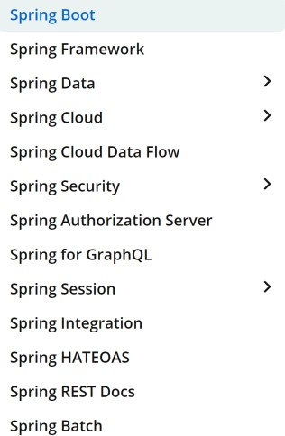
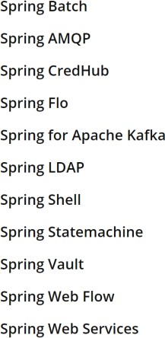
Spring Projects
https://spring.io/projects
Consists of 23 projects (March 2023):
3

Slide 4

Spring History
Rod Johnson
“Expert One-on-One J2EE Design and Development,” Wrox. ISBN 0-7645-4385- 7, 2002
“Expert One-on-One J2EE Development without EJB,” Wrox. ISBN 0-7645-5831-5, 2024
Version | Date | Notes
0.9 | 2003
1.0 | March 24, 2004 | First production release.
2.0 | 2006
3.0 | 2009
4.0 | 2013
5.0 | 2017
6.0 | November 16, 2022
4

Slide 5
Spring Framework Overview
Although Spring is an ecosystem, the heart of all
other projects is based on the Spring Framework.
Spring makes it easy to create Java enterprise applications. It provides everything you need to embrace the Java language in an enterprise environment, and with the flexibility to create many kinds of architectures depending on an application’s needs.
As of Spring Framework 6.0, Spring requires Java 17+.
"Spring“: different things in different contexts
5

Slide 6
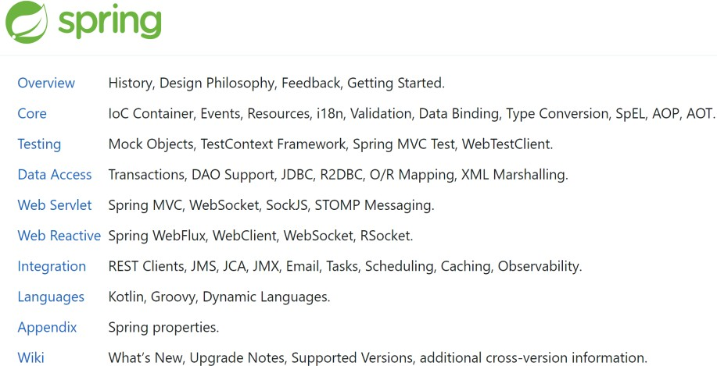
Spring Framework components
https://docs.spring.io/spring-framework/docs/6.0.6/reference/html/
6

Slide 7
Spring Framework Core
Is the core of the Spring ecosystem.
Based on it, other projects are developed.
Foremost amongst these is the Spring Framework’s
Inversion of Control (IoC) container.
7

Slide 8
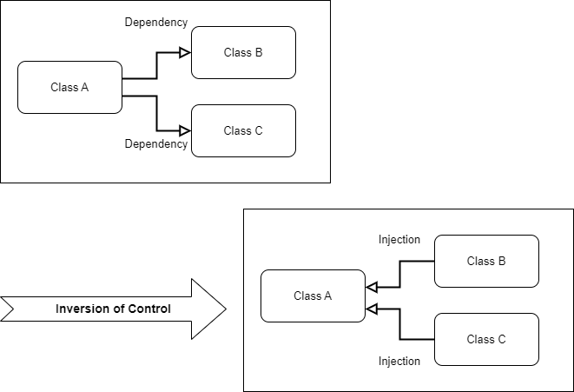
Inversion of Control (IoC)
8

Slide 9
Dependency injection (DI)
Dependency Inject is a technique (a design pattern) that removes hard-code dependencies and makes your application easier to extend and maintain.
9

Slide 10
Without DI
package vvh.ioc.example; public class Car {
package vvh.ioc.example;
Tightly-coupled
private ICEngine engine;
public class ICEngine {
private float cylinder_capacity; private String type;
public void start(){ engine =new Engine(); engine.start();
}
public void start() {
System.out.println("Engine is started");
}
}
}
What will happen when the Engine class is changed?
package vvh.ioc.example;
public class ICEngine {
private float cylinder_capacity; private String type;
public ICEngine(float cylinder_capacity, String type) { this.cylinder_capacity = cylinder_capacity; this.type = type;
}
public void start() {
System.out.println("Engine is started");
}
}
package vvh.ioc.example;
public class MyApp {
public static void main(String[] args) { Car c =new Car();
c.start();
}
}
10

Slide 11
With DI
package vvh.ioc.example; public class ICEngine {
private float cylinder_capacity;
private String type;
public void start() { System.out.println("Engine is started");
}
}
package vvh.ioc.example; public class Car {
private ICEngine engine;
public Car(ICEngine engine) {
this.engine = engine;
}
public void start(){ engine.start();
}
}
package vvh.ioc.example;
public class MyApp {
public static void main(String[] args) { ICEngine engine = new ICEngine(); Car c =new Car(engine);
c.start();
}
}
Inject Engine object to Car class
Changes to the Engine class will not affect to Car class.
What will happen when we have another engine type? (E.g., Hybrid Engine, Electricity Engine, ...)
11

Slide 12
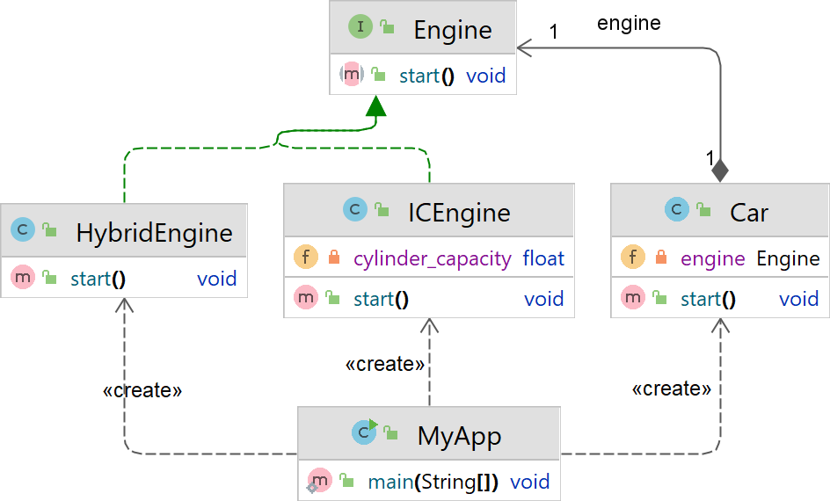
Example
12

Slide 13
Injection Types
Constructor Injection
Property Injection
Method Injection
13

Slide 14
The Spring’s IOC Container
Remind: IoC is also known as dependency injection (DI) - a process whereby objects define their dependencies through constructor arguments, arguments to a factory method, or properties.
The org.springframework.beans
and org.springframework.context packages are the
basis for Spring Framework’s IoC container.
The BeanFactory object provides the configuration framework and basic functionality, and the ApplicationContext object adds more enterprise- specific functionality.
14

Slide 15
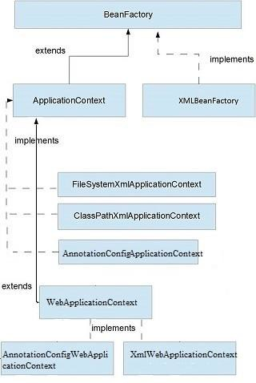
The Spring’s IOC Container
In Spring, the objects that form the backbone of your application and that are managed by the Spring IoC container are called beans.
A bean is an object that is instantiated, assembled, and managed by a Spring IoC container.
Beans, and the dependencies among them, are reflected in the configuration metadata used by a container.
15

Slide 16
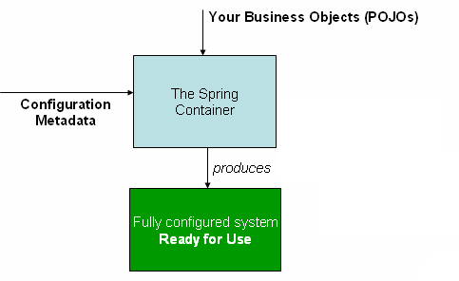
The Spring’s IoC container
The primary job of the ApplicationContext is to manage beans.
16

Slide 17
Spring Bean
In Spring, a bean is an object that the Spring
container instantiates, assembles, and manages.
Any Java POJO class can be a Spring Bean if configured and initialized through the container by providing configuration information.
We should define beans for service layer objects, data access objects (DAOs), presentation objects, infrastructure objects such as Hibernate SessionFactories, JMS Queues, and so forth.
17

Slide 18
Spring Bean Scope
Singleton: (default) Only one instance of the bean will be created per container. This is the default scope for spring bean.
Prototype: An instance of the bean will be created for each request.
WEB-CONTEXT
Request: same as prototype scope, but for web application, an instance of bean will be created for each HTTP request.
Session: Each bean instance will be created for each HTTP Session
Global-Session: Used to create global session beans for
Portlet applications.
18

Slide 19
Configuring Beans in the Container
The primary job of the ApplicationContext is to manage beans ➔ application must provide the bean configuration to the ApplicationContext
container.
Type of configurations:
XML-Based Configuration
Java-Based Configuration
Annotation-Based Configuration
Gradle
implementation 'org.springframework:spring-context:6.0.6'
<dependency>
<groupId>org.springframework</groupId>
<artifactId>spring-context</artifactId>
<version>6.0.6</version>
</dependency>
Maven
19

Slide 20
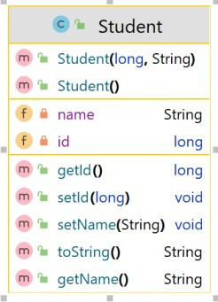
Configuring Beans in the Container
XML-Based Configuration
<?xml version="1.0" encoding="UTF-8"?>
<beans xmlns="http://www.springframework.org/schema/beans" xmlns:xsi="http://www.w3.org/2001/XMLSchema-instance"
xsi:schemaLocation="http://www.springframework.org/schema/ beans http://www.springframework.org/schema/beans/spring-
beans.xsd">
Beans.xml
<bean id="st1" class="org.example.Student">
<property name="id" value="001"/>
<property name="name" value="than thi det"/>
</bean>
import org.springframework.context.ApplicationContext;
</beans> import org.springframework.context.support.ClassPathXmlApplicationContext; public class Main {
public static void main(String[] args) {
ApplicationContext context = new ClassPathXmlApplicationContext("beans.xml"); Student st1 = context.getBean("st1", Student.class);
System.out.println(st1);
}
}
20

Slide 21
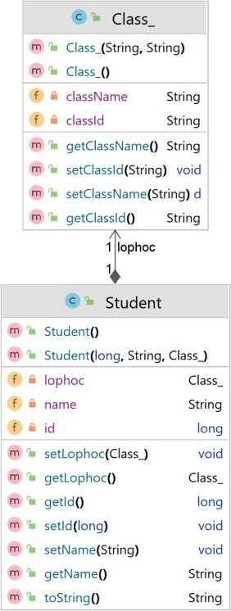
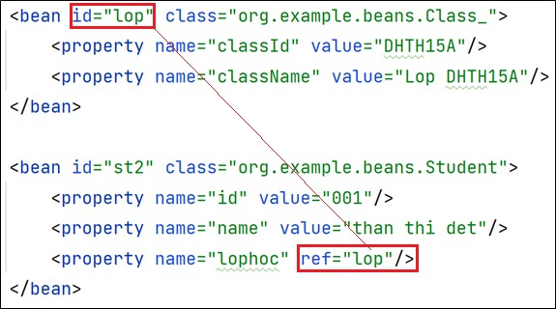
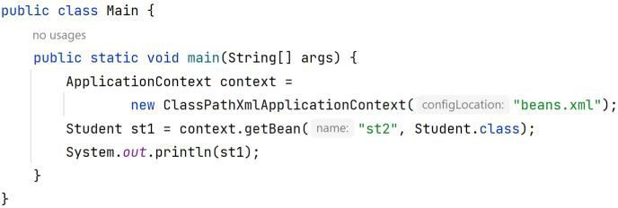
Object Injection
21

Slide 22
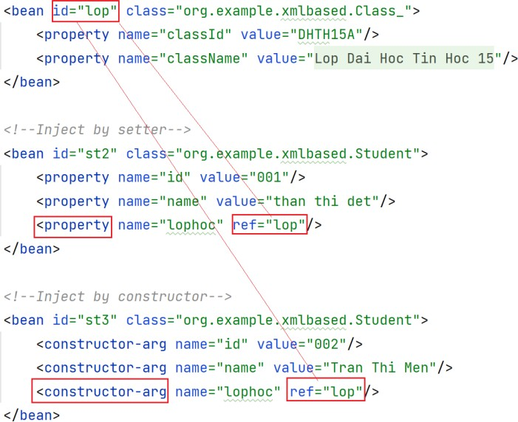
Object Injection (cont.)
22

Slide 23
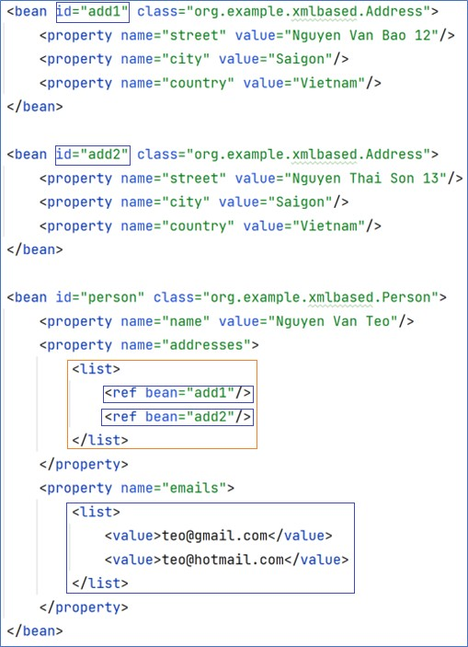
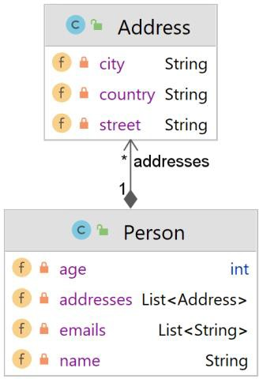
Collection Injection
23

Slide 24
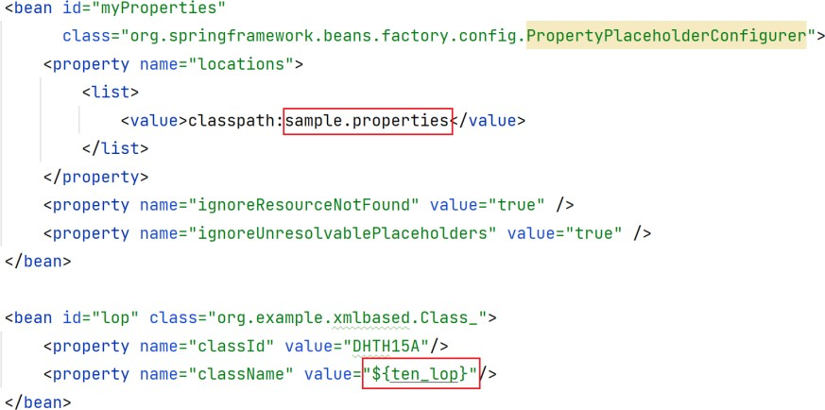
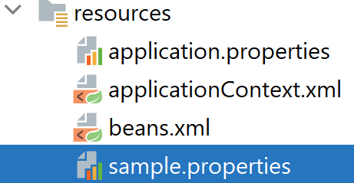

Literal Values Injection
24

Slide 25
Spring’s Auto-wiring
Autowiring feature of spring framework enables you to inject the
object dependency implicitly. It internally uses setter or constructor injection.
Autowiring can't be used to inject primitive and string values. It works with reference only.
No. | Mode | Description
1 | no | The default autowiring mode. It means no auto-wiring by default.
2 | byName | The byName mode injects the object dependency according to name of the bean. In such case, property name and bean name must be same. It internally calls setter method.
3 | byType | The byType mode injects the object dependency according to type. So property name and bean name can be different. It internally calls setter method.
4 | constructor | The constructor mode injects the dependency by calling the constructor of the class. It calls the constructor having large number of parameters.
5 | autodetect | deprecated since Spring 3.
Table: Autowiring Modes
25

Slide 26
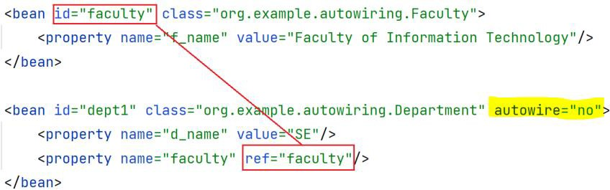
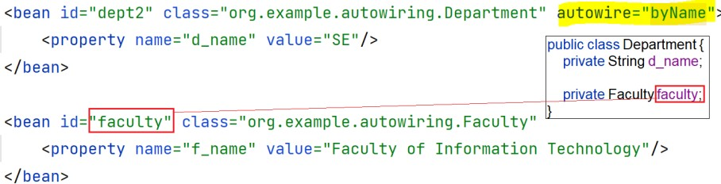
Spring’s Auto-wiring
explicit
can be omitted
Find bean with the id “faculty”
26

Slide 27
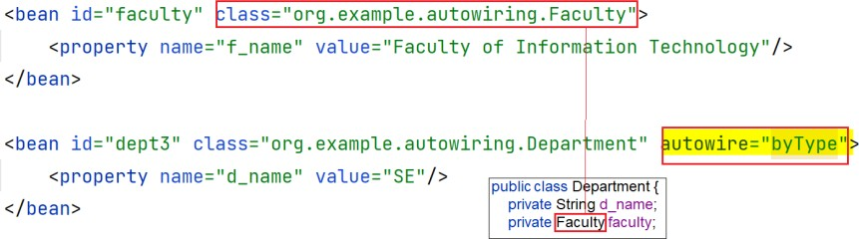
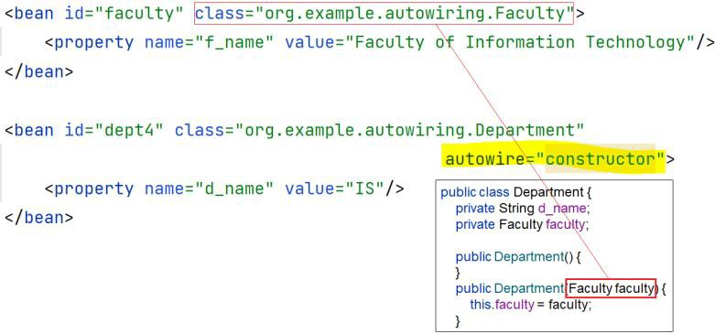
Spring’s Auto-wiring
Find bean with the type “Faculty”
Find bean with the type “Faculty”
27

Slide 28
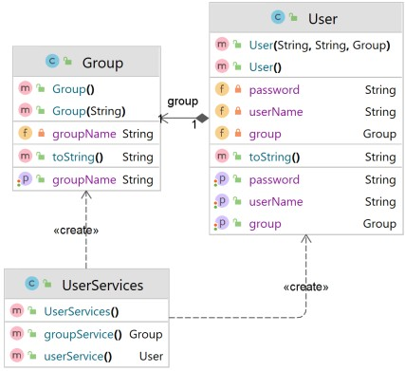
Configuring Beans in the Container
Java-Based Configuration
import org.springframework.context.annotation.Bean;
import org.springframework.context.annotation.Configuration;
@Configuration
public class UserServices { @Bean
public Group groupService() {
return new Group("Admin Group");
}
@Bean
public User userService() {
return new User("teo", "123", groupService());
}
}
import org.springframework.context.ApplicationContext;
import org.springframework.context.annotation.AnnotationConfigApplicationContext; public class Main {
public static void main(String[] args) { ApplicationContext ctx =
new AnnotationConfigApplicationContext(UserServices.class); User u = ctx.getBean(User.class);
System.out.println(u);
}
}
28

Slide 29
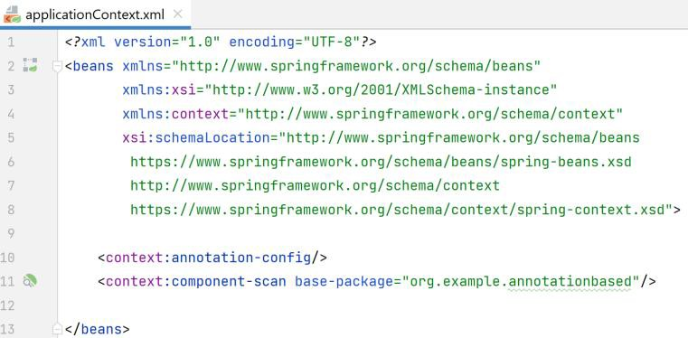
Configuring Beans in the Container
Annotation-Based Configuration
<context:annotation-config/> only looks for annotations on beans in the same application context in which it is defined.
You can also use @Configuration annotation with the same purpose
@Configuration @ComponentScan(“your.package") public class AppConfig {
//no-op
}
29

Slide 30
The @Autowired annotation
The @Autowired annotation allows Spring to resolve and inject collaborating beans into another bean.
30

Slide 31
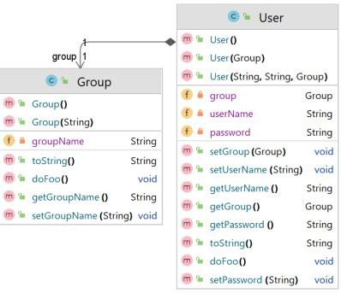
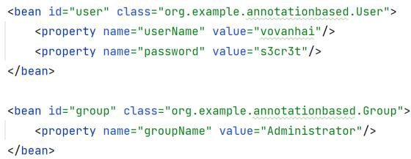
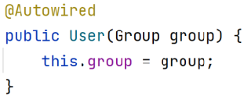
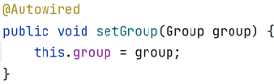

@Autowired xml config
Field
Setter
Constructor
public static void main(String[] args) { ApplicationContext ctx =
new ClassPathXmlApplicationContext("applicationContext.xml"); User us = (User) ctx.getBean("user");
us.doFoo(); System.out.println(us);
}
31

Slide 32
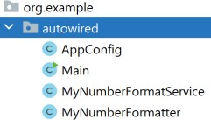
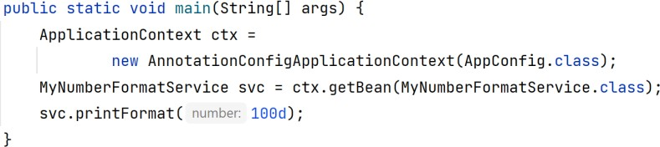
@Autowired Java-based config
@Component
public class MyNumberFormatter { public String format(double number) {
return "My Number Format - " + number;
}
}
@Configuration @ComponentScan("org.example.autowired") public class AppConfig {
//no-op
}
@Component
public class MyNumberFormatService {
private final MyNumberFormatter myNumberFormatter;
//@Autowired - not required. SpringFX is smart enough to have known.
public MyNumberFormatService(MyNumberFormatter myNumberFormatter) { this.myNumberFormatter = myNumberFormatter;
}
public void printFormat(double number) { System.out.println(myNumberFormatter.format(number));
}
}
32

Slide 33
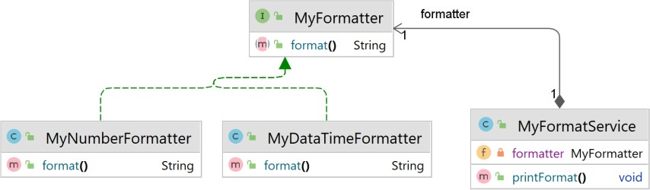
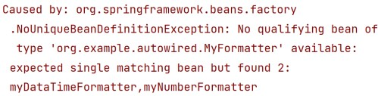
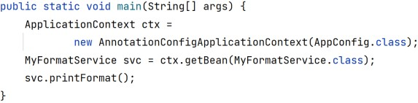
@Autowire Disambiguation
@Component
public class MyFormatService {
Error
private MyFormatter formatter;
public MyFormatService(MyFormatter formatter) { this.formatter = formatter;
}
public void printFormat() { System.out.println(formatter.format());
}
}
33

Slide 34
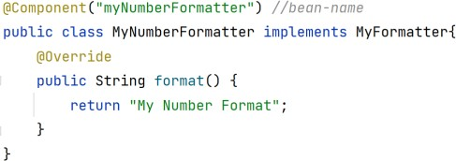
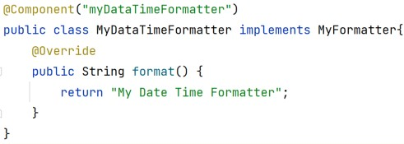
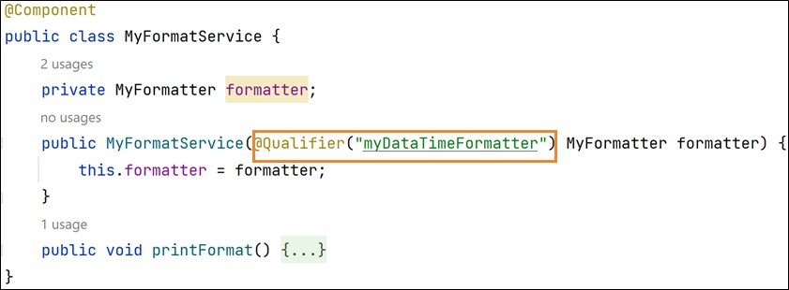
Disambiguation solution: @Qualifier
When there are multiple beans of the same type ➔ use @Qualifier to avoid ambiguity. Spring uses the bean's name as a default qualifier value.
34

Slide 35
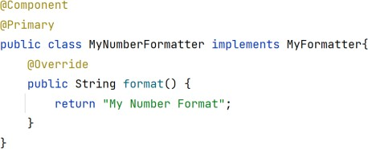
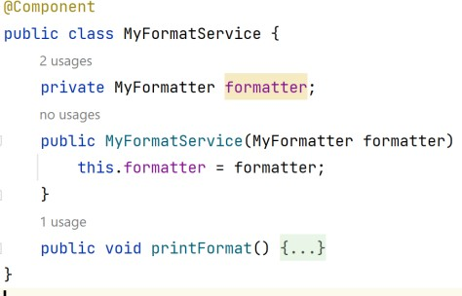
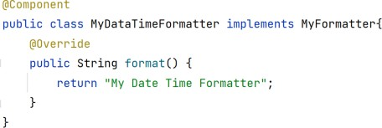
Disambiguation solution: @Primary
@Primary indicates that a particular bean should be given preference when multiple beans are candidates to be autowired to a single-valued dependency.
Automatically select MyNumberFormater class
35

Slide 36

Inject resources with @Value
@Configuration @ComponentScan("org.example.resources") @PropertySource("classpath:application.properties") public class AppConfig {
@Bean
public ClientBean clientBean() { return new ClientBean();
}
}
public class ClientBean { @Value("classpath:beans.xml") private Resource myResource;
@Value("${foo.permission}") private String permission;
public void doSomething() throws IOException { File file = myResource.getFile();
String s = new
String(Files.readAllBytes(file.toPath())); System.out.println(s); System.out.println(permission);
}
}
@Configuration @ComponentScan("org.example.resources") @PropertySource("classpath:application.properties") public class AppConfig {
@Bean
public ClientBean clientBean() { return new ClientBean();
}
}
public class Main {
public static void main(String[] args) throws IOException { AnnotationConfigApplicationContext context =
new
AnnotationConfigApplicationContext(AppConfig.class); ClientBean bean = context.getBean(ClientBean.class); bean.doSomething();
}
}
37

Slide 37



38

