Slide 1
Spring Data
By Vo Van Hai
vovanhai@iuh.edu.vn
1
1

Slide 2
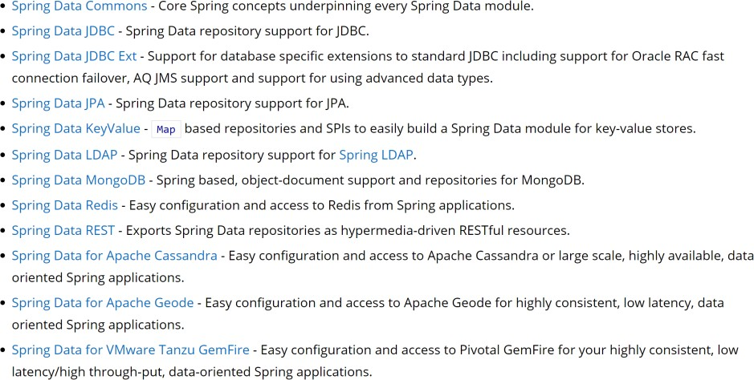
Spring Data - Main modules
https://spring.io/projects/spring-data
2
2

Slide 3
Spring Data Commons
Spring Data Commons is part of the umbrella Spring Data project that provides shared infrastructure across the Spring Data projects. It contains technology neutral repository interfaces as well as a metadata model for persisting Java classes.
Primary goals are:
Powerful Repository and custom object-mapping abstractions
Support for cross-store persistence
Dynamic query generation from query method names
Implementation domain base classes providing properties
Support for transparent auditing (created, last changed)
Possibility to integrate custom repository code
Easy Spring integration with custom namespace
basic
3
3

Slide 4
Accessing data with “pure” JDBC
The Spring Framework provides extensive support for working with SQL databases, from direct JDBC access.
Java’s javax.sql.DataSource interface provides a standard method of working with database
connections.
Use other objects for execute SQL command:
Connection
Statement/PreparedStatement
ResultSet
…
4
4

Slide 5
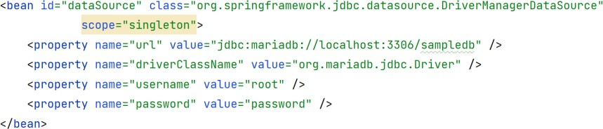
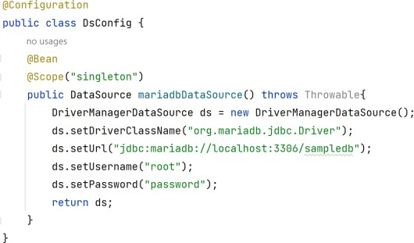
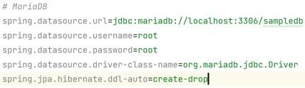
Configure a Data Source
= ClassPathXmlApplicationContext("dbConfig.xml");
= new AnnotationConfigApplicationContext(DsConfig.class);
5
5

Slide 6
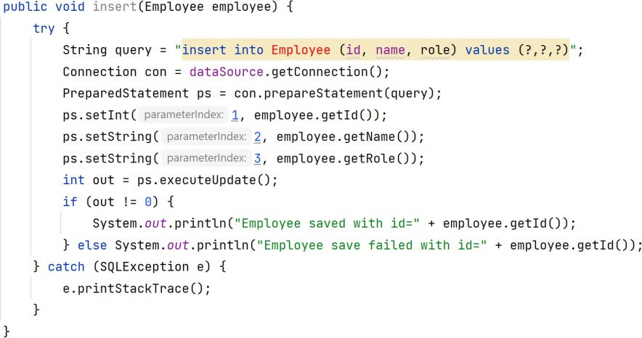
Execute SQL command
The old way with JDBC objects:
6
6

Slide 7
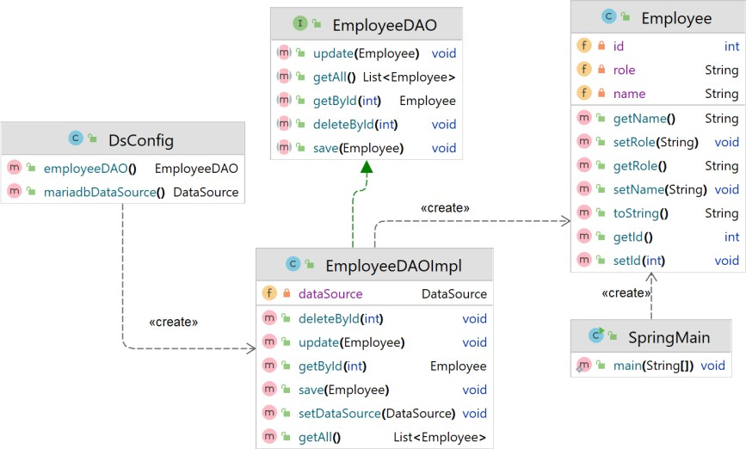
Example
7
7

Slide 8
Using JdbcTemplate
This is the central class in the JDBC core package.
It simplifies the use of JDBC and helps to avoid common errors.
It executes core JDBC workflow, leaving application code to provide SQL and extract results.
It executes SQL queries or updates, initiating iteration over ResultSets and catching JDBC exceptions and translating them to the generic, more informative exception hierarchy defined in the org.springframework.dao package.
8
8

Slide 9
Using JdbcTemplate
Spring’s JdbcTemplate class is auto-configured, and you
can @Autowire them directly into your own beans.
In case of using named parameter, you should use the NamedParameterJdbcTemplate class
public class StudentJDBCTemplate implements StudentDAO {
private DataSource dataSource;
private JdbcTemplate jdbcTemplateObject; @Autowired
public void setDataSource(DataSource dataSource) { this.dataSource = dataSource;
this.jdbcTemplateObject = new JdbcTemplate(dataSource);
}
public void create(String name, Integer age) {
String SQL = "insert into Student (name, age) values (?, ?)"; jdbcTemplateObject.update( SQL, name, age); System.out.println("Created Record Name = " + name + " Age = " + age); return;
}
9
9

Slide 10
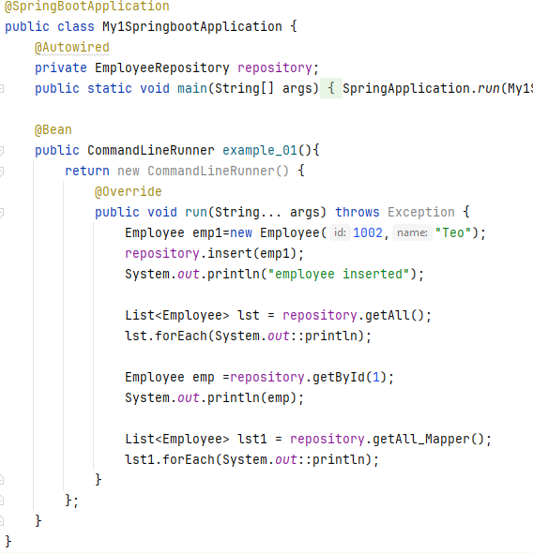
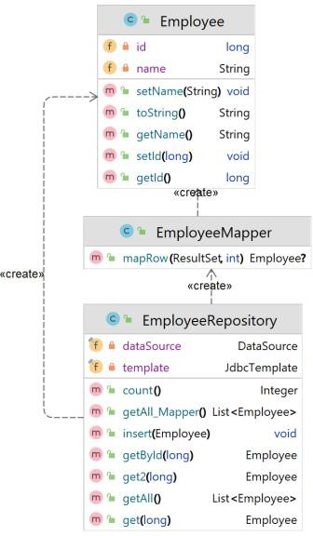
Example
10
10

Slide 11
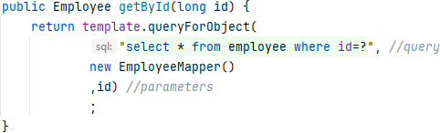
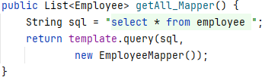
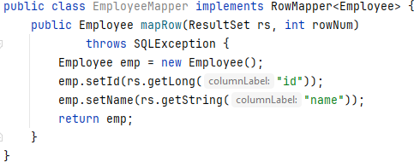
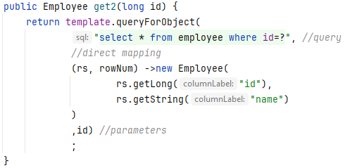
Query row(s) with Rows Mapper
Use RowMapper object for mapping one row of the ResultSet to specific object.
Direct mapping
Mapper class
11
11

Slide 12
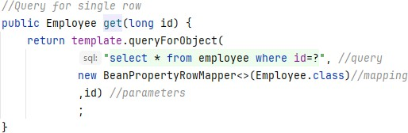
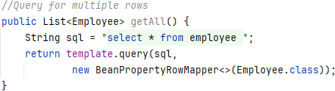
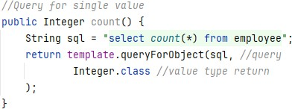
Query with BeanPropertyMapper
Using BeanPropertyMapper object will save you a lot of time.
12
12

Slide 13
Introduction
Spring Data JPA is used to reduce the amount of boilerplate code required to implement the data access object (DAO) layer.
Spring Data JPA is not a JPA provider. It is a library / framework that adds an extra layer of abstraction on the top of our JPA provider. If we decide to use Spring Data JPA, the repository layer of our application contains three layers that are described in the following figure :
13
13

Slide 14
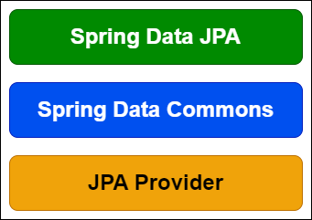
Spring Data JPA components
Spring Data JPA :- It provides
support repositories
for creating JPA by extending the
Spring Data repository interfaces.
Spring Data Commons :- It provides the infrastructure that is shared by the datastore specific Spring Data projects.
JPA Provider :- The JPA Provider implements the Java Persistence API.
14
14

Slide 15
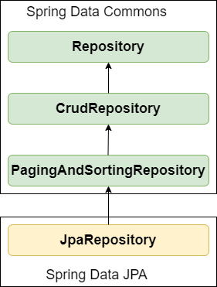
Spring Data Repositories Interfaces
The power of Spring Data JPA lies in the repository abstraction that is provided by the Spring Data Commons project and extended by the datastore specific sub projects.
We can use Spring Data JPA without paying any attention to the actual implementation of the repository abstraction, but we have to be familiar with the Spring Data repository interfaces. These interfaces are described in the following:
15
15

Slide 16
Spring Data Repositories
Spring Data Commons provides the following repository
interfaces:
Repository — Central repository marker interface. Captures the domain type and the ID type.
CrudRepository — Interface for generic CRUD operations on a repository for a specific type.
PagingAndSortingRepository — Extension of CrudRepository to
provide additional methods to retrieve entities using the pagination and sorting abstraction.
QuerydslPredicateExecutor — Interface to allow execution of QueryDSL Predicate instances. It is not a repository interface.
Spring Data JPA provides the following additional repository interfaces:
JpaRepository — JPA specific extension of Repository interface. It
combines all methods declared by the Spring Data Commons repository interfaces behind a single interface.
JpaSpecificationExecutor — It is not a repository interface. It allows
the execution of Specifications based on the JPA criteria API.
16
16

Slide 17
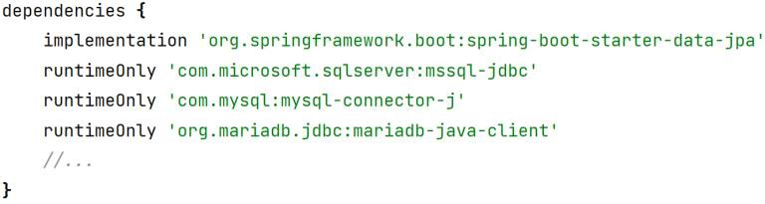
Setting up your project components
The JDBC driver provides a database specific implementation of the JDBC API. (MS SQLServer, MySQL, MariaDB,…)
The JPA Provider implements the Java Persistence API.
Hibernate (default JPA implementation provider)
EclipseLink (you need config yourself)
Spring Data JPA hides the used JPA provider behind its repository abstraction.
17
17

Slide 18
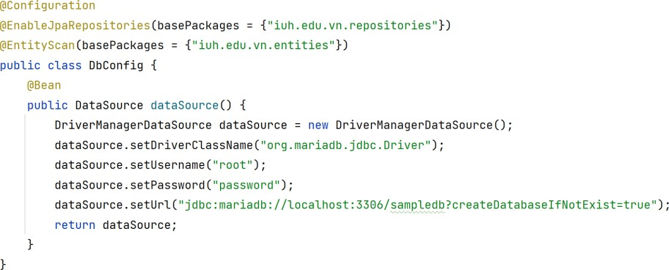
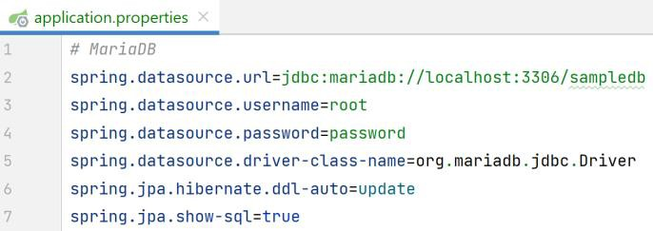

Configure the DataSource
18
18

Slide 19
Entities
Use @Entity for entity
Use @Table if you want to customize your table
Should have @Id for the primary-key.
Use @Column for customize the column
And other annotation if needed
@OnetoMany
@ManytoOne
@OneToOne
…
19
19

Slide 20
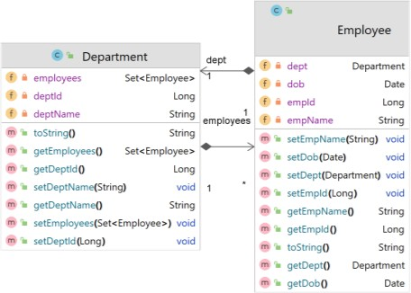
Entity sample
@Entity
public class Department { @Id
@GeneratedValue(strategy = GenerationType.AUTO) private Long deptId;
@Column(unique = true, nullable = false, length = 150) private String deptName;
@OneToMany(mappedBy = "dept",
cascade = CascadeType.ALL, fetch = FetchType.EAGER) private Set<Employee> employees
…
}
@Entity
public class Employee {
@Id @GeneratedValue(strategy = GenerationType.AUTO)
private Long empId; private String empName; private Date dob;
@ManyToOne(fetch = FetchType.LAZY) private Department dept;
…
20
20

Slide 21
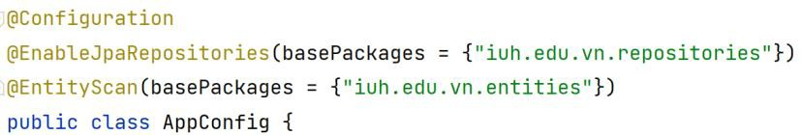
Repositories
Use repository for:
Persist, update and remove one or multiple entities.
Find one or more entities by their primary keys.
Count, get, and remove all entities.
Check if an entity exists with a given primary key.
…
You do not need to write a boilerplate code for CRUD methods.
You should specific pakages where container finding the repositories.
2
1
21

Slide 22
Repositories – Query creation
Auto-Generated Queries: Spring Data JPA can auto- generate database queries based on method names.
Auto-generated queries may not be well-suited for complex use cases. But for simple scenarios, these queries are valuable.
Parsing query method names is divided into subject and predicate.
The first part (find…By…, exists…By…) defines the subject of the query,
The second part forms the predicate
Distinct, And, Or, Between, LessThan, GreaterThan,
IgnoreCase, OrderBy (with Asc, Desc)
Like,
22
22

Slide 23
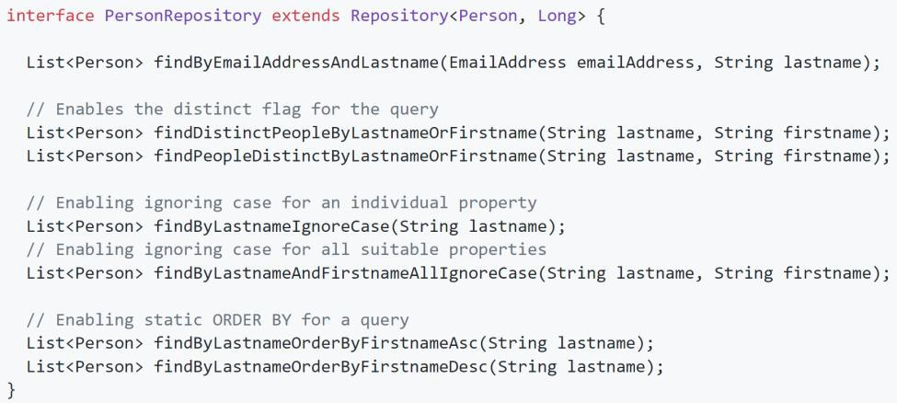
Repositories – Query creation
Example
More: https://docs.spring.io/spring- data/jpa/docs/current/reference/html/#repositories.query-methods.query-creation 23
23

Slide 24

Queries
JPQL
By default, the query definition uses JPQL.
Native
Updatable Queries
@Modifying
@Query("update Employee u set u.status = :status where u.empId = :id") int updateEmployeeStatusForName(@Param("status") Integer status,
@Param("id") Long empId);
24
24

Slide 25
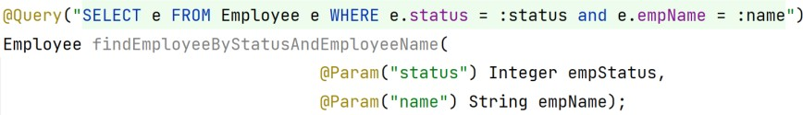
Query Parameters (1)
Indexed Query Parameters
Spring Data will pass method parameters to the query in the same order they appear in the method declaration
@Query("SELECT e FROM Employee e WHERE e.status = ?1") List<Employee> findEmployeeByStatus(Integer status);
@Query("SELECT e FROM Employee e WHERE e.status = ?1 and e.empName = ?2") List<Employee> findEmployeeByStatusAndName(Integer status, String name);
Named Parameters
Each parameter annotated with @Param must have a value string matching the corresponding JPQL or SQL query parameter name.
26
26

Slide 26
Query Parameters (2)
Collection Parameter
Use in the case when the where clause of our JPQL or SQL query contains the IN (or NOT IN) keyword:
Repository @Query(value = "SELECT e FROM Employee e WHERE e.empName IN :names") List<Employee> findEmployeeByNameList( @Param("names") Collection<String> names);
Service public List<Employee> findEmployeeByNameList(Collection<String>names){ return employeeRepository.findEmployeeByNameList(names); }
Application Collection<String> names=List.of("Ty","Teo","Men"); List<Employee> lst = employeeServices.findEmployeeByNameList(names); lst.stream().iterator().forEachRemaining(employee -> { System.out.println("------------------- "+ employee.getEmpName()); }); 27
27

Slide 27
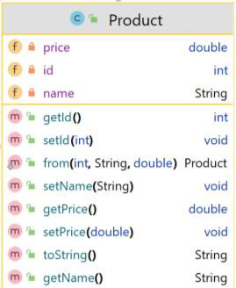
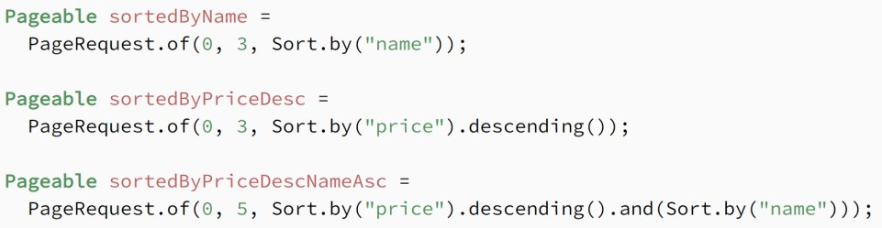
Queries – Pagination and Sorting
Pagination is often helpful when we have a large dataset, and we want to present it to the user in smaller chunks.
Also, we often need to sort that data by some criteria while paging.
import org.springframework.data.domain.Pageable;
//…
public interface ProductRepository extends PagingAndSortingRepository<Product, Integer> {
List<Product> findAllByPrice(double price, Pageable pageable);
}
28
28

Slide 28
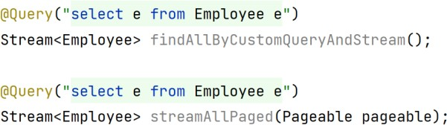
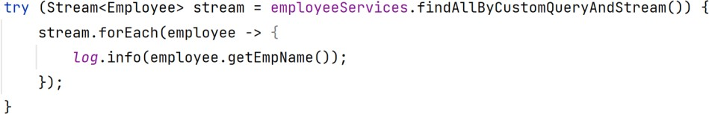
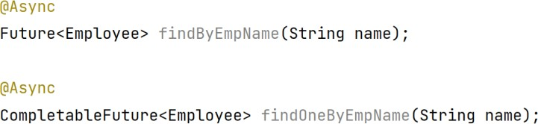
Streaming Query Results
Asynchronous Query Results
29
29

Slide 29
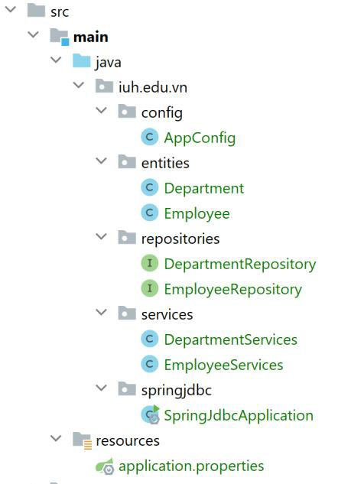
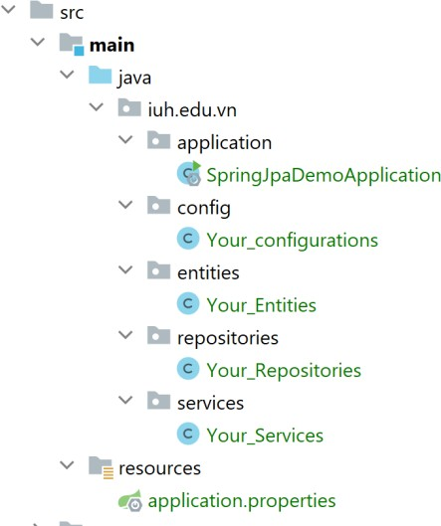
Demo: Directories structures
entities/models/domains
30
30

Slide 30
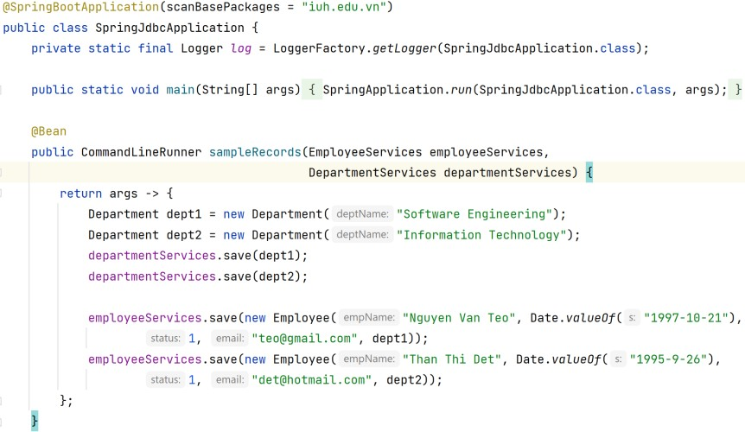
Test application
31
31

Slide 31
MongoDB Model Implementation
MongoDB and Spring Boot can be interacted by using the MongoTemplate class and MongoRepository interface.
MongoTemplate — MongoTemplate implements a set of ready-to-use APIs. A good choice for operations like update, aggregations, and others, MongoTemplate offers finer control over custom queries.
MongoRepository — MongoRepository is used for basic queries that involve all or many fields of the document. Examples include data creation, viewing documents, and more.
implementation 'org.springframework.boot:spring-boot-starter-data-mongodb'
36
36

Slide 32
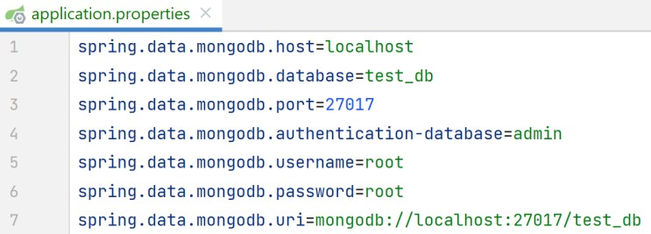
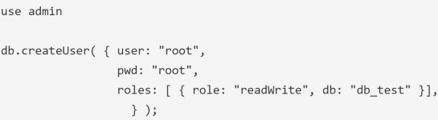
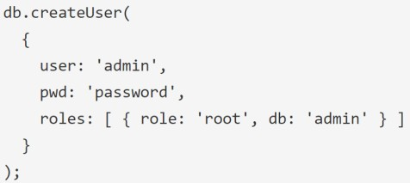
Connect Server
create user ig you did not have one
37
37

Slide 33
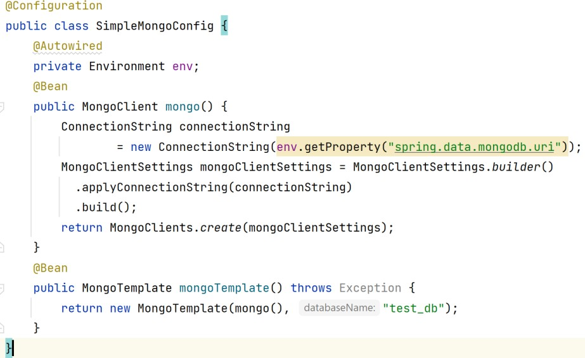
Connect Server -simple
38
38

Slide 34
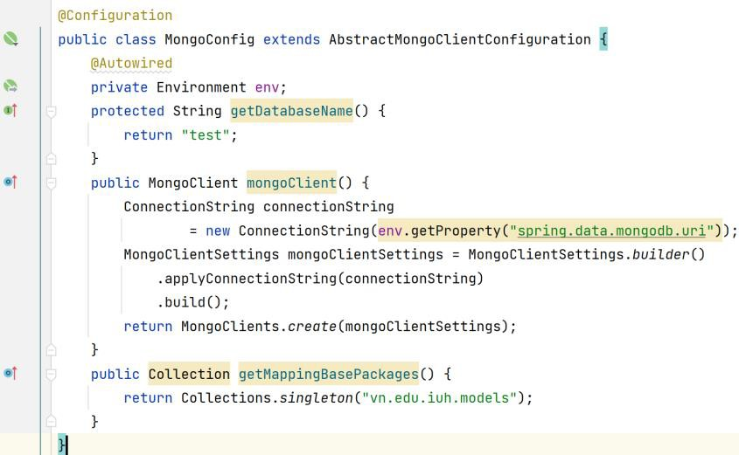
Connect Server – abstract config
39
39

Slide 35
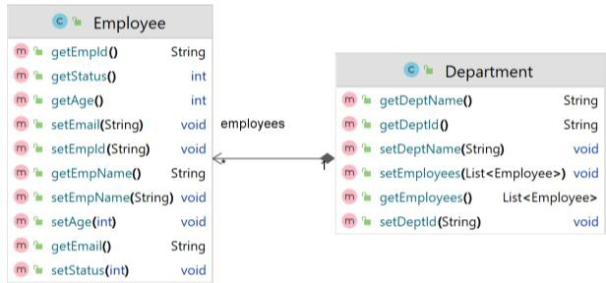
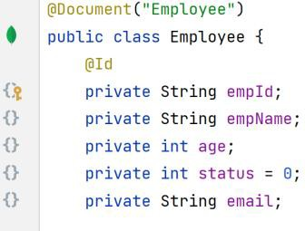
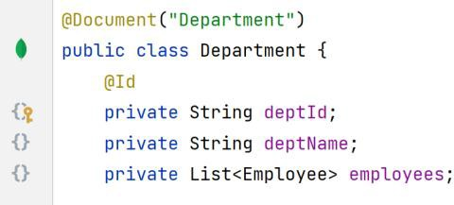
Entities Documentation
40
40

Slide 36
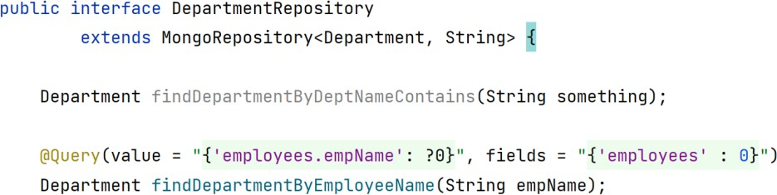
Repositories
Repositories in our application should extends
the MongoRepository<T, ID> interface.
MongoRepository<T, ID> provides most CRUD operators.
We also define more queries using spring naming- method or using @Query annotaion
41
41

Slide 37
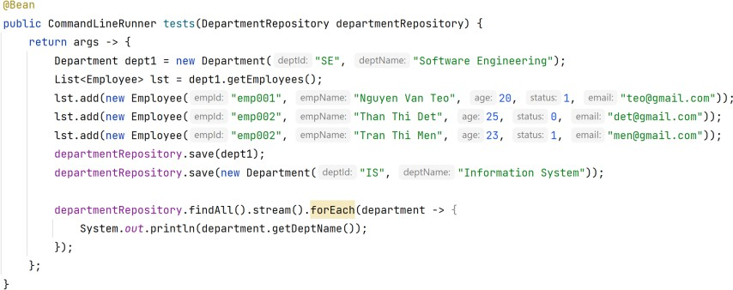
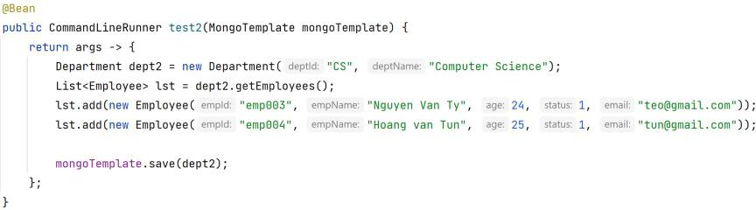
Operations
Using Repository
Using MongoTemplate
4
2
42

Slide 38
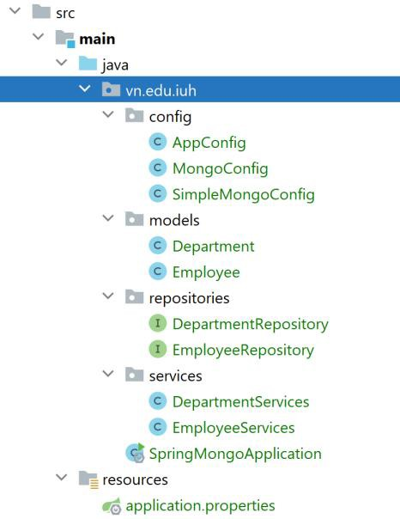
Example structure
43
43

Slide 39








REST introduction
REpresentational State Transfer(REST) is lightweight
approach for communicating between applications.
REST APIs enable you to develop all kinds of web applications having all possible CRUD (Create, Retrieve, Update, Delete) operations.
Characteristics:
Language independent
Platform independent
Can use any data format (XML and JSON are common).
REST API
REST
Web Services
REST Services
RESTful API
RESTful Web Services
RESTful Services
44
44

Slide 40
REST over HTTP
https://www.w3.org/Protocols/rfc2616/rfc261
6.txt
REST uses HTTP methods for communication.
HTTP methods: GET, POST, PUT, PATCH, DELETE, HEAD, OPTIONS, TRACE, CONNECT.
REST methods: POST, GET, PUT, PATCH, DELETE.
Methods | Operation
GET | Returns a representational view of a resource's contents and data.
POST | Primarily operates on resource collections.
PUT | Updates a resource by replacing its content entirely. It's possible to create a resource with a PUT method (careful: creating resource without intention.)
PATCH | Only modifies resource contents. Attention to applying PATCH methods to a whole resource collection.
DELETE | When a DELETE method targets a single resource, that resource is removed entirely. (Avoid using the DELETE method in a resource collection) ₄₅
45

Slide 41
REST methods summary
 | HTTP Method | CRUD | Collection Resource (e.g. /users) | Single Resouce (e.g. /users/123)
 | POST | Create | 201 (Created), ‘Location’ header with | Avoid using POST on a
 |  |  | link to /users/{id} containing new ID | single resource
 | GET | Read | 200 (OK), list of users. Use pagination, | 200 (OK), single user. 404
 |  |  | sorting, and filtering to navigate big | (Not Found), if ID not found
 |  |  | lists | or invalid
 | PUT | Update/Replace | 405 (Method not allowed), unless you | 200 (OK) or 204 (No
 |  |  | want to update every resource in the | Content). Use 404 (Not
 |  |  | entire collection of resource | Found), if ID is not found or
 |  |  |  | invalid
 | PATCH | Partial | 405 (Method not allowed), unless you | 200 (OK) or 204 (No
 |  | Update/Modify | want to modify the collection itself | Content). Use 404 (Not
 |  |  |  | Found), if ID is not found or
 |  |  |  | invalid
 | DELETE | Delete | 405 (Method not allowed), unless you | 200 (OK). 404 (Not Found),
 |  |  | want to delete the whole collection — | if ID not fou
use with caution 46
46

Slide 42
Response status
HTTP response status codes indicate whether a specific HTTP request has been successfully completed.
Responses are grouped in five classes:
Code range | Meaning
100-199 | Informational responses
200-299 | Successful responses
300-399 | Redirection message
400-499 | Client error responses
500-599 | Server error responses
https://developer.mozilla.org/en-US/docs/Web/HTTP/Status
47
47

Slide 43
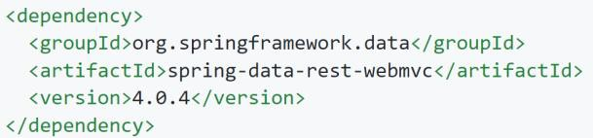
Spring Data REST -Introduction
Spring Data REST is itself a Spring MVC application
and is designed in such a way that it
Spring
should
MVC
integrate with your existing
applications with little effort.
Dependencies
Gradle
Maven
https://docs.spring.io/spring-data/rest/docs/current/reference/html/#reference
48
48

Slide 44
Basic Settings for Spring Data REST
Basic Settings:
Setting the Repository Detection Strategy
Changing the Base URI
Changing Other Spring Data REST Properties
49
49

Slide 45
#1. Setting the Repository Detection Strategy
Spring Data REST uses a implementation of the RepositoryDetectionStrategy interface to determine whether a repository is exported as a REST resource.
The RepositoryDiscoveryStrategies inside this interface enumeration includes the following values:
Name | Description
DEFAULT | Exposes all public repository interfaces but considers the exported flag of @(Repository)RestResource.
ALL | Exposes all repositories independently of type visibility and annotations.
ANNOTATED | Only repositories annotated with @(Repository)RestResource are exposed, unless their exported flag is set to false.
VISIBILITY | Only public repositories annotated are exposed.
Table: Repository detection strategies
50
50

Slide 46
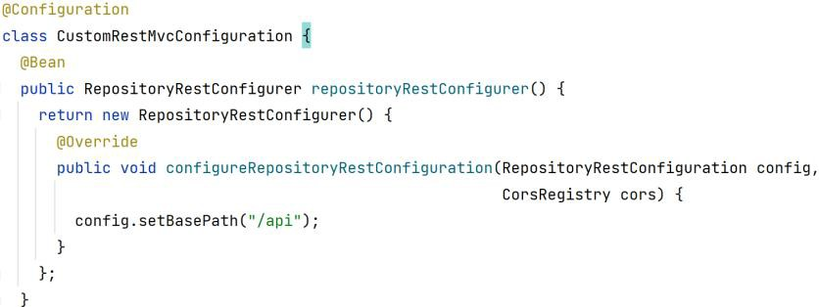
#2. Changing the Base URI
By default, Spring Data REST serves up REST
resources at the root URI, '/’. It’s harmful.
Change the base(root) path by:
Application.properties file: add
spring.data.rest.basePath=/api
Configuration
the instructions:
51
51

Slide 47
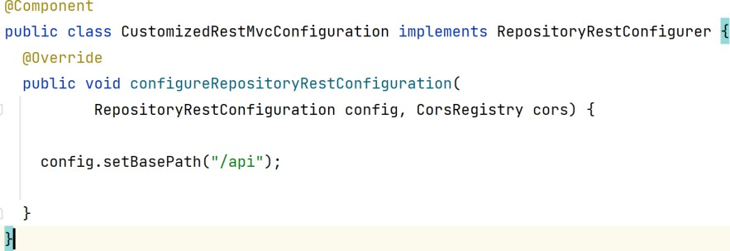
#2. Changing the Base URI
Change the base(root) path by:
3. Implement the RepositoryRestConfigurer interafce
52
52

Slide 48
#3. Changing Other Spring Data REST
Properties
Property | Description
basePath | the root URI for Spring Data REST
defaultPageSize | change the default for the number of items served in a single page
maxPageSize | change the maximum number of items in a single page
pageParamName | change the name of the query parameter for selecting pages
limitParamName | change the name of the query parameter for the number of items to show in a page
sortParamName | change the name of the query parameter for sorting
defaultMediaType | change the default media type to use when none is specified
returnBodyOnCrea te | change whether a body should be returned when creating a new entity
returnBodyOnUpd ate | change whether a body should be returned when updating an entity
53
53

Slide 49
Repository resources
Fundamentals
The core functionality of Spring Data REST is to export resources for Spring Data repositories. Thus, the core artifact to look at and potentially customize the way the exporting works is the repository interface.
public interface DepartmentRepository extends JpaRepository<Department, Long> {
For this repository, Spring Data REST exposes a collection resource at /departments
Repository methods exposure
The resource exposure will follow which methods you have exposed on the repository ➔ all HTTP resources we can register by default.
Use @RestResource(exported = false) annotation to limit
the exposure
54
54

Slide 50
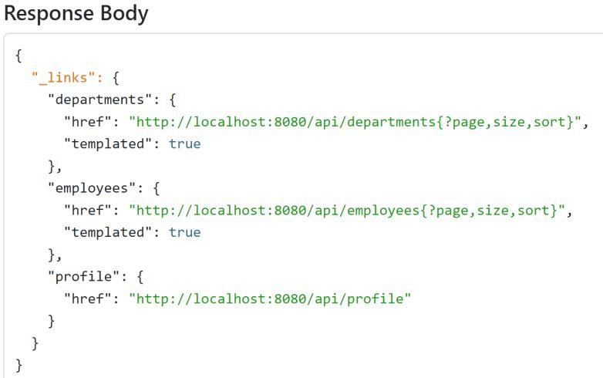
Repository resources (cont)
Resource Discoverability
http://localhost:8080/api
55
55

Slide 51
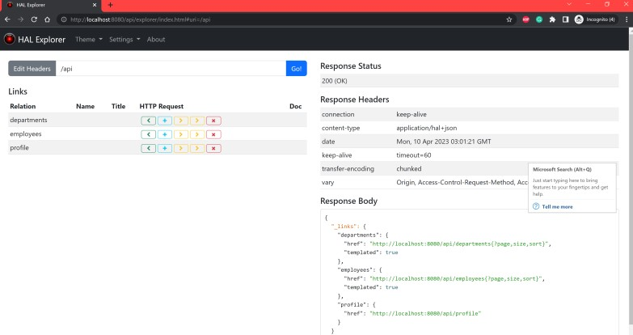
Tools
Postman
CURL
The HAL Explorer
implementation 'org.springframework.data:spring- data-rest-hal-explorer'
56
56

Slide 52
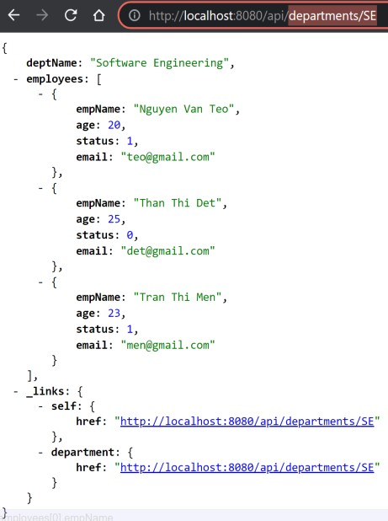
Accessing path
/api/collections_name/{id}
/api/collections_name/{id}/attribute
/api/collections_name/?name=value
57
57

Slide 53
The Collection Resources
Parameters
If the repository has pagination capabilities, the resource takes the following parameters:
page: The page number to access (0 indexed, defaults to 0).
size: The page size requested (defaults to 20).
sort: A collection of sort
($propertyname,)+[asc|desc]?.
Supported Media Types
application/hal+json
application/json
directives in the format
58
58

Slide 54


Whitelabel Error Page
Disable using properties file
server.error.whitelabel.enabled=false
Or suing annotation
@EnableAutoConfiguration(exclude
{ErrorMvcAutoConfiguration.class})
=
Other fixings: (study later)
59
59

Slide 55
Transaction
Global Transactions
Global transactions let you work with multiple transactional resources, typically relational databases and message queues. The application server manages global transactions through the JTA (Java Transaction API).
@EnableTransactionManagement
Local Transactions
Local transactions are resource-specific, such as a transaction associated with a JDBC connection.
Local transactions may be easier to use but have a significant disadvantage: They cannot work across multiple transactional resources.
@Autowired TransactionManager
60
60

Slide 56

61
61

Slide 57

62

