Slide 1

Nan San Fintech Project:
Team 3
Find Trend
Let's get the World Trend NOW!!!

Slide 2
Contents
Search the trending word to be the news title
Title news Summary for Keyword
Relatedwords from Knowledge Graph
Stock Price Trend Chat and CAPM Value

Slide 3
Search the trending word to be the news title
After selecting the most recently discussed words through Google trend, users can decide for themselves whether they want to query related news and topic summaries of popular words, or actively search for them.

Slide 4
Google Hot Words
Moses Brown
Luca
Fatherhood
Argentina vs Uruguay
Islanders
England vs Scotland
Kyrie Irving
Billy Fuccillo
Tommy John surgery
Milkha Singh
Paul McCartney
Cole Beasley
Drinking alcohol
India vs New Zealand
Grand Army
HBO Max Integration Test Email
Biden student loans
Travis Barker
College World Series
Dave Portnoy

Slide 5
Title news Summary for Keyword
Crawl specific word news for keywords, and automatically generate a summary through a summary module to output a summary that can adjust the amount of articles.

Slide 6
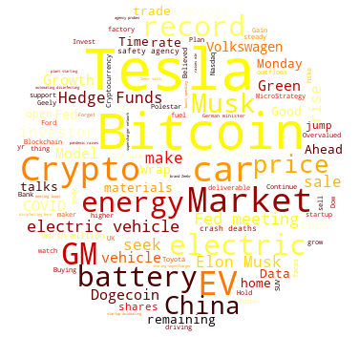
Word Cloud of【Tesla】News

Slide 7
Summary of 【Tesla】Keyword News
(TSLA) Sink or Swim Time for Tesla Tesla-Backed CureVac Plunges On Underwhelming COVID-19 Vaccine Efficacy Data Bitcoin ‘Options Smile’ Shows Market Fearful of Downside Despite Tesla News Redwood Materials is setting up shop near the Tesla Gigafactory as part of broader expansion Novavax, Tesla Rise Premarket; Lordstown Motors Slumps Win a Tesla: This Model S will hit 60 mph in 2.3 seconds Green groups seek injunction for Tesla factory permits in Germany Canoo to build its first electric vehicle factory in Oklahoma Here's Why General Motors (GM) Could be the Best Stock to Play EV Revolution Old car makers are the hot new trade: Morning Brief Online car marketplace YesAuto reveals what the family car says about dad GM And Waymo Increase The Competition In The EV and Autonomous Cars Sector 3 Electric Vehicle Stocks Poised to Gain Over the Long Term 12 Best Cryptocurrency Stocks to Invest in 2021 Today’s Market Wrap Up and a Look Ahead to Tomorrow Mercedes USA CEO: We're moving fast in the direction of EVs MicroStrategy to Sell $1B Worth of Stock to Buy Bitcoin GameStop Poised to Trade With Tech Giants in Russell 1000 Dogecoin Meme Photo Becomes Most Expensive NFT Ever Sold Mark Cuban Invests in Decentralized Data Marketplace dClimate 10 Best Growth Stocks to Buy and Hold for Several Years UPDATE 1-Bitcoin rises 9.8% to $39,035 WIMI Hologram is Facing a New Investment Opportunity of 100 Billion Yuan, Thanks to the First Year of Mass Production of LiDAR Audi E-Tron GT buyers will get three years of free DC fast charging Elon Musk to sell last remaining California home 10 Penny Stocks Robinhood Traders are Buying in 2021 Stock Futures Are Off to Positive Start Ahead of Monday’s Session NFTs Continue to Thrive, but with Improved Environmental Footprint Carnomaly Is Revolutionizing The Future Of Car Buying And Ownership Through Its New Platform Powered By Blockchain Technology Watch Ubisoft's Forward event at E3 2021 in 12 minutes 10 Major Companies That Accept Bitcoin Crypto Outflows Continue for Second Week Straight Bitcoin and other cryptos lose steam as summer lull sets in Electric auto startups hit speed bumps after heady debuts Silicon Laboratories Stock Is Believed To Be Modestly Overvalued China new energy vehicle sales to grow over 40%/yr in next 5 yearsindustry body Polestar to make electric SUV at U.S. Volvo plant, starting in 2022 Two Apple Daily executives on HK national security charge denied bail Pivotal Point Reached in Battery Electric Vehicles As "Hockey Stick" Demand Inflection Point Occurred in 2020 Toyota Sienna 2021 Biden will meet U.S. financial regulators on Monday Aptinyx Stock Is Believed To Be Significantly Overvalued GM Gains On $35 Billion EV Spending Plan, Higher Guidance Qatar foreign minister: no tangible progress on Afghanistan yet AudioCodes Stock Gives Every Indication Of Being Significantly Overvalued U.S. has administered 300 million COVID-19 shots in 150 daysWhite House official Some 16.1 mln Russians got both components of COVID-19 vaccines America's $2 Trillion Infrastructure Boom Could Send ESG Stocks Soaring Andreessen Horowitz Has Its Own Media: So Far That’s a Good Thing El Salvador Doesn’t Need a Bitcoin Mandate Do Hedge Funds Love Nuverra Environmental Solutions Inc (NES)?

Slide 8
Relatedwords from Knowledge Graph
Crawling news of specific words for keywords, and then obtaining related related words through the knowledge graph model.

Slide 9
Related Words
objection
network
jumps
could
sharing
environmental
gigafactory
Bitcoin
groups
German
Plaid
use
Stocks
Model
says
Musk
Plaid
talks
minister
supercharger
file
permit
Stock
S

Slide 10
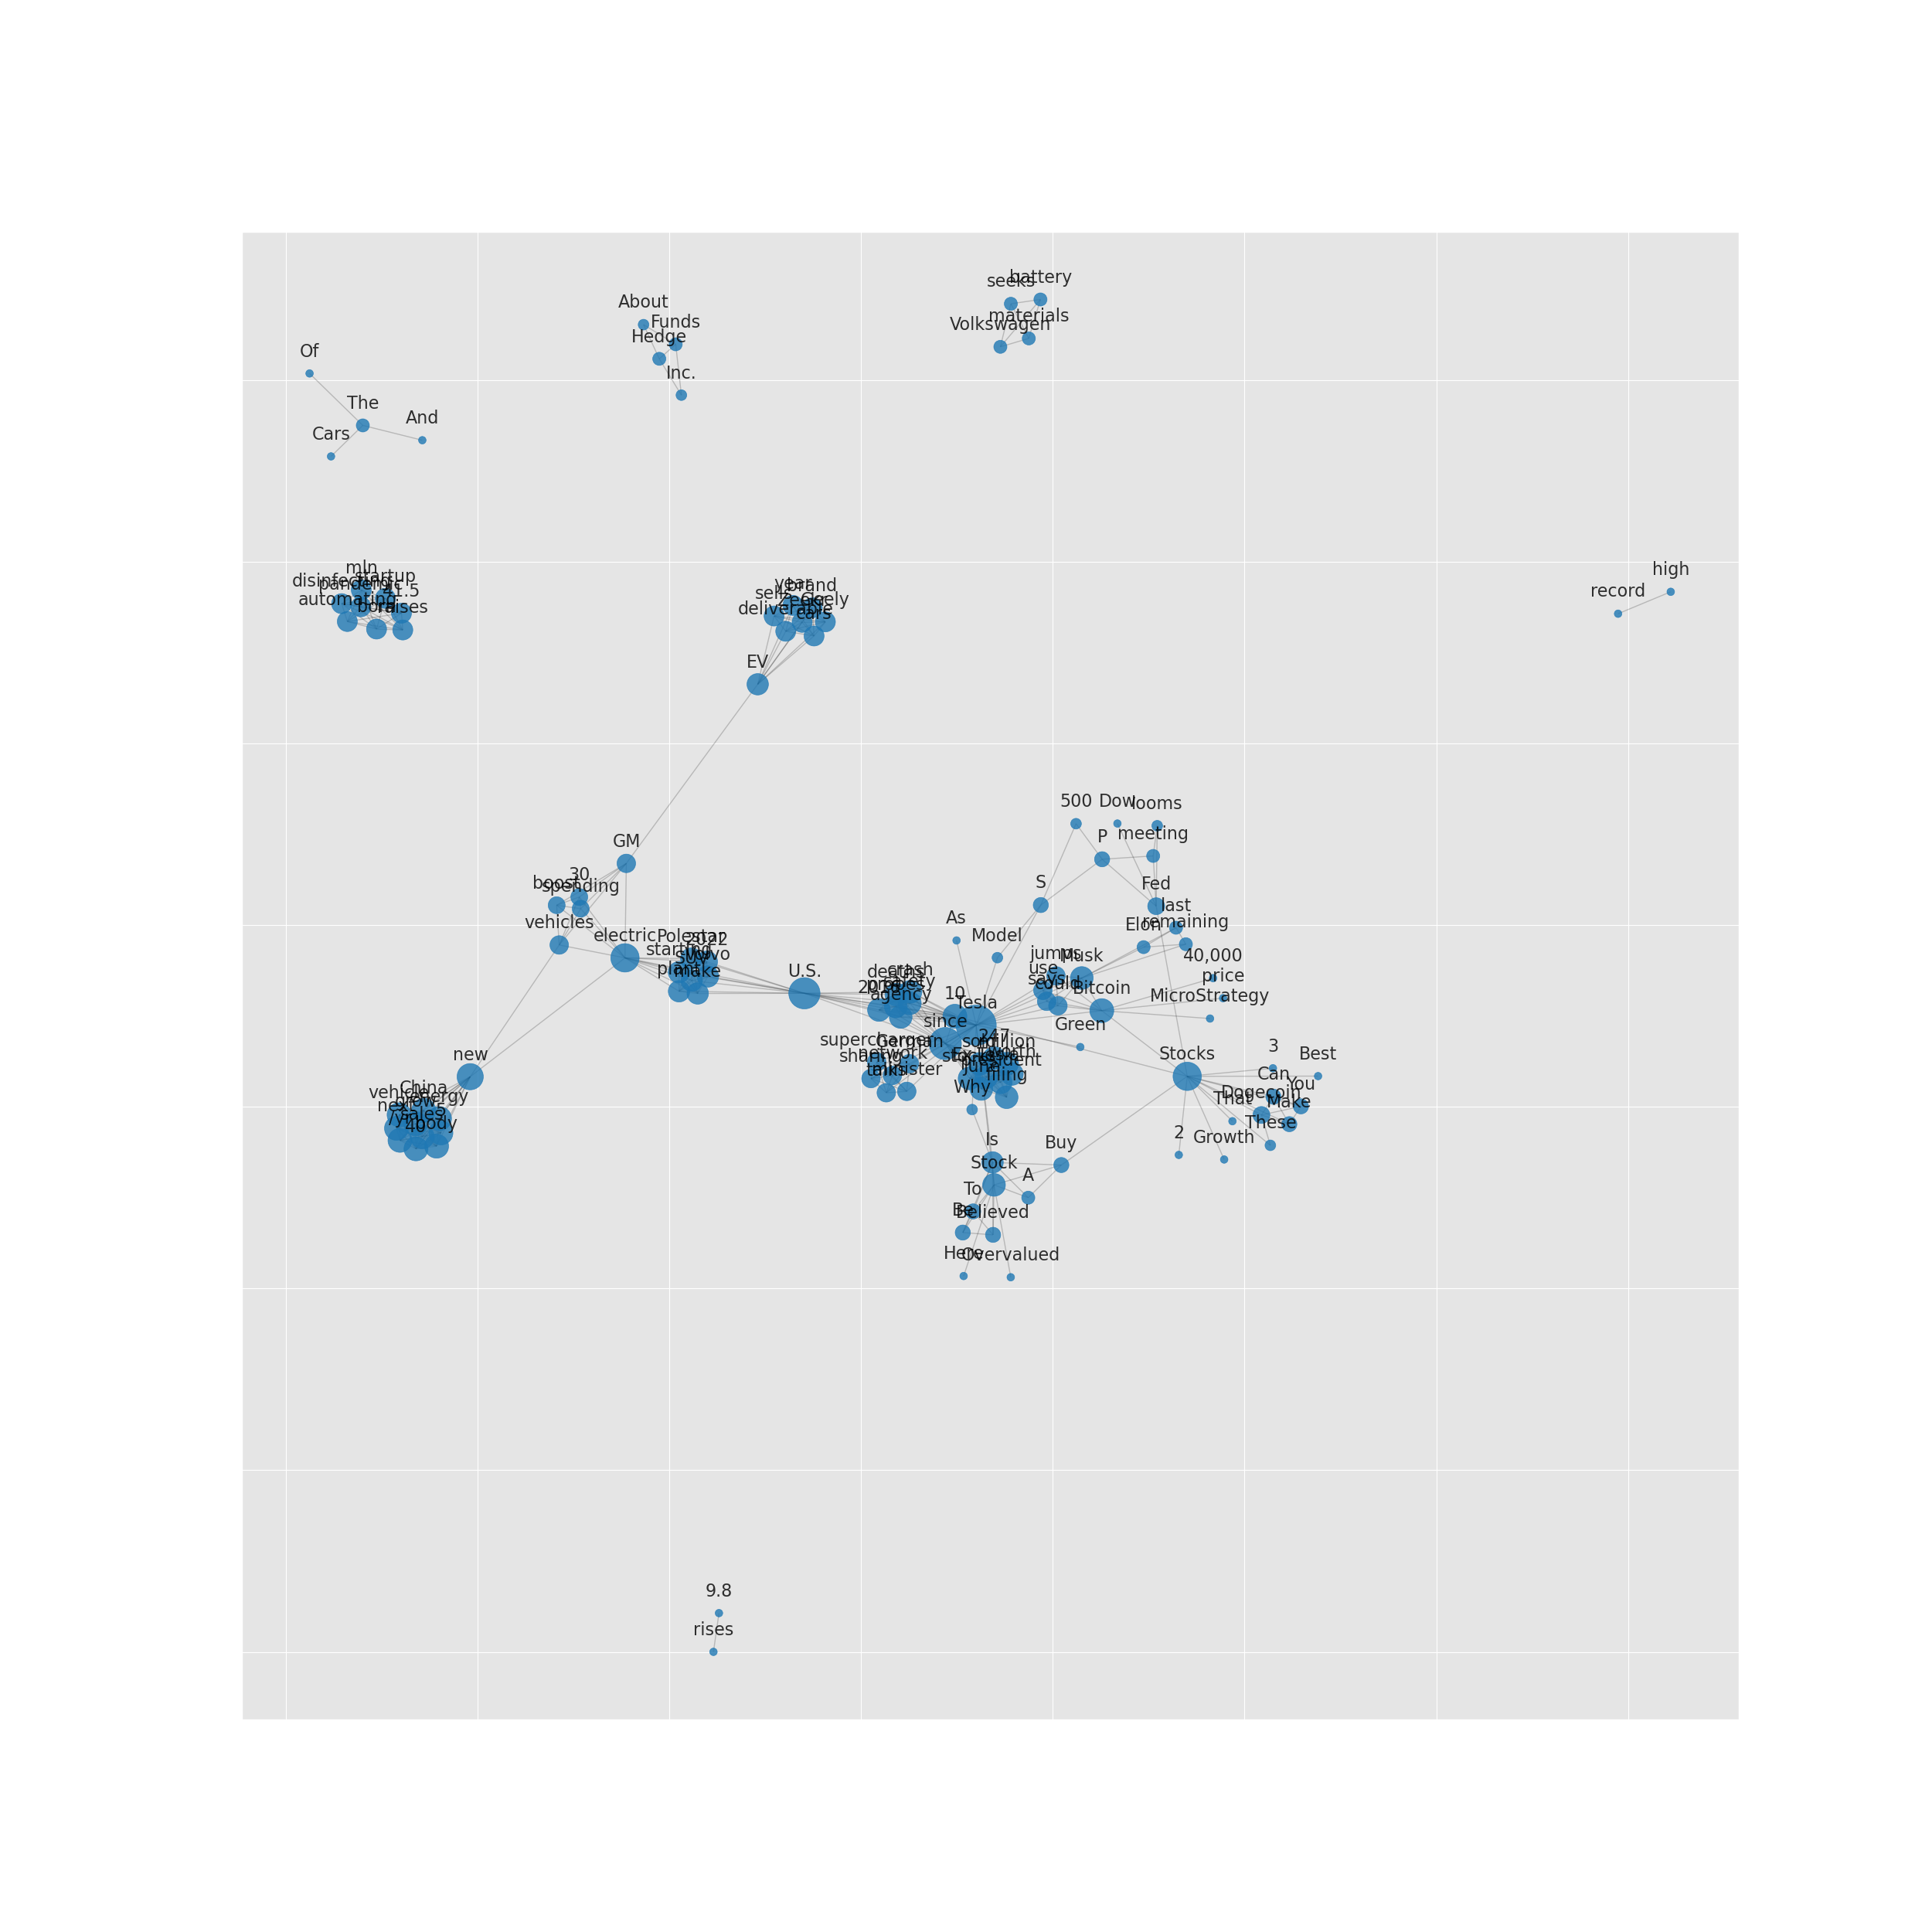
Knowledge Graph of 【Tesla】News

Slide 11
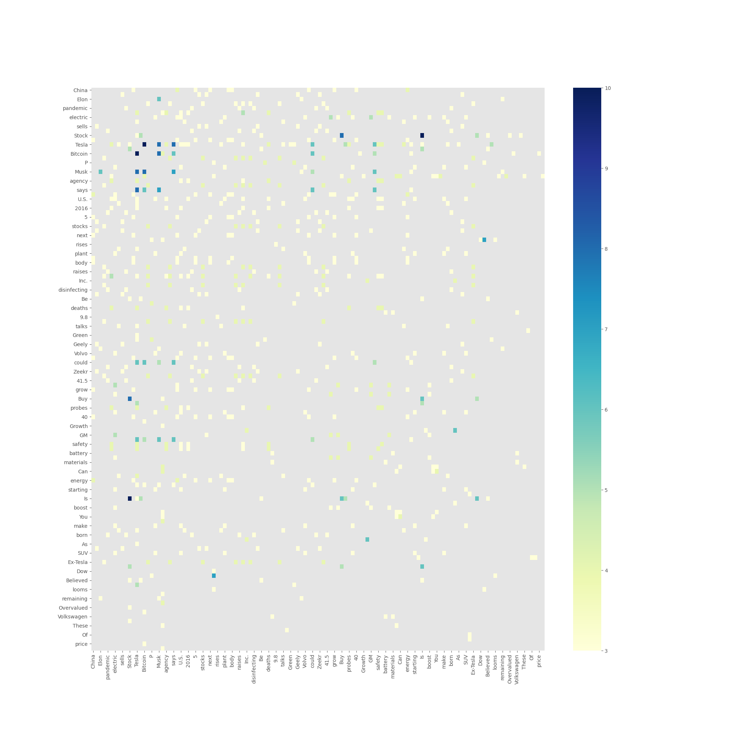
Co-occurence matrix of 【Tesla】News

Slide 12
Stock Price Trend Chat and CAPM Value
Draw the stock price trend graph of each stock price and use the yield of the U.S. 1-year Treasury bond as the risk-free rate of return to calculate the expected one-year rate of return for CAPM.

Slide 13
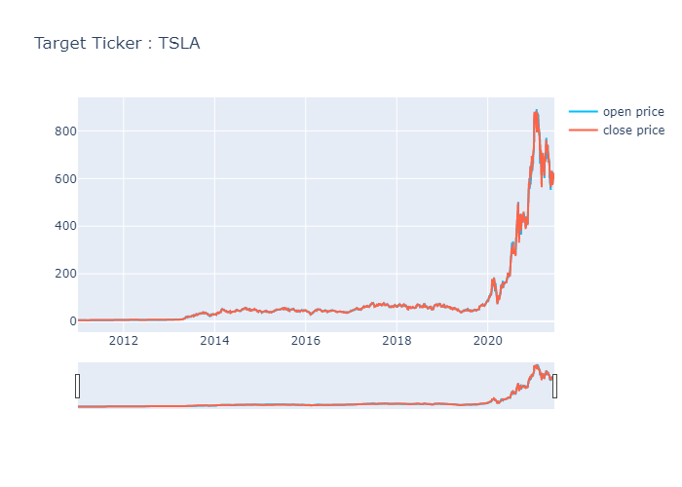
【TSLA】Price Trend Chart

Slide 14
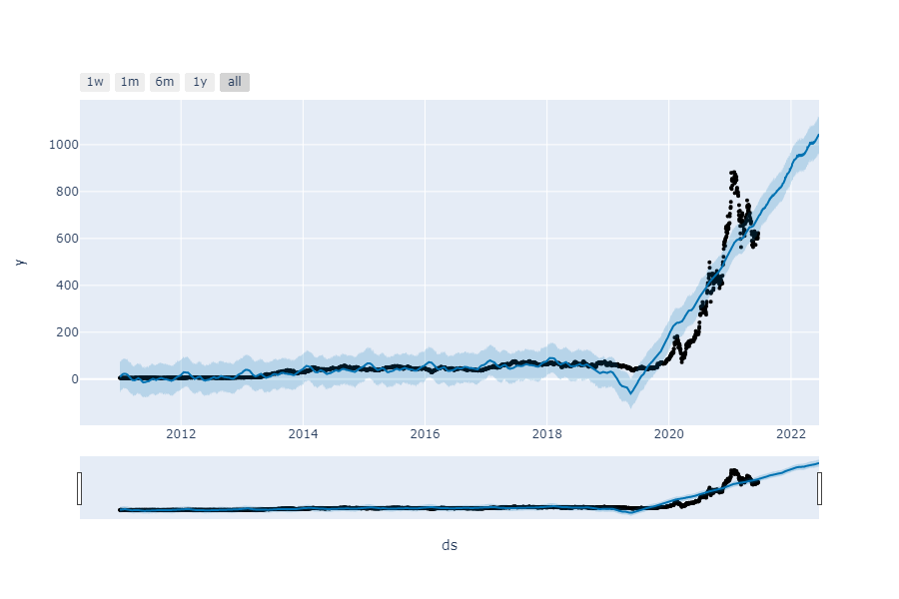
【TSLA】Price Prediction Trend Chat

Slide 15
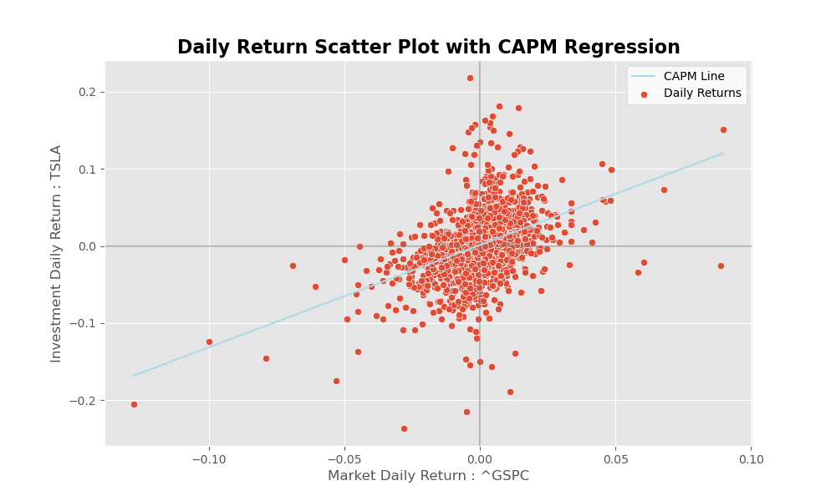
【TSLA】CAPM Value
Beta：1.3263
Alpha：0.0012
Risk-Free Rate：0.0072
CAPM Value：21.79%

