Slide 1
DSP-HW1
電資-電子三甲
邱昭文
105820025

Slide 2
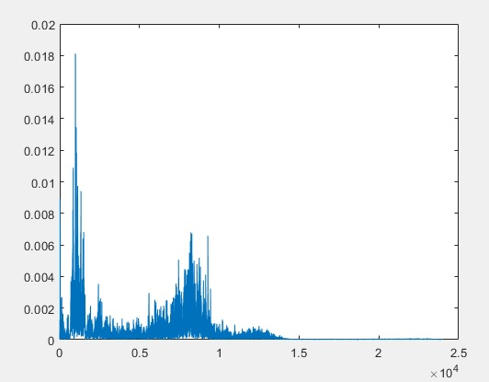
輸入頻譜

Slide 3
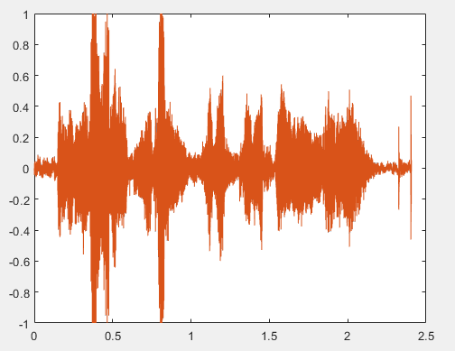
輸入波形圖

Slide 4
輸出頻譜程式碼
[x, fs]=audioread(‘巴巴’.wav');
sound(x, fs);
t=(1:length(x))/fs;
win = hanning(length(x)); K = sum(win)/length(x);
X = abs(fft(x.*win));
Xm = X(1:length(x)/2);
Xm = Xm/(length(x)/2);
Xm(1,1) = Xm(1,1)/2;
Xm = Xm/K;
f = (0:length(x)/2-1)*fs/length(x);
plot(f, Xm)

Slide 5
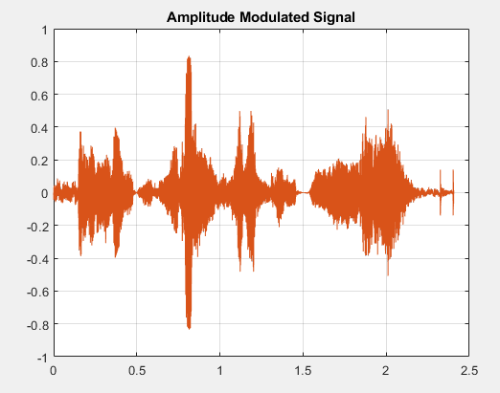
AM輸出波形圖

Slide 6
AM程式碼
clc;
close all;
clear all;
[x, fs]=audioread(‘origin’.wav');
t=(1:length(x))/fs;
am=x';
y=cos(pi*t).*am;
plot(t,y)
title('Amplitude Modulated Signal')
grid on;
sound(y,fs)

Slide 7
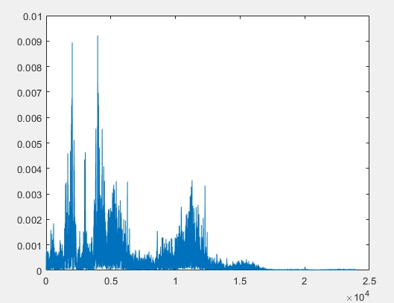
FM輸出頻譜

Slide 8
FM程式碼-1
clc;
close all;
clear all;
[x, fs]=audioread(‘origin’.wav');
t=(1:length(x))/fs;
am=x';
y=cos(pi*t*90000).*am;
title('Amplitude Modulated Signal')
grid on;
sound(y,fs)

Slide 9
FM程式碼-2
t=(1:length(y))/fs;
win = hanning(length(y)); K = sum(win)/length(y);
y=y';
X = abs(fft(y.*win));
Xm = X(1:length(y)/2);
Xm = Xm/(length(y)/2);
Xm(1,1) = Xm(1,1)/2;
Xm = Xm/K;
f = (0:length(y)/2-1)*fs/length(y);
plot(f, Xm)

Slide 10
THANK

