Slide 1

Survival Prediction of
Breast Cancer Patients

Slide 2
CONTENTS
1
4
Introduction
Model training
3
Feature Engineering
5
Result

Slide 3
Introduction
延时符

Slide 4
01
Steps
Step 01
Step 02
Step 03
Step 04
Filter data
Construct the data set
Pre-processing
Model training
-Extract effective information
-Screening for differentially expressed genes
-Filter valid clinical data
Integrate patient clinical information and genetic information to construct a data set
Drop the missing values & outliers
Data normalization
Data standardization
Use the processed data set to train the model

Slide 5
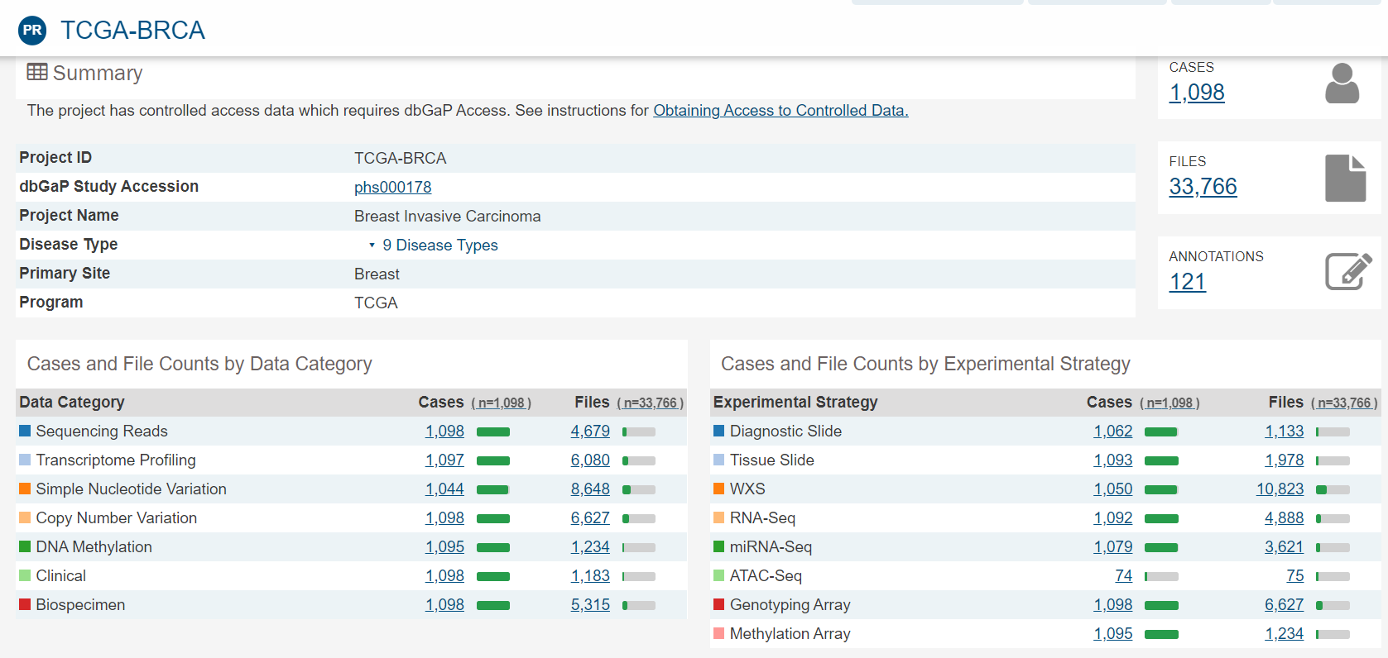
01
Data
TCGA-BRCA
1109 patients’ information
60484 genes
113 Normal tissue sample
1109 Tumor tissue sample
Division of dataset
training set : testing set=4：1

Slide 6
01
Data
TCGA-BRCA
1109 patients’ information
60484 genes
113 Normal tissue sample
1109 Tumor tissue sample
Division of dataset
training set : testing set=4：1

Slide 7
Differential gene
01
Differentially expressed
gene analysis
Genes that are different from normal genes due to gene mutation or methylation
Differentially expressed gene analysis
The process of analyzing the expression level of genes to find the differential genes

Slide 8
DESeq
01
DESeq & edgeR
An R language analysis suite that is used to analyze RNA-seq data and gene expression differences.
Estimated according to negative binomial distribution
Use FDR (false discovery rate) to calculate differences between the genes
edgeR
The process of analyzing the expression level of genes to find the differential genes
Including empirical Bayes methods, exact tests, and generalized linear models

Slide 9
01
Deepsurv
Deepsurv proposed the use of COX based on deep learning for survival analysis and using it into clinic systems. Deepsurv uses a deeper network and more advanced training techniques, such as ReLU and Dropout. The output is a risk value which used C-index as evaluation indicator. Deepsurv's simulation experiment includes two types: linear and nonlinear. In linear risk model Deepsurv has the same performance as COX but it’s far better than COX in non-linear models.

Slide 10
Feature Engineering

Slide 11
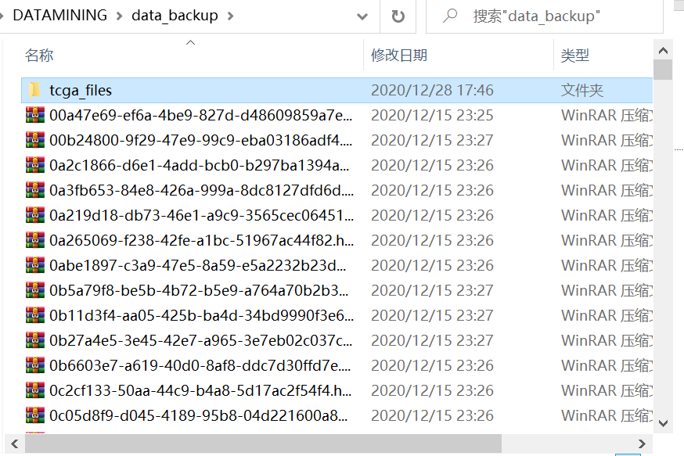
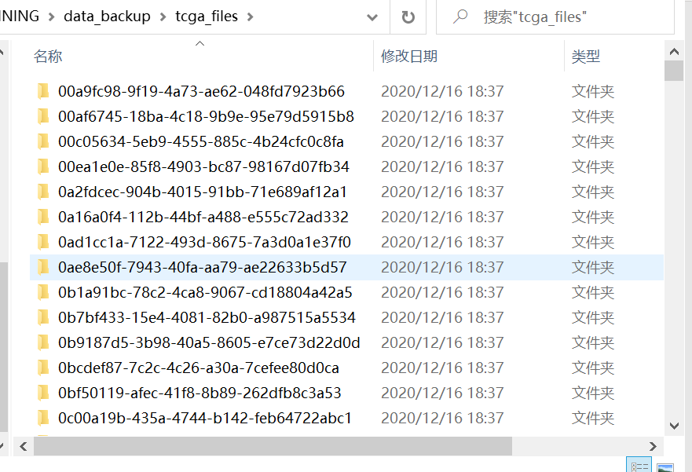
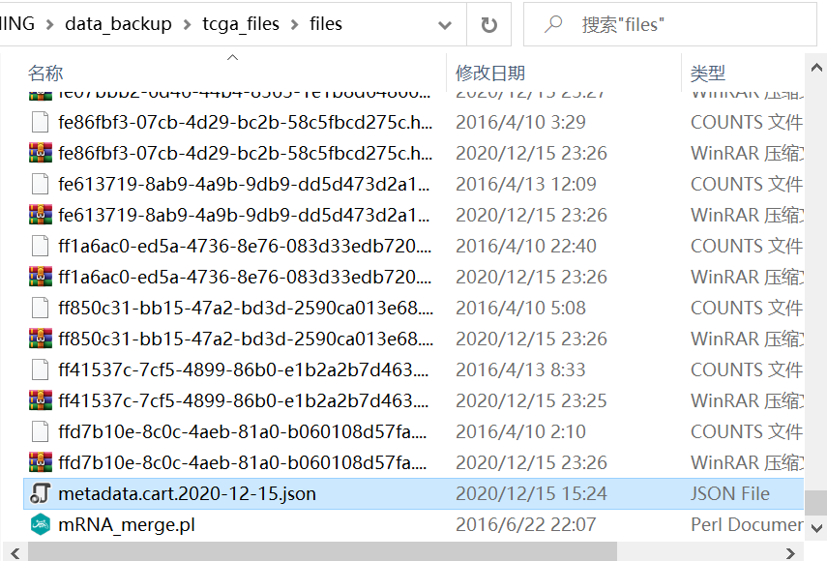
03
Filter data
Use scripting language to extract genetic and clinical information respectively

Slide 12
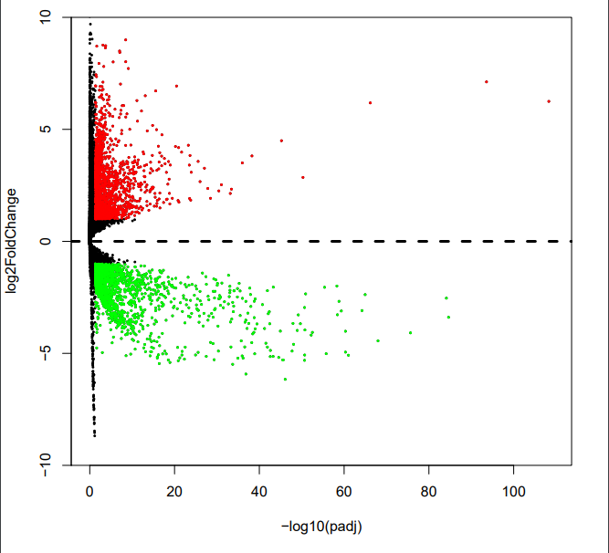
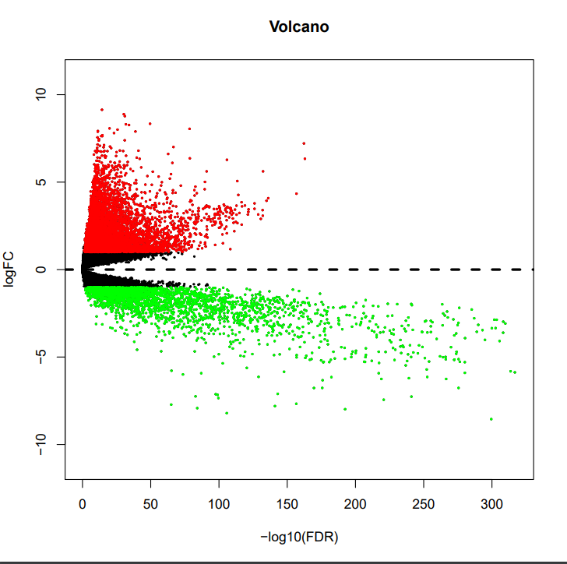
03
Filter data
First used DESeq and edgeR in filter layer to make differentially expressed gene analysis
Filter 3618 difference genes and 9065 genes respectively
differential gene volcano map of DESeq
differential gene volcano map of edgeR

Slide 13
03
Data Merging &
Data Pre-processing
Combine genetic information and clinical information
Drop the missing values & outliers
Data normalization
Data standardization

Slide 14
Model training

Slide 15
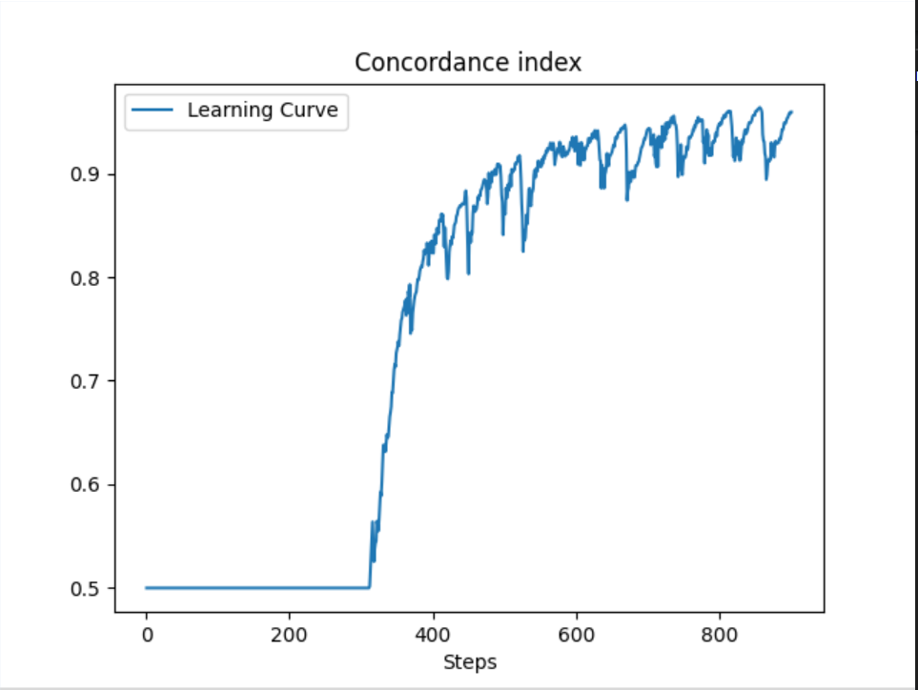
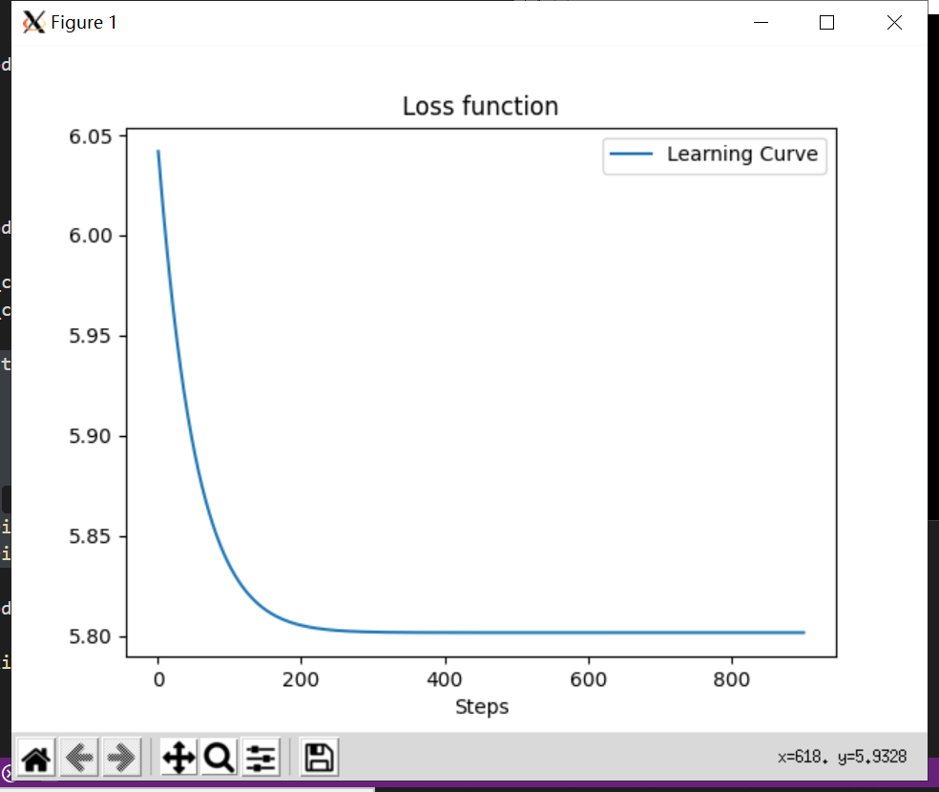
04
Model training

Slide 16
Result

Slide 17
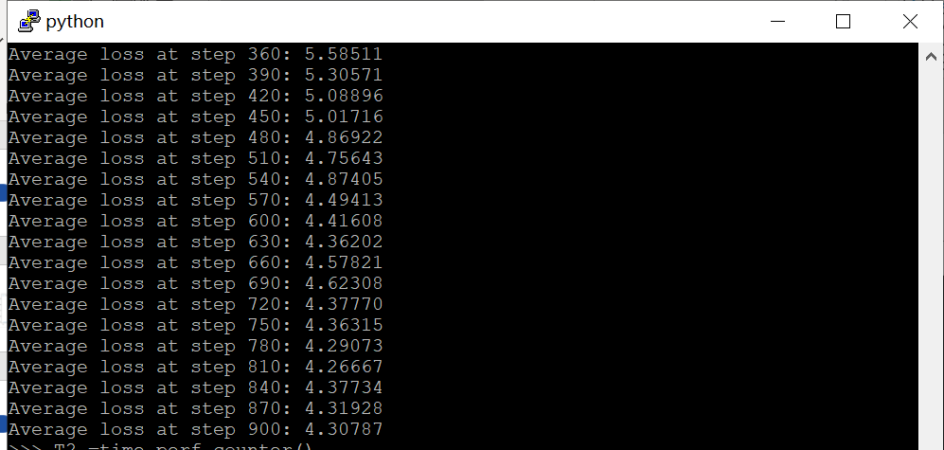
05
Result

Slide 18
THANKS FOR YOUR LISTENING!

