Slide 1

Agentic Financial Advisor Bot for Investment Strategies
Kevin Juandi

Slide 2
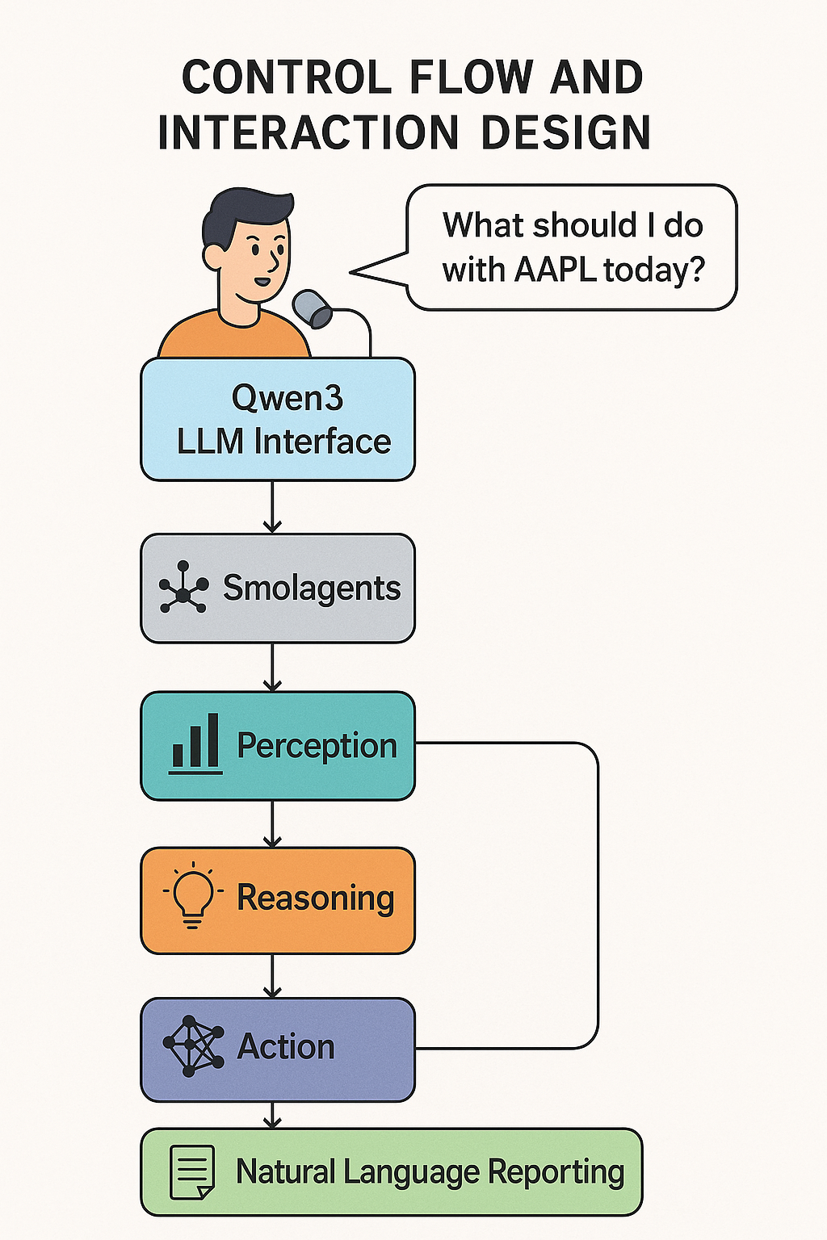
System Architecture
Perception
Action Selection
Natural Language Reporting
Self-Evaluation
Reasoning
Pull and preprocess live financial data.
Apply models to predict outcomes.
Choose advisory outputs based on predictions.
Pass planning output to LLM to produce clear advice.
Log past predictions and compare to real outcomes over time.
Yahoo Finance API, Bloomberg API, CCXT
ARIMA, Reservoir Computing
FinRL
Qwen3
Backtesting

Slide 3
RC Forecasting Demo

Slide 4
RL Portfolio

Slide 5
Agentic Demo

Slide 6
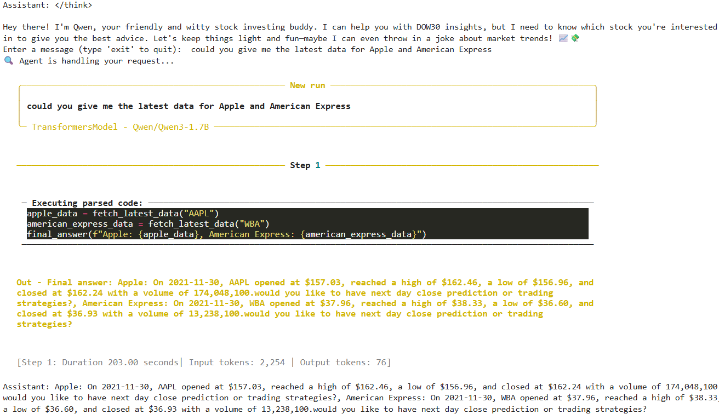

Slide 7
Future Improvement
A unified agentic pipeline
Automated retraining
Personalised advice using user memory
And Stigmergic multi-agent RL for scalable portfolio strategies

Slide 8

Thank You

