Slide 1
Detecting and Clustering Natural Disaster News
Iya Chivileva

Slide 2
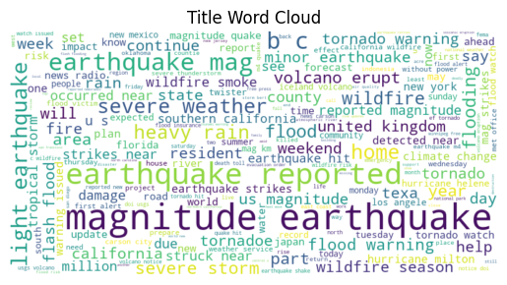
Project Methodology Overview
1. Data Understanding (EDA)
Analyzed publishing trends, title structure, and keyword focus
Identified data quality issues (duplicates, missing links, encoding)
🔹 2. Data Cleaning
🔹 3. NER & Event Extraction
Compared:
🧠 Transformer-based NER (high precision, context-aware)
⚙️ SpaCy + Rule-based (faster, but less accurate)v
🔹 4. Feature Engineering
🔹 5. Clustering & Evaluation
Tested KMeans, Agglomerative, DBSCAN
Final clusters refined via downsampling + feature pruning
Best results with KMeans (silhouette ~0.85 → ~0.40 after balancing)

Slide 3
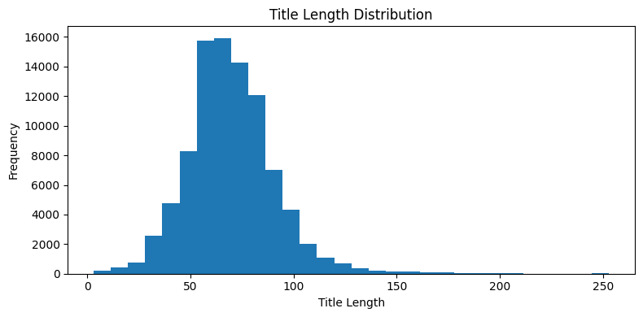
Exploratory Data Analysis (EDA) Key Findings
📦 Dataset Size: 91K+ disaster-related English articles from 135 countries & 5.8K+ domains
📉 Missing Data:
url_mobile missing in 72%
socialimage missing in 13%
📄 Duplicates:
2,176 exact row duplicates
26K+ duplicate titles (syndicated/reposted content)
🌍 Geographic Bias:
65% of content from US
UK, Canada, India follow
🕒 Temporal Trends:
Publishing spikes at midnight (likely automated)
Consistent activity across all days
⚠️ Data Quality Flags:
514 broken URLs
Domain metadata mismatches
Most titles range between 40–90 characters
Follows a near-normal distribution centered around 60–70 characters
Very few titles exceed 150 characters

Slide 4
Data Cleaning Summary
Removed 2176 exact duplicate rows.
Removed 0 duplicate URLs.
Removed 24144 duplicate titles.
Removing 220 truly inaccessible URLs.
Removed 1 empty title row.
✅ Core Steps
Removed duplicates (full-row, URL, title)
Normalized non-ASCII titles (e.g., “Türkiye”, em dashes)
Flagged and dropped broken URLs (404, error)
Cleaned categorical fields (language, sourcecountry)
Parsed domains into subdomain, root, TLD
Approach 1: Extracted locations using spaCy (NER) + Matched disaster keywords (e.g., earthquake, flood)
Approach 2: extracted disaster events & locations using Transformers model

Slide 5
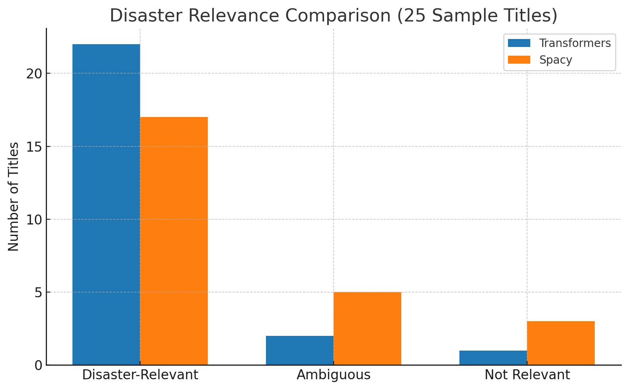
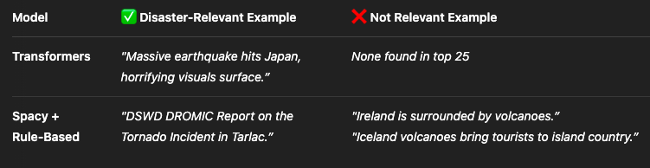
Title Processing: Transformers vs. Spacy + Rule-Based
✅ Key Takeaways
Transformers found more relevant titles (23.6k vs. 20.6k rows)
Higher quality input = better clustering (silhouette ~0.85 vs ~0.13)
Spacy + Rule-Based model included non-disaster content (e.g., tourism, geology)
Transformers better capture urgency + event context
Used ChatGPT to classify 25 random titles per model into disaster, ambiguous, or irrelevant.

Slide 6

Initial Workflow & Clustering Methods
🔹 Steps Taken
Filtered “transformers dataset” to include rows with both Disaster_Event and Location
Extracted keywords using YAKE from cleaned titles
Engineered features: month, season, country_extracted
Embedded keywords using SentenceTransformer (all-MiniLM-L6-v2)
Combined structured and embedded features
🔹 Clustering Methods Compared
KMeans (n=5)
Agglomerative Clustering
DBSCAN (eps=1.5, min_samples=5)
🔹 Initial Results
KMeans: Best performance
Silhouette Score: ~0.85
Comparison of Clustering Models

Slide 7
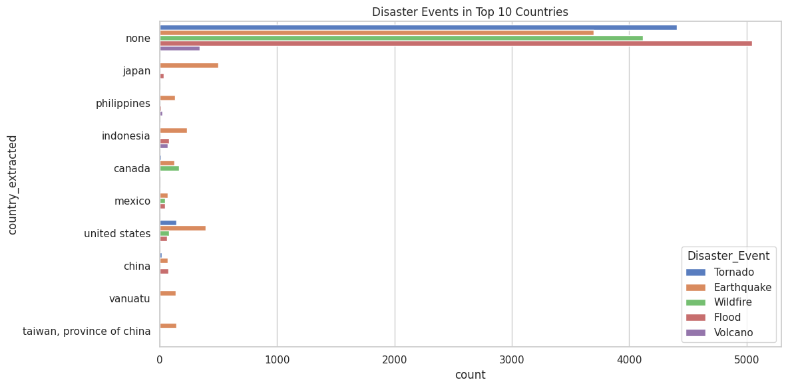
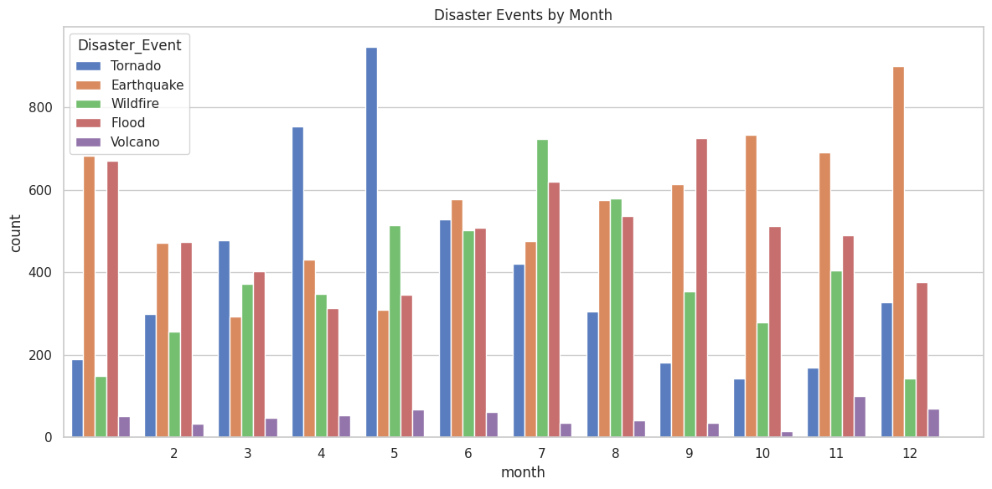
Feature Engineering Insights
✅ 1. Seasonality Patterns
Tornadoes are highly seasonal, peaking in spring
Wildfires dominate in summer
Earthquakes and floods occur year-round but spike in winter and autumn
➡ season is a valuable feature for capturing disaster type variability
✅ 3. Monthly Trends
Tornadoes peak around April–May
Earthquakes spike in winter months
Wildfires rise in summer (Jul–Aug)
Floods consistent but surge in September
➡ month is a strong time-based signal
🧠 Conclusion
season and month are strong temporal features
country_extracted is relevant but noisy

Slide 8
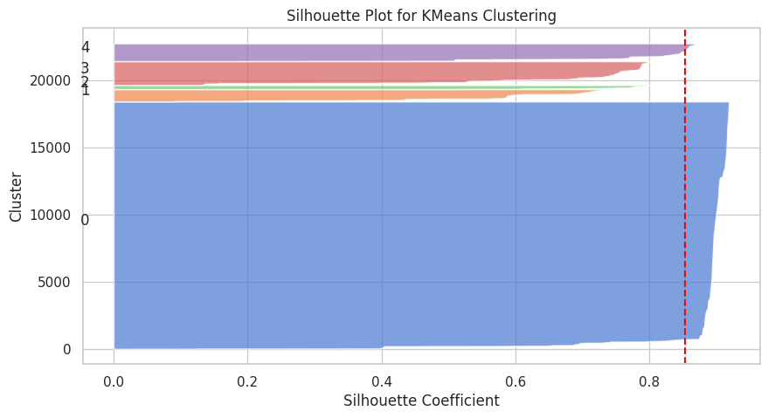

Initial KMeans Clustering Results
Key Findings
One dominant cluster (Cluster 0) captured most well-structured disaster data
Remaining clusters were small, low-quality, and noisy
Overclustering observed due to dataset imbalance
🔹 Cluster Quality (Silhouette Plot)
Cluster 0: ~0.85 (strong cohesion)
Others: narrow width, low score
🔹 Initial Issues
Highly imbalanced categories (e.g., Earthquake: 6,700+ vs. Volcano: 600)
Noisy categorical features (country_extracted) (92 unique values)
Embedding dominated clustering due to dimensionality
Initial Value Counts for Disaster Event

Slide 9
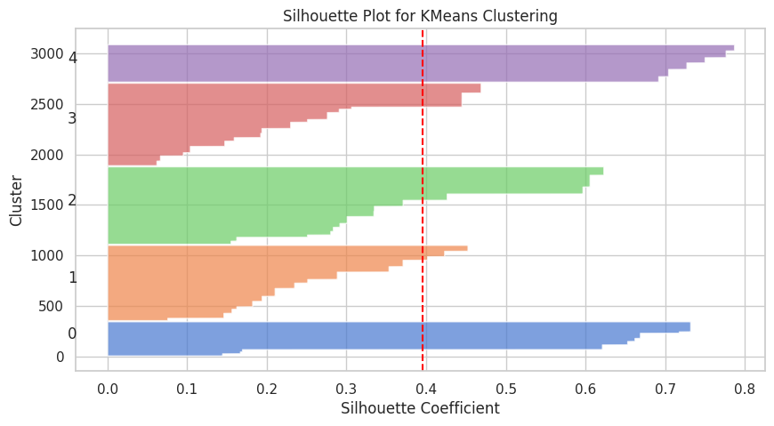
Improvements & Final KMeans Results
🔹 Steps Taken to Improve
Removed noisy features: country_extracted, embedded keywords
Balanced disaster categories via downsampling
Normalized and scaled combined features
Re-clustered using KMeans (n=5)
🔹 Final Results
Silhouette Score: Dropped to ~0.40 (expected with more balanced data)
Clusters became more interpretable and semantically meaningful
Each cluster mapped to a distinct disaster type
🔹 Conclusion
Sacrificed numeric cohesion for better semantic clarity
Achieved cleaner, fairer disaster clustering across categories
Cluster 0:
- Most common keyword: Volcano
- Size: 339
Cluster 1:
- Most common keyword: Earthquake
- Size: 746
Cluster 2:
- Most common keyword: Tornado
- Size: 767
Cluster 3:
- Most common keyword: Wildfire
- Size: 817
Cluster 4:
- Most common keyword: Flood
- Size: 371

Slide 10

Conclusion
This project built a complete NLP pipeline for extracting and clustering global disaster-related news articles.
Extensive EDA revealed valuable patterns in article publishing, geography, and content structure — informing cleaning and modeling decisions.
Two NER approaches were compared:
Transformer-based NER: slower but far more accurate and semantically aware
Rule-based SpaCy NER: lightweight but more error-prone
Feature engineering choices were critical to clustering success.
KMeans clustering delivered the best performance and interpretability after balancing and feature pruning.
The final result was a set of semantically meaningful and balanced disaster event clusters, ready for use in alerting systems, research, or real-time dashboards.

