Slide 1
CS 4795 — Artificial Intelligence
Handwritten Digit Recognition
Using Supervised Machine Learning on Fashion MNIST
Chizaram Ikpo
Student ID: 3760059
Final Project Presentation
CS 4795 — Handwritten Digit Recognition | Chizaram Ikpo

Slide 2
Problem Statement & Motivation
The Problem
Why This Matters
Can simple ML algorithms classify clothing images accurately?
How do KNN and Logistic Regression compare on image data?
How close can classical methods get to deep learning benchmarks?
Pattern recognition is a core AI challenge
Image classification powers real-world AI systems
Benchmarking foundational algorithms builds intuition for their trade-offs
Results are measurable, visual, and interpretable
CS 4795 — Handwritten Digit Recognition | Chizaram Ikpo

Slide 3
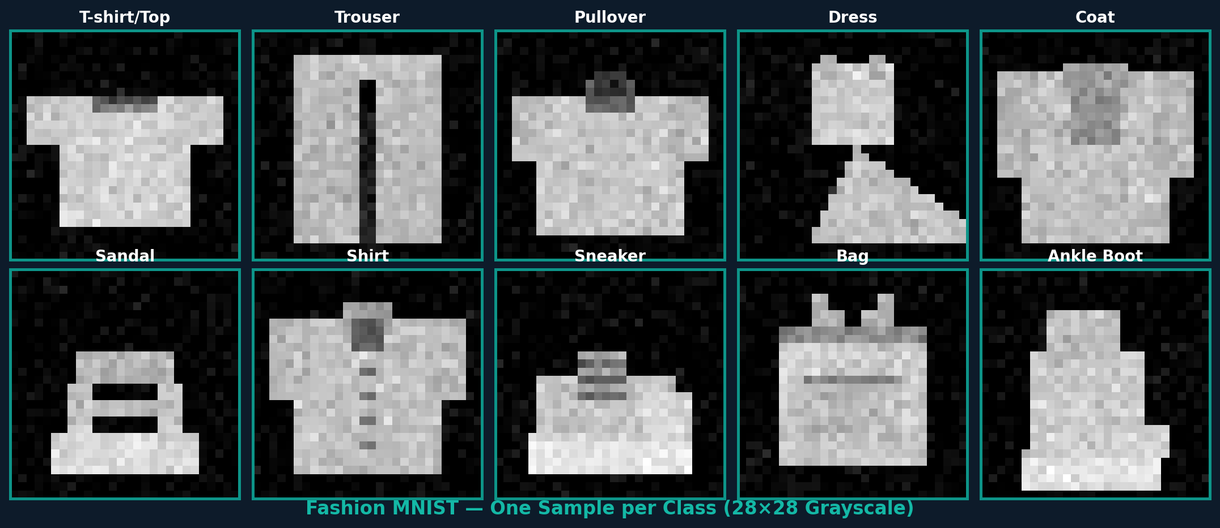
Dataset: Fashion MNIST
70,000
28×28
10
Images
Resolution
Classes
60K train / 10K test
Grayscale pixels
Clothing categories
CS 4795 — Handwritten Digit Recognition | Chizaram Ikpo

Slide 4
Approach & Methodology
Load Dataset
Preprocess
Split Data
01
Import Fashion MNIST via scikit-learn / Keras
02
Flatten 28×28 images → 784-dim vectors; normalize pixels to [0, 1]
03
60,000 training samples — 10,000 test samples
Train Models
Evaluate
Compare
04
Fit KNN and Logistic Regression classifiers
05
Accuracy score, confusion matrix, misclassification analysis
06
Benchmark results against state-of-the-art deep learning
CS 4795 — Handwritten Digit Recognition | Chizaram Ikpo

Slide 5
Algorithms Used
k-Nearest Neighbors (KNN)
Logistic Regression
Type: Instance-based, non-parametric
How it works: Classifies by majority vote among K nearest training samples
Distance metric: Euclidean distance on pixel values
K value: Tuned via cross-validation
Strength: Simple, no explicit training phase
Weakness: Slow at prediction; sensitive to high dimensions
Type: Parametric, linear model
How it works: Learns decision boundaries via gradient-based optimization
Solver: LBFGS with multi-class One-vs-Rest strategy
Regularization: L2 penalty to prevent overfitting
Strength: Fast, interpretable, probabilistic output
Weakness: Assumes linear separability in pixel space
CS 4795 — Handwritten Digit Recognition | Chizaram Ikpo

Slide 6
Results: Model Performance
🏆 KNN
Logistic Regression
85.8%
84.5%
Accuracy
Accuracy
Best performing model
Strong on visually distinct classes (sandal, bag)
Minor confusion between shirt / T-shirt / coat
Competitive performance despite simplicity
Faster to train than KNN
Also struggles with visually similar clothing items
CS 4795 — Handwritten Digit Recognition | Chizaram Ikpo

Slide 7
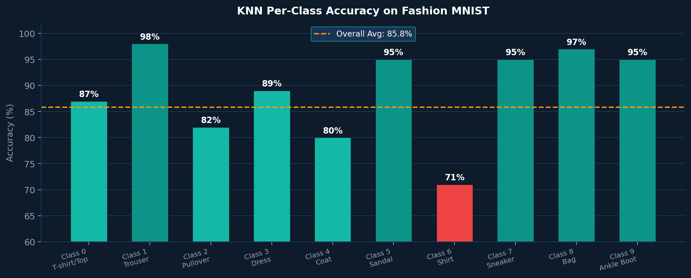
Per-Class Accuracy Breakdown (KNN)
Shirt (Class 6) is the hardest class — only 71% accuracy — due to visual overlap with T-shirt and Coat.
CS 4795 — Handwritten Digit Recognition | Chizaram Ikpo

Slide 8
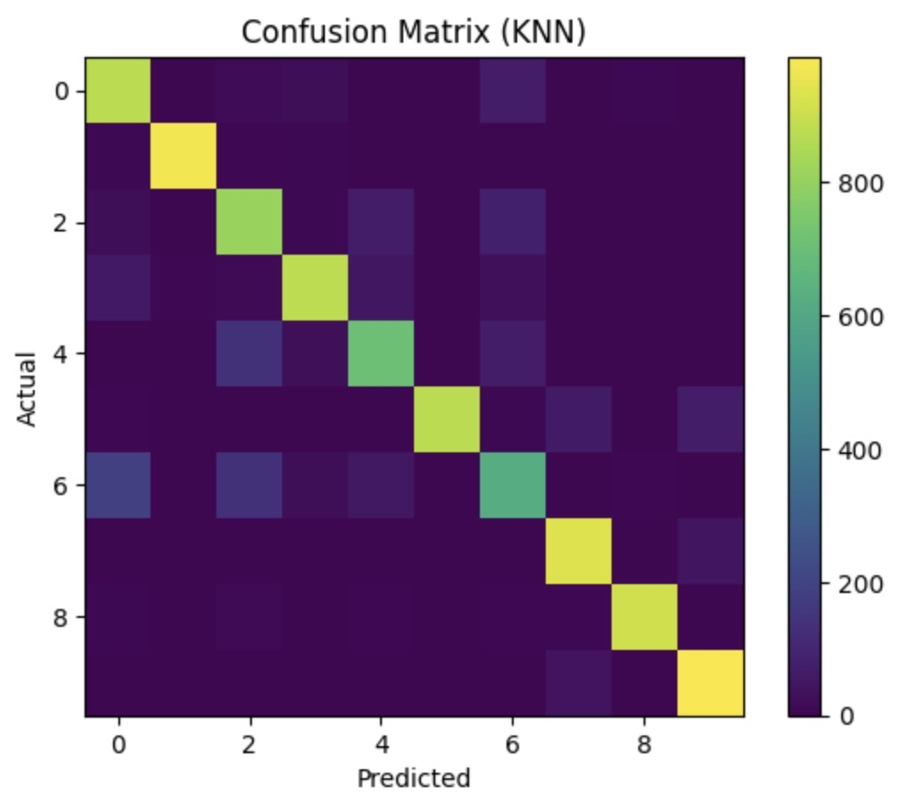
Confusion Matrix (KNN)
How to Read This
Diagonal (bright): Correct predictions
Off-diagonal (dark): Misclassifications
Brighter = more samples predicted there
Key Observations
Classes 7 & 9 (Sneaker/Ankle Boot) score highest
Class 6 (Shirt) most confused — similar to T-shirt & coat
Class 4 (Coat) also blends with pullover/shirt
Strong diagonal overall → good model performance
CS 4795 — Handwritten Digit Recognition | Chizaram Ikpo

Slide 9
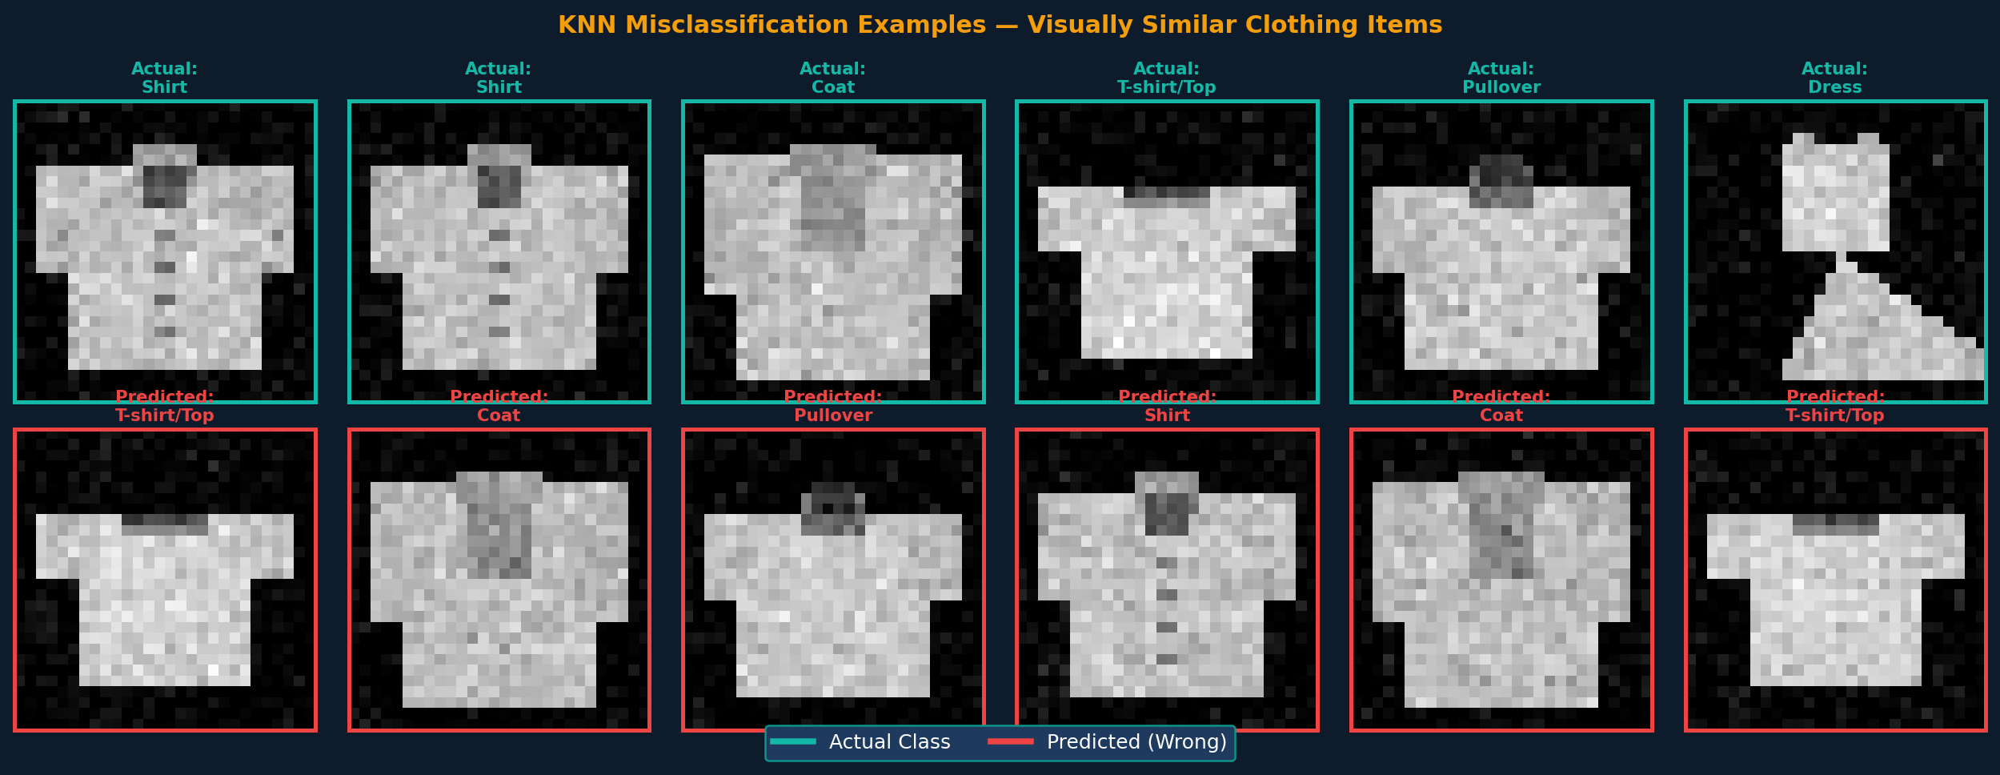
Misclassification Examples
Key Insight: Shirt, T-shirt, Coat and Pullover share similar silhouettes at 28×28 pixels — making them the primary source of KNN errors. This is a structural limitation of pixel-space distance metrics.
CS 4795 — Handwritten Digit Recognition | Chizaram Ikpo

Slide 10
Best Performing Algorithm: KNN
🏆 KNN outperformed Logistic Regression with 85.8% vs 84.5% accuracy (+1.3%)
Why KNN Won on Fashion MNIST:
Non-Linear Boundaries
Fashion items don't separate linearly in pixel space — KNN captures complex decision shapes that logistic regression cannot.
No Distributional Assumptions
KNN makes no assumptions about data distribution, making it robust to the varied shapes and textures of clothing.
Local Pattern Matching
Nearby pixels matter most — KNN leverages local similarity in image space effectively.
CS 4795 — Handwritten Digit Recognition | Chizaram Ikpo

Slide 11
Comparison with State-of-the-Art
Model | Accuracy | Type
Logistic Regression | 84.5% | Classical
KNN ★ | 85.8% | Classical ★
SVM | ~89.7% | Classical
CNN (Deep) | ~93.5% | Deep Learning
Gap Analysis: KNN reaches ~85.8% — about 7.7% below deep learning CNNs. The gap reflects the fundamental advantage of learned hierarchical features vs. raw pixel similarity.
CS 4795 — Handwritten Digit Recognition | Chizaram Ikpo

Slide 12
Analysis & Discussion
What Worked Well
Where Models Struggled
Both models exceeded 84% — strong for classical ML
KNN excelled at visually distinct classes (bag, sandal, sneaker)
Simple pipeline was sufficient for a solid baseline
Shirt (class 6) consistently misclassified as T-shirt or coat
Pullover confused with coat due to similar silhouettes
Raw pixels lose spatial structure — no feature learning
Limitations
Potential Improvements
KNN is computationally expensive at prediction time (O(n))
No data augmentation applied
Flattening images ignores 2D spatial relationships
Add PCA / dimensionality reduction before KNN
Try SVM with RBF kernel for better boundary modeling
Apply CNN for hierarchical feature extraction
CS 4795 — Handwritten Digit Recognition | Chizaram Ikpo

Slide 13
Conclusion
Classical ML can achieve competitive accuracy on image classification — but architectural choices matter.
Both KNN and Logistic Regression successfully classify Fashion MNIST clothing images
KNN (85.8%) narrowly outperformed Logistic Regression (84.5%) on this dataset
Simple models close the gap but cannot match deep learning's ~93–95% without feature engineering
Primary failure mode: visually similar clothing (shirt/T-shirt/coat) — a challenge even for humans
This project demonstrates the value and limits of classical supervised learning for vision tasks
CS 4795 — Handwritten Digit Recognition | Chizaram Ikpo

Slide 14
Repository & References
📁 GitHub Repository
https://github.com/Chiz05/AI-MNIST-Digit-Recognition
Includes: Dataset loader · Training scripts · Evaluation code · Project proposal · Final report
References
Xiao, H. et al. (2017). Fashion-MNIST: A novel image dataset for benchmarking machine learning algorithms.
LeCun, Y., Bottou, L., Bengio, Y., & Haffner, P. (1998). Gradient-based learning applied to document recognition.
Goodfellow, I., Bengio, Y., & Courville, A. (2016). Deep Learning. MIT Press.
Scikit-learn Documentation — scikit-learn.org
CS 4795 — Handwritten Digit Recognition | Chizaram Ikpo

