Slide 1
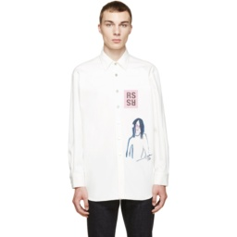
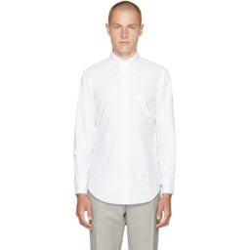
Composed retrieval input
Two frozen endpoints
Four query-gallery pairs
One final ranking
Endpoint A
Original paths
Cross mean
FashionIQ
Query
composer
S₀₀ = q₀ · g₀
S₁₁ = q₁ · g₁
Remove graphics
Use hidden placket
Crossed paths
Joint rank-path router
FashionGen
q₀
Gallery
encoder
S₀₁ = q₀ · g₁
S₁₀ = q₁ · g₀
Reference image
Conservative fusion
+ target refinement
CIRR
g₀
2 × 2 compatibility matrix
Gallery images
Endpoint B
Single ranked list
Query
composer
q₁
9 → 1
Gallery
encoder
g₁
Recovered target

