Slide 1



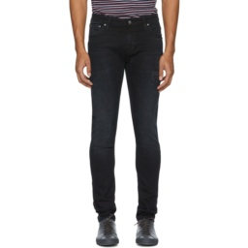
Composed query
Seventeen rank paths
Candidates near top-k
Listwise action scoring
Safe decision
Base ranking S₀₀
Two-layer scorer
Utility above
threshold?
Endpoint B
S₁₁
Cross mean
X
Candidate
responsibility
None
class
Reference image
No
Keep base
Yes
Choose path
Membership changes at k
Fade front thigh
Add contrast stitching
Convert scores to ranks
Utility of each path
Query-candidate pair
Rank trace
Cutoff k
One final ranking
9 steps toward S₁₁
Average over R@1, 5, 10
23 → 4
8 steps toward X
Base path is shared
Recovered target

