Slide 1
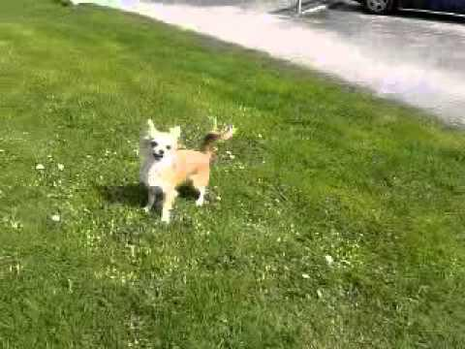
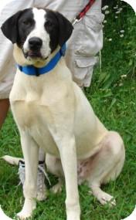
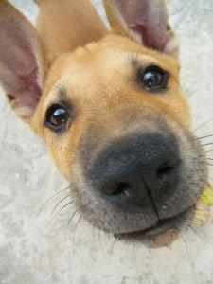
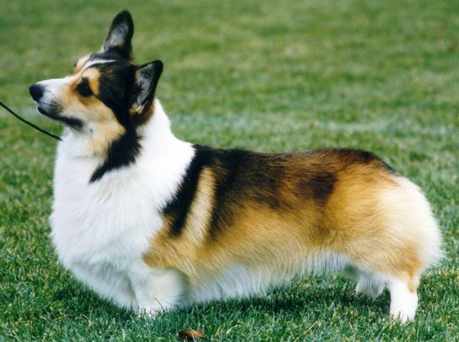
CIRR query
Conservative fusion
Top-50 candidates
Target refinement
Refined ranking
Strong endpoint
S₁₁
Region
projection
Query
projection
Fused score
Residual
Cross path
S₁₀
…
Candidate
Candidate
Reference image
Re-rank candidates
75%
25%
Attention over regions
Bigger dog
Closer to camera
81 → 4
Fused gallery score
Residual score
MLP
8 region tokens per image
Pooled target
Recovered target
Segment features stay frozen
Strong query q₁
1.18M trainable parameters

