Slide 1
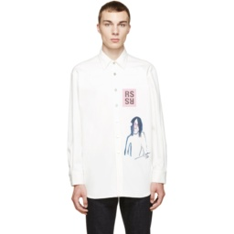
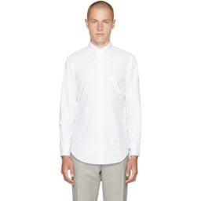
Composed Retrieval Input
Frozen CIR Endpoints
CrossPath Compatibility Matrix
Path Fusion and Ranking
q₀ · g₀
q₀ · g₁
Cross mean
0 parameters
Endpoint 0
Remove graphics
Hidden placket
or
four paths
q₁ · g₀
q₁ · g₁
Reference image
Cutoff-aware
routing
q₀
g₀
query + gallery
Off-diagonal retrieval paths
rank 9 → 1
Endpoint 1
Gallery images
q₁
g₁
Recovered target

