Slide 1

Multi-Agent NLP-to-SQL Pipeline for Manufacturing Operations: An Agentic Case Study on the Production Database
Team Members:
Wisdom Favour Chizoba
Thiruselvam Shreecharan
Proposal Presentation
Guided By:
Prof. Hamidreza Heidari

Slide 2
Introduction:
In electronics manufacturing, test and quality data is spread across many database tables whose column names differ by product. Engineers without SQL skills wait for custom queries, which delays quality decisions.
Key motivations:
Single-shot text-to-SQL often fails: it cannot inspect data, test queries or recover from errors
LLM agents with tool use are now mature, but their benefit on industrial schemas is unproven
Enable self-service access to production data for quality and production staff

Slide 3
Project Scope:
Aim:
This project explores a multi-agent LLM workflow (Planner, Coder and Critic agents) that translates natural-language questions into SQL queries on a snapshot of the manufacturing production database.
Includes:
Snapshot of the MariaDB production database in a local Docker container
Multi-agent workflow built with an orchestration framework (e.g., LangGraph)
Autonomous self-correction: error logs are fed back to the Coder agent
SELECT-only validation and read-only connection
Evaluation of execution accuracy, query accuracy, latency and token usage
Out of Scope (Current Phase):
Write operations or any access to the live production system
Deployment as a production service

Slide 4
Objectives:
Build a multi-agent workflow (Planner, Coder, Critic) that turns natural-language questions into SQL queries.
Enable autonomous self-correction: the Critic executes queries and feeds error logs back to the Coder.
Ensure safe execution with SELECT-only validation, a read-only connection and a containerized local database.
Evaluate execution accuracy, query accuracy, latency and token usage.

Slide 5
Technology Stack:
Process | Tool / Framework | Purpose
Data Source | MariaDB (Docker container) | Local snapshot of the production database
Orchestration | LangGraph (or similar) | Planner, Coder and Critic agent workflow
Language Model | LLM API (Anthropic) | Question understanding and SQL generation
Safety | SQL validation, read-only DB user | SELECT-only execution; unsafe queries blocked
Evaluation | Python (pandas) | Accuracy, latency and token-usage analysis
(Optional) Interface | Streamlit UI | Interactive demo for questions and answers

Slide 6
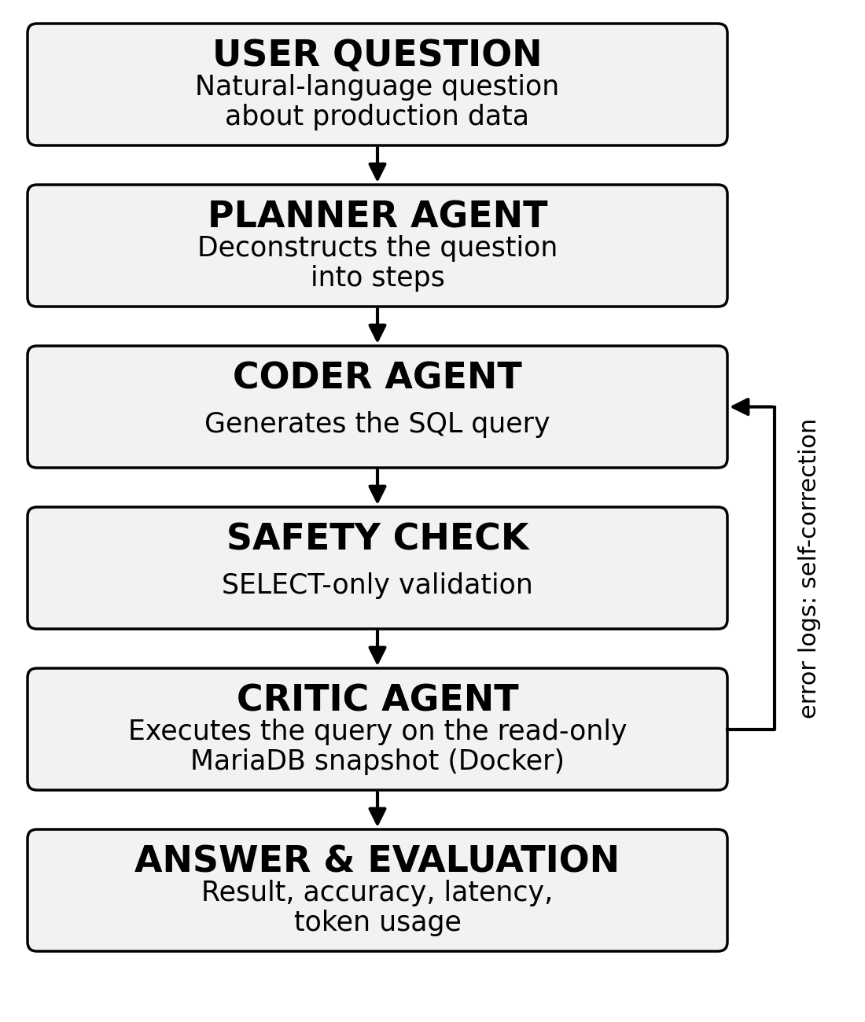
Project flow chart:

Slide 7
Working Methodology:
Step 1: Data Preparation
Loaded a snapshot of the MariaDB production database into a local Docker container.
Extracted the schema and defined test questions with ground-truth SQL.
Step 2: Multi-Agent Development
Planner agent deconstructs the question; Coder agent generates the SQL (e.g., LangGraph).
Critic agent executes the query and feeds error logs back for self-correction.
Step 3: Safety and Integration
SELECT-only validation and read-only database connection.
Step limit to prevent endless agent loops.
Step 4: Evaluation and Comparison
Measured execution accuracy, query accuracy, latency and token usage.
Fallback to a single agent if the multi-agent setup proves unreliable.

Slide 8
Bill of Materials(BOM):
Component | Specifications | Quantity | Cost
LLM API access | Pay-per-use, Anthropic API | 1 | Usage-based
Database | MariaDB production snapshot in Docker | 1 | Free
Software | Open source (Python, LangGraph, Docker) | - | Free

Slide 9
Expected Outcomes:
Working multi-agent NLP-to-SQL pipeline (Planner, Coder, Critic) on the production database snapshot
About 85 % of generated queries execute without syntax errors
Average query generation time below 5 seconds with minimal token usage
100 % of write or unsafe queries blocked

Slide 10
Safety & Ethical Checklist:
Read-only, SELECT-only execution; write and unsafe queries are blocked
Containerized local database (Docker); the live production system is never accessed
Production data used only in the local snapshot; company approval for data use has been obtained before experiments
Transparency and reproducibility: logged agent traces, code and documentation on GitHub; AI tool use declared

Slide 11
Future Work:
Compare additional language models on accuracy, cost and latency
Extend the pipeline to the full production database and further tables
Add a user interface for engineers with query review before execution
Connect the assistant to existing dashboards and reporting tools

Slide 12
Bibliography
A new Approach to Programming: AI Agents, LLMs, and an SQL Generation Case Study - WebThesis. (n.d.). https://webthesis.biblio.polito.it/35273/
Bogdanov, O., Jung, Y., Dhir, C., Gaddam, P., Jain, S., Tumati, L., Parthasarathy, V., & Shirgaonkar, A. (2026). AgentNLQ: a General-Purpose agent for natural language to SQL. arXiv. https://doi.org/10.48550/arxiv.2605.19010
Martinenghi, D. (2024, October 10). Large language models to query your data: Retrieving advertising industry user’s data using natural language. https://www.politesi.polimi.it/handle/10589/226333
Narasimhan, A., Bhamboo, A. K., Devnathan, A., Vellaisamy, J., & Vijayaraghavan, V. (2024). Benchmarking Large Language Models for NL-to-SQL: A Comprehensive Evaluation of Accuracy, Cost and Throughput. TechRxiv. https://doi.org/10.36227/techrxiv.173121325.56335825/v1

Slide 13
Milestones:​
 | (Oct)Week 43 | Week 44 | (Nov)Week 45 | Week 46 | Week 47 | Week 48 | Week 49 | (Dec)Week 50 | Week 51 | Week 52 | Week 53 | (Jan)Week 01 | Week 02
Proposal, literature review & baseline
Multi-agent development
Experiments & analysis
Final presentation & report

Slide 14
Thank You
Repository link

