Slide 1
AQUAPONICS
WATER QUALITY MONITORING SYSTEM
TEAM OMEGA
Pratam Kalligudda
Pankaj Sangtani
Chloe Rowley

Slide 2
PROBLEM STATEMENT
Develop a solution ensuring food security, addressing inefficient agriculture, weak supply chains, and limited market access for small, low-income farmers, which cause food scarcity, poverty, and environment damage, hampering overall development.

Slide 3
INTRODUCTION
What is Aquaponics?
How Aquaponics works?
It is a combination of aquaculture and hydroponics
Fish produce waste that the bacteria convert into nutrients for the plants
Plant roots absorb these nutrients
In return, plant roots clean and filter the water for the fish to live

Slide 4
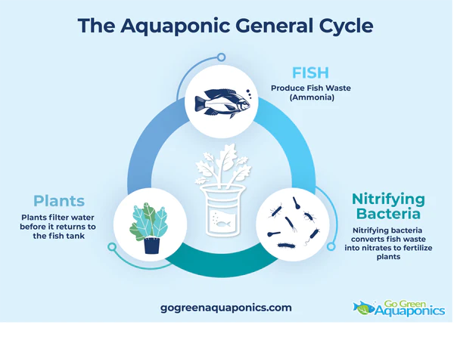

Slide 5
Advantages
Disadvantages
Aquaponics is a sustainable and intensive production system.
It offers two potential incomes from fish and plant production.
Aquaponics is water efficient.
It does not require soil or large space of land.
Do not use fertilizer, pesticides, and other chemicals because they might affect the fish in the system.
Aquaponics allows you to grow food all year round by regulating the temperatures as per what you are growing and using greenhouses.
The produce harvested from aquaponic systems is organic and free from chemicals.
It might be expensive to set up and build.
Daily maintenance is required.
It needs knowledge of fish, bacteria, and plant production.
It requires a reliable electrical source.

Slide 6
Types of Plants that can be grown in Aquaponics
Media Based Aquaponics System: lettuce, tomato, ginger, eggplant, cucumber, and any plants that will fit your grow bed.
Raft System: lettuce, basil, kale, cabbage, swiss chard, bok choy, mint, watercress, and other small rooting plants
Nutrient Film Technique (NFT): lettuce, strawberry, spinach, parsley, dill, and other small rooting plants.

Slide 7
Water Quality Parameters
Parameter | Target Range
Ammonia | 0 ppm
Nitrate | 0 ppm
pH | 6-7
Water temperature | 64-86 Fahrenheit
Dissolved oxygen | 5-8 ppm

Slide 8
How the application works?
This app allows a user to check the water quality of the aquaponics even when the user is far away
It gives the data from the IoT devices from which we can see if the parameter is below or above the ideal range from which users will be able to tweak the nutrition or pH or other water quality to make sure that the plant grows fast
By regularly testing the water quality, you ensure any problems that arise be resolved long before they have had the chance to cause actual damage.

Slide 9
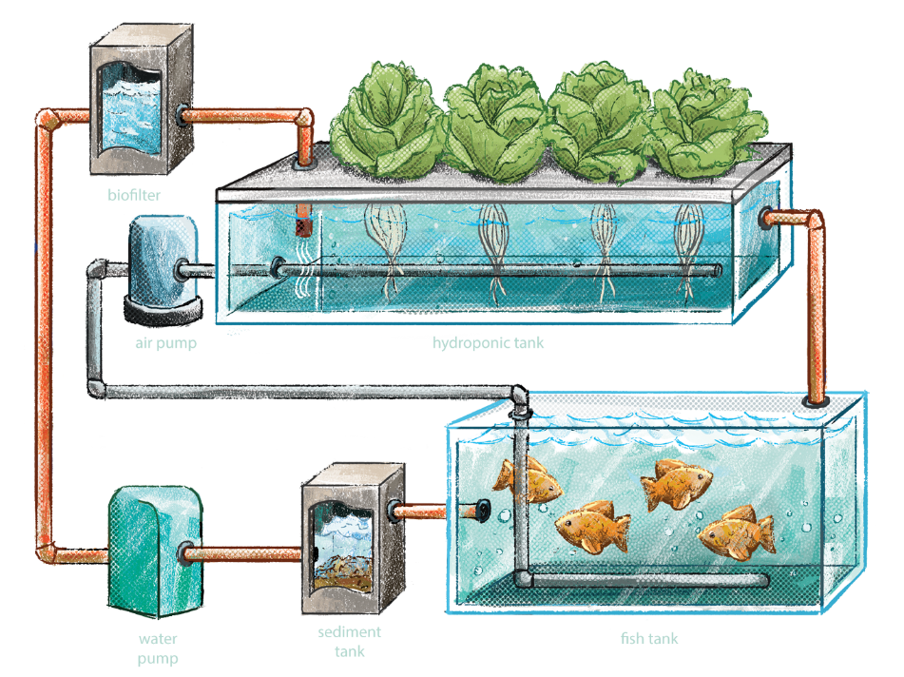
Future Scope
Add Timers and Controllers
These are used for controlling the lighting, pumping, and temperature.

Slide 10
THANK YOU

