Slide 1
Machine Vision
- Lead Frame Inspection
B053022013張瓊文

Slide 2
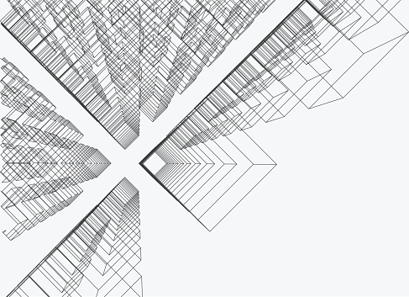
Image
Pre-processing
Problem
Solving
1.
2.

Slide 3
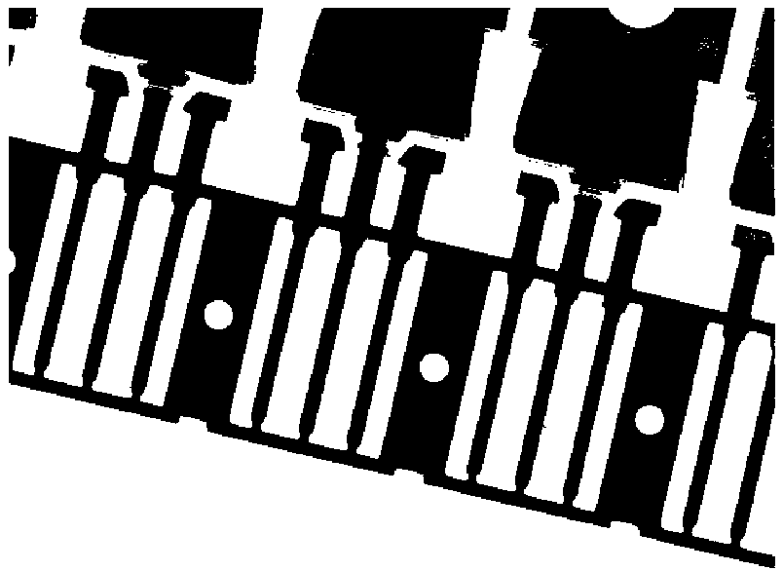
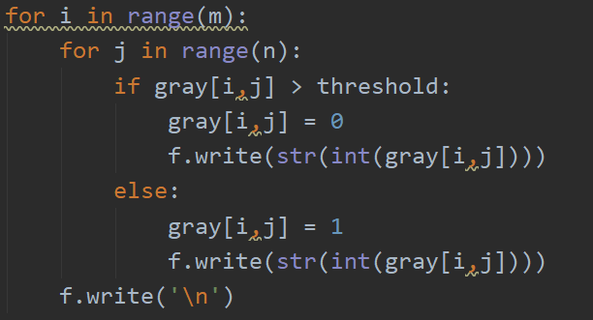
Image Pre-processing – object_label.py
Gray image to Binary image
Set threshold as 50 :
black
white

Slide 4
Image Pre-processing
Component labeling – Sequential Labeling Algorithm(Two-Pass Algorithm)
0
A
0
A
A
0
0
B
A
B
Case 2.
Current Pixel = Neighbor Pixel Label
Case 3.
Current Pixel = Neighbor Pixel Label
Case 4.
Current Pixel = Minimum Neighbor Pixel Label
& create equivalence table
Case 1.
Current Pixel = New Label

Slide 5
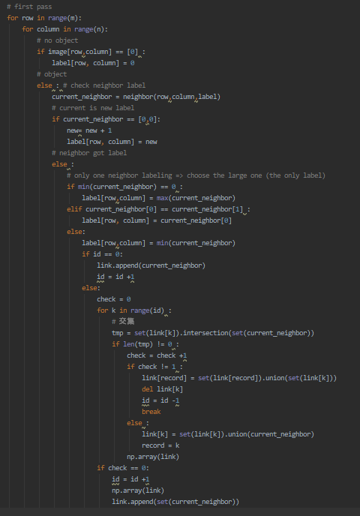
# First Pass
Record the relation of labels

Slide 6
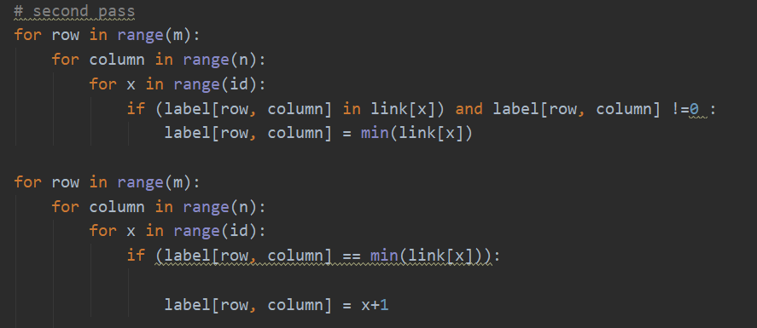
# Second Pass

Slide 7
# Second Pass
Number of Labels = Object numbers

Slide 8
Problem Solving – lead_frame.py
Number of Circle
Lead Width
Diameter of Circle
Center of Circle
Inclination Angle

Slide 9
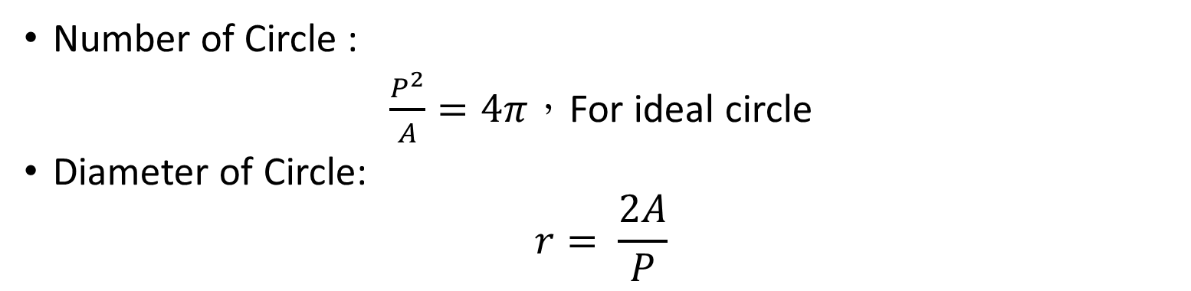
Problem Solving – Circle Detection
Number of Circle :
$\frac{P^{2}}{A}=4π，$For ideal circle
Diameter of Circle:
$$r= \frac{2A}{P}$$
Perimeter : If any 4 neighbor equal to 0, the pixel is seen as boundary
Area : total number of each pixel
In this case, range from 0.75 to 1.2 could be taken as a circle.

Slide 10
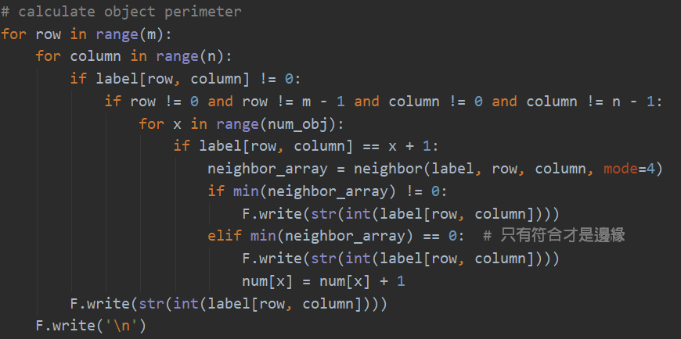
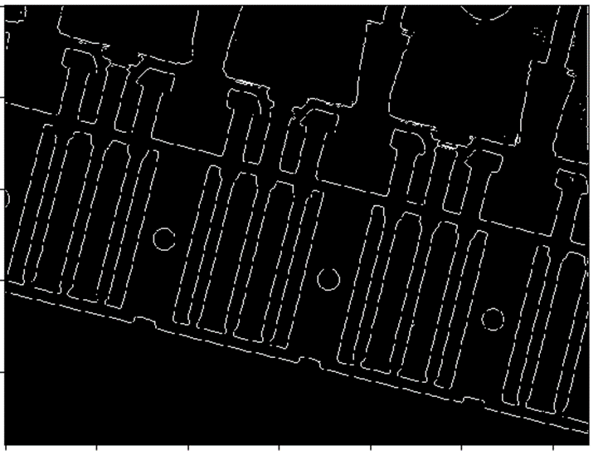
#Perimeter

Slide 11
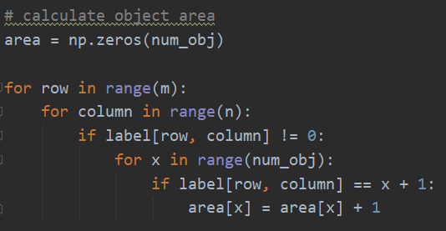
#Area

Slide 12
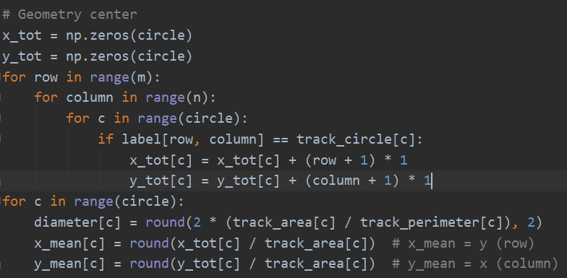
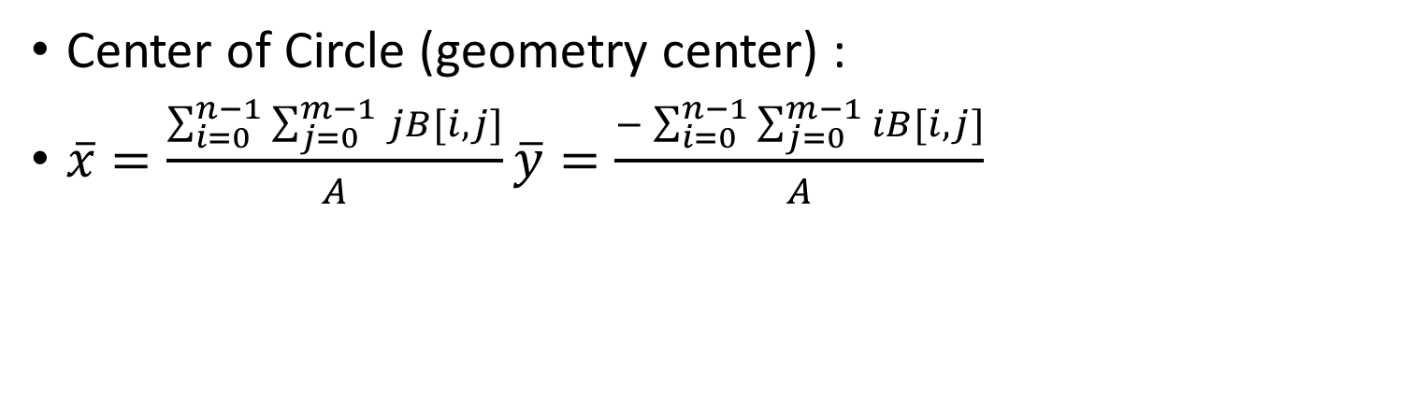
Problem Solving – Circle Detection
Center of Circle (geometry center) :
$\overline{x}=\frac{\sum_{i=0}^{n−1}{\sum_{j=0}^{m−1}{jB[i,j]}}}{A}\overline{y}=\frac{−\sum_{i=0}^{n−1}{\sum_{j=0}^{m−1}{iB[i,j]}}}{A}$

Slide 13
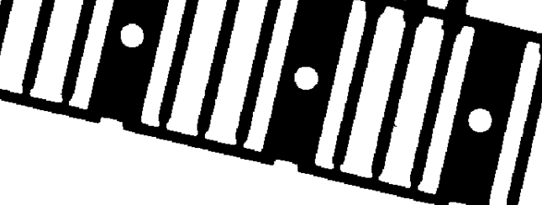

Problem Solving – Inclination Angle
$$θ$$

Slide 14
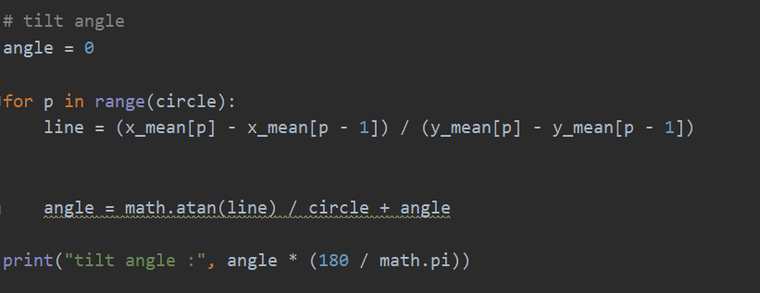
Problem Solving – Inclination Angle

Slide 15
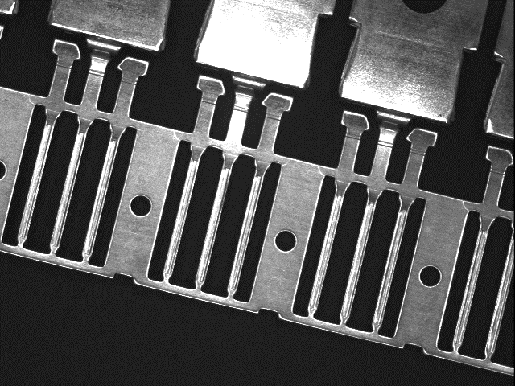
Problem Solving – Lead Width
Step 2.
Choose the parallel line between two lines found in step 1
Step 1.
Find all zero line
& crossing circle line
Step 3.
Record all the labels crossing the red line and calculate the number of each labels
Step 4.
Take the average of each label’s number and filter the labels much larger than the average

Slide 16
Result

Slide 17
Clp2
1 center of circle: [ 257.0 , 175.0 ] diameter 13.85
2 center of circle: [ 300.0 , 355.0 ] diameter 13.85
3 center of circle: [ 344.0 , 535.0 ] diameter 13.97
Number of Circle : 3
tilt angle : 13.5859276252769
number of lead : 10
Each lead length :
[12, 12, 13, 12, 13, 13, 12, 12, 12, 11]

Slide 18
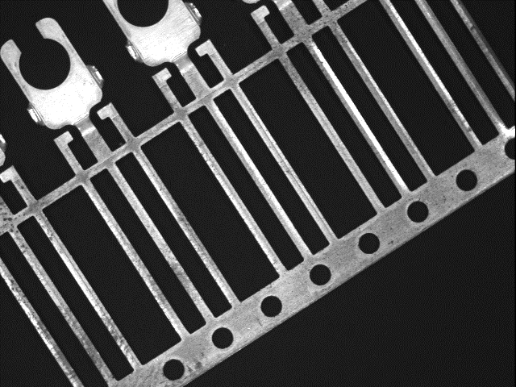
Clp5
1 center of circle: [ 224.0 , 579.0 ] diameter 14.54
2 center of circle: [ 263.0 , 519.0 ] diameter 14.6
3 center of circle: [ 303.0 , 458.0 ] diameter 14.37
4 center of circle: [ 342.0 , 398.0 ] diameter 14.43
5 center of circle: [ 381.0 , 337.0 ] diameter 14.41
6 center of circle: [ 420.0 , 276.0 ] diameter 14.2
7 center of circle: [ 459.0 , 216.0 ] diameter 14.4
Number of Circle : 7
tilt angle : -32.918494616307484
number of lead : 14
Each lead length :
[10, 11, 10, 11, 11, 11, 10, 11, 10, 10, 11, 11, 10, 10]

