Slide 1
Midterm Report
Qiong-Wen Zhang
Nov 18, 2020

Slide 2
Simulation Phantom
The Shepp and Logan “Head Phantom”
Develop Environment : Python + Matplotlib

Slide 3
Phantom Design – Parameters for tomography simulation
#1 Shepp-logan phantom
#2 Modified shepp-logan phantom => improving contrast
Center Coordinate | Major Axis | Minor Axis | Rotation Angle | 1. Refractive Index | 2. Refractive Index
(0,0) | 0.92 | 0.69 | 90 | 2 | 1
(0,-0.0184) | 0.874 | 0.6624 | 90 | -0.98 | -0.8
(-0.22,0) | 0.31 | 0.11 | 72 | -0.02 | -0.2
(0.22,1) | 0.41 | 0.16 | 108 | -0.02 | -0.2
(0,0.35) | 0.25 | 0.21 | 90 | 0.01 | 0.1
(0,0.1) | 0.046 | 0.046 | 0 | 0.01 | 0.1
(0,-0.1) | 0.046 | 0.046 | 0 | 0.01 | 0.1
(-0.08,-0.605) | 0.046 | 0.023 | 0 | 0.01 | 0.1
(0,-0.605) | 0.023 | 0.023 | 0 | 0.01 | 0.1
(0.06,-0.605) | 0.046 | 0.023 | 90 | 0.01 | 0.1

Slide 4
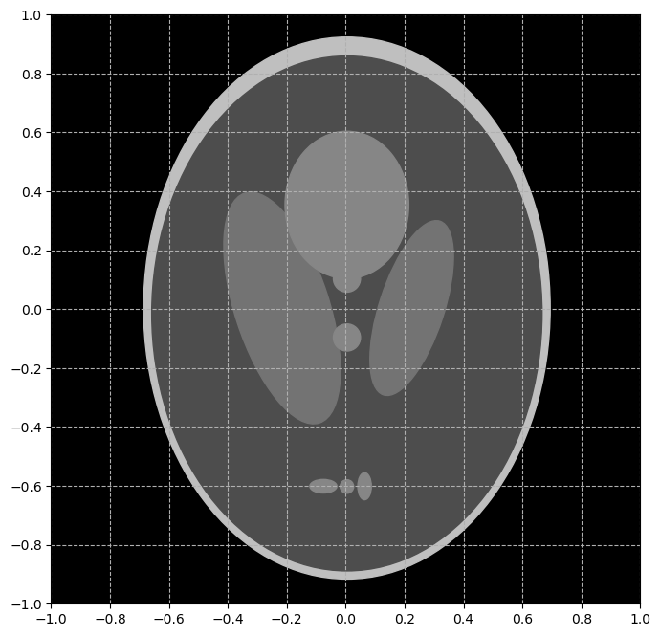
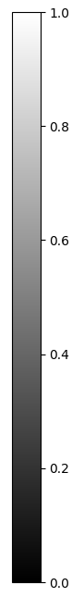
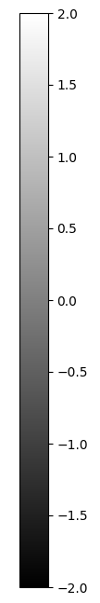
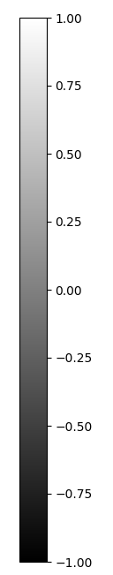
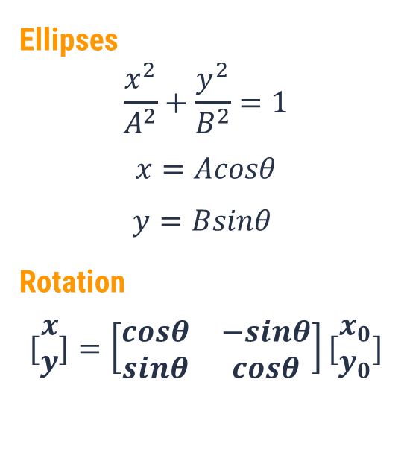
Phantom Design – Implementation detail
Intensity
Ellipses
$$\frac{x^{2}}{A^{2}}+\frac{y^{2}}{B^{2}}=1$$
$$x=Acosθ$$
$$y=Bsinθ$$
Rotation
$$[\begin{matrix}x \\ y\end{matrix}]=\left[\begin{matrix}cosθ & −sinθ \\ sinθ & cosθ\end{matrix}\right][\begin{matrix}x_{0} \\ y_{0}\end{matrix}]$$
640 x 640
#1
#2

Slide 5
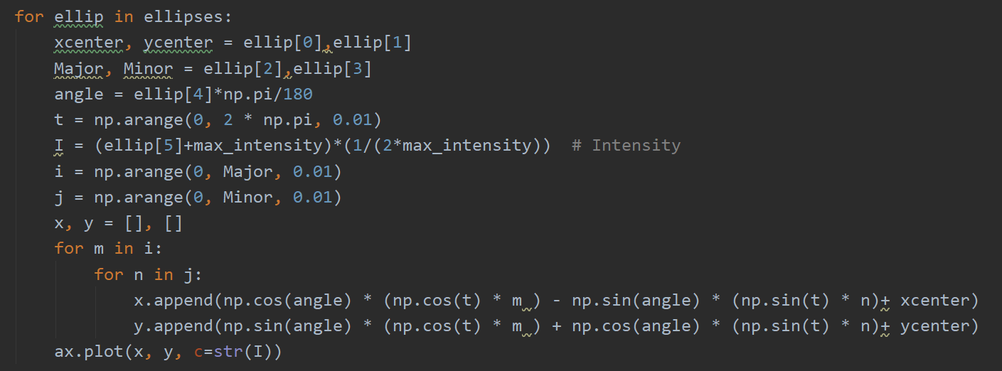
Phantom Design – Implementation

Slide 6
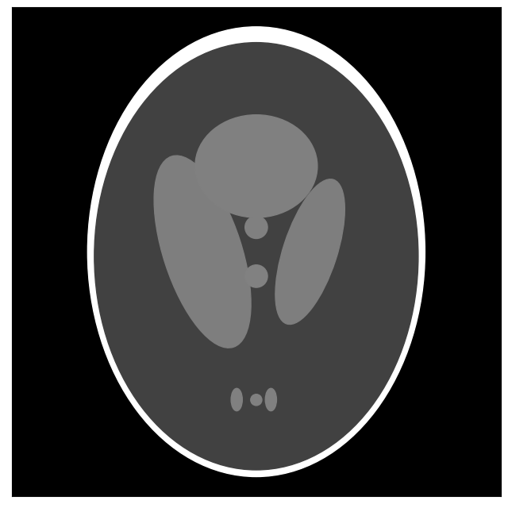
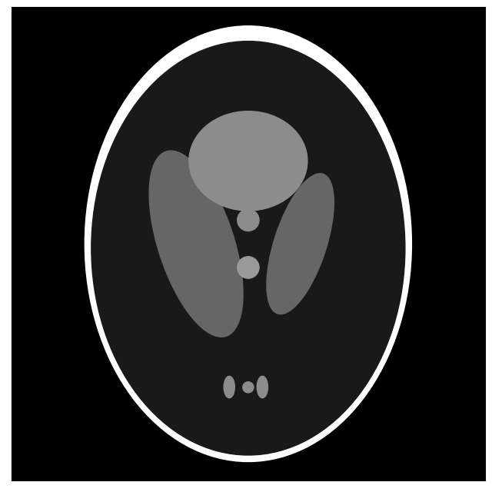
Phantom Design – Results
#1 Shepp-logan phantom
#2 Modified shepp-logan phantom

Slide 7
Fourier Transform

Slide 8
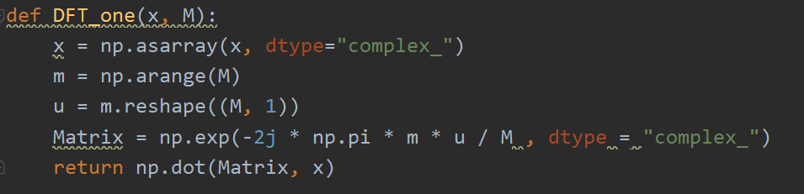

1D Fourier Transform
$F\left(u\right)= \frac{1}{M}\sum_{m}^{M−1}{f\left(m\right)exp⁡(−j2π\frac{mu}{M})}$
1 x M

Slide 9

2D Fourier Transform
$F\left(u,v\right)=\frac{1}{N}\sum_{n}^{N−1}{[}\frac{1}{M}\sum_{m}^{M−1}{f\left(m\right)exp⁡(−j2π\frac{mu}{M})]exp⁡(−j2π\frac{nv}{N})}$
Twice one dimensional Fourier transform
1D Fourier transform for every row
1D Fourier transform for every column
1 x N
1 x M
MxN

Slide 10
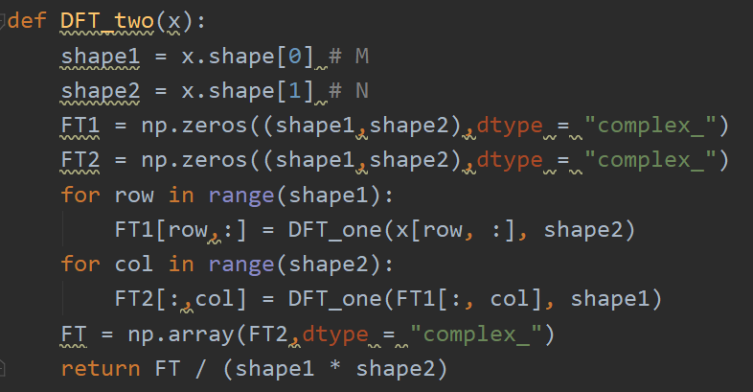
2D Fourier Transform

Slide 11
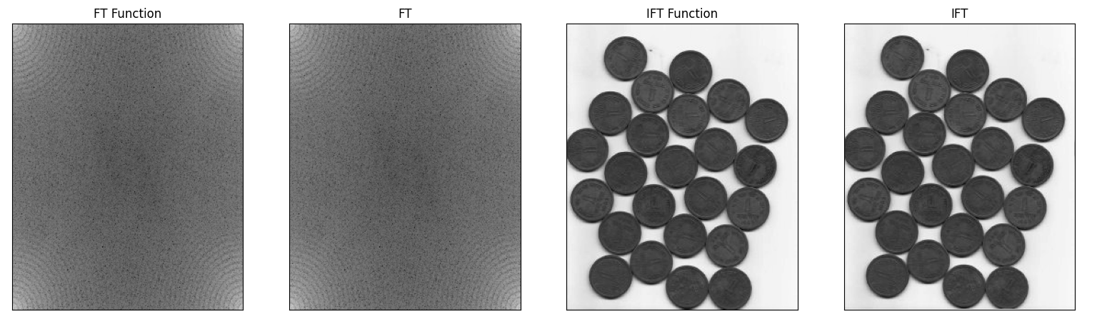
2D Fourier Transform – Result1

Slide 12
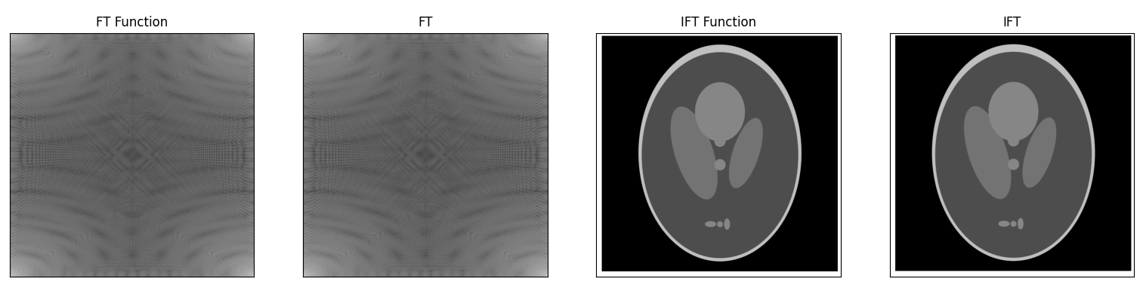
2D Fourier Transform – Result2

Slide 13
GUI Design
User interface for computed tomography reconstruction
Develop Environment : Python + Pyqt5 + Qt designer

Slide 14
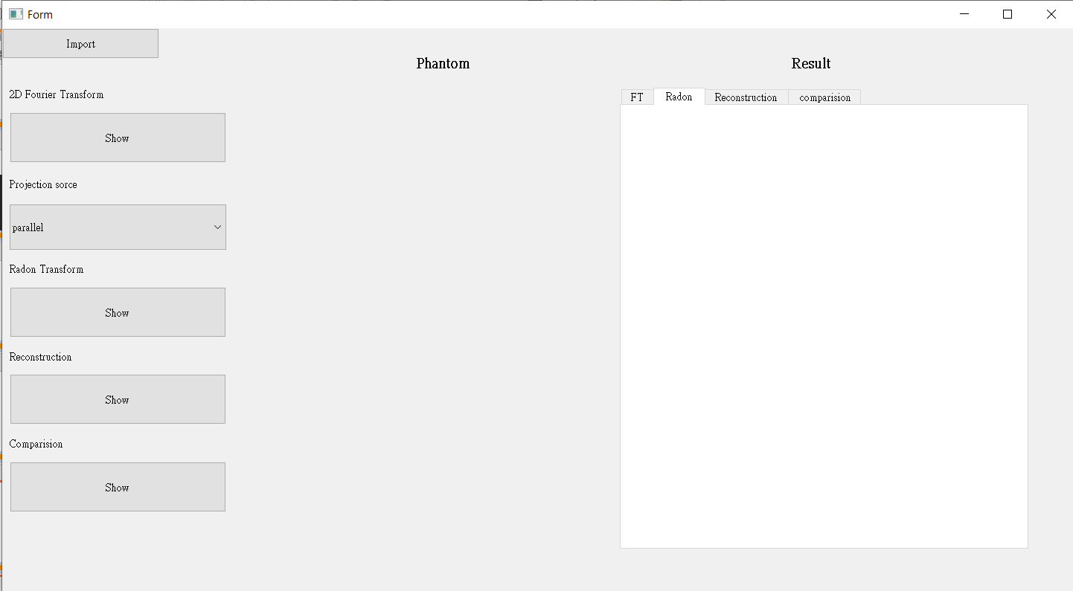
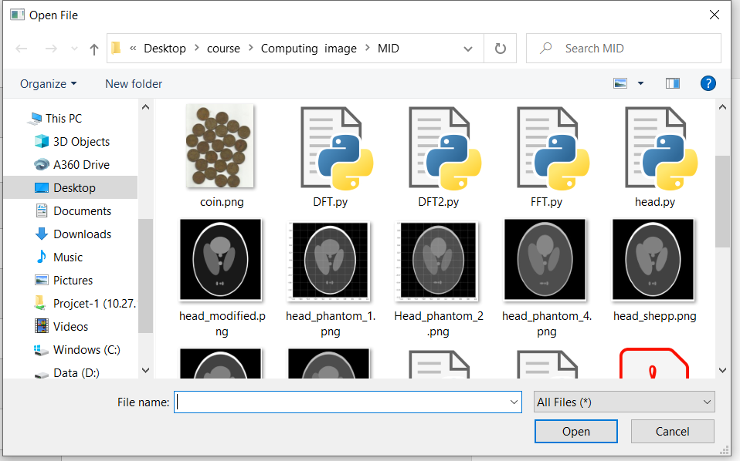
(1) Import File (phantom)

Slide 15
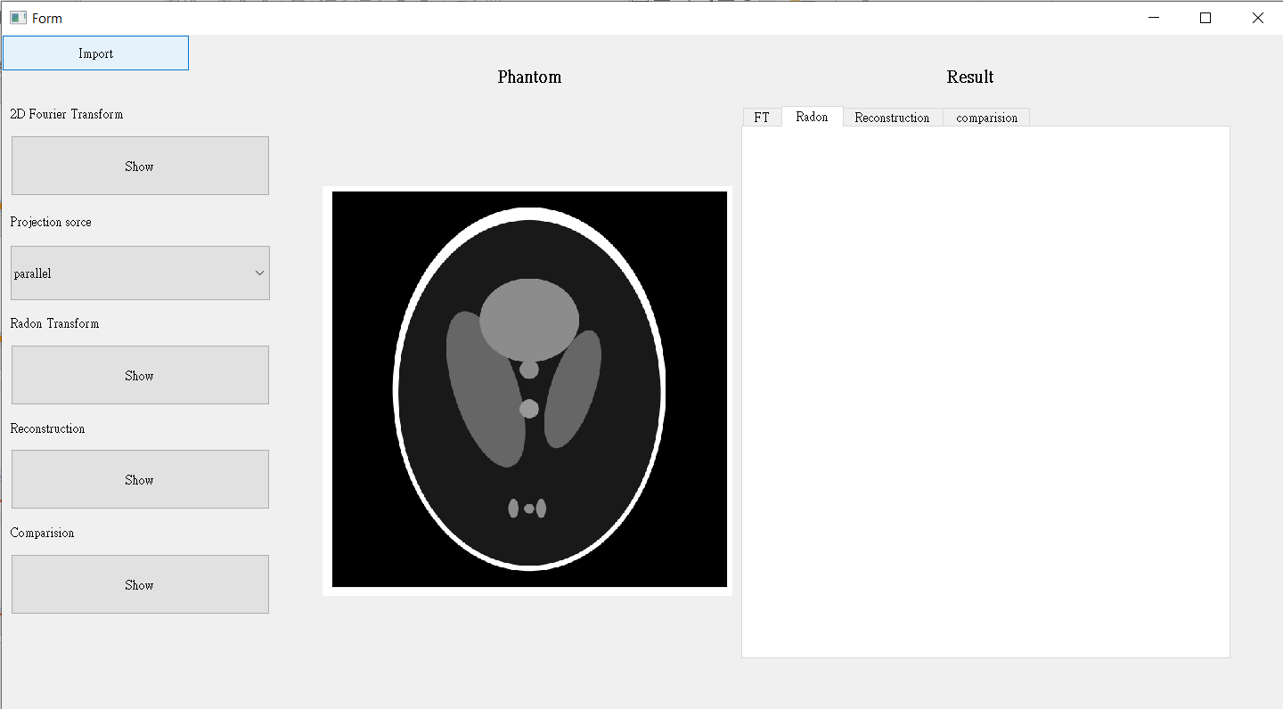
(2) Display phantom

Slide 16
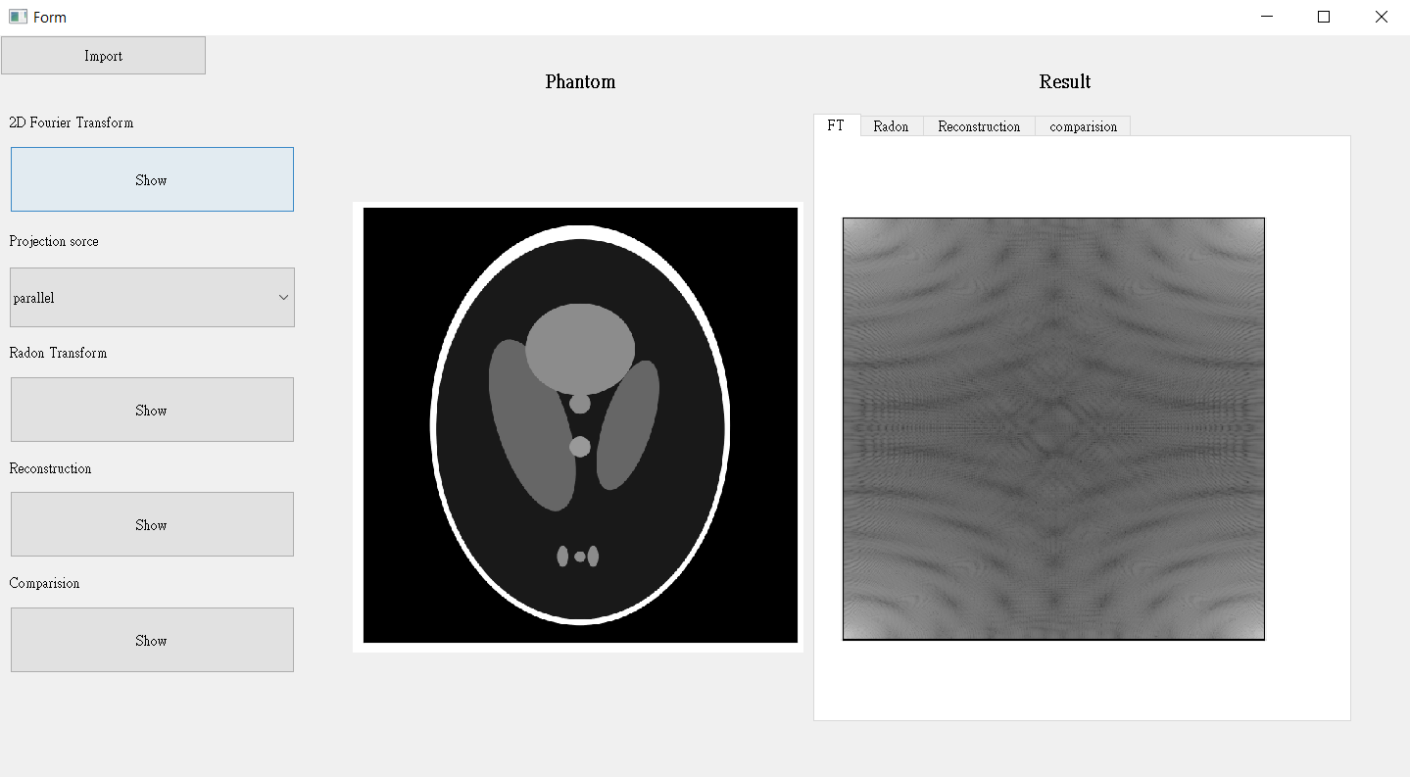
(3) Image Fourier Transform

Slide 17

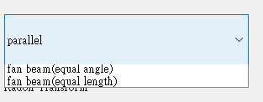
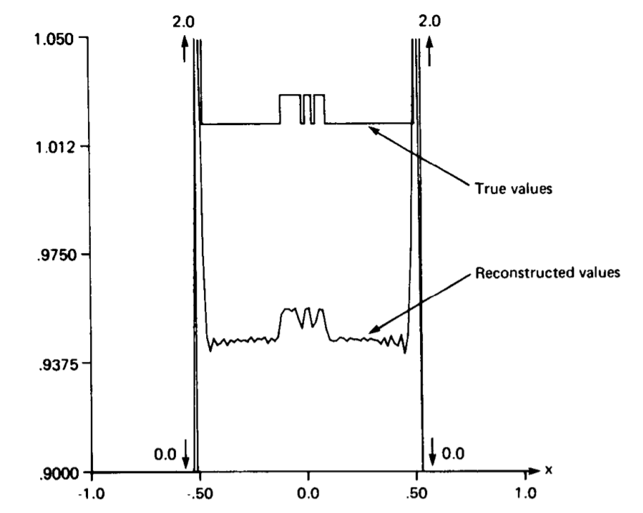
Choose projection source
Radon Transform
Reconstruction : Fourier Slice Theorem,
filtered backprojection algorithm
Enter a line y =? , Make Numerical comparison of the true and the reconstructed values

Slide 18
THANKS!

