Slide 1
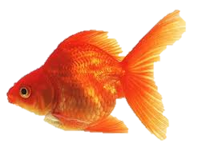
Final Project -
Image Tracking

Slide 2



Template1
Window search
Template2
15 pixels
74x44
Template
Template
Image
44x74
15 pixels
Template
240
320

Slide 3
Three-Step Search
74
Template
Whole Image Template Matching : 74x44 =3256
Window
Three-Step Search(Practical): 9+9+9 = 27
44
44
74

Slide 4
Template Matching
Sum of Square Difference(SSD)
Bhattacharyya Coefficient

Slide 5
Sum of Square Difference
SSD = SSD + np.square(image[row,column]-template[x,y])
74
Template
Smaller SSD contribute to higher similarity of image
Limitation of deformation object
Window
44
44
74

Slide 6
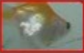
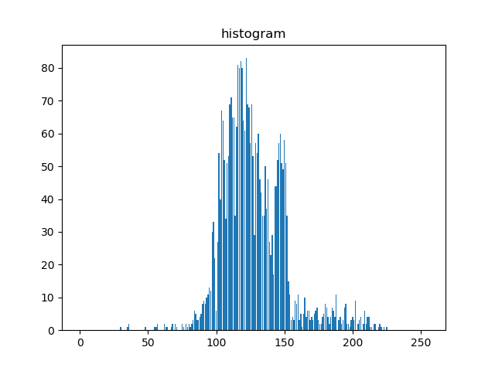
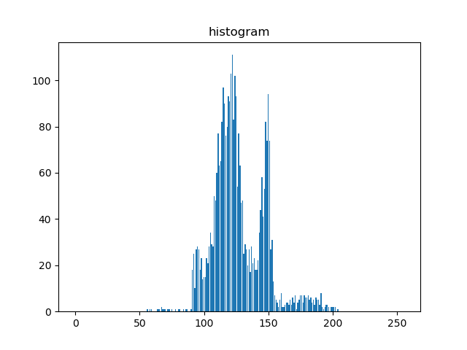
Bhattacharyya Coefficient
Template2
Probability density function
histogram_template
histogram_image

Slide 7








Bhattacharyya Coefficient
$$P′$$
$$θ$$
histogram_template = [P1,P2,P3…..,Pm]
histogram_image = [Q1,Q2,Q3…..,Qm]
$$Q′$$
$$Bhattacharyya Coefficient=$$
$$f\left[P′,Q′\right]=cosθ= \sum_{i=1}^{m}{\sqrt{PiQi}}$$
$$θ$$
$f\left[P′,Q′\right]$
$$Similarity$$
$$Bhattacharyya Coefficient$$

Slide 8
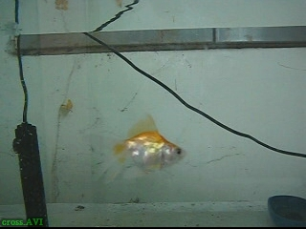
Test
240x320
image
Template1
Template2
74x44
44x74
def rgb2gray(rgb):
return np.dot(rgb[..., :3], [0.299, 0.587, 0.114])
gray = rgb2gray(image)
template1 = rgb2gray(template1)
template2 = rgb2gray(template2)

Slide 9
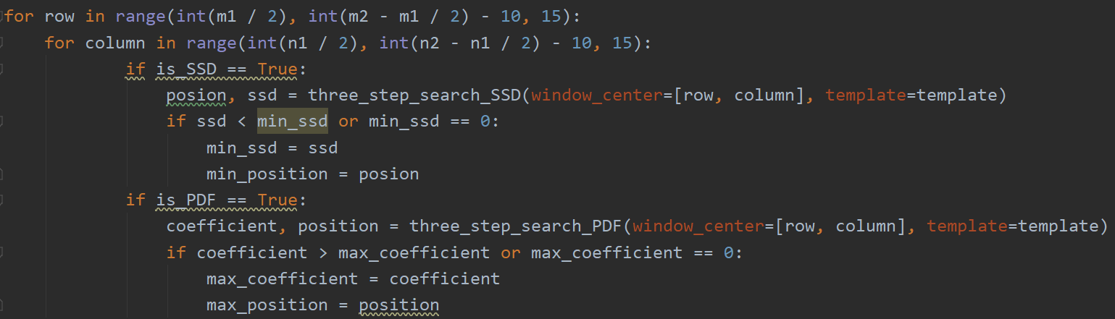
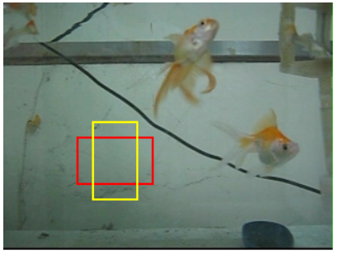
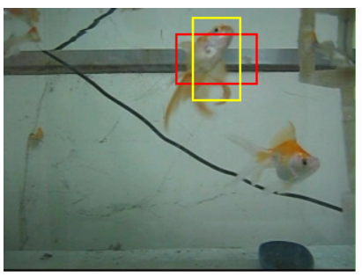
Window search

Slide 10
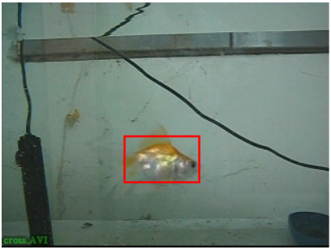
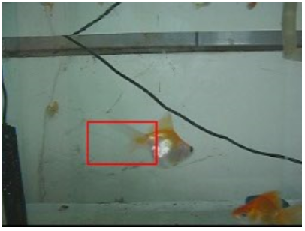
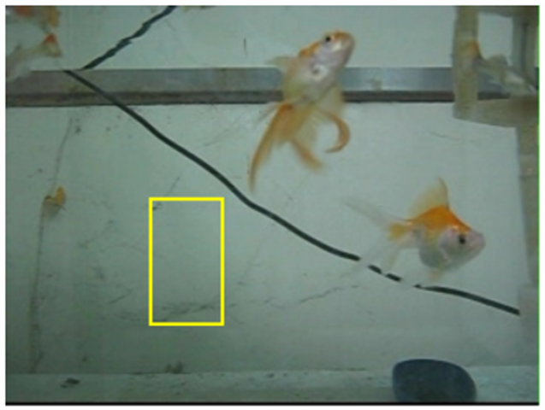
TTS + SSD
Template1
Template2
Template
Test 1
Test 4
????

Slide 11
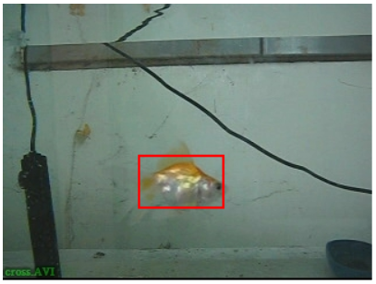
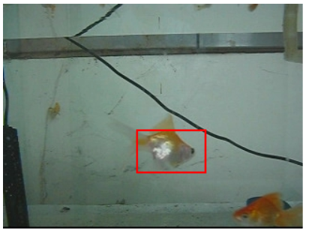
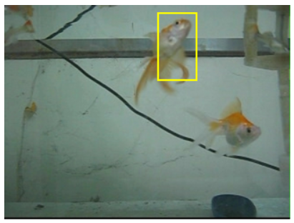
TTS + Bhattacharyya Coefficient
Template1
Template2
Template
Test 1
Test 4

Slide 12
Thank You

