Slide 1
TalentGuard
🛡️
AI
Preventing employee turnover with responsible AI
Hackathon Trusted AI March 2026
🔒 Cybersecurity
⚖️ Ethics AI

Slide 2
CONTEXT
The problem
📉
🔍
⚖️
33%
0
HIGH
Turnover rate
Predictive tools
Legal exposure
of employees in the dataset have left
HR teams lack systems to anticipate departures
HR data is sensitive — GDPR & AI Act apply
→ Our answer: TalentGuard AI

Slide 3
SOLUTION
How it works
01
02
03
04
05
🔒
🤖
💬
⚖️
🎯
→
→
→
→
GDPR
Anonymization
Random Forest
Model
NLP Sentiment
Analysis
Fairness Audit
AIF360
Simulator
📊 Dashboard · 🔍 Individual analysis · ⚖️ Fairness audit · 🔐 Security · 🎯 Risk simulator

Slide 4
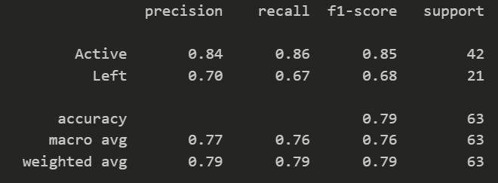
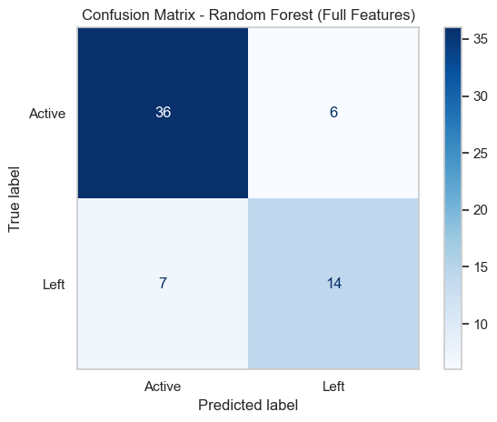
Model
Random forest
Columns removed:
To avoid leaks:
DateofTermination
EmpStatusID
EmploymentStatus
HasTermDate
TermReason
After creation of ternure:
DateofHire
LastPerformanceReview_Date
Becase they were not predictive:
ManagerID
ManagerName

Slide 5
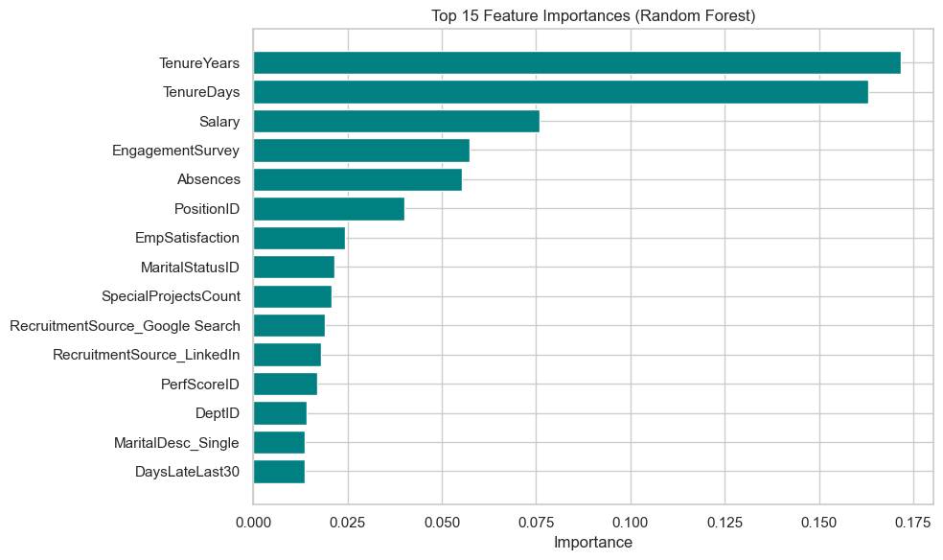
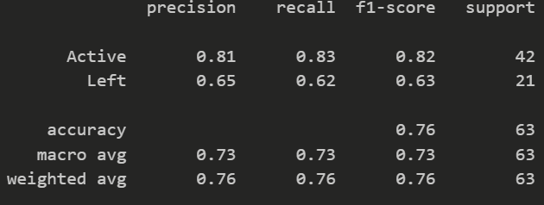


Slide 6
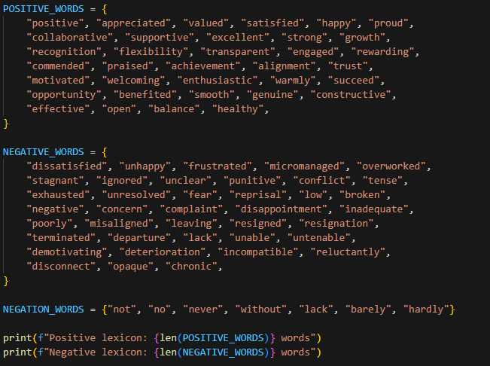
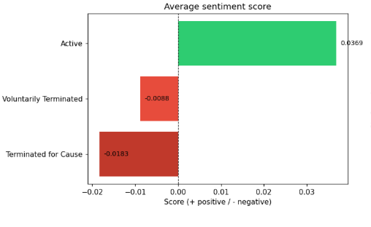
Employee Feedback Analysis with NLP and Machine Learning
Step 1 : 2 columns generated with AI to simulate employee comments (ExitInterview_Feedback, InternalTransferRequest)
Step 2 : lexicon-based sentiment analysis. Each comment is tokenized and scored : score = (positive_words –negative_words) / total_words
Step 3 : Text Vectorization (comments are transformed into numerical vectors with TF-IDF, weighting words by frequency and rarity.)

Slide 7
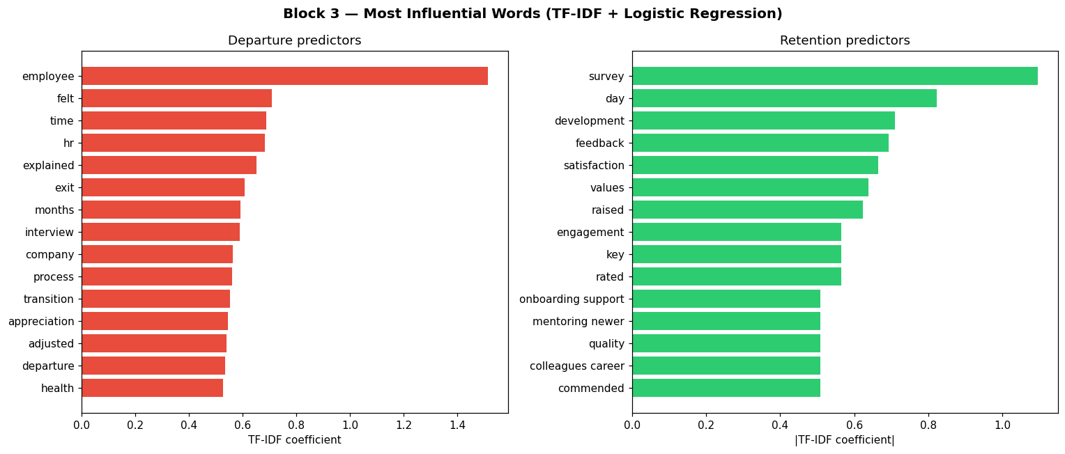
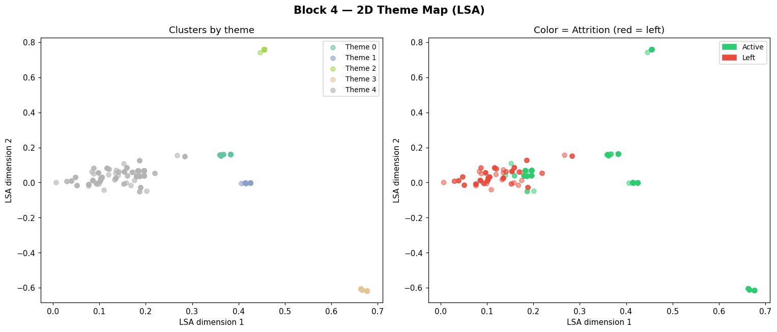
Employee Feedback Analysis with NLP and Machine Learning
Step 4 : Logistic Regression modeling
(coefficients reveal words associated with leaving)
Step5: Theme discovery with LSA and K-Means
Step_6: composite risk score

Slide 8
AXIS 1 — CYBERSECURITY
Protecting HR data
~311 employees (after anonymization)
Target variable: Termd (0 = active, 1 = left)
Turnover rate: ~33%
Sensitive attributes present: Gender, RaceDesc, GenderID
Technique | Columns affected | Justification
Suppression | Employee_Name , ManagerName | Direct identifiers
Pseudonymization | EmpID | Truncated SHA-256 hash, non-reversible
Generalization | DOB AgeGroup | Useful info without exact date
Masking | Zip first 2 digits | Reduction of geographic precision
Model exclusion | Gender , RaceDesc , GenderID | Retained only for fairness audit

Slide 9
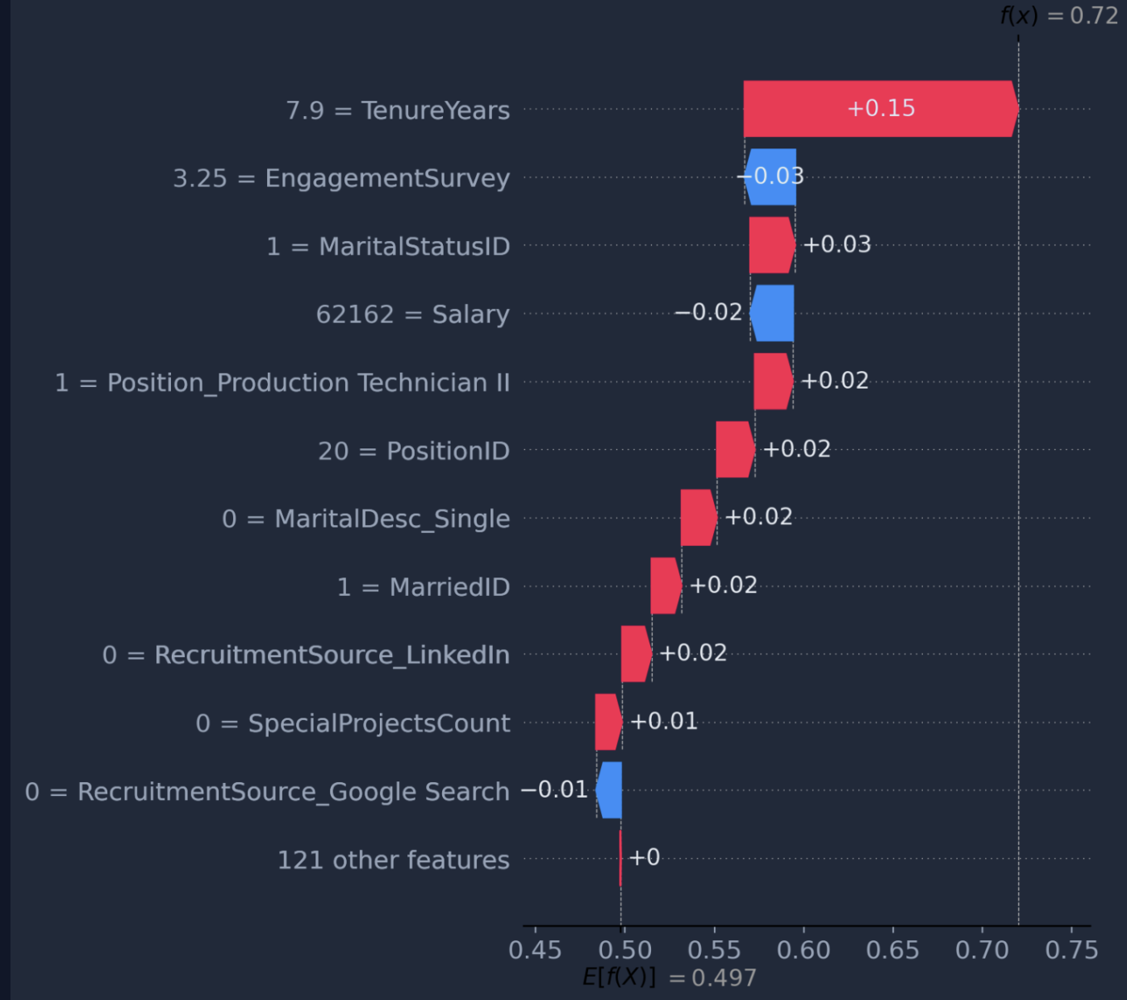
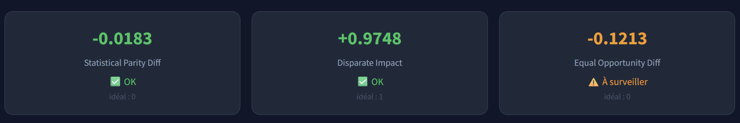
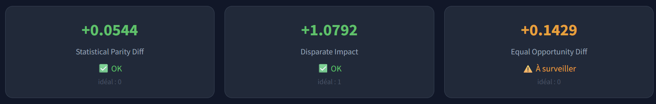
AXIS 2 — ETHICS AI
Fairness audit
Shap
Gender (M vs F)
Ethnicity (White vs others)
Speaker 4

Slide 10
The application
📊
🔍
⚖️
🔐
🎯
Dashboard
Individual
analysis
Fairness
audit
Security
Risk
simulator
Risk scores · RF vs NLP
Top 10 at-risk employees
SHAP waterfall
Auto HR recommendation
AIF360 metrics
Gender & ethnicity
Input validation
Attack simulation
5 sliders → live score
Frugal model
$ streamlit run app.py → http://localhost:8501

