Slide 1
BOOKING HOTEL
BACK-END
FRONT-END
DATABASE
Spring Framework
ReactJS
My SQL Workbench

Slide 2
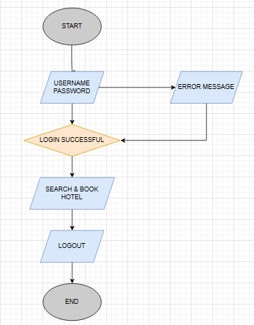
START
EDIT PROFILE
USERNAME
PASSWORD
EMAIL
ERROR MESSAGE
LOGIN SUCCESSFUL
HOTEL DETAIL
HOTEL
HOTEL DETAIL
BOOKING
ADD TO FAVORITE
PAYMENT
END

