Slide 1
Extracting Relations Between Chemicals and Genes in Biomedical Text
Chloё Smart

Slide 2

Motivation
Large amounts of research needed to develop a drug
Causes bottlenecks within drug design and discovery
Solution is automation with deep learning models

Slide 3
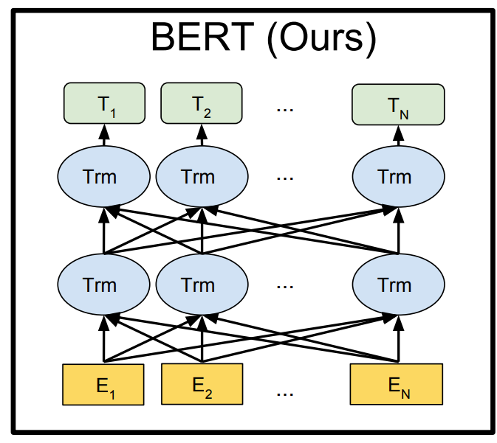
BERT
BERT pre-trains bidirectional representations from text
Can be used to perform biomedical relation extraction.
PubMedBERT uses domain-specific pre-training

Slide 4
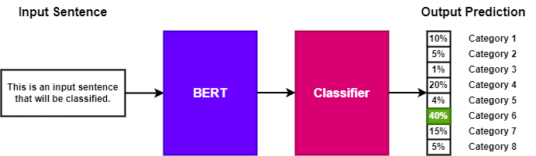
Text Classification

Slide 5
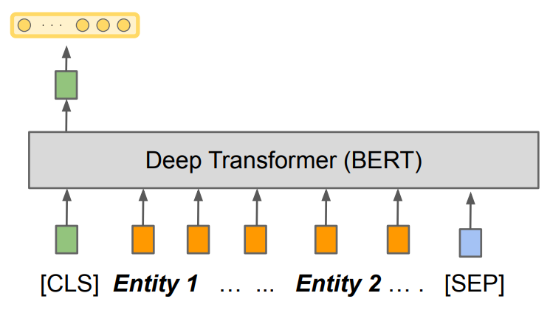
Sentence Representations
[CLS] embeddings tend to represent the sentence as a whole.
Can extract [CLS] embeddings and classify them

Slide 6
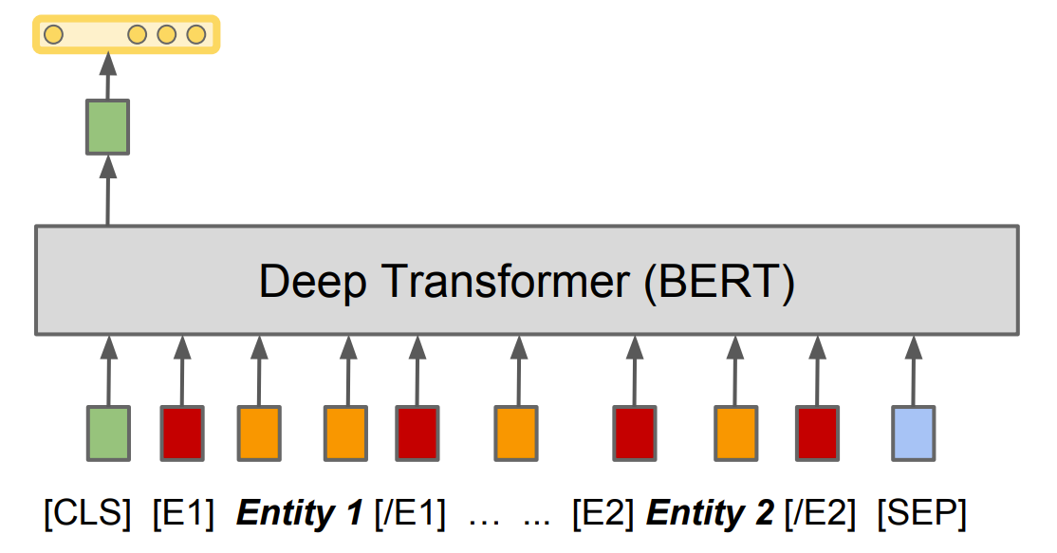
Entity Markers
Can add tags around entities
Gives BERT more information about which entities are of interest
Could improve [CLS] representation

Slide 7
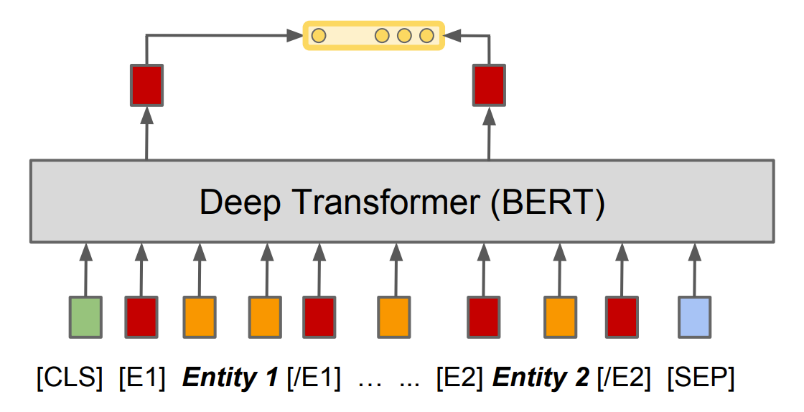
Entity Representations
Could get more information from the entities themselves
Extract beginning tags of each entity and concatenate them together
Will classifying entity representations be more effective than classifying [CLS] representations?

Slide 8

Entity Information
How much entity information does BERT require within the text input?

Slide 9
Context and Mention
Contains both the entity mentions and surrounding context
Equivalent structure to previous question

Slide 10
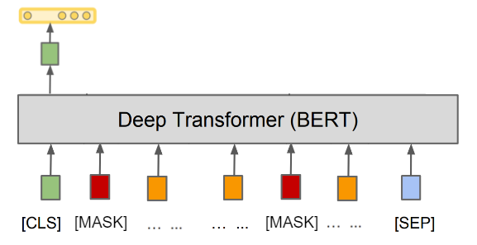
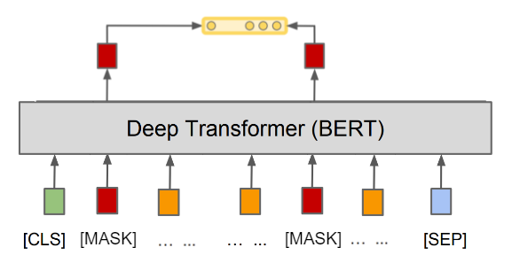
Context
Can represent only context by using [MASK] tags
Doesn't provide information about entities

Slide 11

Context and Type
[CHEM] for chemicals, [GENE] for genes
Might give BERT more ideas about the surrounding context
This is the ‘Special masking’ input

Slide 12
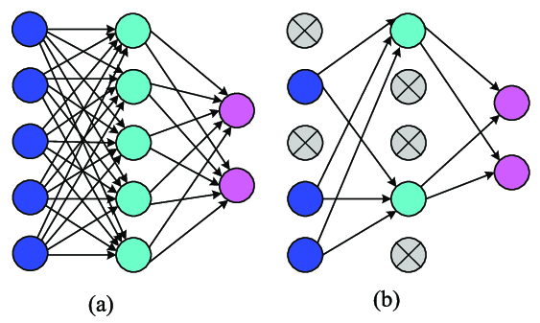
Dropout
Can use dropout to regularise
Promotes generalisation
What is the optimal dropout level for different sentence representations?

Slide 13
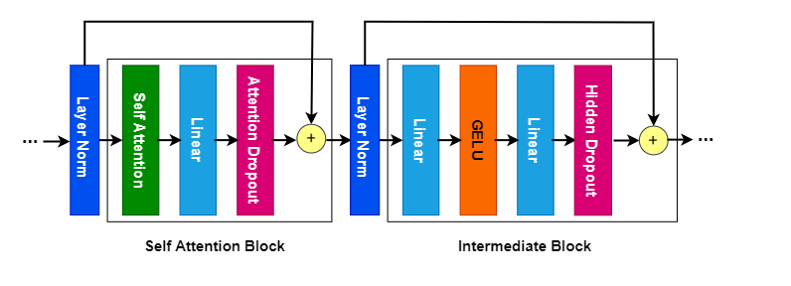
Method
Adjust Attention_probs_dropout and Hidden_dropout_prob parameters
Values will range from 0.1-0.7, incrementing by 0.1 each time

Slide 14
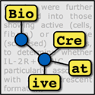
DrugProt Dataset
DrugProt is a dataset that contains information about the interactions between drugs and proteins.
The dataset was created by collecting data from various sources, including public databases and literature.

Slide 15
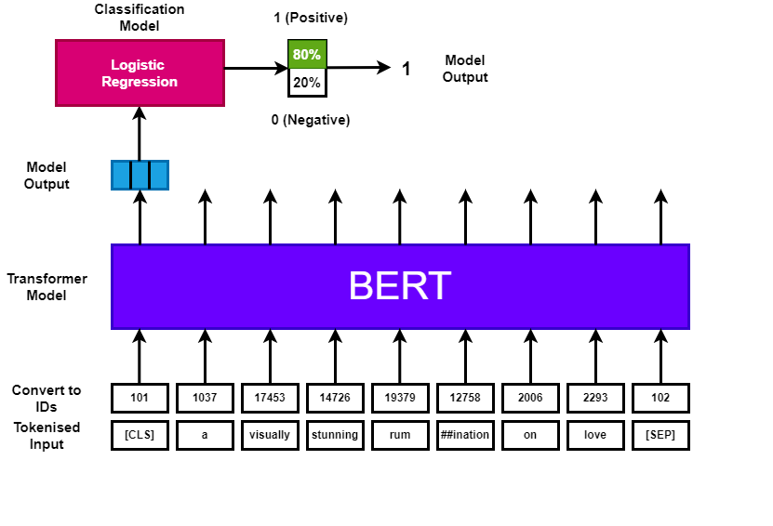
Feature Extraction

Slide 16
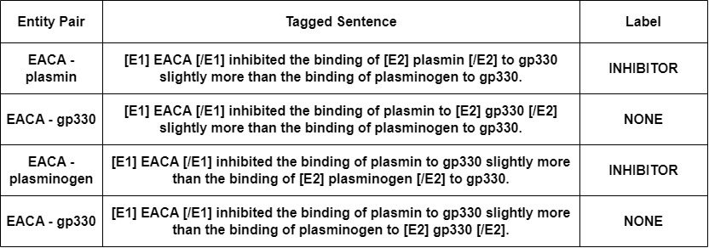
Cartesian Product

Slide 17
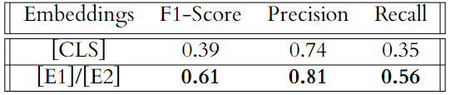
Results For Representations
Will classifying entity representations be more effective than classifying [CLS] representations? YES!
Could be potentially due to different vector sizes ([CLS] has size 768, [E1]+[E2] has size 1536).
Increased dimension reduces confusion regarding class boundaries for logistic regression.

Slide 18
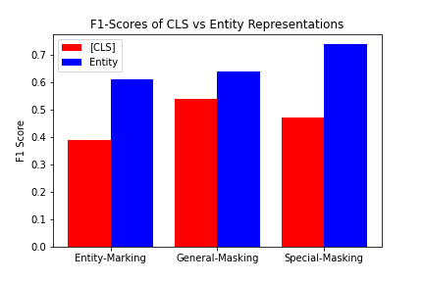
Results for Context
How much entity information does BERT require within the text input? CONTEXT + TYPE!
Using input with context and type provided the best results
[CLS] representations were best with the input with just context

Slide 19
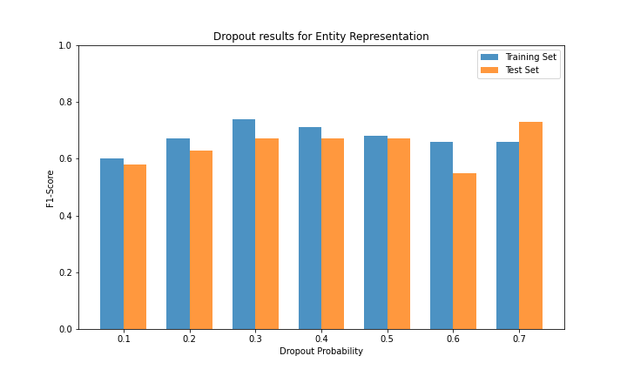
Results For Dropout
What is optimal dropout level for different sentence representations?
Best dropout = 0.5
Smallest difference between training and test sets
Excessive dropout causes degradation in performance

Slide 20
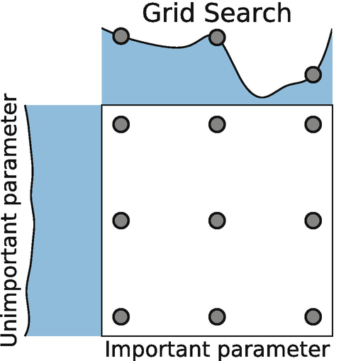
Discussion
Can improve logistic regression by tuning its hyperparameters
Grid search gave hyperparameters that improved F1 Scores by 10\%

Slide 21
Applying Results
Used optimal logistic regression parameters
Entity representations
Context and type sentences
0.5 dropout
Best relation F1 Score: 90% for PART-OF relation
Overall model F1 score: 78%
Shows promising results for biomedical relation extraction

