Slide 1

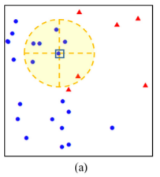
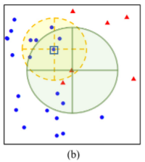
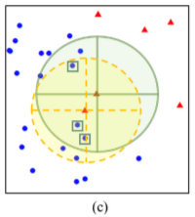
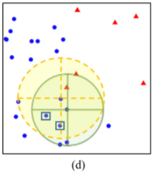
Neighbourhood-based undersampling approach for handling imbalanced and overlapped data
Pattaramon Vuttipittayamongkol∗ , Eyad Elyan
School of Computing Sciences and Digital Media, Robert Gordon University, UK
Abstract
Experiments
This paper proposes an undersampling framework for handling class imbalance in binary datasets by removing potential overlapped data points. Our methods are designed to identify and eliminate majority class instances from the overlapping region. Accurate identification and elimination of these instances maximise the visibility of the minority class instances and at the same time minimises excessive elimination of data, which reduces information loss. Four methods based on neighbourhood searching with different criteria to identify potential overlapped instances are proposed in this paper. Extensive experiments using simulated and real-world datasets were carried out. Results show comparable performance with state-of-the-art methods across different common metrics with exceptional and statistically significant improvements in sensitivity.
We simulated 66 datasets representing a wide range of scenarios including extremely imbalanced and overlapped datasets and used them for evaluating our methods.
Three experiments were carried out. In Experiment I, we discuss performance of our methods using simulated datasets. In Experiment II, we evaluate our methods using real-world datasets, and further in Experiment III, performance on the large, high-dimension real-world datasets is discussed.
Results and discussion
Experiment I: Simulations
Our NB-based methods produced exceptionally high sensitivity. Comparable results with SMOTE and BLSMOTE were achieved in terms of G-means, but with lower precision and recall. Our NB-based methods significantly outperformed ENN in sensitivity and G-mean with comparable F1-score. More importantly, our methods outperformed state-of-the-art kmUnder and OBU in all measures.
Experiment II: Real-world datasets
NB-Comm on average ranked best in F1-score and G-mean. The method also showed high average ranking in terms of sensitivity, and relatively good ranking in precision. This high performance across the different measures reflects a good trade-off between true positive and false positive rates of NB-Comm. NB-Basic and NB-Tomek showed competitive average ranking in F1-score. In particular, NB-Basic and OBU had higher positive class accuracy but lower negative class accuracy than NB-Tomek and kmUnder. Thus, NB-Basic, OBU, NB-Tomek, and kmUnder performed comparably on these datasets. As a result of the trade-off for the highest positive accuracy, NB-Rec did not perform well in F1-score. NB-Rec is thus more desirable. Our NB-based methods ranked top in sensitivity. In particular, NB-Rec and NB-Basic provided significantly higher sensitivity than BLSMOTE, ENN and the baseline. NB-Basic provided competitive sensitivity and G-mean with state-of-the-art kmUnder and OBU, however with higher precision and F1-score ranks. Finally, these results are consistent with the results obtained using SVM, which indicates a stable performance of our methods across different learning algorithms.
Experiment III: Large and high-dimensional datasets
The performance of our methods on the large high-dimensional datasets was consistent with the previous experiments. NB-Rec performed best in sensitivity on all of the large high-dimensional datasets and had reasonable true negative rates (as can be observed from G-mean), however highly suffered from high false positives due to the trade-off nature on a large and highly imbalanced dataset. NB-Basic, NB-Tomek, and NB-Comm showed significantly higher improvements over ENN and OBU. They were competitive with kmUnder on average.
Proposed methods
1. Basic Neighbourhood Search
The method removes any negative query that has a positive neighbour. As can be seen in Fig.(a), the query in the centre of the circle is marked as a potential overlapped instance because one of its nearest neighbours is a positive instance.
2. Modified Tomek Link Search
Modified Tomek Link Search is proposed as an extension of NB-Basic to address potential excessive elimination of negative instances. For every negative instance x with a positive neighbour y, x is removed only if it appears within the k nearest neighbours of the positive instance y. In other words, when the neighbourhood between a negative query and a positive query is established in both directions, the negative query in the modified Tomek Link is eliminated (Fig.(b)).
3. Common Nearest Neighbours Search
NB-Comm, to remove common negative neighbours of positive instances. Two positive queries will be used for considering the elimination of a negative instance. The common negative nearest neighbours of any two positive queries are identified as potential overlapped instances and removed (Fig.(c)).
4. Recursive search
NB-Rec is proposed as an extension of NB-Comm to ensure sufficient and accurate elimination of overlapped negative instances. From Algorithm 3, X is the set of potential negative instances to be eliminated by NB-Comm, all elements in X are used as the secondary queries in NB-Rec as described in Algorithm 4. The negative instances that are the common nearest neighbours of any pair of secondary queries are then to be eliminated along with all elements in X. We hypothesise that by introducing this extension, a finer-grained search criteria are provided. As a result, more overlapped negative instances will be detected, hence further improvements in sensitivity are expected (Fig. (d)).
Conclusions
The proposed methods were compared against well-established and advanced methods and achieved the highest sensitivity with competitive G-means. Our methods also showed competitive performance across all degrees of class overlap on the simulated datasets. The four approaches provided different benefits and trade-offs:
NB-Rec yielded exceptionally high sensitivity at all degrees of class imbalance and class overlap but had higher false positives at higher class imbalance degrees;
(2) NB-Basic resulted in competitive sensitivity with better trade-offs of fewer negative class prediction errors (false positives) than the state-of-the-art methods;
(3) NB-Tomek and NB-Comm showed similar trade-offs and were comparable to the state-of-the-art methods in all metrics. These methods provide different options that suit various problem domains.

