Slide 1
Pizza Perish
Chloe Woodman
2D Shooter

Slide 2

Log Line
What is your game about in one or two sentences?
My game is about a zombie apocalypse, you play as a pizza boy whom shoots pizzas at zombies to stop them from eating your brain.
What is the core concept? What is the big idea? What are the epic moments?
The core concept is purely to fire at as many zombies at possible, for every zombie who is beaten, you get a higher score, the game is about how many zombies you kill in 30 seconds.
When Enemy approaches
A delivery boy must shoot them
Before they eat him.

Slide 3
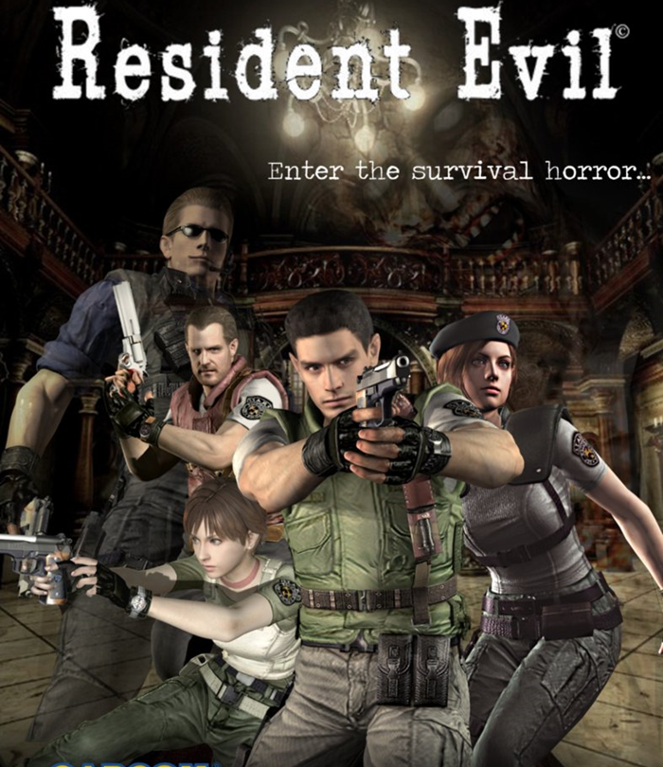
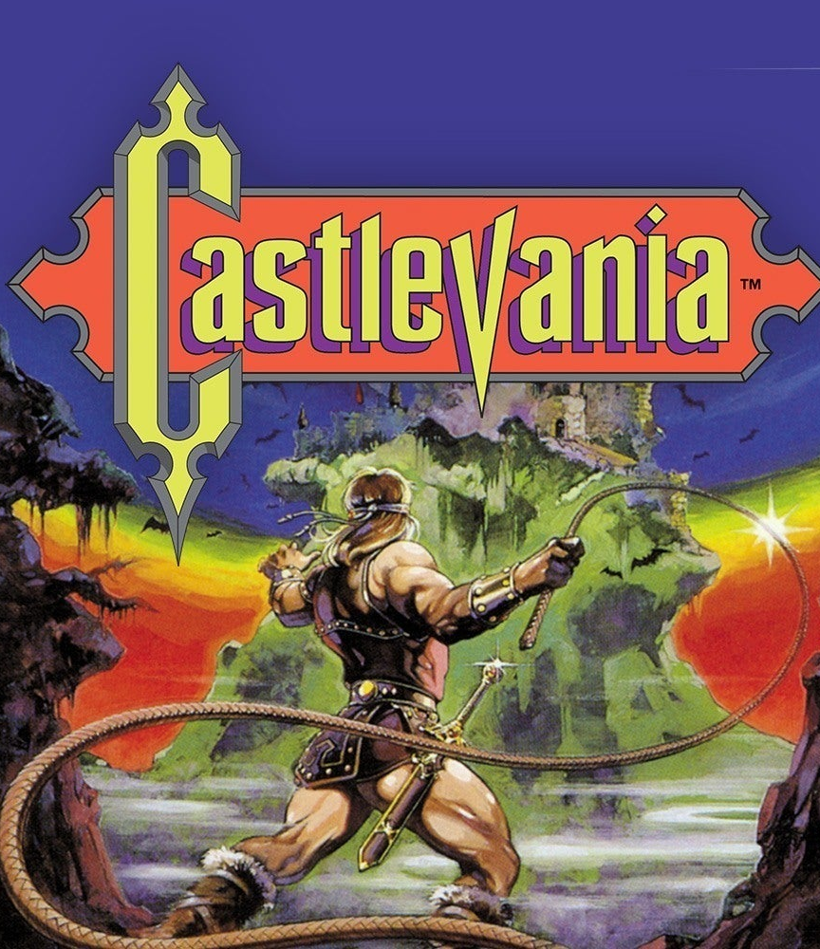
Inspired By

Slide 4
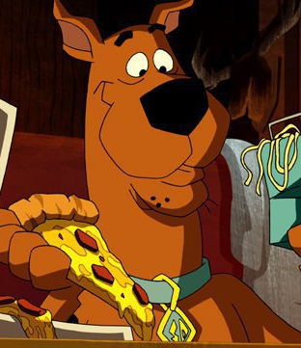
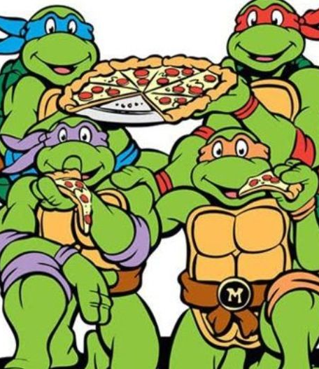
SO why pizzas?
Ever since classical animations, from the 80s to present, it is not uncommon for pizza to be a popular trope; for example, teenage mutant ninja turtles, scooby doo, the Simpsons, it was even starred in a SpongeBob episode “Pizza Delivery”.
Pizza is synonymous with not only being a great food, but also videogames, so I believed it would be clever to implement this pizza-video game relationship into an actual videogame mechanic.
I decided to come up with zombies and in zombie lore they are known to eat brains, I simply came up with a unique concept where you can feed them pizzas instead to get them to leave your brain alone.

Slide 5
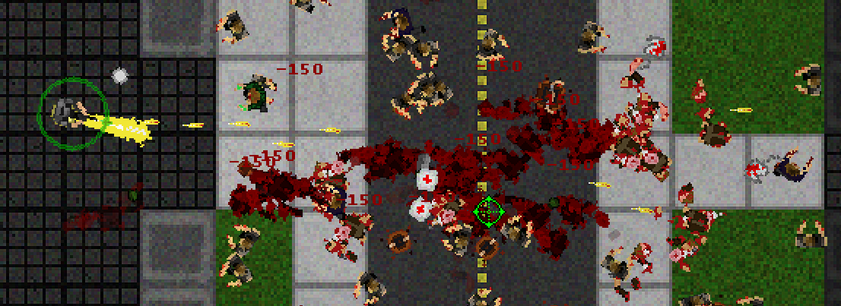
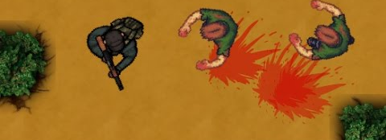
Genre of the Game
The genre of the game is a 2D shooter top down game.
It is this genre because of the main defence against the enemy (zombies) which is by shooting pizza at them to quench their hunger.
I also chose for the game to be top down due to the environments being quite small, considering the aim is to get to the delivery car, so to take advantage of the small environment to the best of its abilities, I think a top down approach is more visually appealing than a platformer.

Slide 6
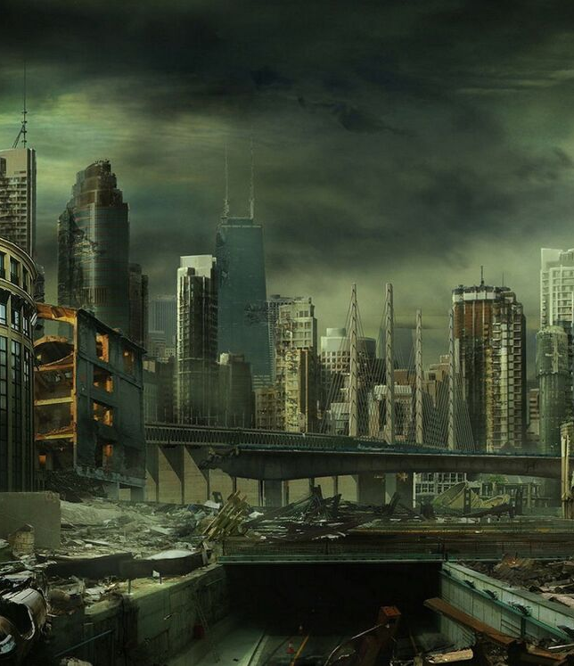
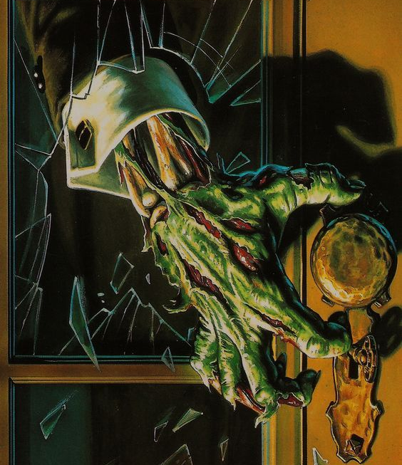
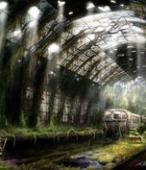
Colour Board and Themes

Slide 7
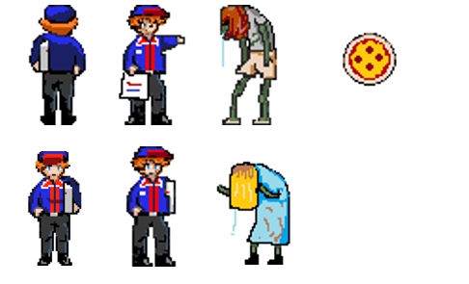
Characters
Pizza boy from different perspectives, enemy zombies of two variations.
The game will hold a pixel art style, very similar to old classic Gameboy games, as I believe this art style is charming and also a nice call back to the idea of pizza being very popular in 80s media

Slide 8
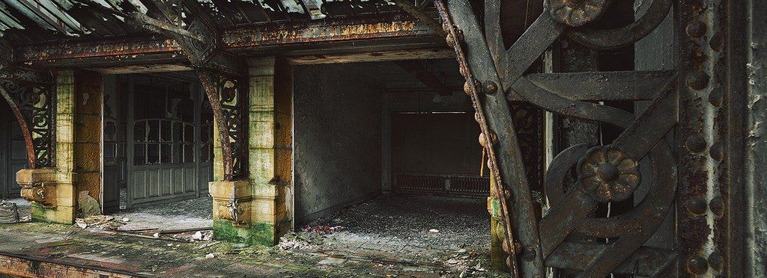
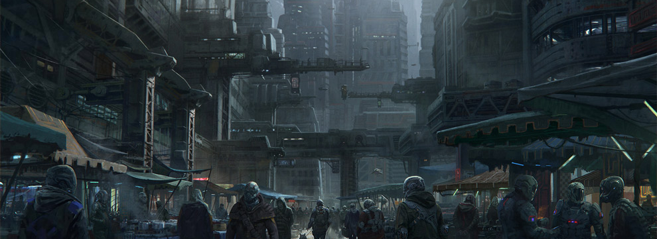
Environments
Since the story of the game involves a zombie apocalypse, due to the lack of humanity, the infrastructure may be abandoned and overgrown; I want to set the game post outbreak where it is clear that the world has had this problem for a long duration of time. This is because I believe it explains the quantity of enemies and how there is so many around the area wherever you go.

Slide 9
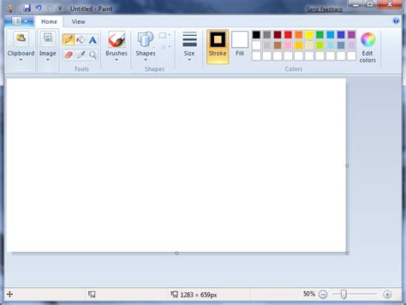
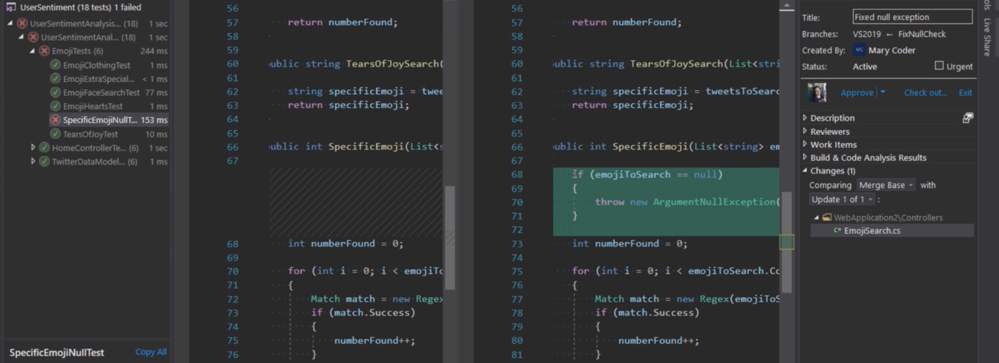
Resources
Resources that will be used for the development of the game may be:
visual studio for C++ SDL2 programming
Paint for sprites design

Slide 10
Features
Creative designs
Pizza attack mechanic which is original
Uses a power up weapon, which is a garlic bread sword so there is a reward for effort
Game over/retry option

Slide 11
Effects
Sound effects
May be adventurous theme
Background music
Menu
Animations
Charge up mechanic
Pixel style art

Slide 12
Thank you

