Slide 1
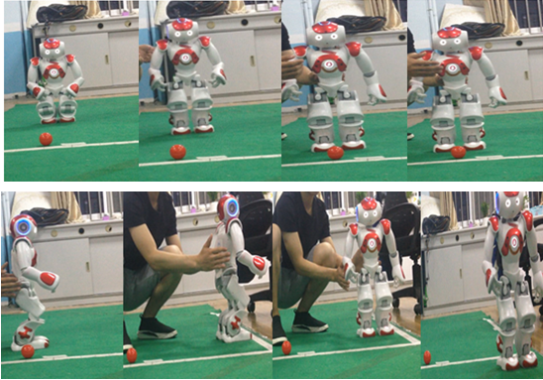
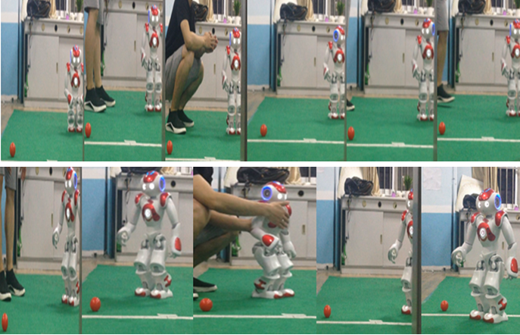
Problem Setting: In robotics competition/robotics performance, if we use RF communication module, there would be more than 10 robotic teams communicating with robots at the same time, each team has multiple robots to control, for example, like playing soccer. What is an effective way to use RF communication without interference with other transmitters? How do we get precise synchronous frequency signal?

Slide 2
Precise Synchronous Frequency Offset Apparatus in Robotics Application
The Precise Synchronous Frequency Offset Apparatus is developed in response to the urgent need of RF module communication of robotics. It adopts computer intelligent measurement and control technology to realize the high precision of synchronous frequency calibration. It completely got rid of the design idea and structure mode of the traditional synchronous excitation system, with the microcontroller as the core, combined with the specially designed frequency calibration measurement interface, under the support of a full scope of synchronous frequency calibration software, the traditional analog phase-locked loop (PLL) synchronous frequency calibration method is completely replaced by the real-time frequency measurement and control of the microcontroller.
Solution:
Frequency calibration: Standard Frequency (SF) signal 1(MHz) from China Central Television (CCTV).
Interlaced scan
Phase-Alternating Line (PAL) – based TV (First scan odd-numbered lines, then even-numbered lines, in total 625H, 312.5H each.)
At 16H and 329H of any CCTV programs, they contain 20 synchronous pulses from cesium atomic clock whose precision can reach 10^{-11} – 10^{-15}.
Extract 20 synchronous pulses to get SF -> calibrate VCXO with SF -> processing frequency –> transmit
Thus, we can assign the frequency to each robot from 200 MHz, step size as 1 MHz increment, e.g. the second robot RF communication can be set as 201 MHz, the third 202MHz, etc.

Slide 3
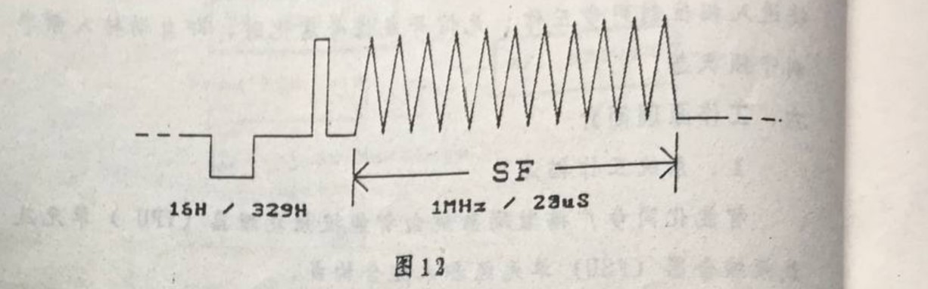
System’s building blocks: Intelligent Processing Unit (IPU), Frequency Synthesizer Unit (FSU), Frequency Multiplier Board Unit, Uninterruptible Power Supply (UPS).
Principles of the apparatus: National Metrology Institute standard frequency signal is embedded in the CCTV programs’ 16H and 329H (interlaced scan in China). Near-ground microwave, TV broadcasting network and satellite transmitted (Doppler Effects corrected) CCTV programs all contain this signal. Utilize demodulated video signals from either TV or satellite TV receiver to calibrate the frequency of IPU.

Slide 4
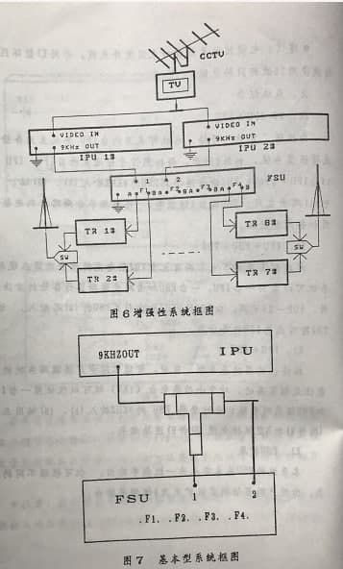
Based on the video signal quality, microcontroller of IPU would automatically calibrate frequency of the high voltage-controlled crystal oscillator (VCXO), then output 9 kHz calibrated VCXO signal (after frequency conversion). The output from IPU is the input to FSU.
IPU-1# and IPU-2# are main/standby in operation, automatically switched at FSU. The optimally chosen signal out of the two locks 8 frequency synthesizer PLL circuits simultaneously, where every 2 PLL is main/standby major frequency. After switch, they’re sent to the transmitters through the medium wave.

Slide 5
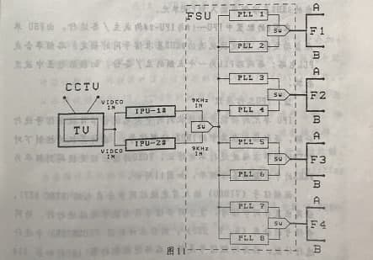
Principles of IPU:
The function of the IPU is to decompose the received CCTV program video signal, to extract the 1MHz standard frequency signal in it, and to continuously calibrate the accuracy of the frequency of the VCXO under the control of the microcontroller. The output of the VCXO is converted to obtain a frequency of 9kHz medium wave as excitation reference frequency.

Slide 6
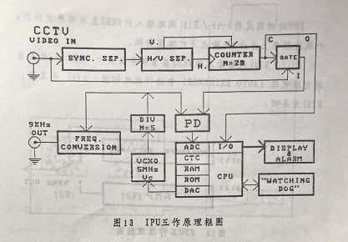
Video input -> Synchronizer Separator (get the composite synchronization signal) -> H/V Separator (separate the horizontal and vertical synchronization signals (by the digital circuit)) -> Counter -> Counter overflow signal (choose the signal from 16H/329H), (opening the gate) -> compare the SF with VCXO decomposed frequency 1 MHz at Phase Detector (PD) -> phase/time error function processed in MCU (ADC) -> data sampling, operation, analysis -> output by DAC to feedback control VCXO
VCXO 1MHz -> frequency conversion -> 9kHz
Can change “M=5” and change frequency synthesizer to get any frequency we want.

Slide 7
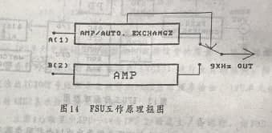
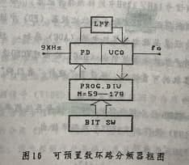
Principles of FSU:
The function of the FSU is to convert the 9kHz reference frequency of the A(1)/B(2) input to 4 carrier frequencies and output it to the broadcasting transmitter in 8 channels. The 9kHz reference frequency of the A(1)/B(2) two-way input is amplified (AMP) and then switched in the automatic switching circuit; A(1) is the main use, and B(2) is the backup.
Carrier frequency f0 is derived from multiplying 9kHz through PLL:

Slide 8
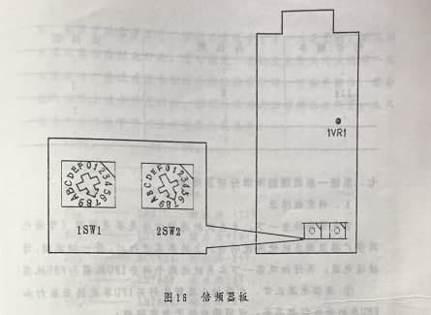
The preset frequency division coefficient N is represented by two hexadecimal numbers of high order and low order, which can be directly selected on the dial switch conveniently. The specific method is as follows:
The user frequency can be found from the corresponding preset number through the table. According to the preset number, set the preset switch 1SW1 to the high digit and 2SW2 to the low digit, and then the required frequency value can be obtained.

Slide 9
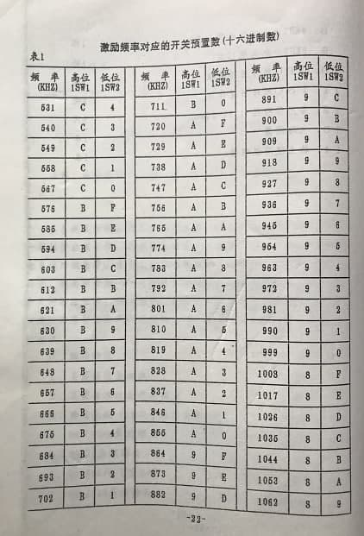
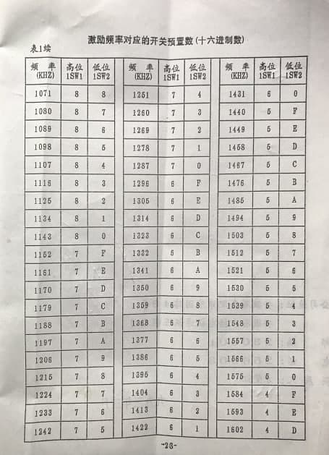

Slide 10
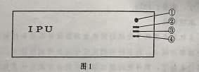
1) WORK/ALARM light
“green”- normal
“red” - alarm, buzz
2) SF light
“on” - normal
“blink” - not stable
“off”- no SF or non-CCTV signal
3) DATA light
“on”- 8kB space refreshed completely
“blink”- in the process of refreshing
“off” – no data operation
4) P/F (Phase-Frequency status) light
“on”- SF is provided, phase status works synchronizedly
“blink”- SF has a pause of >1 hr, i.e. frequency status engages
“off”- greater than 24 hrs frequency uncalibrated

Slide 11
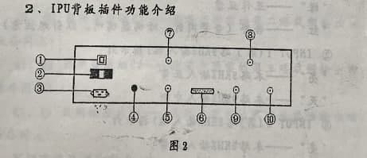
The back of the IPU board:
8) UPS input
9) 1MHz SF output(for testing)
10) 5MHz VCXO output (for testing)

Slide 12
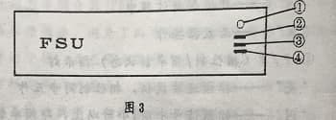
1) WORK/ALARM light
“green”- normal
“red”- alarm, buzz
2) INPUT 1 light (the first 9kHz input)
“on”-input 9kHz normal
“off”- input 9kHz interrupted
3) INPUT2 light (the second 9kHz input）
“on”- input 9kHz normal
“off”- input 9kHz interrupted
4) PLL light
“on”- all PLL normal
“off”- at least one of PLL unlocked

Slide 13
Troubleshooting and testing:
Simple analysis and elimination of the system’s general failure:
1. Identify the source of the failure:
Check the connection -> compare with the manual
Turn on the power -> observe IPU and FSU
a) The power is normal; the power plug is in good contact -> both IPU and FSU panel lights are off -> both have problems
b) IPU panel light is off or alarming; FSU panel light W/A alarms while INPUT1 and INPUT2 lights are both off -> then IPU has problems
c) IPU light is normal; FSU panel light has W/A alarming -> the issue is in FSU
2. IPU
If the issue is in IPU, then take off the panel of the IPU unit and observe the inside of the machine:
1) Power board
Check the right part of the interior board: if the 3 green lights are off -> the power has issues
Check in order: master fuse, power transformer, etc.
One of the 3 lights is on -> the power and the master fuse are normal
The power interface, the rectifier and filter circuit or the sub-fuse is broken which corresponds to the one whose light is off. Rule out each by order.
Sub-fuse and the above are all good -> three terminal voltage regulator is broken -> check the corresponding relation between each green LED and each voltage regulator:

Slide 14
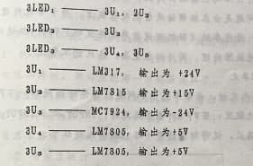
a) 3LED1 off -> 3U1 or 3U2 -> measure 3JKa (Testing Point) “3” and “2” end voltage to the ground respectively -> “3” (24V, 3U1), “2” (15V, 3U2).
b) 3LED2 off -> 3U3
c) 3LED3 off -> 3U4 or 3U5 broken -> 3JKb (TP) “3” and “2” end voltage to “1” end respectively -> “3”to “1” (5V, 3U4), “2” to “1” (5V, 3U5).

Slide 15
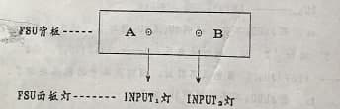
3. FSU
IPU is normal -> check FSU panel lights condition
W/A light has alarming light on; one of INPUT1 and INPUT2 is off -> the 9 kHz input circuit whose light is off is broken
Power board:
All the lights on the panel are off -> remove the frontal panel
All the 3 green LEDs are off -> either power transformer and its connection or master fuse broke
One of the 2 LEDs are on -> the above are normal
The problem is in the sub-fuse and connection and the rectifier filter circuit whose light is off
The sub-fuse and the above are good -> its three-terminal regulator is broken
Check the relation between the 2LEDs and the regulator:

Slide 16
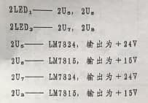
a) 2LED1 is off -> 2U5 or 2U8 broken
Measure 2JK4 (TP) “1” end and “2” end voltage to the ground respectively -> “2” (24V, 2U5), “1” (15V, 2U8)
b) 2LED2 off -> 2U7 or 2U8 broken
Measure 2JK4 (TP) “1” end and “2” end voltage to the ground respectively -> “2” -> 24V(2U7), “1” -> 15V(2U8)

Slide 17
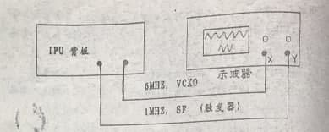
The whole system troubleshooting and testing:
Both IPU and FSU panel lights are normal -> the system is normal
Use two Q9 cables to connect the back of the board of IPU point 9 and 10 outputs (please see the pictures before), with Y, X on dual trace oscilloscope respectively:
Crystal oscillator output is continuous, while the standard signal output is discontinuous (so only one piece in the picture).

