Slide 1
Notes:
鸭鸭女装
感谢老板们和殷帅
致歉

Slide 2
Why frontend / backend?

Slide 3
LAMP ?

Slide 4
LAMP
OR
LAMJ
LAPP
LNMP
WAMP
MAMP
…
…

Slide 5
System
Server
Database
Language

Slide 6
Language
Ruby on rails
Spring Boot
Flask
.NET Framework
NodeJS
Ruby
Java
Python
.NET
Javascript
Notes:
拿来主义
尝试，思想，说话
考古
时间/空间复杂度

Slide 7
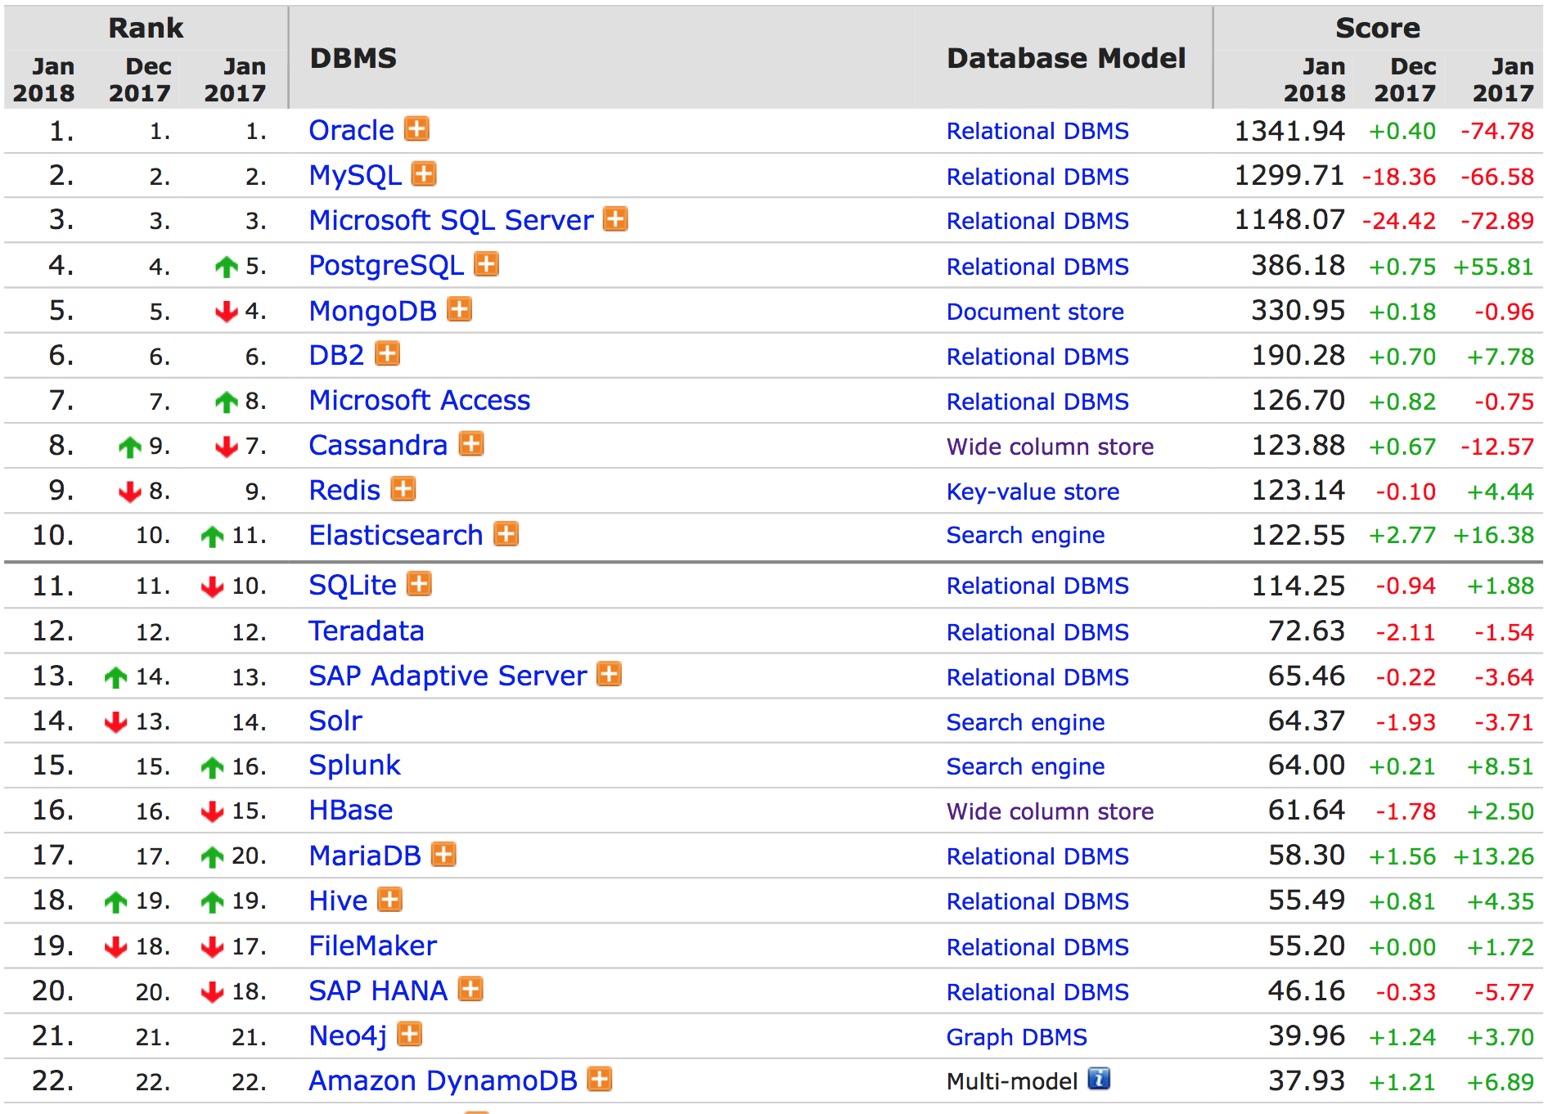
Database

Slide 8
Server
System
Nginx
Apache
Tomcat
Ubuntu
Debian
Macintosh
Windows

Slide 9
Frontend
MVC, MVVM, MVP, MVW
JavaScript, TypeScript, CoffeeScript, Dart
JS Framework: ReactJS ( Redux ), Angular, Vue, jQuery
CSS, LESS, SCSS
UI Framework: Bootstrap, Material Design, Ant Design
XML, HTML, XHTML

Slide 10
Others
ORM
RESTful, RPC
JSON, XML, Bytes
Notes:
soa
soap rmi

Slide 11
Ubuntu + Nginx + PostgreSQL + Flask + Vue

Slide 12
So Many People / So Big Project !!

Slide 13
Git

Slide 14
AM
– Agile Development

Slide 15
Jetkins
Codeships
CI
Travis
– Continuous Integration
Strider
Notes:
Roll back

Slide 16
QE
– Quality Engineer

Slide 17
TDD
– Test-Driven Development

Slide 18
Version control
Back-up
Multiple environment
Notes:
bt

Slide 19
So Many Users !!

Slide 20
Cache

Slide 21
Queue

Slide 22
读写分离

Slide 23
Distributed or Cluster
Notes:
高内聚低耦合
并发，吞吐量，响应速度
心跳检测

Slide 24
Batch Processing
Notes:
负载均衡 ddos
dns cdn 反向代理 ip http重定向

Slide 25
Docker => Kubernetes

Slide 26
Log

Slide 27
SRE
– Site Reliability Engineer
Notes:
Op
调度

Slide 28
Data Science

Slide 29
Security

Slide 30
泛化与定制化

Slide 31
Document ( release doc, wiki, readme, commit, notes, etc. )
Code style && code review ( lint )
So … Rules OR Freedom
OKR ( Objective key resource )
Licence
算法 / 基础知识 重要吗？
IDE or vim or emacs
善用工具

Slide 32
中庸

Slide 33
Q&A

